Slide 1
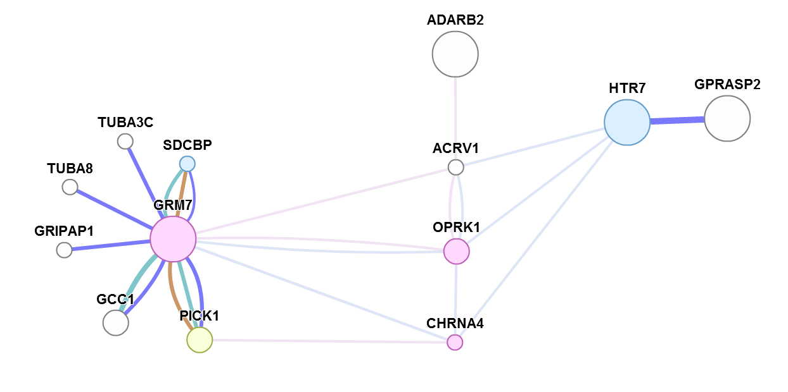
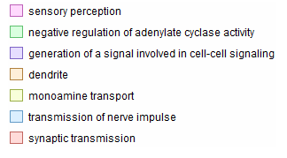
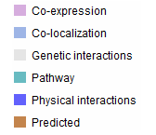
FIGURE. Predicted function and networks of the migraine susceptibility genes detected in the Norfolk pGWAS study.
Predictions from genemania.org, accessed 07102010. Only selected gene functions are highlighted.
Functions Legend
Networks Legend
Mostafavi S., Ray D., Warde-Farley D., Grouios C., and Morris Q (2008) GeneMANIA: a real-time multiple association network integration algorithm for predicting gene function. Genome Biology. Suppl 1. doi:10.1186/gb-2008-9-s1-s4

