Slide 1
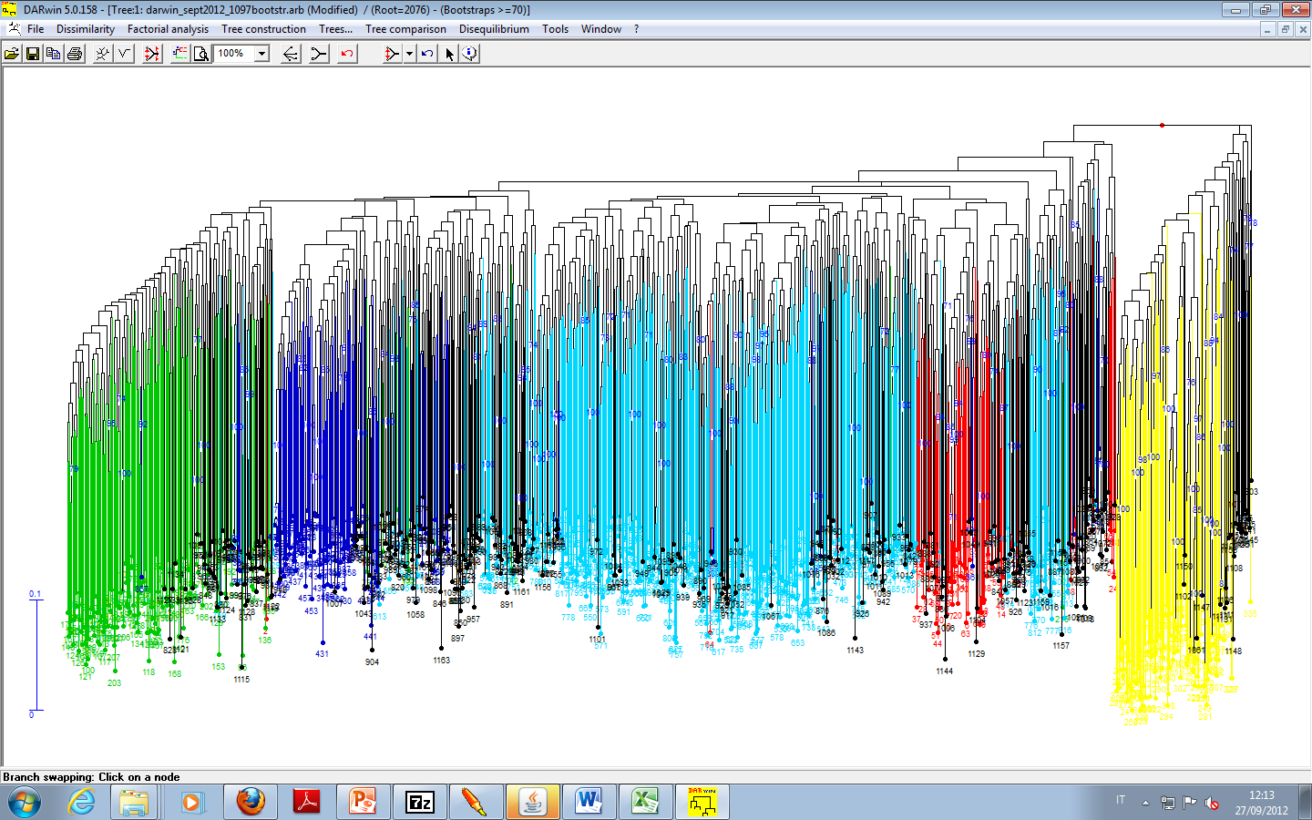
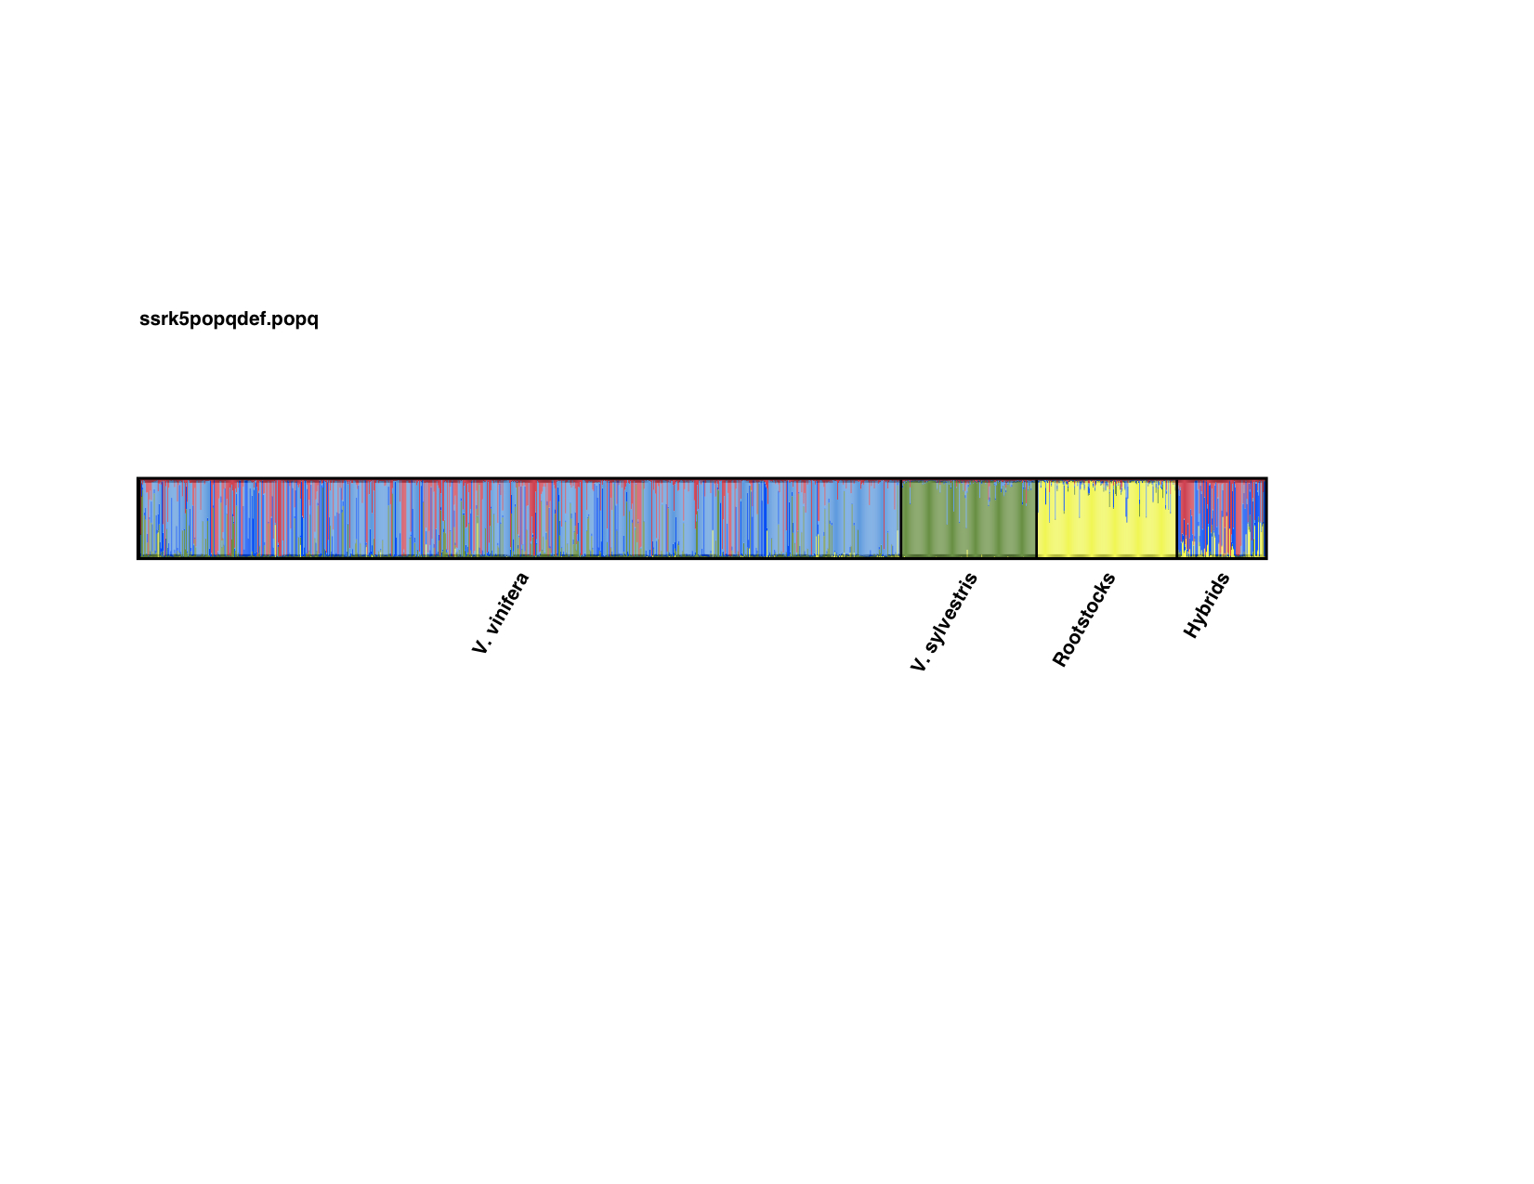
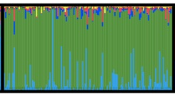



SNPs
Neighbour Joining tree
S1
S2
S1
S4
S2
S1
S3
S5
SSRs
S4
S3
S1
S2
S1
S5
SSRs
STRUCTURE K=5
Hyb (admixed)
Rootstocks: S5
Sylvestris (S4)
Vinifera (S1, S2, S3)
SNPs

