Slide 1
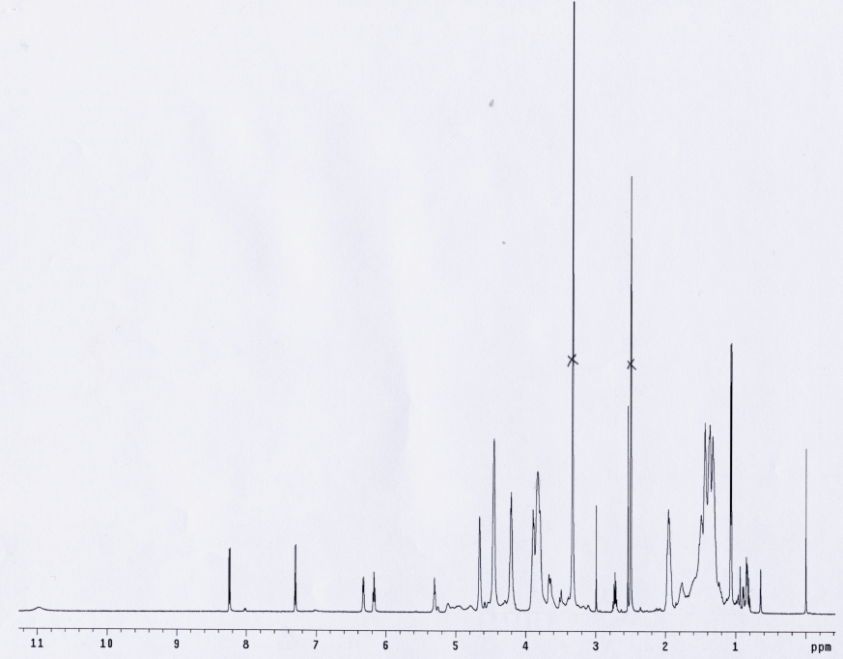
A
B
δ, ppm
Figure SM1: (A) ¹H NMR spectrum of CPVA-p4GEMC conjugate in DMSO-d₆ and (B) UV absorbance spectrum of N-isobutyryl Gemcitabine (52 µM). Based on the proton signal at 0.604 ppm, cholesterol content corresponds to 6 moieties per polymer molecules. Drug loading was calculated by integration of distinctive peaks of aromatic protons at 7.30 and 8.25 ppm in comparison to methylene protons of PVA. UV spectrum showed single peak at 268 nm (ε₂₆₈=9476). Both calculations resulted in the same Gemcitabine content (14%).

