Slide 1
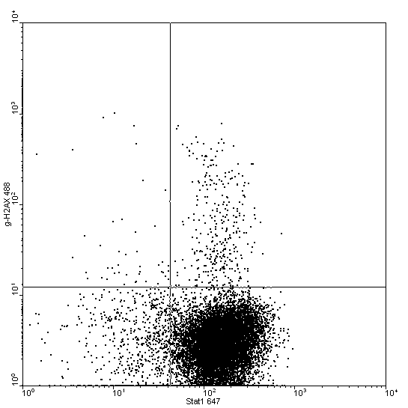
A
B
γ-H2AX
C
Stat1
D

