Slide 1
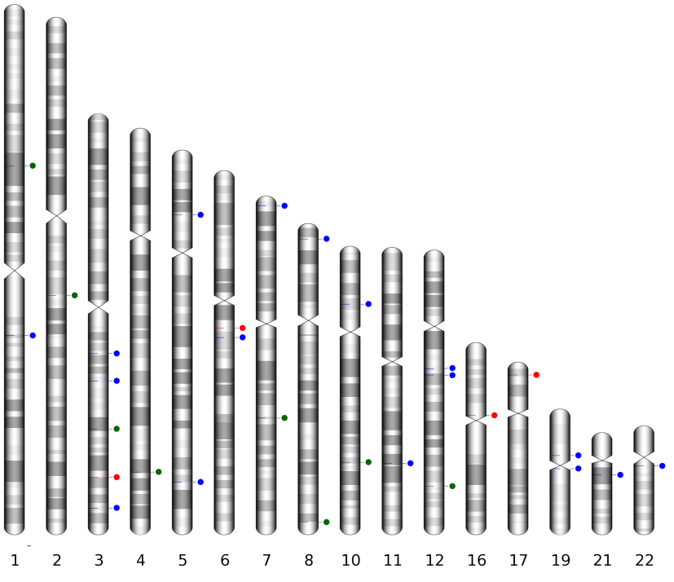
Figure S1. The 29 human-specific HERV-K insertion loci in the human genome.
17 Human-specific full-length HERV-K
4 Non-classical insertion of HERV-K
8 Human-specific truncated HERV-K
12 Human-specific HERV-K polymorphic loci

