Slide 1
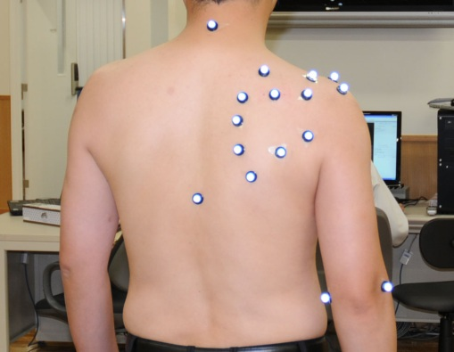
A) Markers on the body surface.

Slide 2
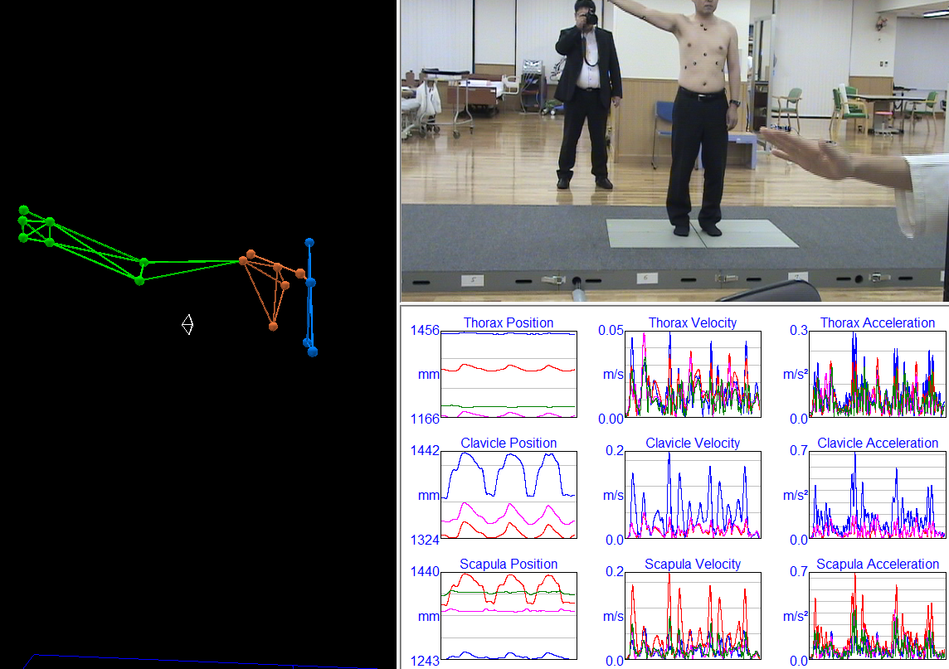
B) Screenshot of motion (vector data).

Slide 3
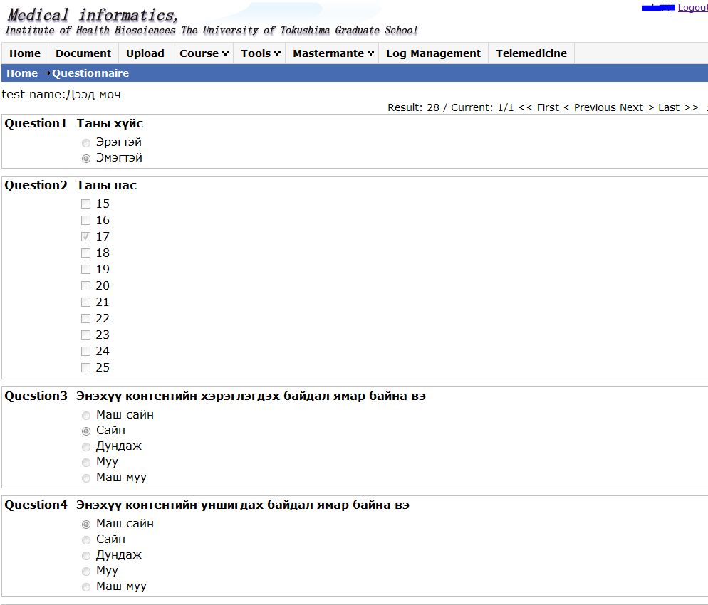
C) Questionnaire on the “Learning management system” .

