Slide 1
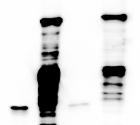
Input
Pull down
MBP-PIF4
MBP
pulled down by GST-PAR1
Supplementary Figure 1. In vitro pull-down assay shows specific interaction between PAR1 and PIF4.
MBP or MBP-PIF4 was pulled down by GST-PAR1 immobilized on glutathione beads. Proteins bound to GST-PAR1 were detected by immunoblotting using anti-MBP antibody. Only MBP-PIF4, but not MBP alone, was pullded down by GST-PAR1 suggesting specific interaction between PAR1 and PIF4.

