Slide 1
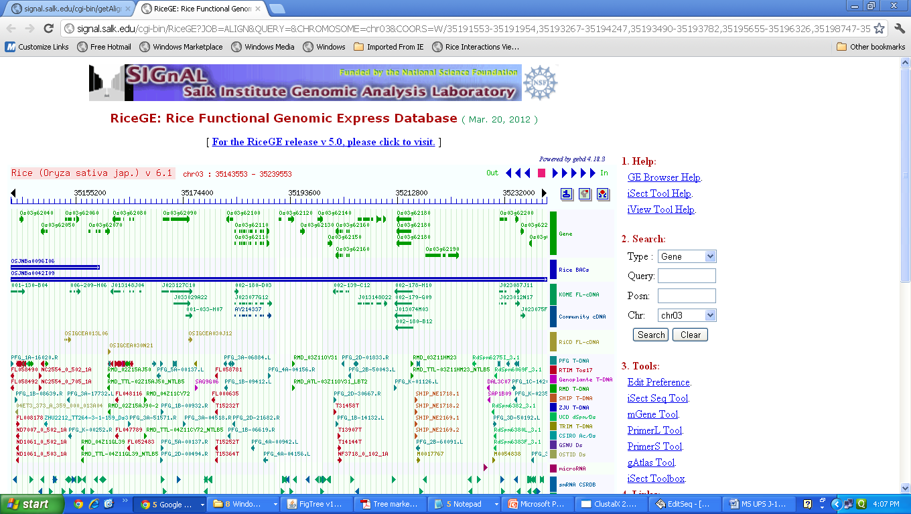

Tandem organization of 4 DnaJ domain containing genes on chromosome 3

