Slide 1
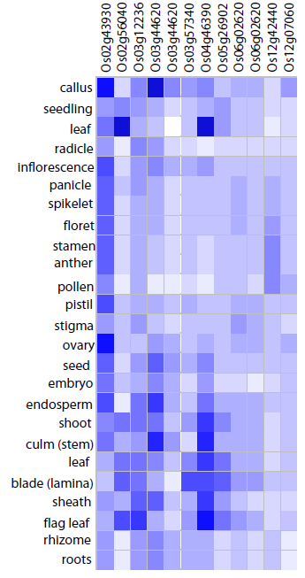
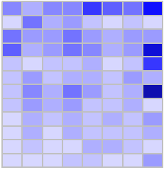
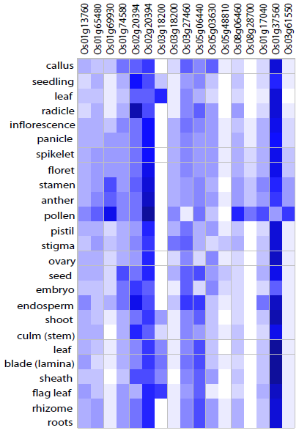
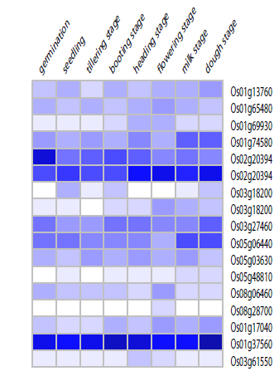
a
b
Tillering stage
Flowering stage
Heading stage
Germination
Booting stage
Dough stage
Seedling
Milk stage
Type A
Tillering stage
Flowering stage
Heading stage
Germination
Booting stage
Dough stage
Seedling
Milk stage
Type B

