Slide 1
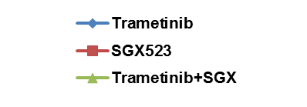
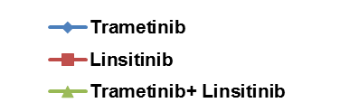
Figure S2.
A
B
% Growth Inhibition
% Growth Inhibition
Drug Concentration (nM)
Drug Concentration (nM)
SGX-523 x1, Trametinib x1/5
Linsitinib x1, Trametinib x1/5

