Slide 1
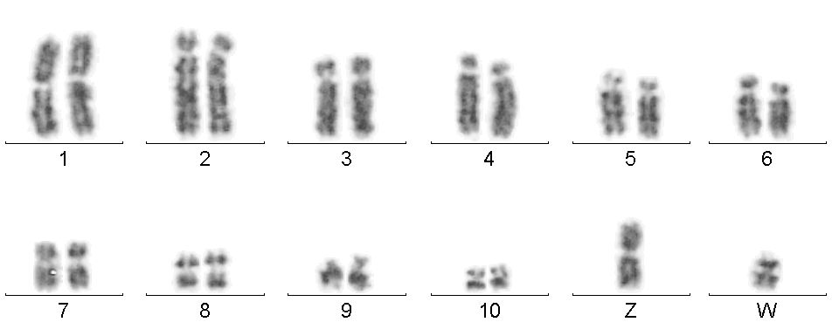
Macaw #315, female

Slide 2
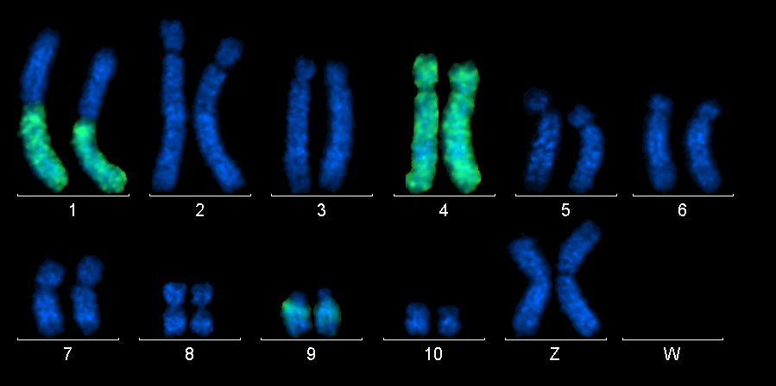
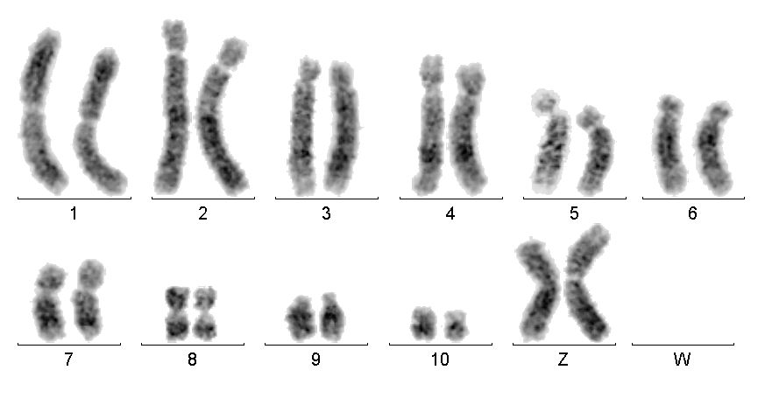
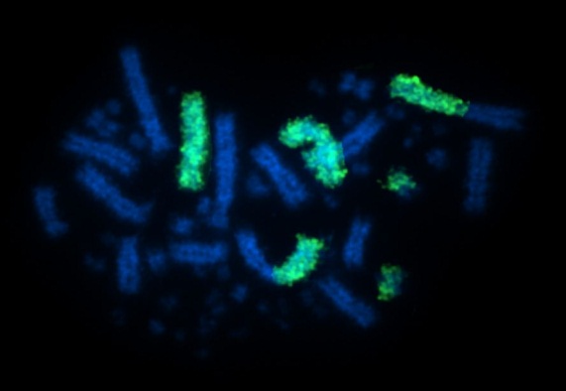
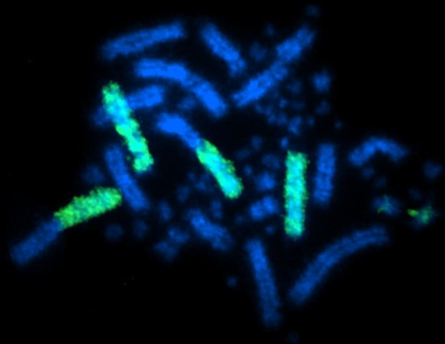
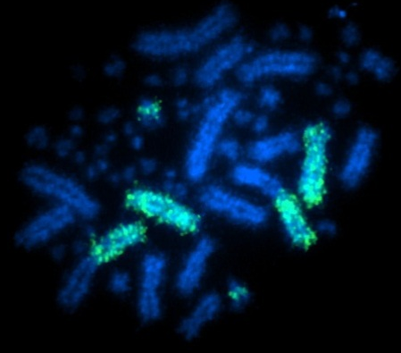
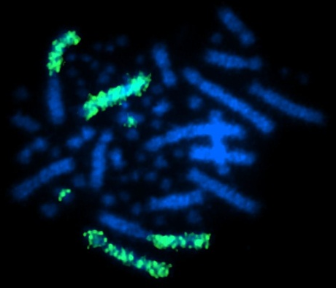
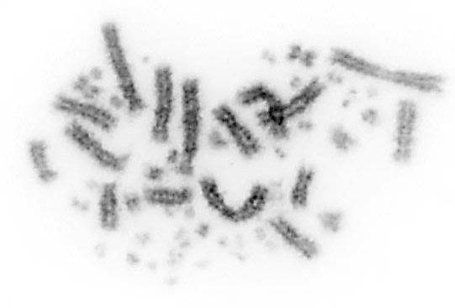
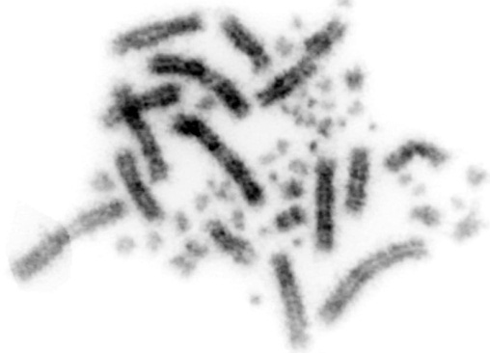
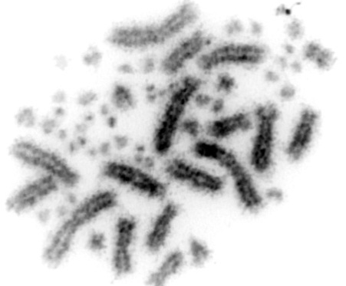
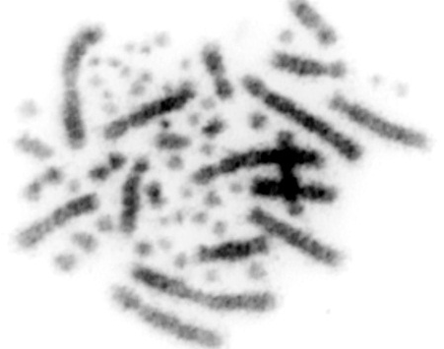
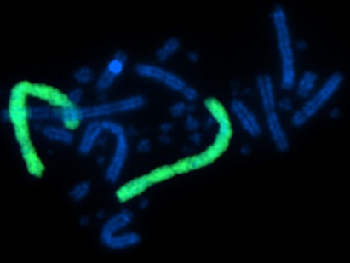
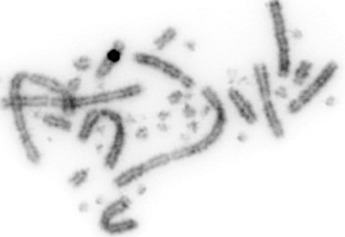
GGA1
AMA1q,4,9q
Chicken control

Slide 3
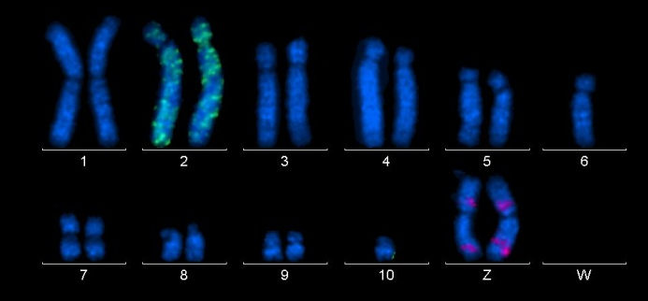
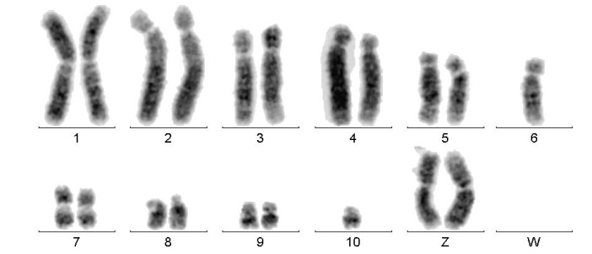
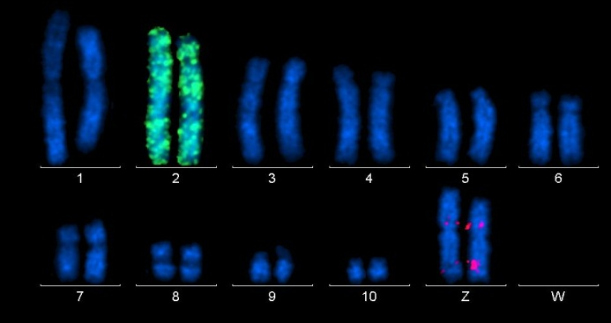
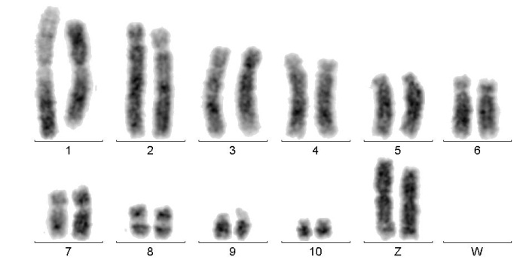
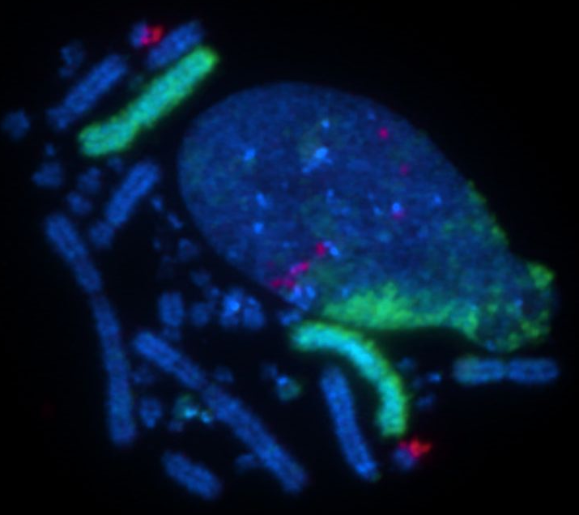
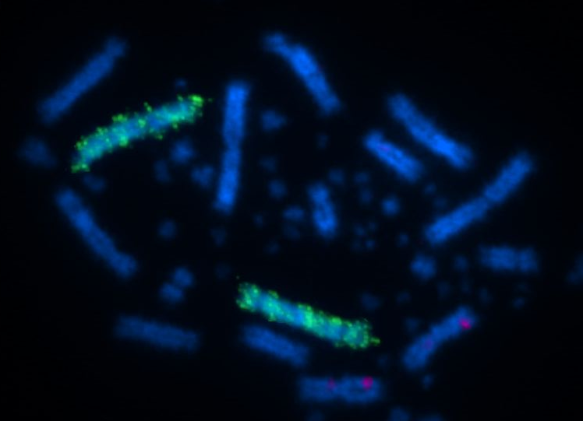
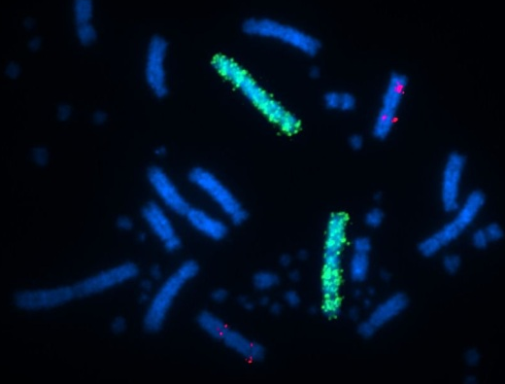
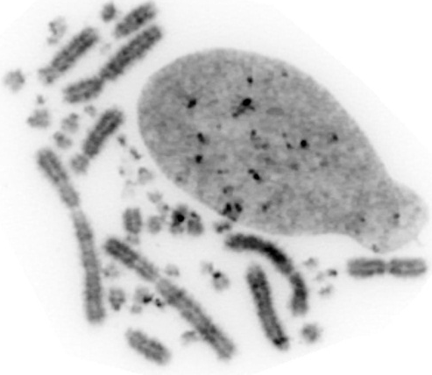
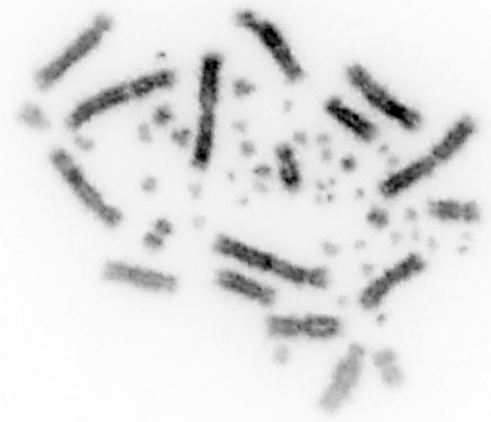
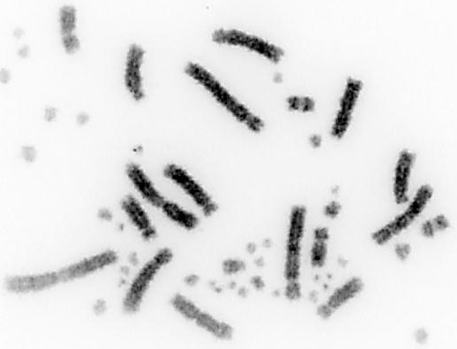
GGA2
AMA2
GGA11
GGA11
GGA11 – AMAZ!!!
GGA11
Chicken control
GGA11
Red – GGA11 BAC pool

Slide 4
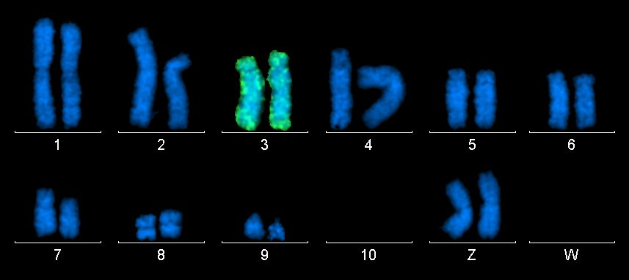
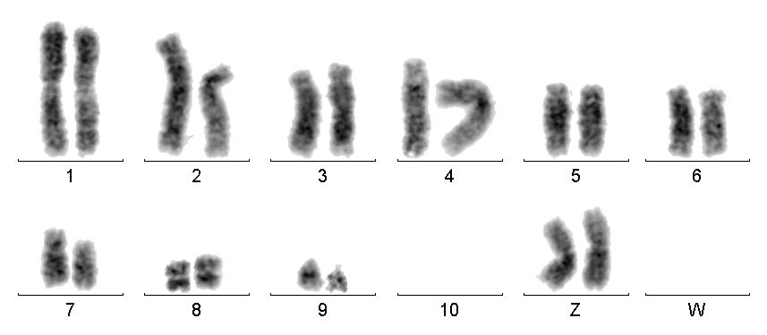
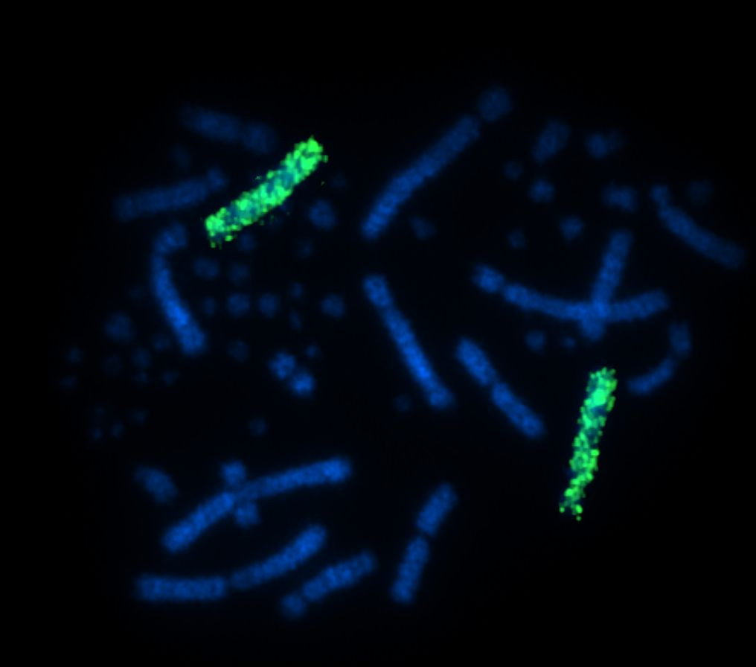
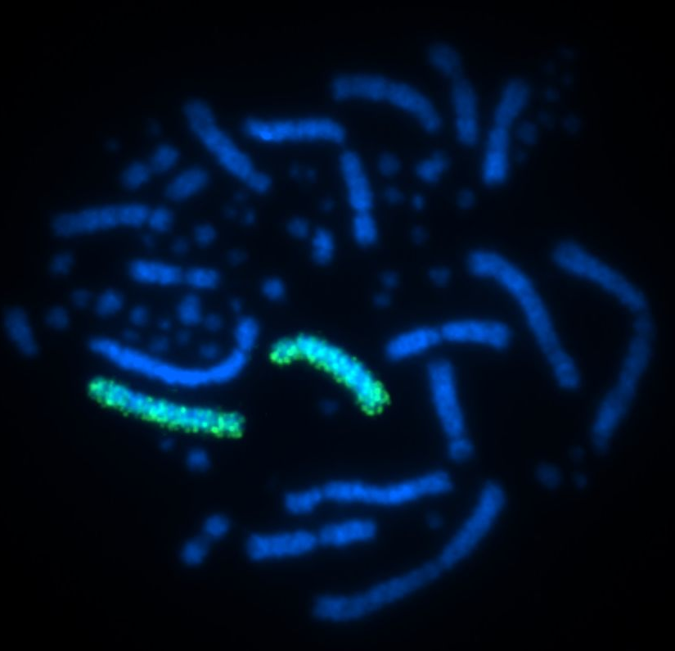
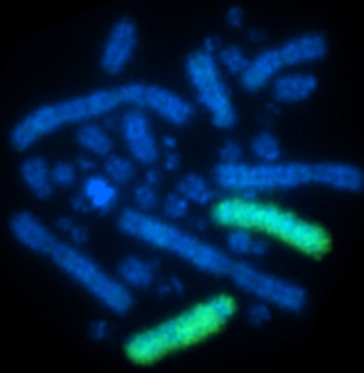
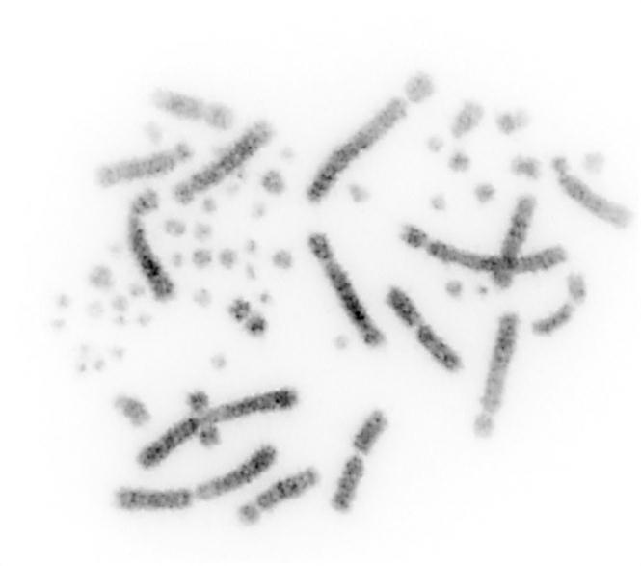
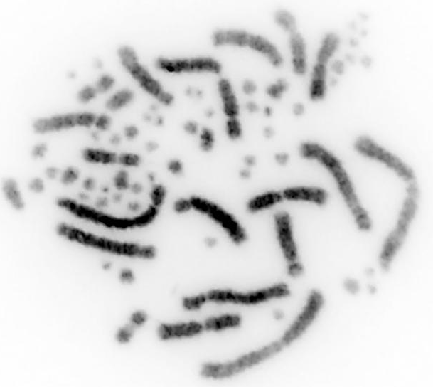
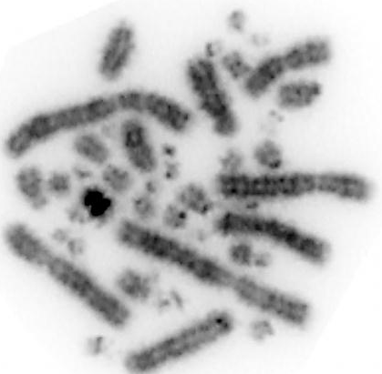
GGA3
AMA3
Chicken control

Slide 5
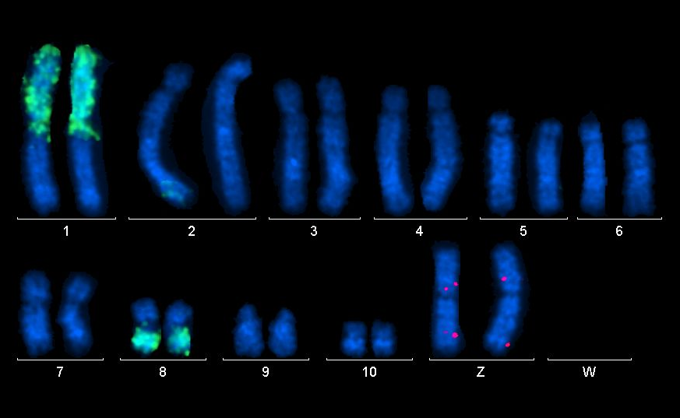
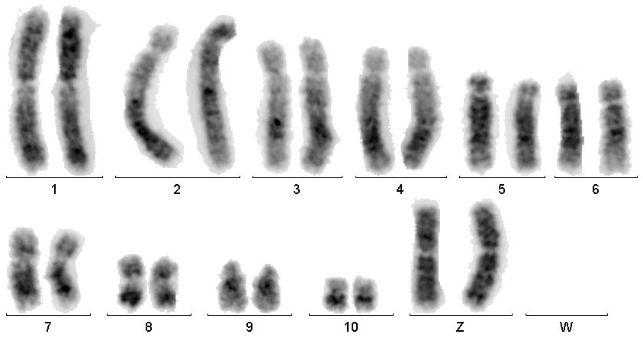
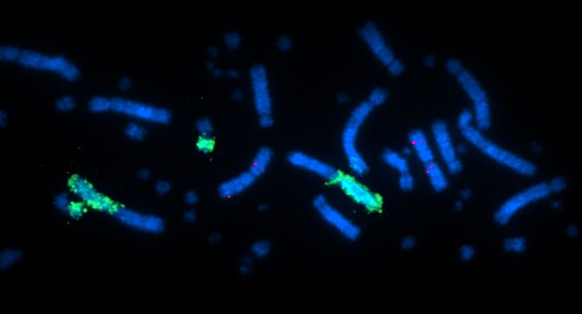
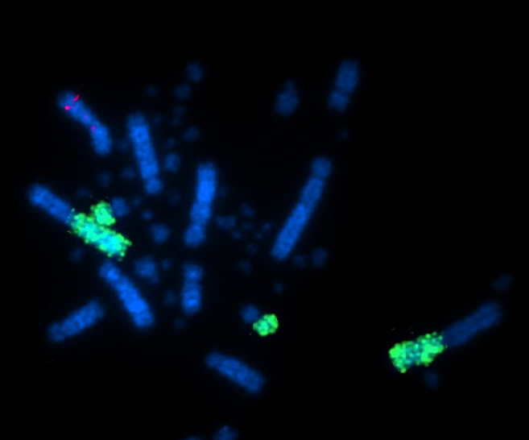
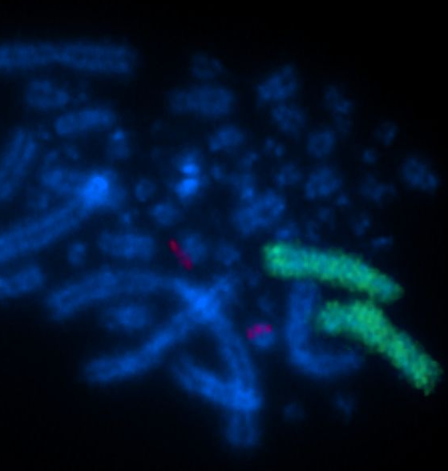
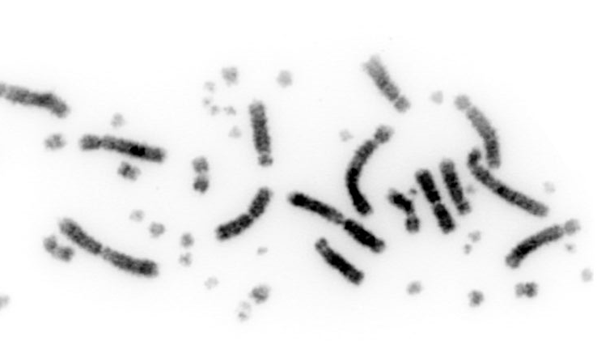
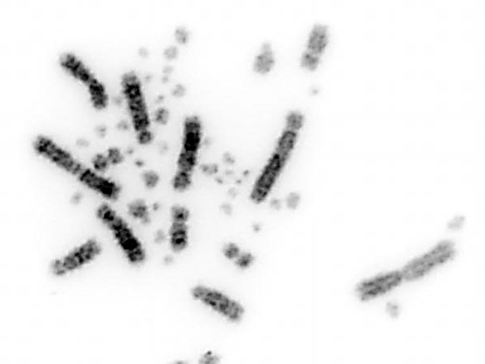
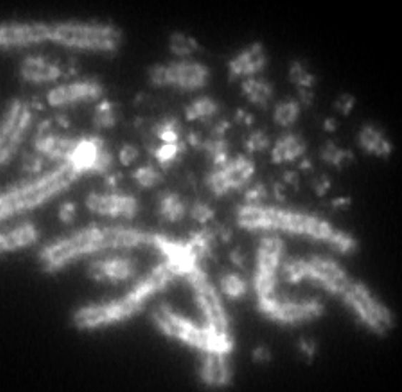
GGA4
AMA1p, 8q
GGA11
GGA11
GGA11 – AMAZ!!!
Chicken control
Red – GGA11 BAC pool

Slide 6
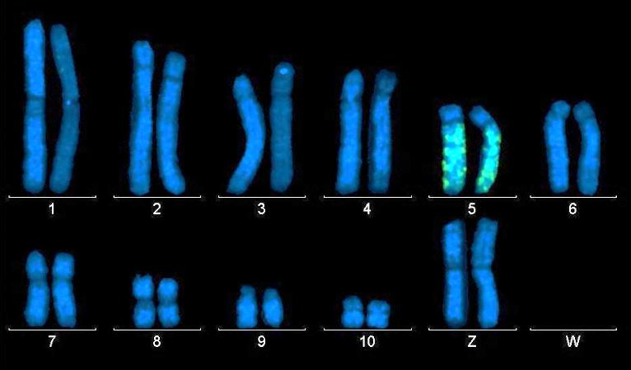
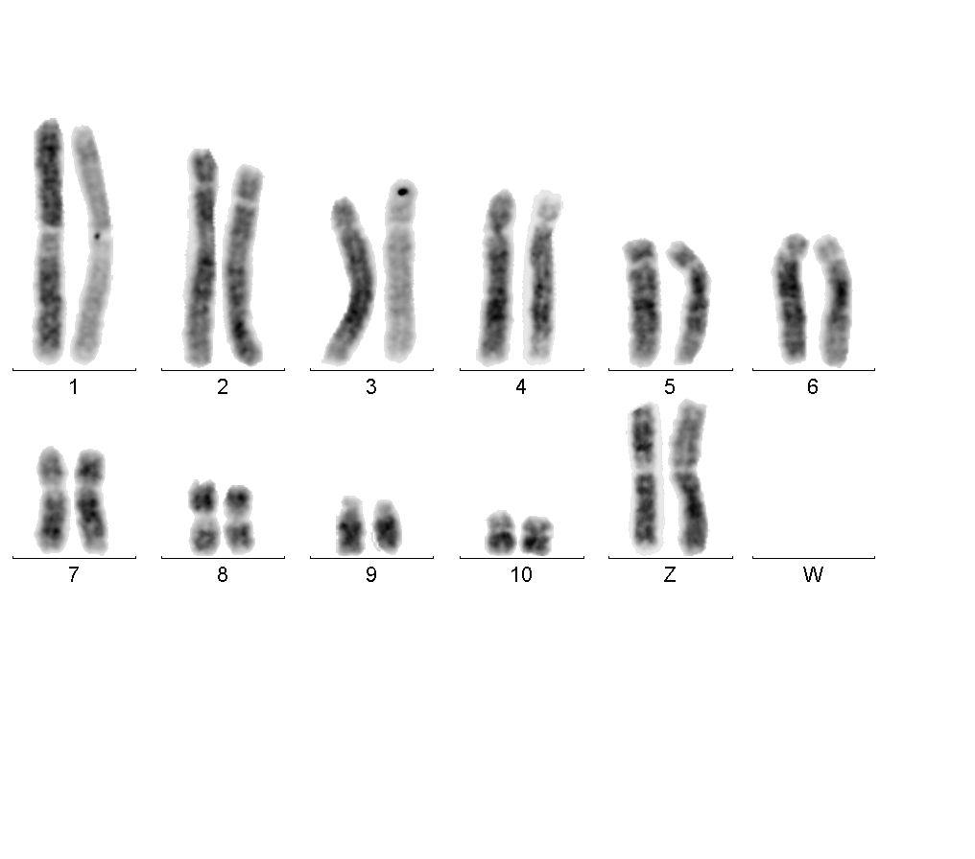
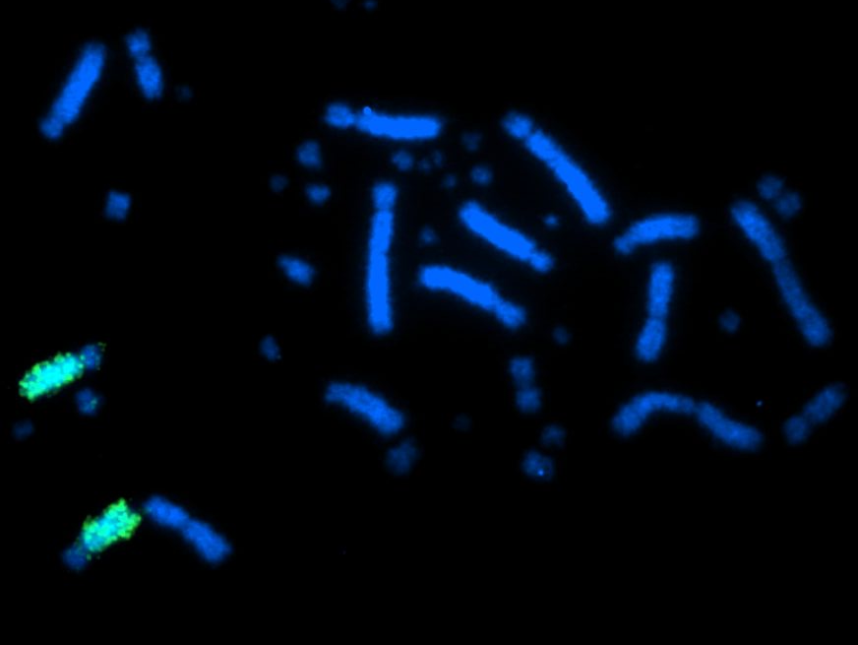
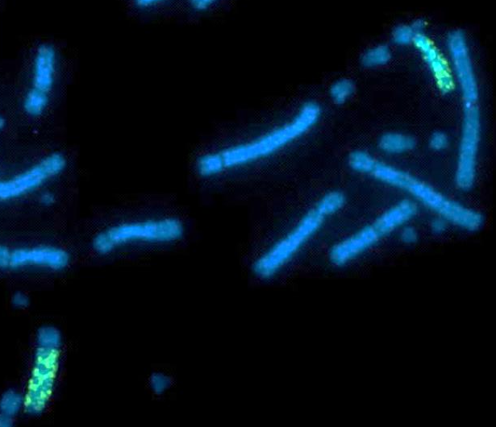
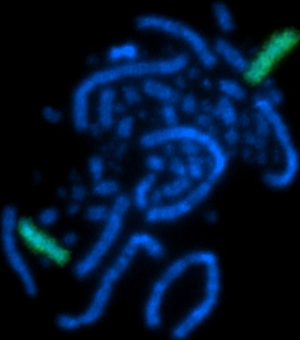
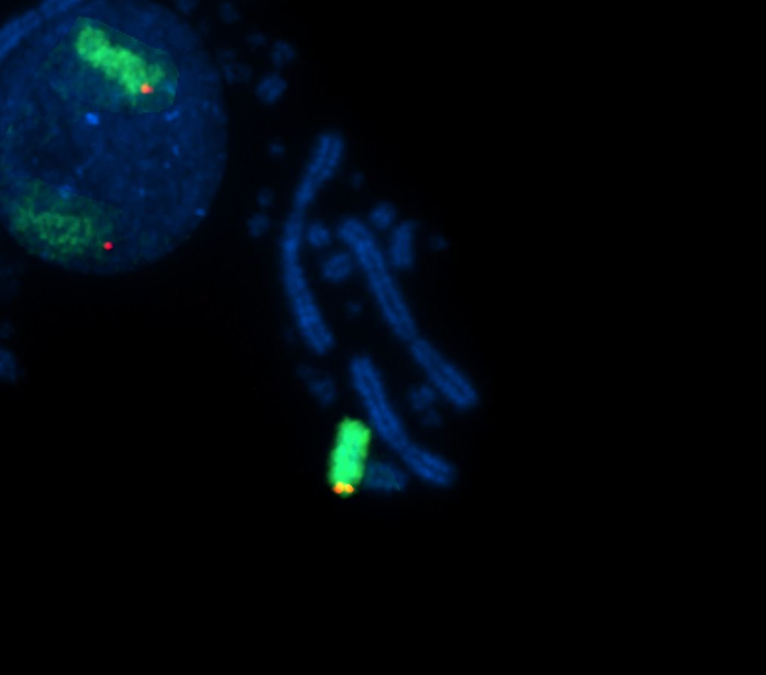
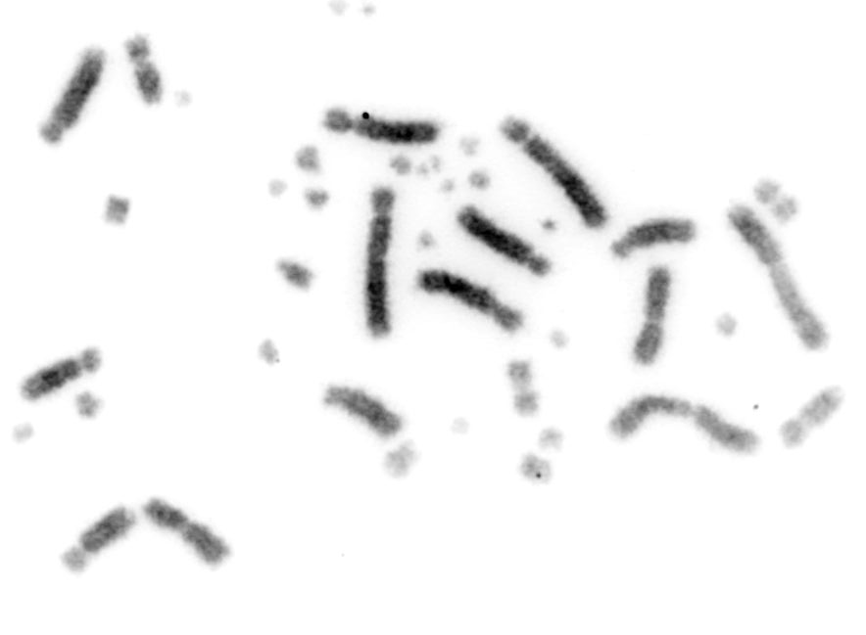
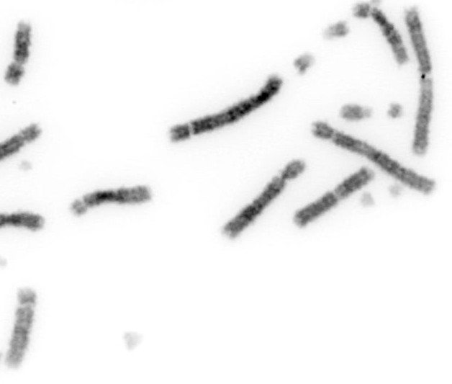
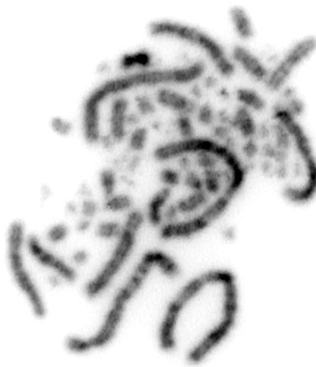
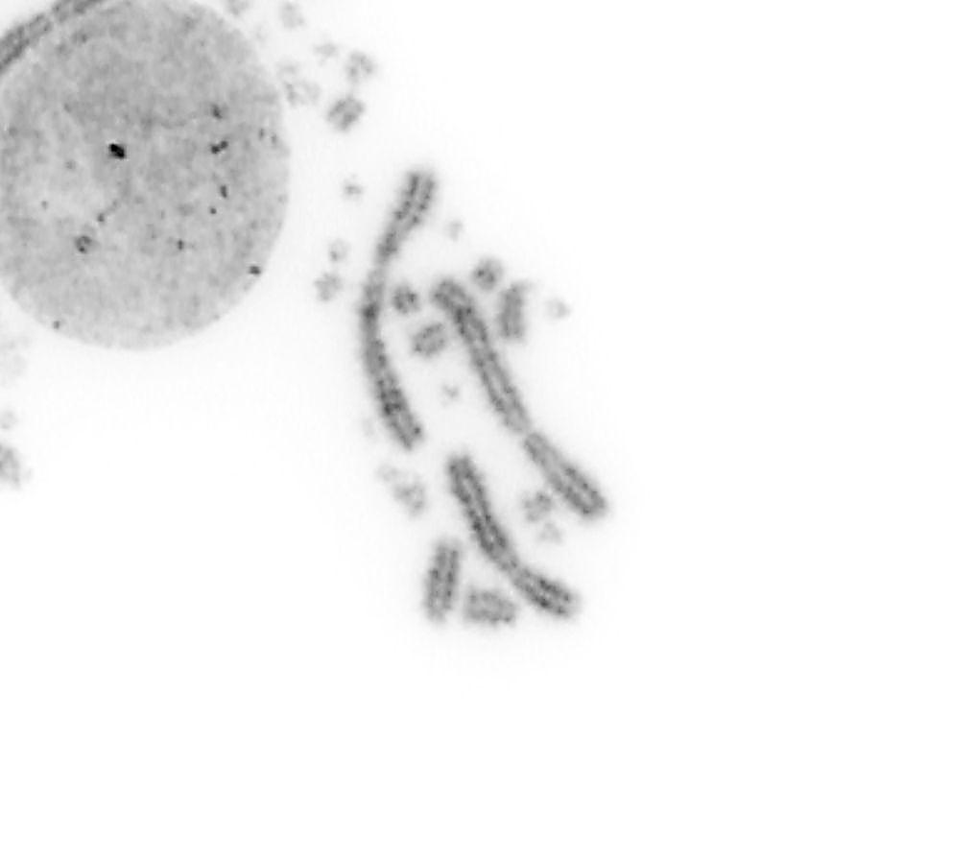
GGA5
AMA5q
Chicken control
Red: BAC P1H3 on GGA5
No signal on macaw

Slide 7
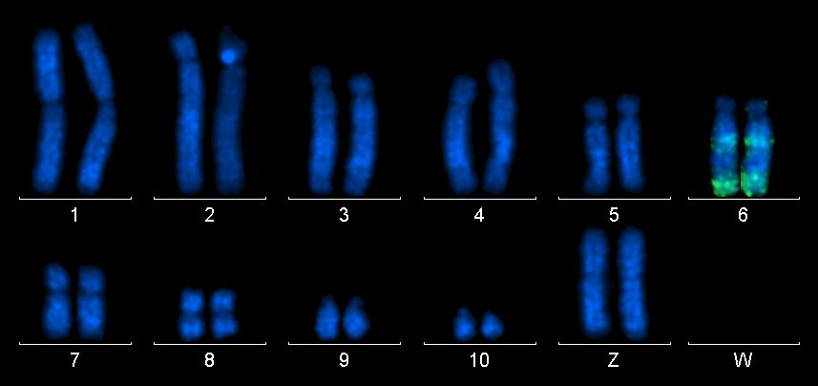













GGA6
AMA6 segments
Chicken control
Red: FZF – GGA6

Slide 8












GGA7
AMA6q
Chicken control
Red: FZF – GGA6

Slide 9











AMA6
GGA6 and GGA7 are
Syntenic in macaw
GGA6 paint
GGA7 paint
7
6
7
CHICKEN CONTROL
Paint for GGA6
Paint for GGA7
BAC clone for GGA6
6
Macaw-GGA6 paint and BAC
Macaw-GGA7 paint and BAC
Chicken GGA6 BAC clone
(CHY4 gene) gives clear
signal in macaw!!!
7
6
Macaw-GGA6 and 7 paints and BAC
6
7

Slide 10












GGA8
AMA7p,7qter and micros
Chicken control

Slide 11












GGA9
AMA7qmid
Chicken control

Slide 12








GGAZ
AMAZ
Male- Erica
Female-#315
Chicken control (female)
W
W

Slide 13


GGAW
No signal
Chicken control (female)
No signal on macaw W chromosome – similar situation is with mammalian Y
which , as a rule, does not give Zoo-FISH signal across diverged species.

Slide 14








5.8S, 18S, 28S rDNA
3 pairs of microchromosomes with NORs
(Chicken and California condor have
only one NOR chromosome)
Chicken control – 1 NOR

Slide 15




W
Telomeres
Macaw #315
Z
Macaw has telomeres at
chromosome ends only -
no interstitial telomeric sites.
Prominent number of
Telomeric sequences are in
microchromosomes
W
Z

