Slide 1
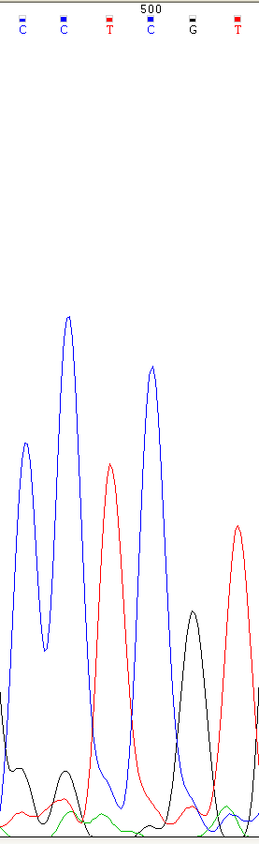
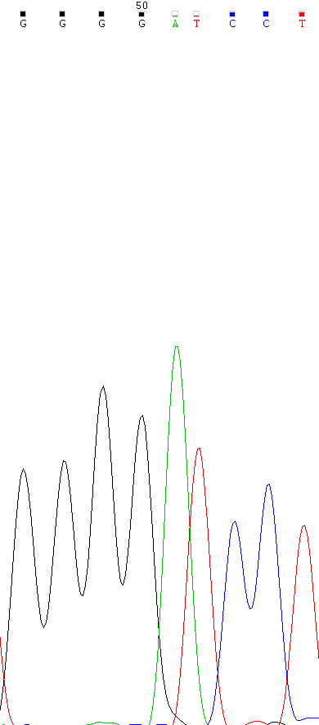
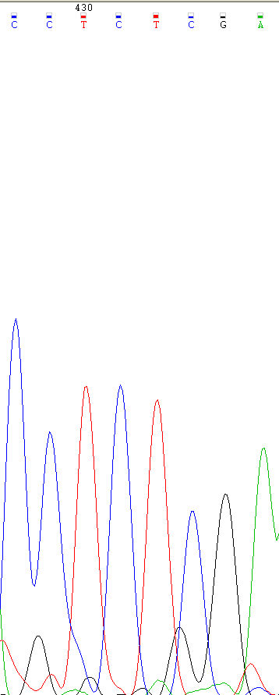
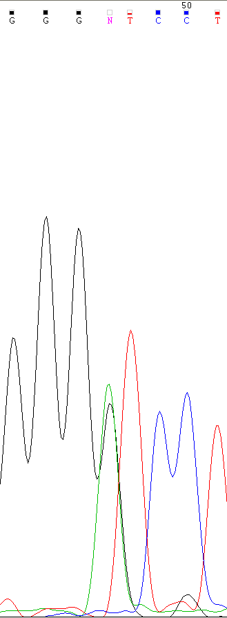
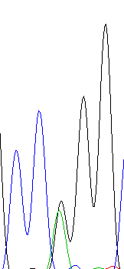
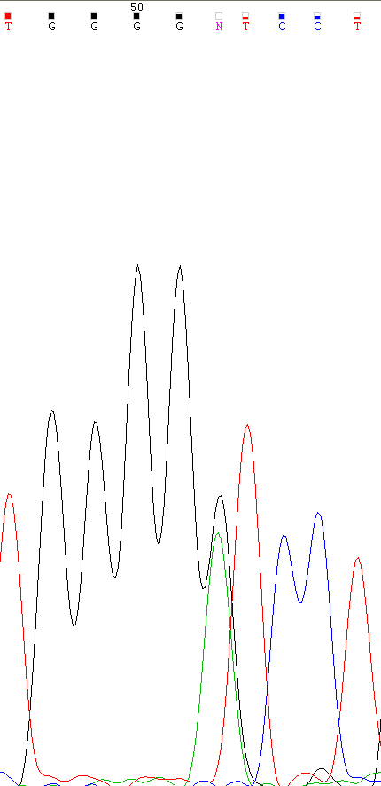
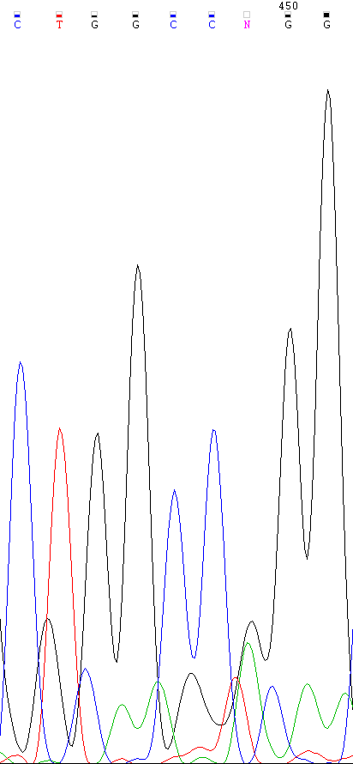
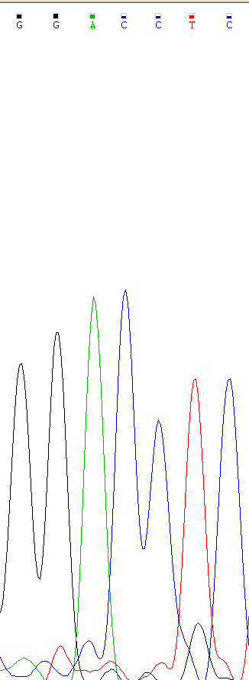
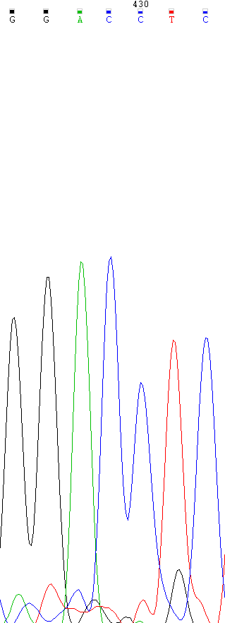
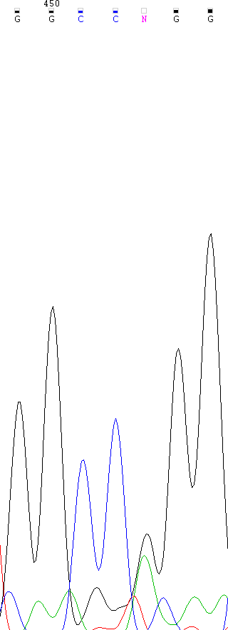
A
B
C
WT
Pro136
SW480
Leu136
WT
Val10
SW48
Leu10
WT
Pro136
SW48
Leu136
CCC
CTC
GTC
ATC
CCC
CTC
D
E
WT
Val10
KM12C
Leu10
WT
Pro136
KM12C
Leu136
WT
Gly388
KM12C
Arg388
WT
Val10
KM12SM
Leu10
WT
Pro136
KM12SM
Leu136
WT
Gly388
KM12SM
Arg388
GTC
ATC
CCC
CTC
GGG
AGG
GTC
ATC
CCC
CTC
GGG
AGG
Supplementary Figure 1

