Slide 1
Supplementary Figure S1 legend
Supplementary Fig. S1. Scatter plots of MRM quantitation data using pooling serum and individual serum from healthy control group, before HCC treatment group, and after HCC treatment group.
Left panel represents pooled serum from healthy control group, before HCC treatment group, and after HCC treatment group. Error bars represent the standard deviations from 5 technical replicates. Horizontal bars indicate the average serum level of the protein; P-values were calculated by ANOVA.
Right panels indicate individual samples.
See also Supplementary Table S4 and Supplementary Figure S2

Slide 2
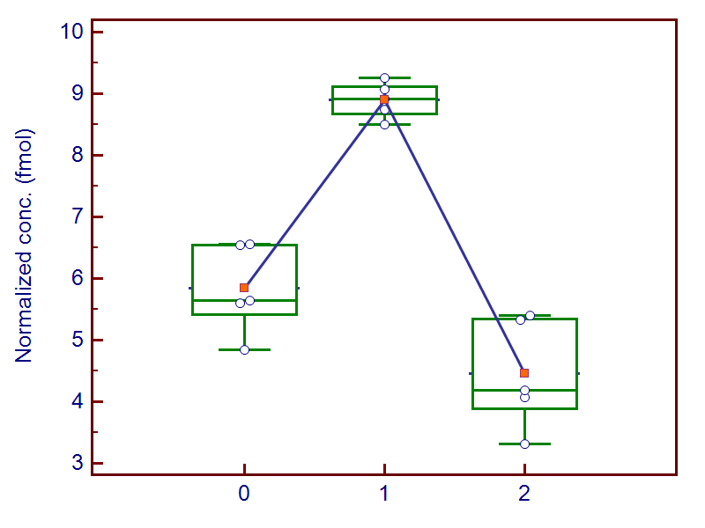
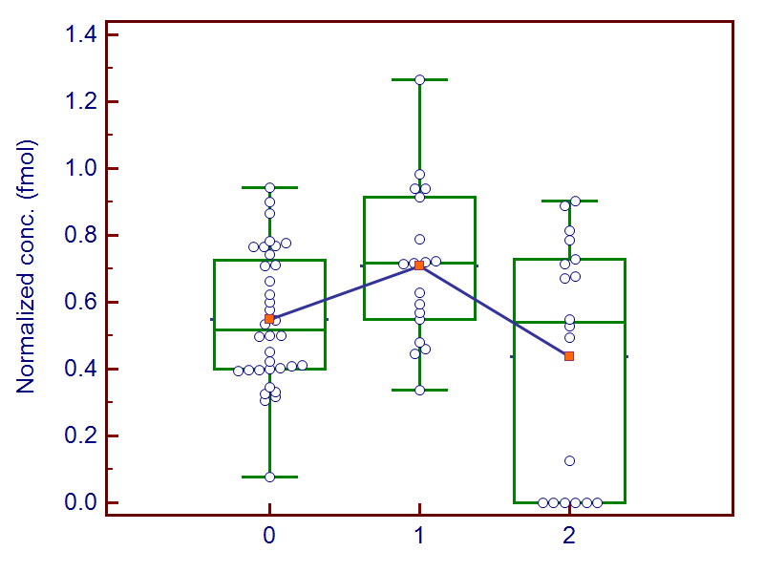


Supplementary Figure S1. As a result of the MRM analysis, a list of the 9 proteins where the expression profile of pooling specimen and individual specimen match with each other.
1. Very long-chain specific acyl-CoA dehydrogenase, mitochondria (ACADVL)
Pooled serum
Individual serum
AAQAPSSFQLLYDLK
 | Healthy control | Before HCC treatment | After HCC treatment
Average | 5.84 | 8.89 | 4.46
STDEV | 0.72 | 0.29 | 0.89
CV (%) | 12.40 | 3.30 | 19.88
AAQAPSSFQLLYDLK
 | Healthy control | Before HCC treatment | After HCC treatment
Average | 0.55 | 0.71 | 0.44
STDEV | 0.20 | 0.23 | 0.36
CV (%) | 36.49 | 32.94 | 82.65
 |  | Healthy control vs. Before HCC treatment | Before HCC treatment vs. After HCC treatment
Fold change | 1.52 |  | 1.99
 | Healthy control vs. Before HCC treatment | Before HCC treatment vs. After HCC treatment
Meaningful difference ( p < 0.05) | Yes | Yes

Slide 3
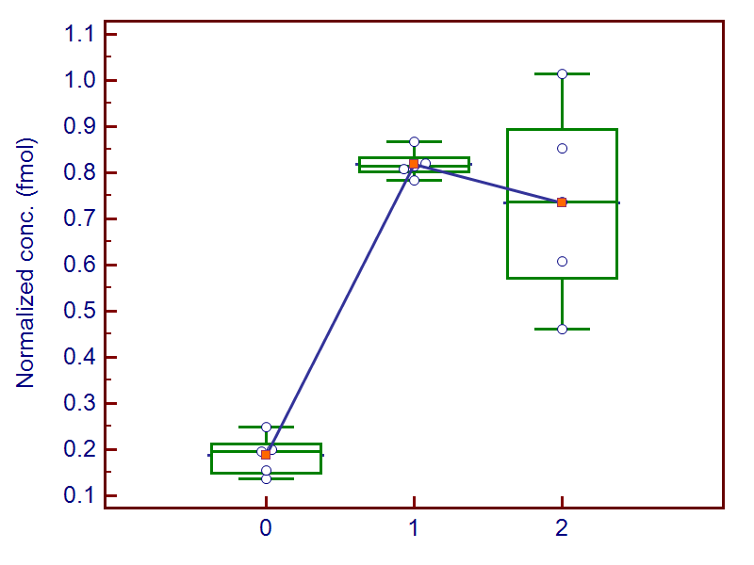
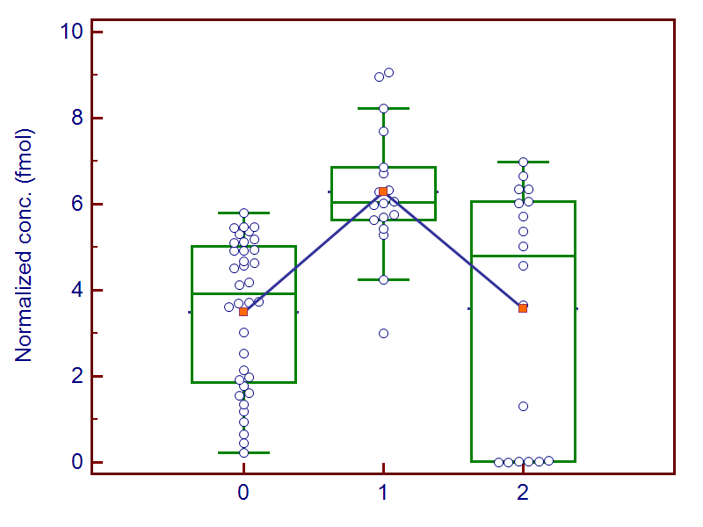
2. Actin binding protein, anillin (ANLN)
Pooled serum
Individual serum
TQSLPVTEK
 | Healthy control | Before HCC treatment | After HCC treatment
Average | 0.19 | 0.82 | 0.73
STDEV | 0.04 | 0.03 | 0.21
CV (%) | 23.64 | 3.72 | 29.16
TQSLPVTEK
 | Healthy control | Before HCC treatment | After HCC treatment
Average | 3.49 | 6.29 | 3.56
STDEV | 1.74 | 1.51 | 2.88
CV (%) | 49.88 | 24.08 | 80.73
 |  | Healthy control vs. Before HCC treatment | Before HCC treatment vs. After HCC treatment
Fold change | 4.37 |  | 1.11
 | Healthy control vs. Before HCC treatment | Before HCC treatment vs. After HCC treatment
Meaningful difference ( p < 0.05) | Yes | Yes

Slide 4
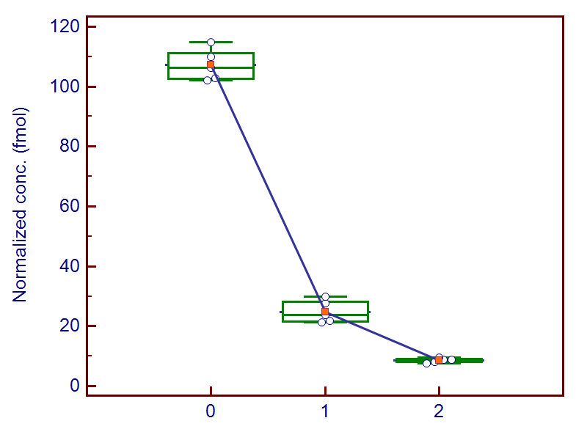
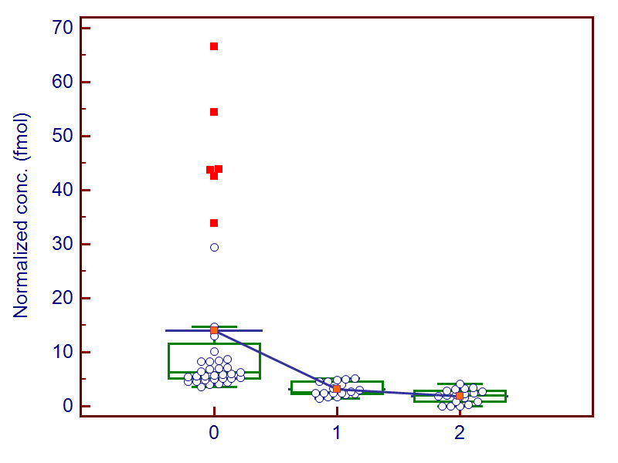
3. Brain acid soluble protein 1 (BASP1)
Pooled serum
Individual serum
AEGAATEEEGTPK
 | Healthy control | Before HCC treatment | After HCC treatment
Average | 107.18 | 24.84 | 8.63
STDEV | 5.25 | 3.76 | 0.79
CV (%) | 4.89 | 15.12 | 9.12
AEGAATEEEGTPK
 | Healthy control | Before HCC treatment | After HCC treatment
Average | 14.01 | 3.10 | 1.88
STDEV | 16.40 | 1.24 | 1.29
CV (%) | 117.08 | 40.01 | 68.36
 |  | Healthy control vs. Before HCC treatment | Before HCC treatment vs. After HCC treatment
Fold change | 0.23 |  | 2.88
 | Healthy control vs. Before HCC treatment | Before HCC treatment vs. After HCC treatment
Meaningful difference ( p < 0.05) | Yes | No

Slide 5
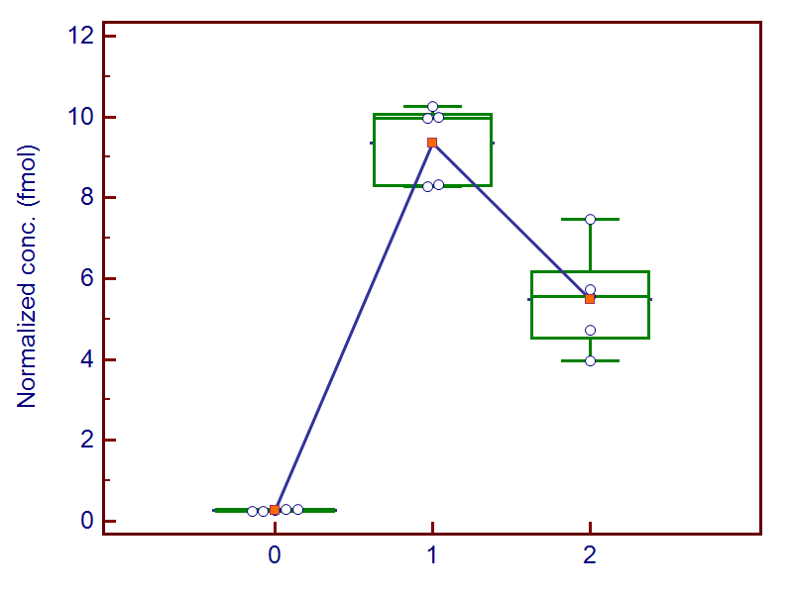
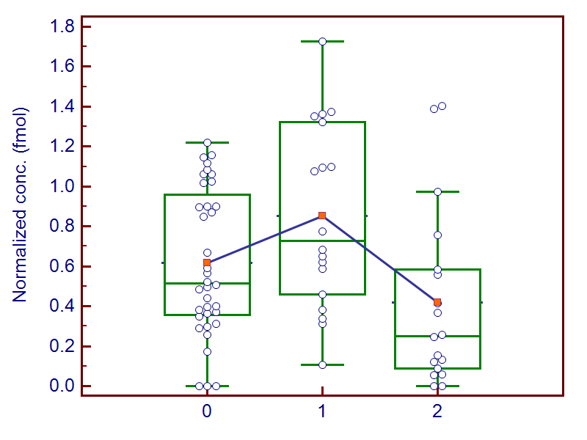
4. C-1-tetrahydrofolate synthase, cytoplasmic (MTHFD1)
Pooled serum
Individual serum
TDTESELDLISR
 | Healthy control | Before HCC treatment | After HCC treatment
Average | 0.27 | 9.36 | 5.49
STDEV | 0.02 | 0.98 | 1.31
CV (%) | 7.75 | 10.45 | 23.80
TDTESELDLISR
 | Healthy control | Before HCC treatment | After HCC treatment
Average | 0.62 | 0.85 | 0.42
STDEV | 0.37 | 0.46 | 0.45
CV (%) | 59.43 | 54.22 | 106.50
 |  | Healthy control vs. Before HCC treatment | Before HCC treatment vs. After HCC treatment
Fold change | 34.98 |  | 1.70
 | Healthy control vs. Before HCC treatment | Before HCC treatment vs. After HCC treatment
Meaningful difference ( p < 0.05) | No | Yes

Slide 6
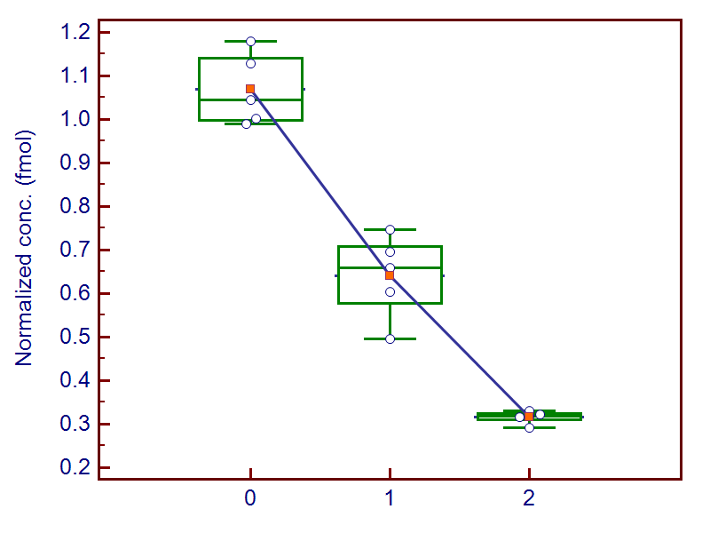
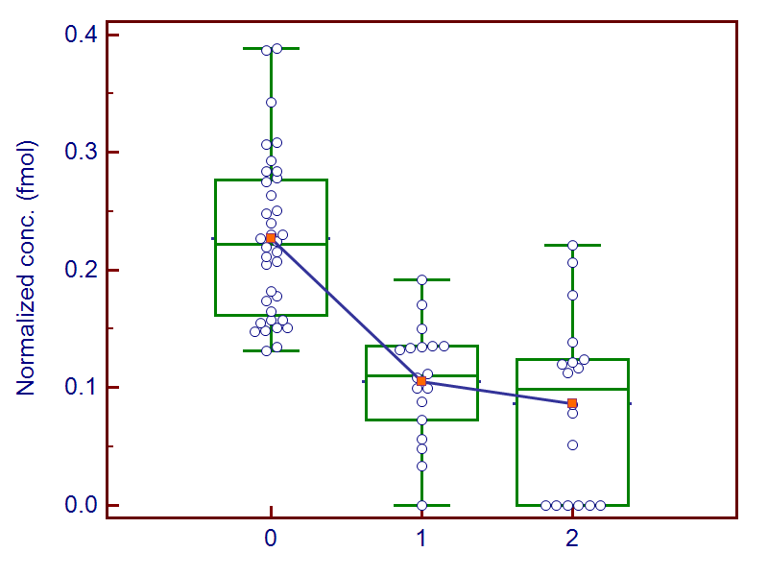
5. Calpain-1 catalytic subunit (CAPN1)
Pooled serum
Individual serum
YLGQDYEQLR
 | Healthy control | Before HCC treatment | After HCC treatment
Average | 1.07 | 0.64 | 0.32
STDEV | 0.08 | 0.10 | 0.02
CV (%) | 7.72 | 15.00 | 4.79
YLGQDYEQLR
 | Healthy control | Before HCC treatment | After HCC treatment
Average | 0.23 | 0.11 | 0.09
STDEV | 0.07 | 0.05 | 0.07
CV (%) | 30.36 | 46.80 | 86.66
 |  | Healthy control vs. Before HCC treatment | Before HCC treatment vs. After HCC treatment
Fold change | 0.60 |  | 2.02
 | Healthy control vs. Before HCC treatment | Before HCC treatment vs. After HCC treatment
Meaningful difference ( p < 0.05) | Yes | No

Slide 7
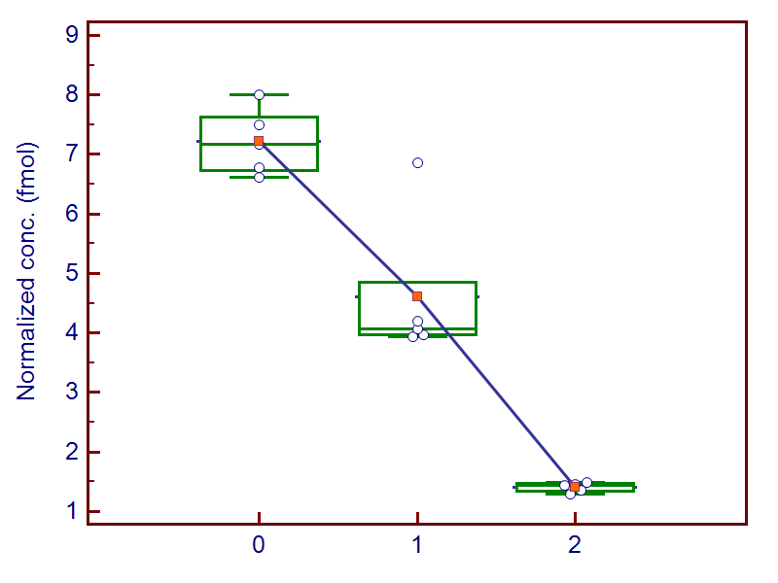
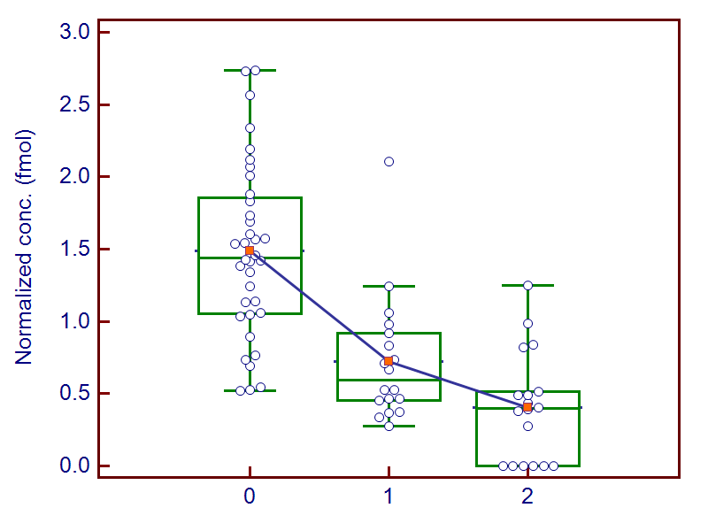
6. Complementary C4-A (C4A)
Pooled serum
Individual serum
VGDTLNLNLR
 | Healthy control | Before HCC treatment | After HCC treatment
Average | 7.21 | 4.61 | 1.41
STDEV | 0.56 | 1.26 | 0.08
CV (%) | 7.80 | 27.34 | 5.91
VGDTLNLNLR
 | Healthy control | Before HCC treatment | After HCC treatment
Average | 1.49 | 0.72 | 0.40
STDEV | 0.60 | 0.44 | 0.38
CV (%) | 40.40 | 60.76 | 93.85
 |  | Healthy control vs. Before HCC treatment | Before HCC treatment vs. After HCC treatment
Fold change | 0.64 |  | 3.27
 | Healthy control vs. Before HCC treatment | Before HCC treatment vs. After HCC treatment
Meaningful difference ( p < 0.05) | Yes | No

Slide 8
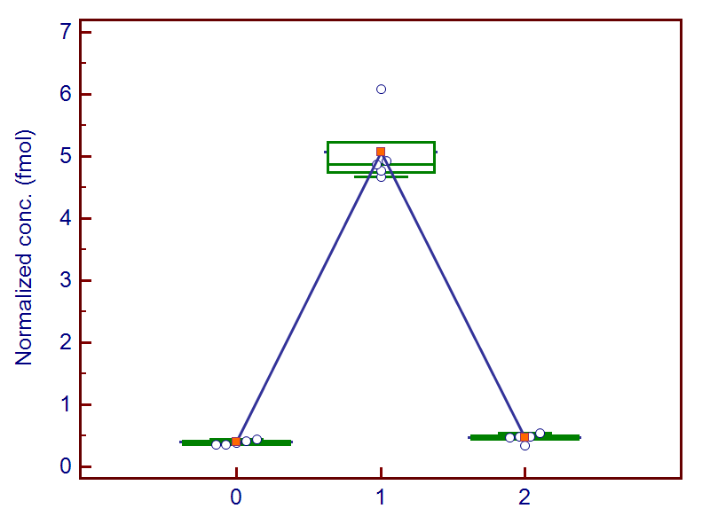
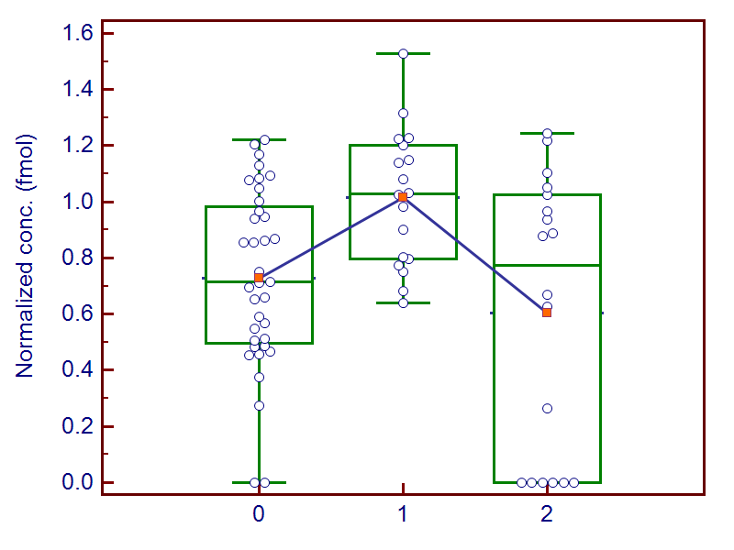
7. Alpha-fetoprotein (AFP)
Pooled serum
Individual serum
GYQELLEK
 | Healthy control | Before HCC treatment | After HCC treatment
Average | 0.39 | 5.07 | 0.47
STDEV | 0.04 | 0.58 | 0.07
CV (%) | 9.11 | 11.43 | 15.23
GYQELLEK
 | Healthy control | Before HCC treatment | After HCC treatment
Average | 0.73 | 1.01 | 0.60
STDEV | 0.30 | 0.24 | 0.49
CV (%) | 43.49 | 23.95 | 81.51
 |  | Healthy control vs. Before HCC treatment | Before HCC treatment vs. After HCC treatment
Fold change | 12.90 |  | 10.87
 | Healthy control vs. Before HCC treatment | Before HCC treatment vs. After HCC treatment
Meaningful difference ( p < 0.05) | Yes | Yes

Slide 9
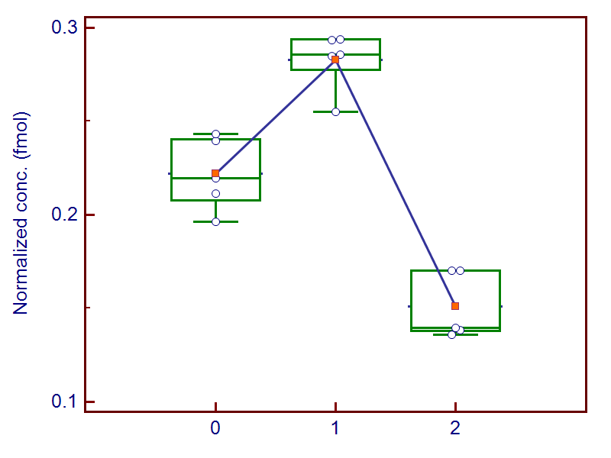
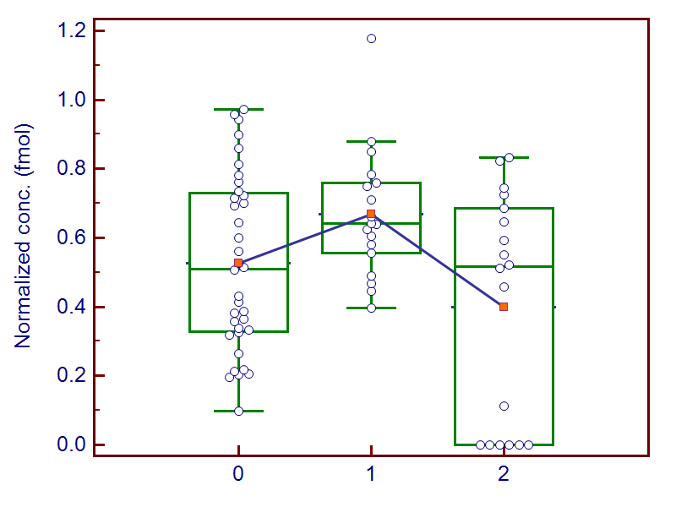
8. Filamin-B (FLNB)
Pooled serum
Individual serum
APLNVQFNSPLPGDAVK
 | Healthy control | Before HCC treatment | After HCC treatment
Average | 0.22 | 0.28 | 0.15
STDEV | 0.02 | 0.02 | 0.02
CV (%) | 8.86 | 5.66 | 11.72
APLNVQFNSPLPGDAVK
 | Healthy control | Before HCC treatment | After HCC treatment
Average | 0.53 | 0.67 | 0.40
STDEV | 0.25 | 0.19 | 0.33
CV (%) | 48.07 | 27.86 | 82.75
 |  | Healthy control vs. Before HCC treatment | Before HCC treatment vs. After HCC treatment
Fold change | 1.27 |  | 1.87
 | Healthy control vs. Before HCC treatment | Before HCC treatment vs. After HCC treatment
Meaningful difference ( p < 0.05) | No | Yes

Slide 10
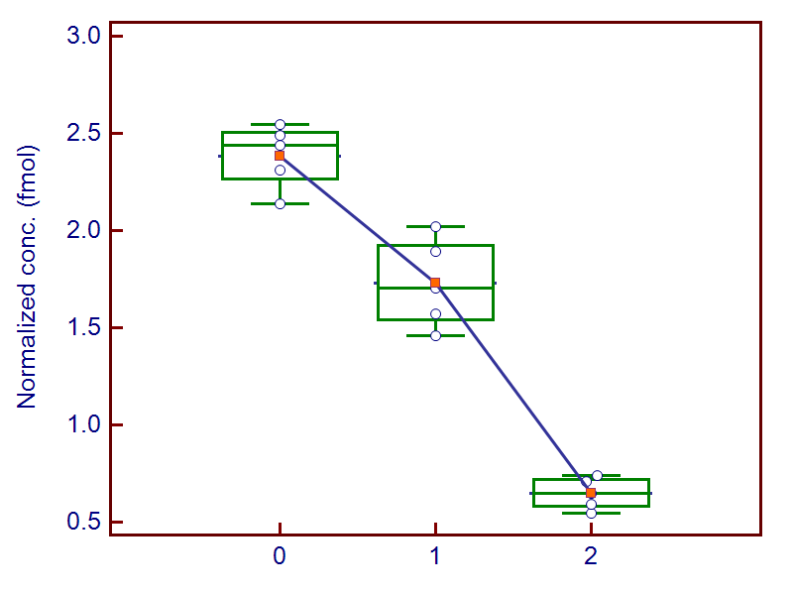
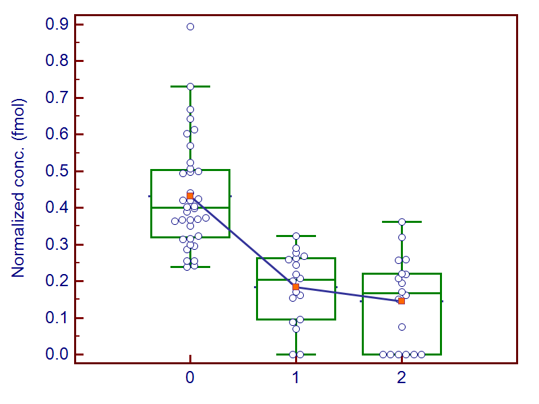
9. Polyadenylate-binding protein 1 (PABPC1)
Pooled serum
Individual serum
EFSPFGTITSAK
 | Healthy control | Before HCC treatment | After HCC treatment
Average | 2.38 | 1.73 | 0.65
STDEV | 0.16 | 0.23 | 0.08
CV (%) | 6.89 | 13.21 | 12.30
EFSPFGTITSAK
 | Healthy control | Before HCC treatment | After HCC treatment
Average | 0.43 | 0.18 | 0.14
STDEV | 0.15 | 0.10 | 0.12
CV (%) | 34.48 | 53.57 | 84.49
 |  | Healthy control vs. Before HCC treatment | Before HCC treatment vs. After HCC treatment
Fold change | 0.73 |  | 2.67
 | Healthy control vs. Before HCC treatment | Before HCC treatment vs. After HCC treatment
Meaningful difference ( p < 0.05) | Yes | No

