Slide 1
Figure S1
A
Constitutive
Low+Med
rank-sum
p-values
Feature capturing
T-richness upstream of TSS:
0.519
Regulated
Low+Med
7.3 ∙ 10⁻¹⁰
1.2 ∙ 10⁻⁶
Constitutive
High+V.High
max
%T
20bp window
in [-70,-11]
%(T+A)
6.2 ∙ 10⁻⁴
0.0029
0.343
Regulated
High+V.High
B
Constitutive
Low+Med
Feature capturing
A-richness
at TSS and
downstream:
0.86
Regulated
Low+Med
5.5 ∙ 10⁻¹¹
4.5 ∙ 10⁻⁸
Constitutive
High+V.High
%A in [0,49]
0.0082
0.012
0.867
Regulated
High+V.High
C
Constitutive
Low+Med
Feature capturing
G\C-depletion
around TSS:
0.273
Regulated
Low+Med
6.3 ∙ 10⁻¹³
7.2 ∙ 10⁻⁷
Constitutive
High+V.High
%(G+C) in [-50,49]
0.0179
0.116
0.447
Regulated
High+V.High
D
Constitutive
Low+Med
Feature capturing
G-depletion
around TSS:
0.164
Regulated
Low+Med
3.4 ∙ 10⁻⁸
3 ∙ 10⁻⁴
Constitutive
High+V.High
%G in [-50,49]
9.4 ∙ 10⁻⁴
0.0094
0.396
Regulated
High+V.High

Slide 2
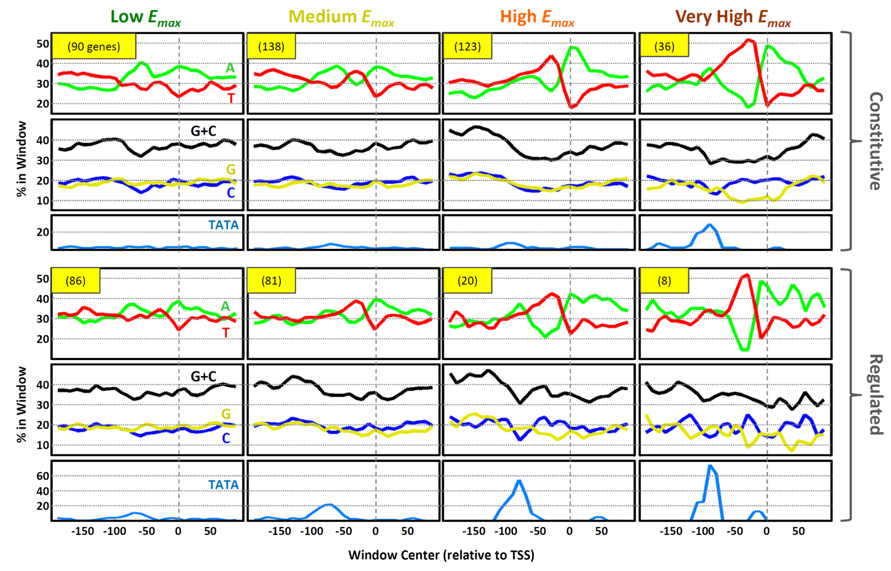
Figure S2

Slide 3
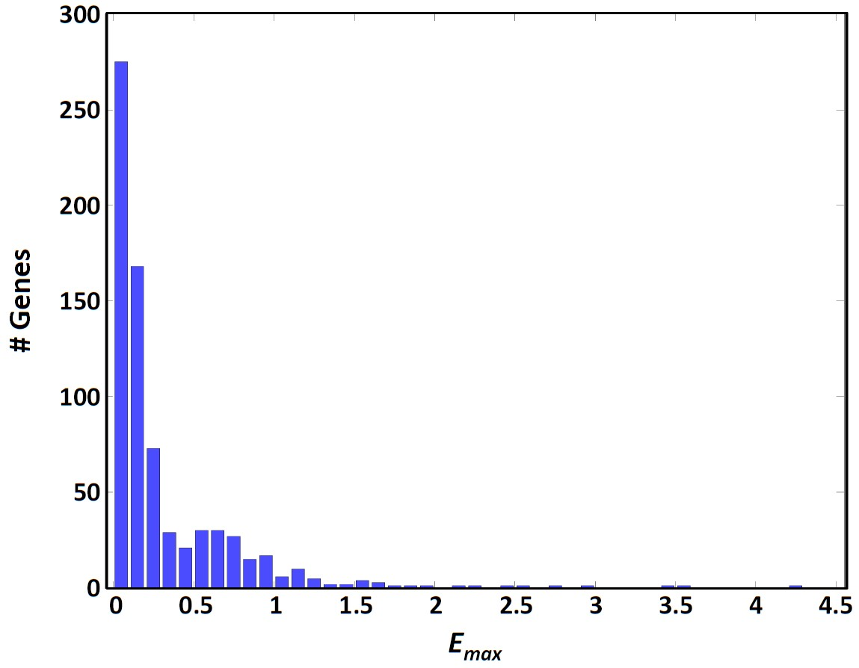
Figure S3

Slide 4
Figure S4
Human Constitutively Expressed (10 cell lines)
rank-sum p-values
A
High
Max Exp.
B
High
Max Exp.
5.4 ∙ 10⁻²¹
Low
Max Exp.
1.3 ∙ 10⁻¹²
Low
Max Exp.
%A in
[-50,49]
%T in
[-50,49]
0.183
3.4 ∙ 10⁻⁴⁵
All
0.0019
2.8 ∙ 10⁻³⁵
All
C
High
Max Exp.
D
High
Max Exp.
1.8 ∙ 10⁻¹⁰
Low
Max Exp.
2.3 ∙ 10⁻¹⁹
Low
Max Exp.
%G in
[0,49]
%C in
[-20,9]
1.6 ∙ 10⁻⁵
9.2 ∙ 10⁻³⁷
All
3.3 ∙ 10⁻⁴
1.4 ∙ 10⁻¹⁷
All
E
High
Max Exp.
F
High
Max Exp.
7 ∙ 10⁻²⁴
Low
Max Exp.
1.1 ∙ 10⁻³⁰
Low
Max Exp.
%(G+C) in
[-50,49]
%GpC in
[-50,49]
0.0055
1.9 ∙ 10⁻⁵⁷
All
0.91
2.7 ∙ 10⁻⁵⁰
All
G
High
Max Exp.
3.5 ∙ 10⁻⁵⁰
Low
Max Exp.
%CpG in
[-50,49]
0.926
4.4 ∙ 10⁻⁸⁰
All

Slide 5
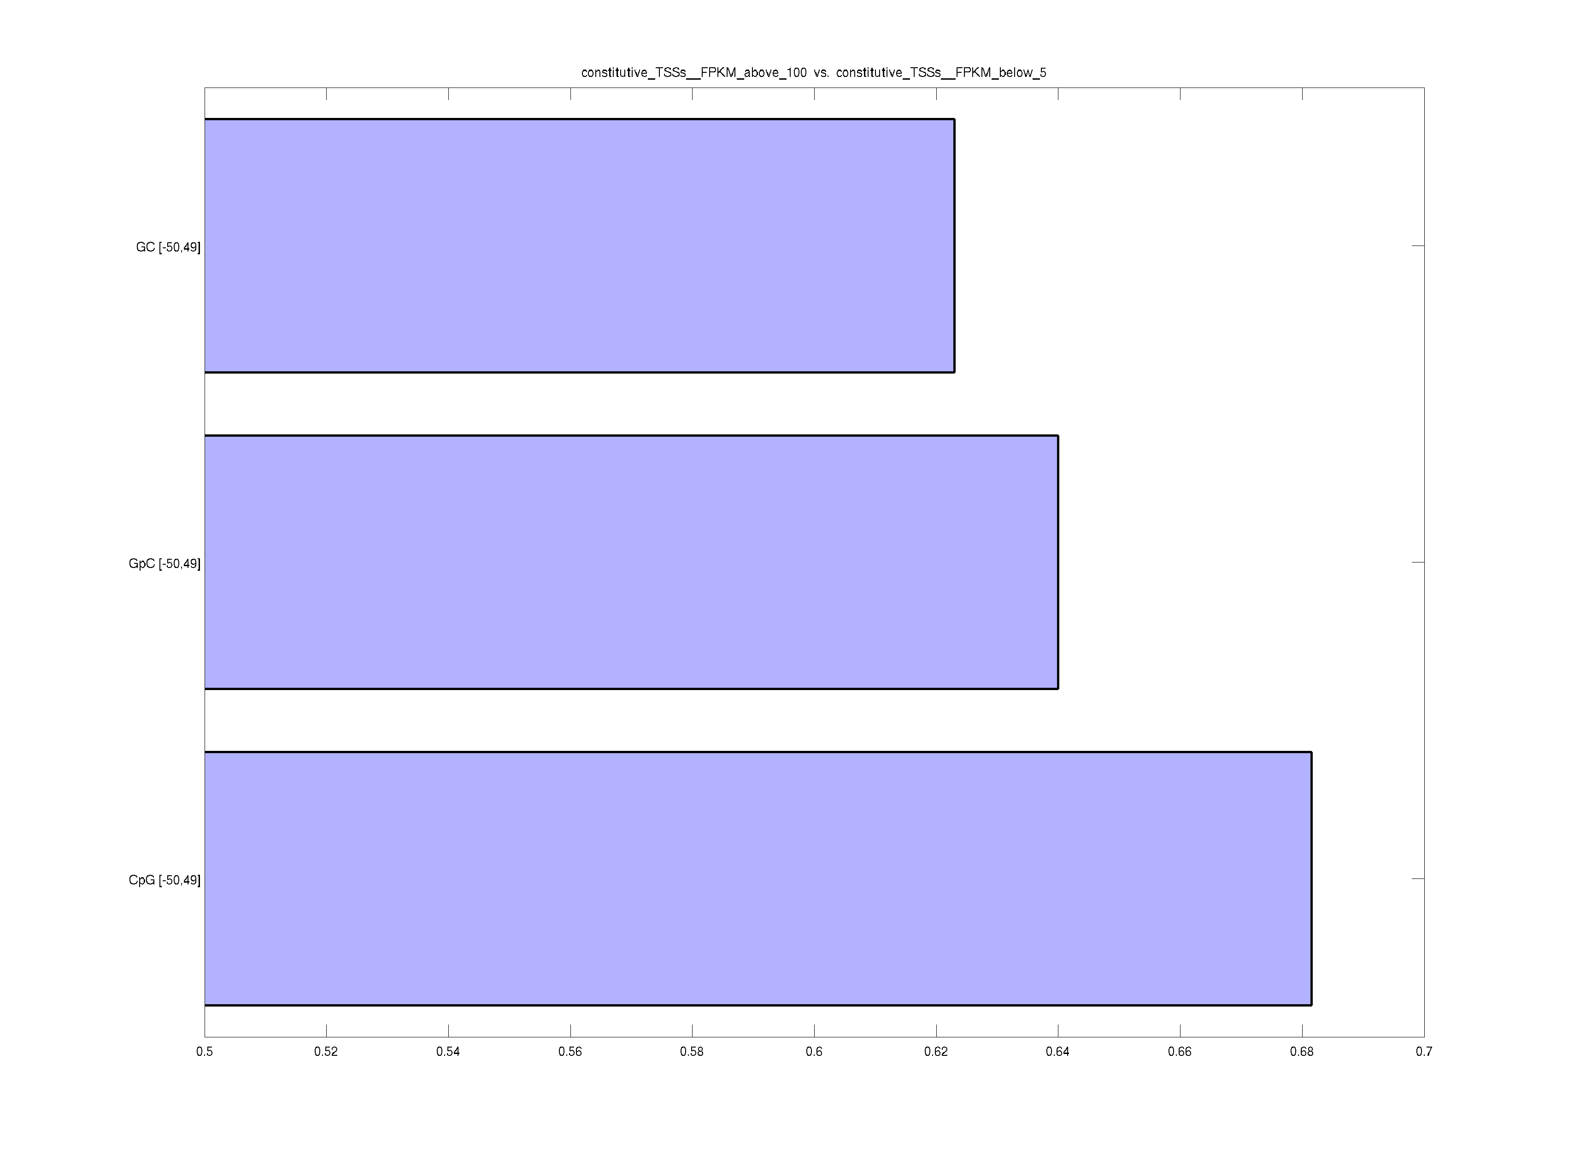
Figure S5
Human Constitutively Expressed (10 cell lines)
High Max Exp. Vs. Low Max Exp.
%(G+C) in [-50,49]
0.623
%(GpC) in [-50,49]
0.64
%(CpG) in [-50,49]
0.682
0.5
0.6
0.7
AUC

Slide 6
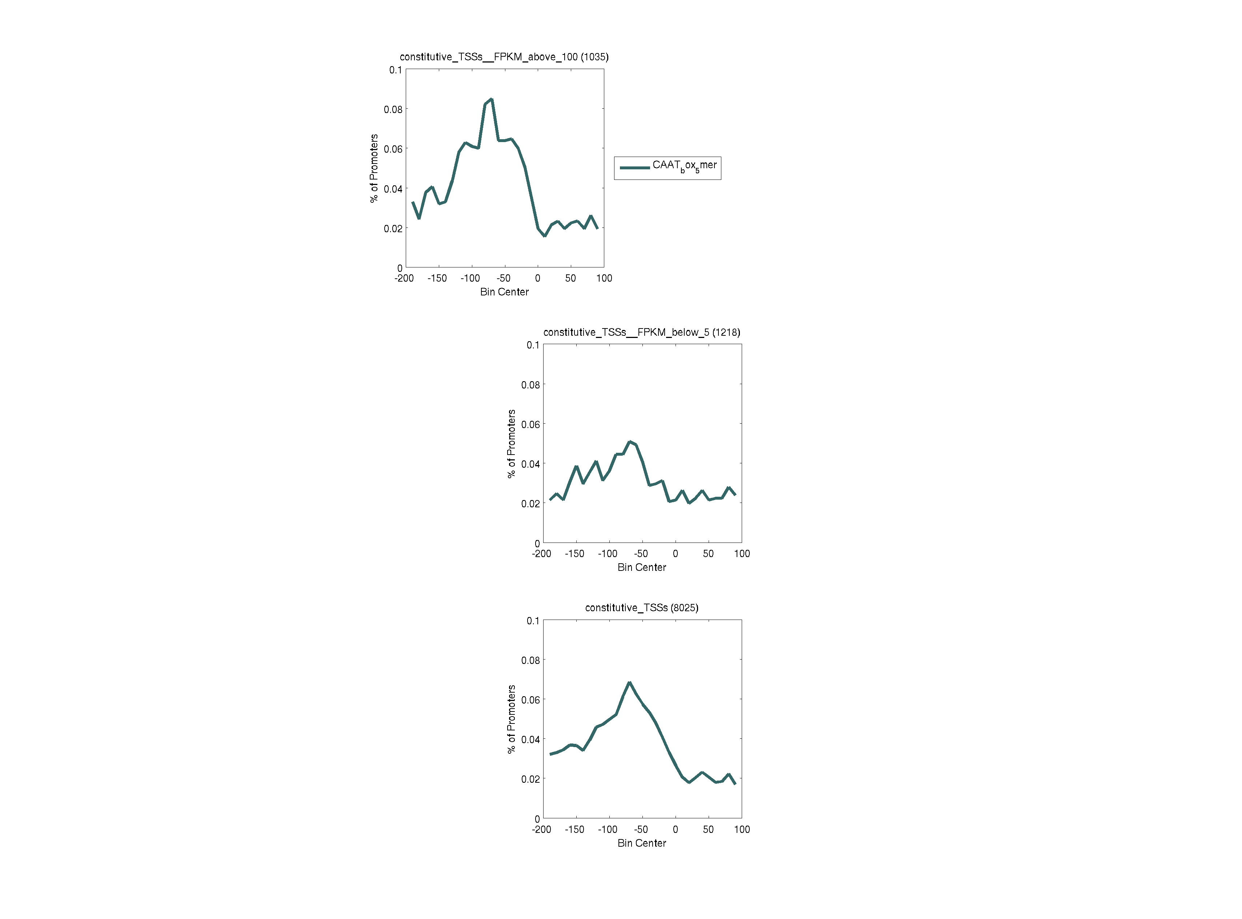
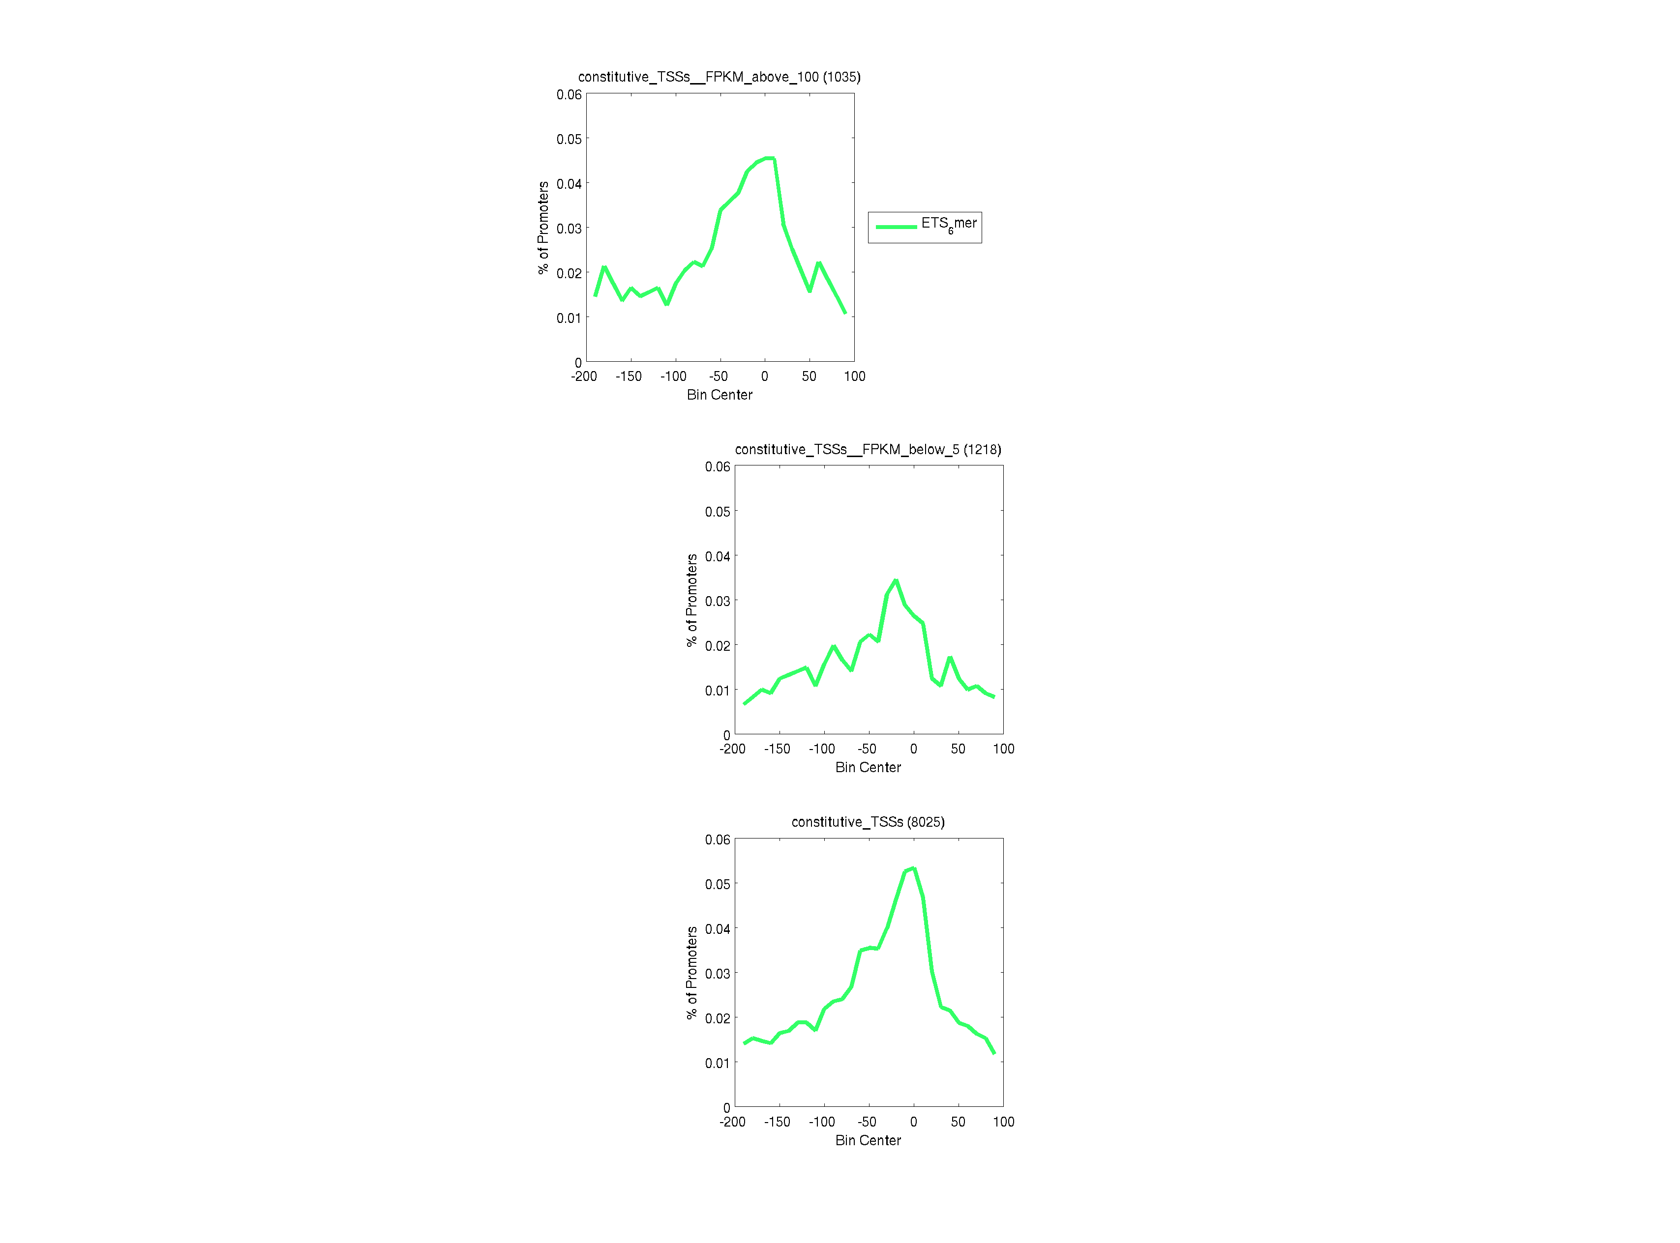
Figure S6
Human Constitutively Expressed (10 cell lines)
High Max Exp.
(1035 TSSs)
Low Max Exp.
(1218 TSSs)
All
(8025 TSSs)
10
CCAAT
+
ATTGG
0
(NF-Y)
% TSSs with Hits in Window
6
CCGGAA
+
TTCCGG
0
(ETS)
-150
-50
50
-150
-50
50
-150
-50
50
Window Center (relative to TSS)

Slide 7
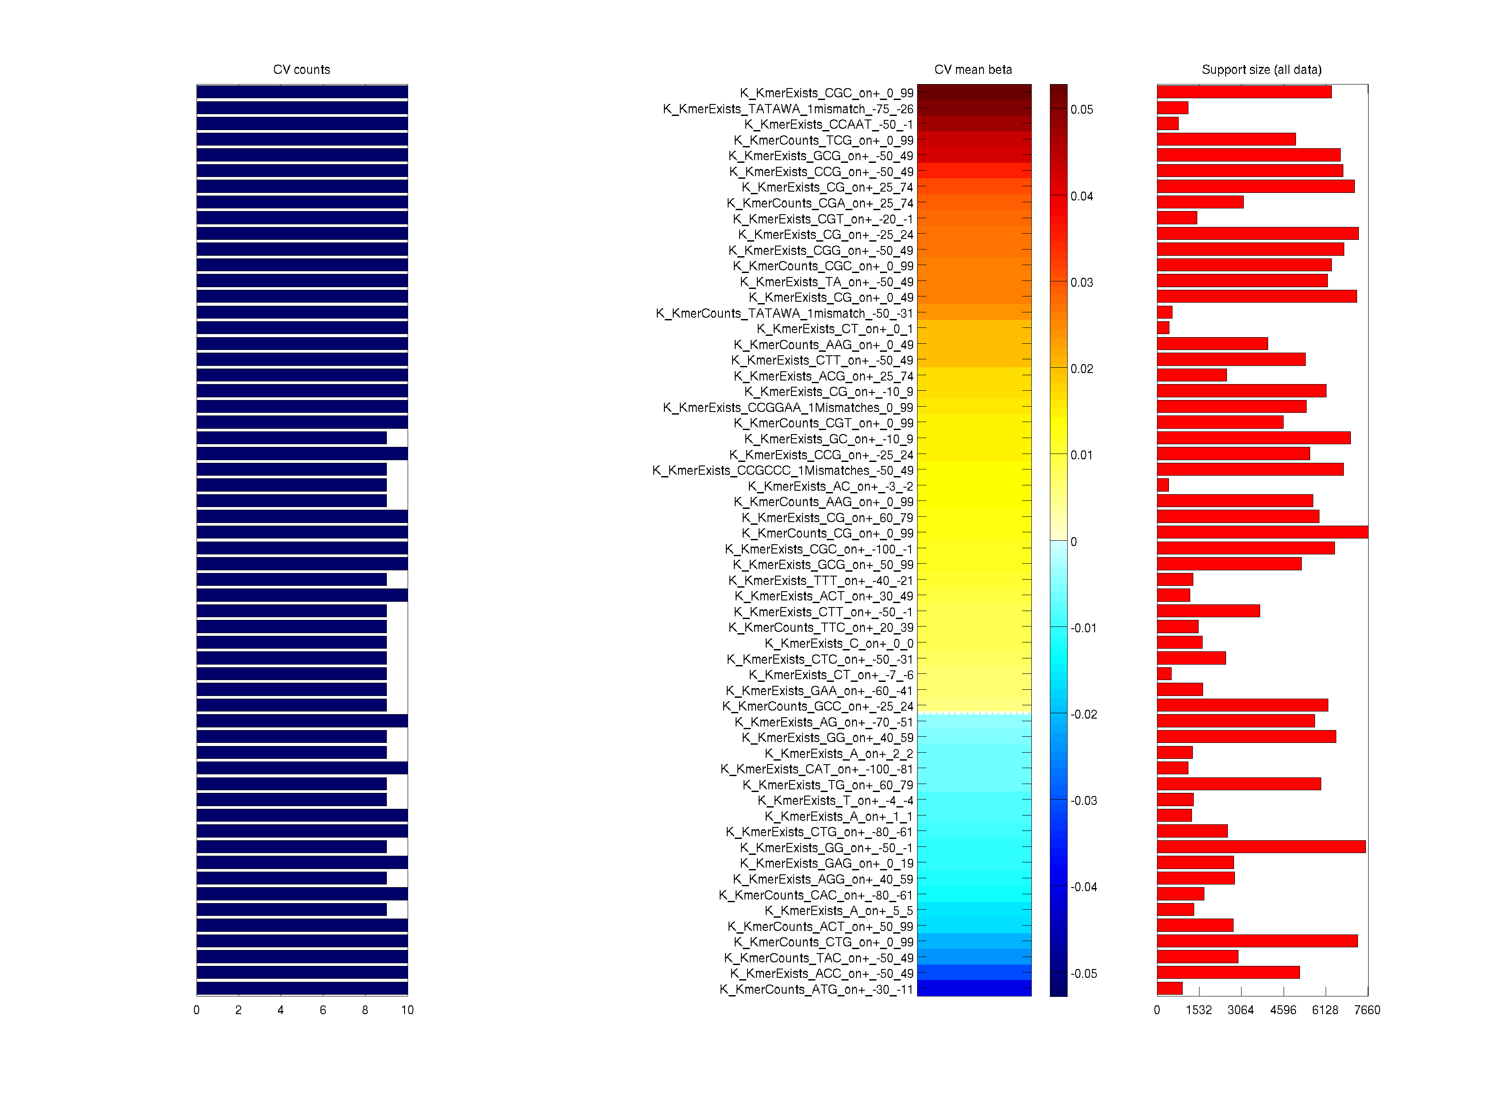
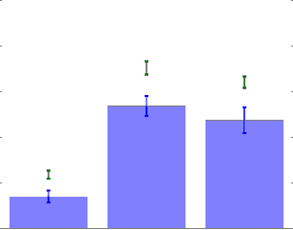
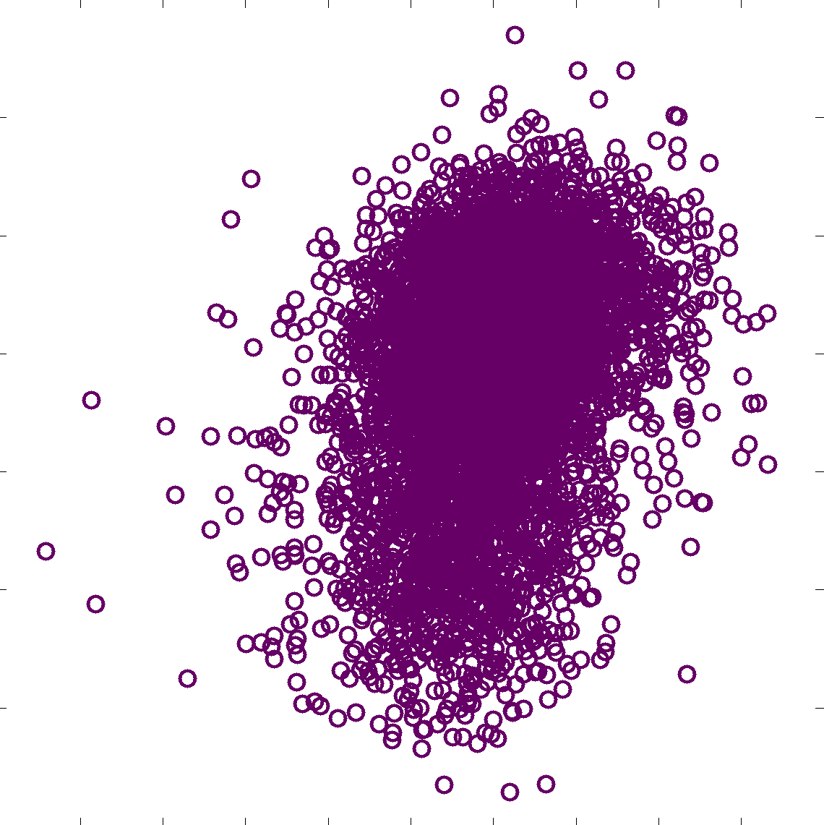
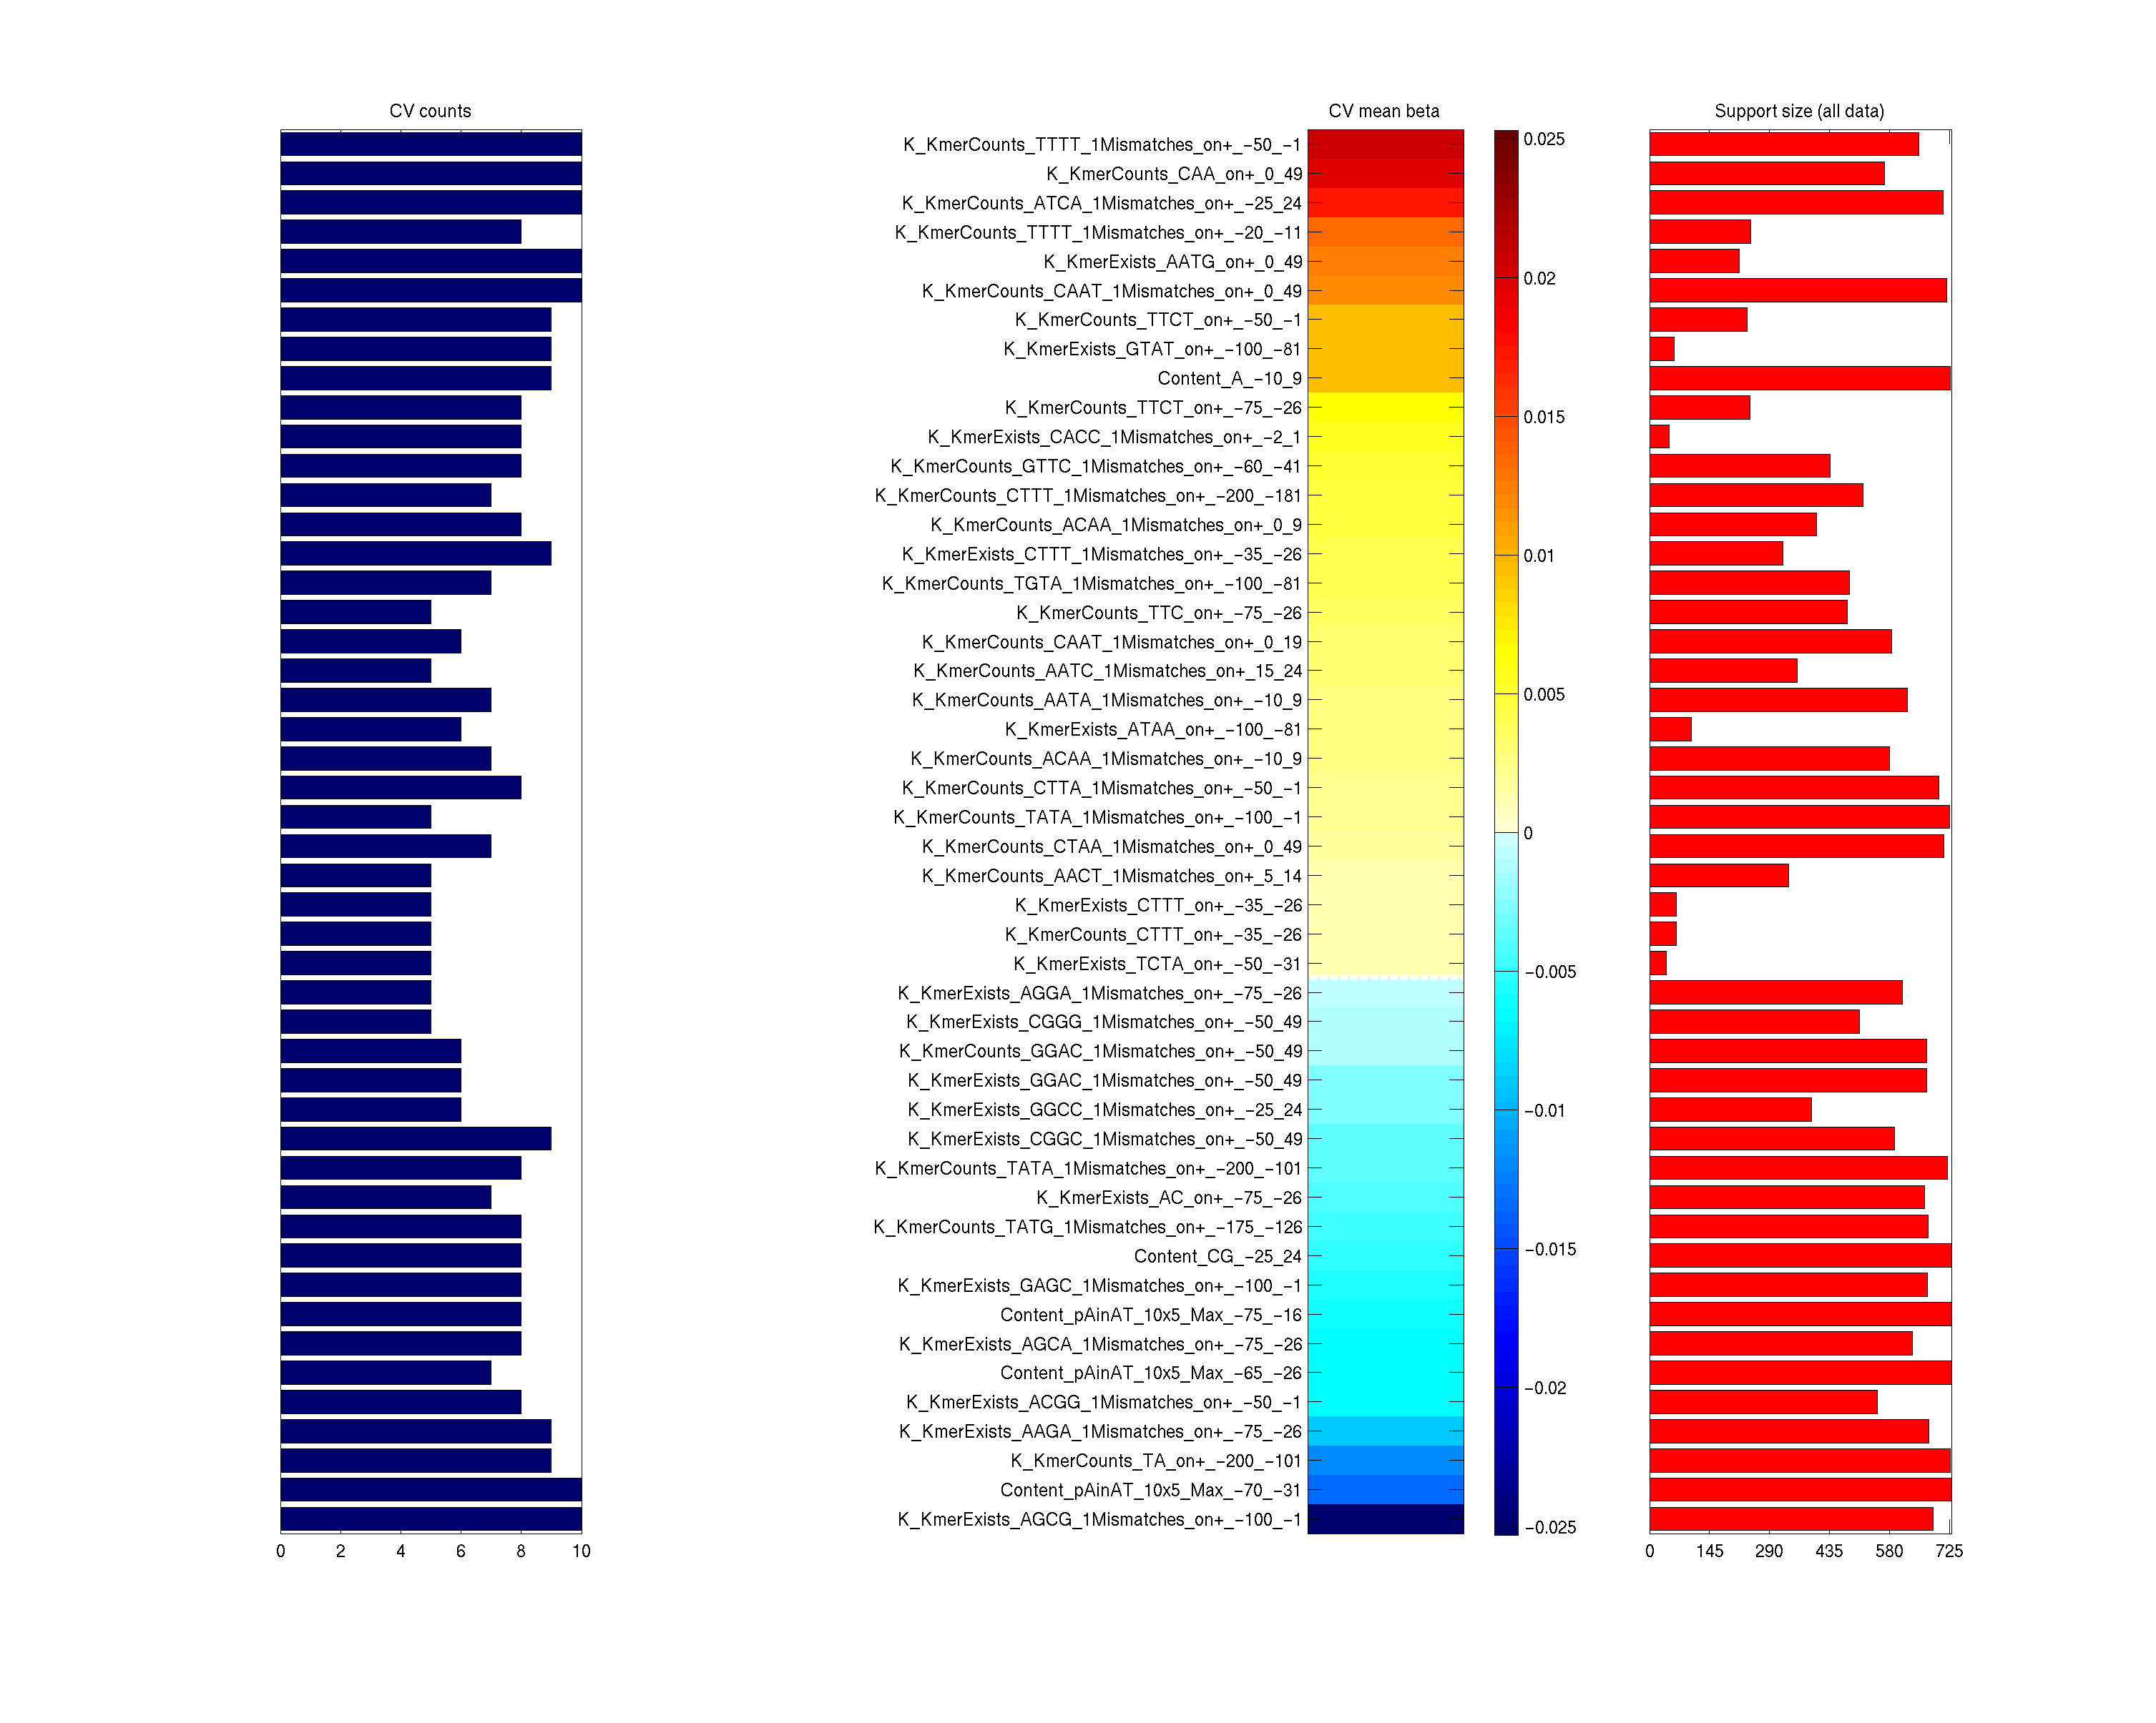
Figure S7
 | [0,99] | (1) | CGC | (1)
 | [-75,-26] | 1m (1) (±) | TATAWA | (2)
 | [-50,-1] | (1) (±) | CCAAT | (3)
 | [0,99] | (#) | TCG | (4)
 | [-50,49] | (1) | GCG | (5)
 | [-50,49] | (1) | CCG | (6)
 | [25,74] | (1) | CG | (7)
 | [25,74] | (#) | CGA | (8)
 | [-20,-1] | (1) | CGT | (9)
 | [-25,24] | (1) | CG | (10)
 | [-50,49] | (1) | CGG | (11)
 | [0,99] | (#) | CGC | (12)
 | [-50,49] | (1) | TA | (13)
 | [0,49] | (1) | CG | (14)
 | [-50,-31] | 1m (#) (±) | TATAWA | (15)
 | [0,1] | (1) | CT | (16)
 | [0,49] | (#) | AAG | (17)
 | [-50,49] | (1) | CTT | (18)
 | [25,74] | (1) | ACG | (19)
 | [-10,9] | (1) | CG | (20)
 | [0,99] | 1m (1) (±) | CCGGAA | (21)
 | [0,99] | (1) | CGT | (22)
 | [-10,9] | (1) | GC | (23)
 | [-25,24] | (1) | CCG | (24)
 | [-50,49] | 1m (1) (±) | CCGCCC | (25)
 | [-3,-2] | (1) | AC | (26)
 | [0,99] | (#) | AAG | (27)
 | [60,79] | (1) | CG | (28)
 | [0,99] | (1) | CG | (29)
 | [-100,-1] | (1) | CGC | (30)
 | [50,99] | (1) | GCG | (31)
 | [-40,-21] | (1) | TTT | (32)
 | [30,49] | (1) | ACT | (33)
 | [-50,-1] | (1) | CTT | (34)
 | [20,39] | (#) | TTC | (35)
 | [0,0] | (1) | C | (36)
 | [-50,-31] | (1) | CTC | (37)
 | [-7,-6] | (1) | CT | (38)
 | [-60,-41] | (1) | GAA | (39)
 | [-25,24] | (#) | GCC | (40)
 | [-70,-51] | (1) | AG | (41)
 | [40,59] | (1) | GG | (42)
 | [2,2] | (1) | A | (43)
 | [-100,-81] | (1) | CAT | (44)
 | [60,79] | (1) | TG | (45)
 | [-4,-4] | (1) | T | (46)
 | [-1,-1] | (1) | A | (47)
 | [-80,-61] | (1) | CTG | (48)
 | [-50,-1] | (1) | GG | (49)
 | [0,19] | (1) | GAG | (50)
 | [40,59] | (1) | AGG | (51)
 | [-80,-61] | (#) | CAC | (52)
 | [5,5] | (1) | A | (53)
 | [50,99] | (#) | ACT | (54)
 | [0,99] | (#) | CTG | (55)
 | [-50,49] | (#) | TAC | (56)
 | [-50,49] | (1) | ACC | (57)
 | [-30,-11] | (#) | ATG | (58)
0.5
Performance
(CV Mean)
1.5
1m - Up to 1 mismatch
(1) - k-mer existence
(#) - k-mer counts
(±) - Also on ‘-’ strand
0.4
train
test
0.3
Test Prediction
0.2
0.1
CV Mean Effect Size
0
R²
r
ρ
-2
log FPKM
-0.05
0
0.05
-12
8

