Slide 1
Figure S-1. Mean of observed (points) and population predicted (solid line) plasma concentrations for rolofylline (first panel), M1-trans (second panel) and M1-cis (third panel). Doses are as indicated atop each subplot.

Slide 2
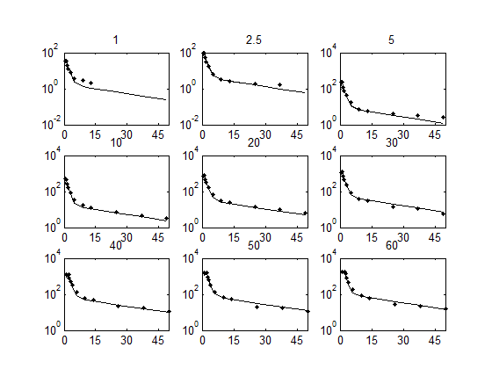

Slide 3
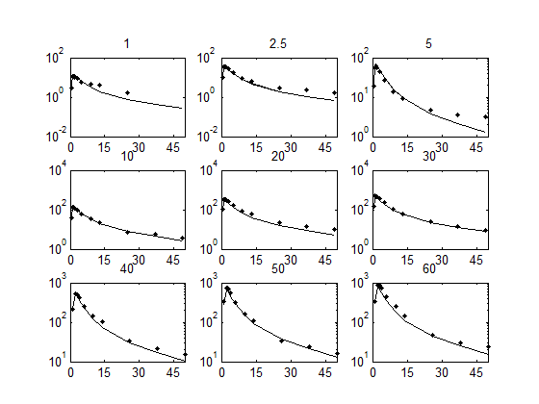

Slide 4
