Slide 1
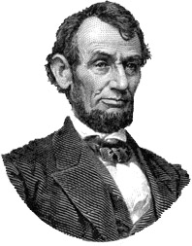

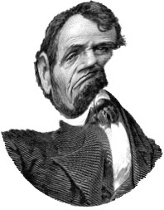

ORIGINAL SPEECH
SPECTRALLY
DEGRADED
8 CHANNELS
ANALYSIS FILTER RANGE:
250-6800 Hz
SYNTHESIS FILTER RANGE:
250-6800 Hz
SPECTRALLY DEGRADED AND
FREQUENCY
MISMATCHED
(6.5 mm)
8 CHANNELS
ANALYSIS FILTER RANGE:
250-6800 Hz
SYNTHESIS FILTER RANGE:
854-11,000 Hz
FREQUENCY MISMATCHED
(1.5 octaves)
(done with STRAIGHT,
By Hideki
Kawahara)

