Slide 1
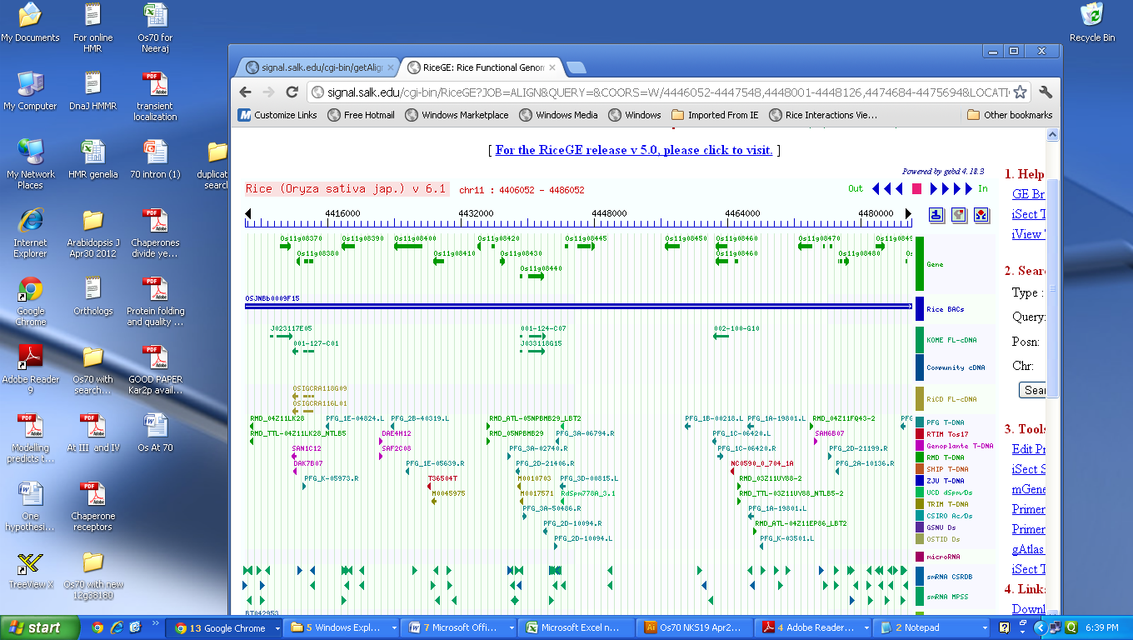
Tandem organization of 4 Hsp70 genes on chromosome 11

