Slide 1
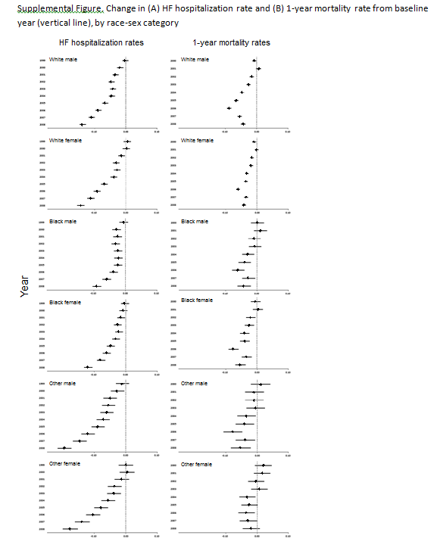
Estimates of non-transformed change in HF hospitalization or 1-year mortality rate between a given year and baseline year (log scale), using hierarchical Poisson regression or logistic regression models, respectively.

