Slide 1
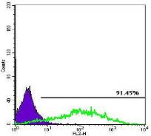
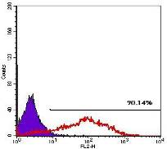
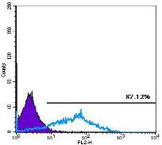
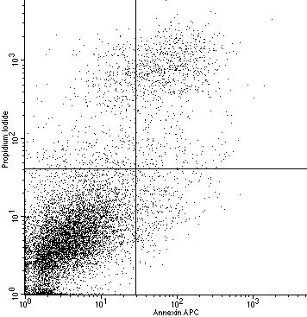

Supplemental Figure 2
*
*
*
(A)
day 1
day 2
day 3
counts
counts
counts
EpCAM-PE
EpCAM-PE
EpCAM-PE
(B)
5%
(C)
8%
8%
GFP
EpCAM
4%
84%
3%
3%
85%
PI
PI
Annexin V-APC
Annexin V APC

