Slide 1
Supplemental Fig. S1 Icelogo plots of HLA-A2, HLA-B7 and HLA-B44 binding peptides of 8-14 mer length and Icelogo plots of HLA-C binding peptides of 8-11 mer length. Peptides of different length clearly display a similar binding motif.

Slide 2
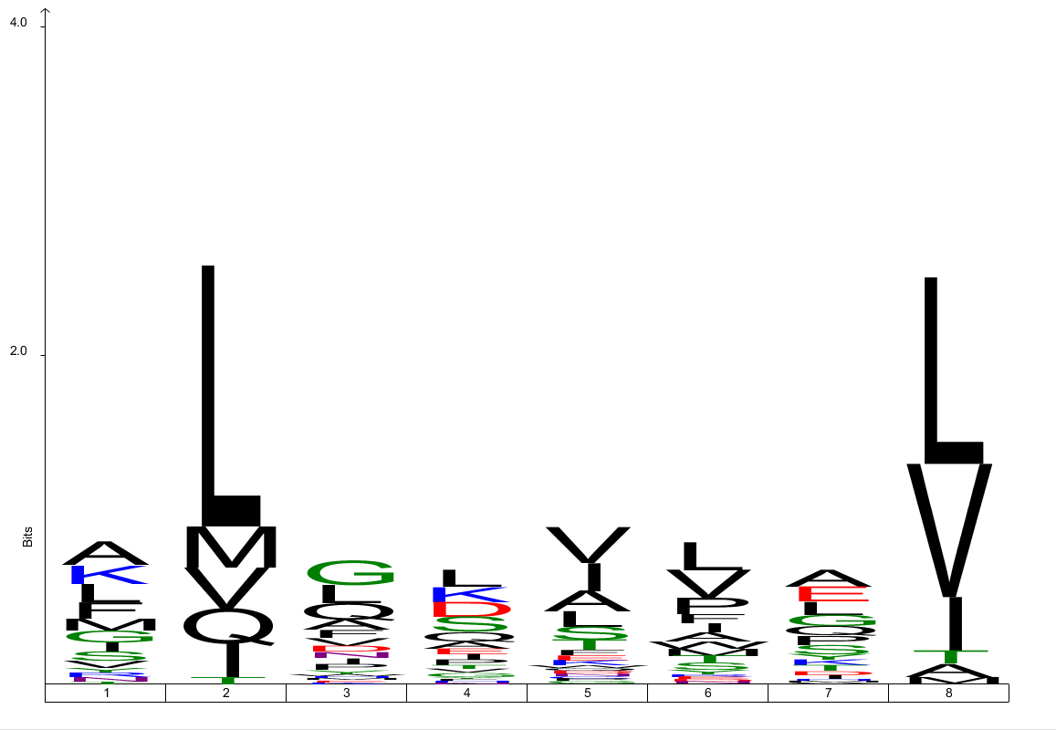
HLA-A2
61 peptides

Slide 3
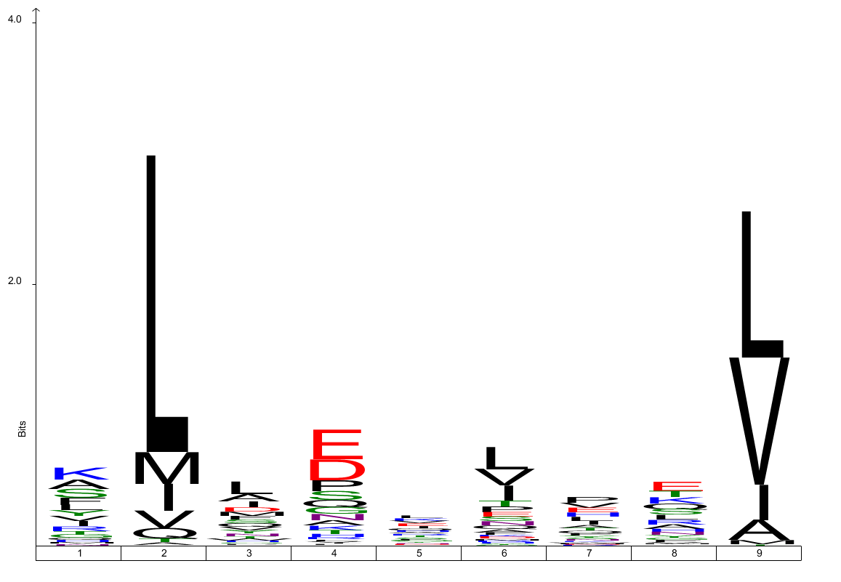
HLA-A2
3302 peptides

Slide 4
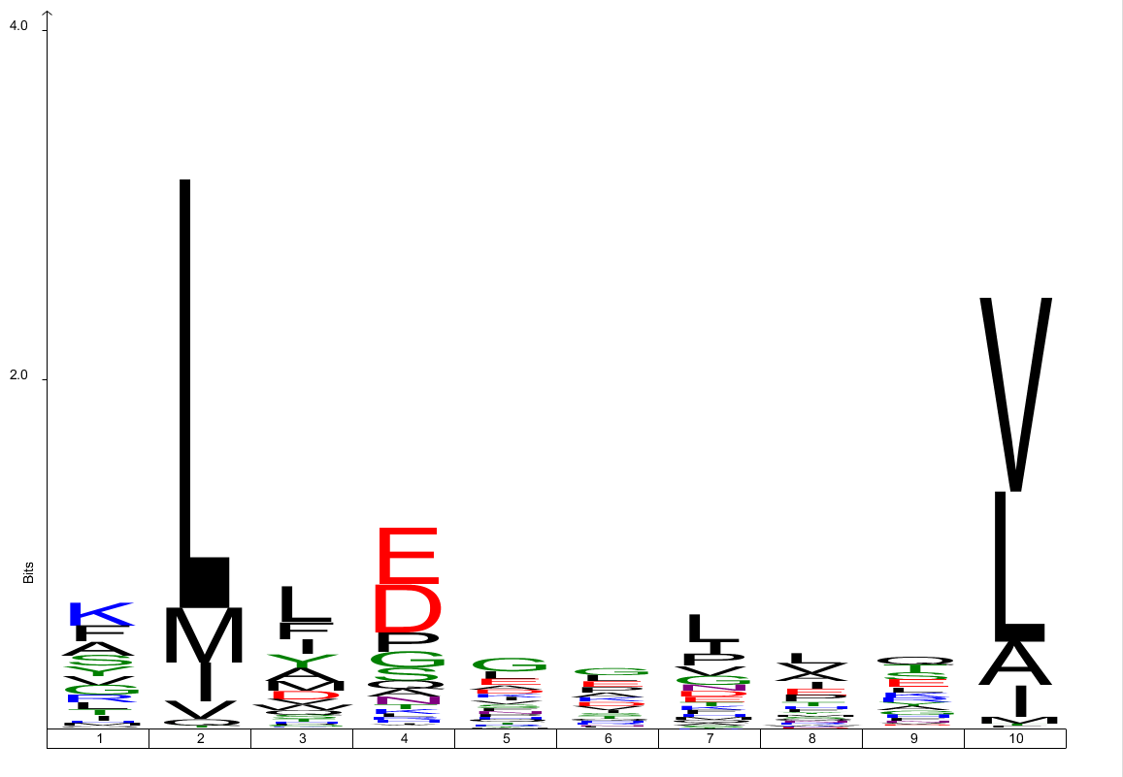
HLA-A2
712 peptides

Slide 5
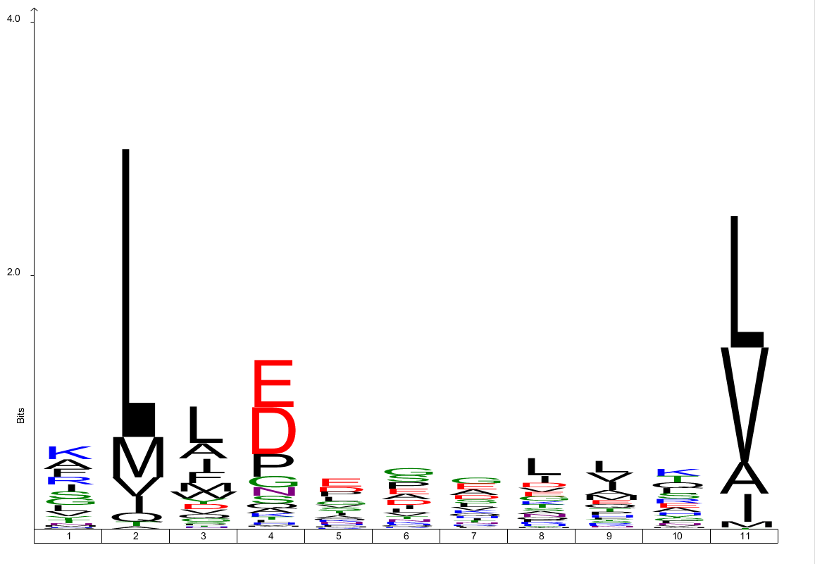
HLA-A2
621 peptides

Slide 6
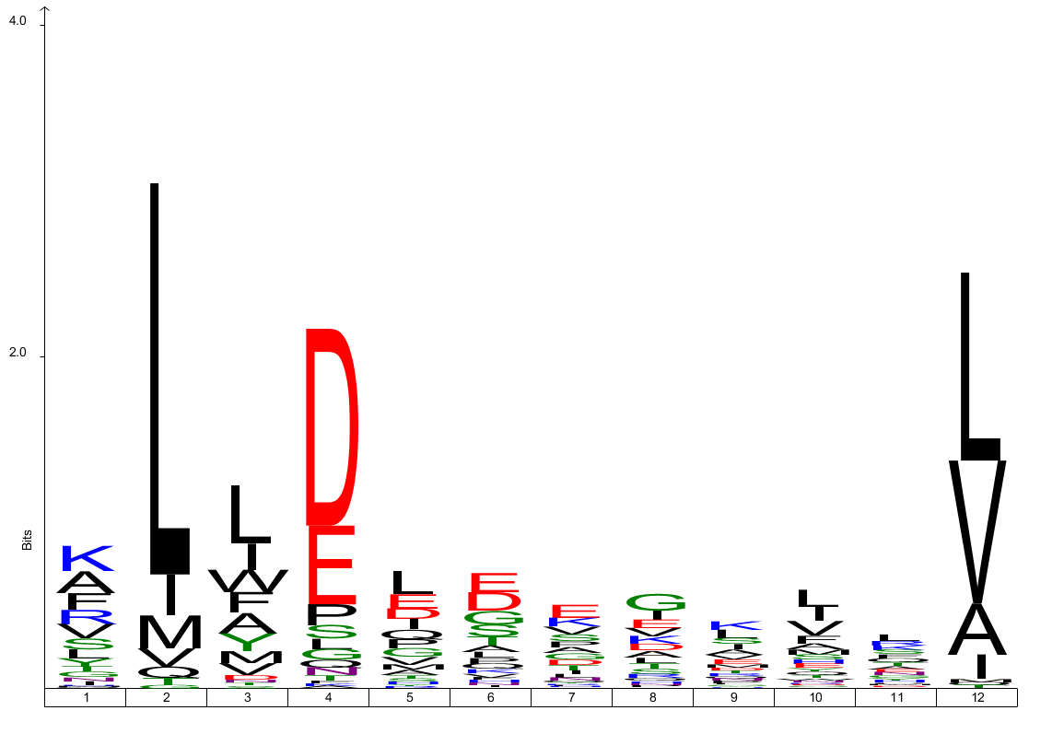
HLA-A2
137 peptides

Slide 7
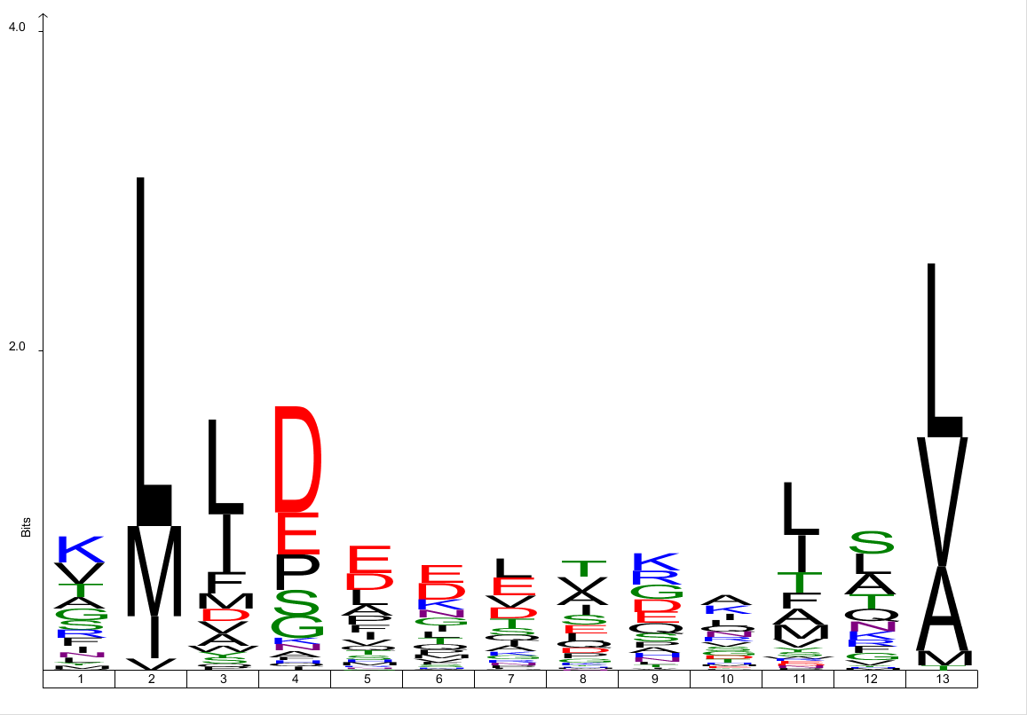
HLA-A2
83 peptides

Slide 8
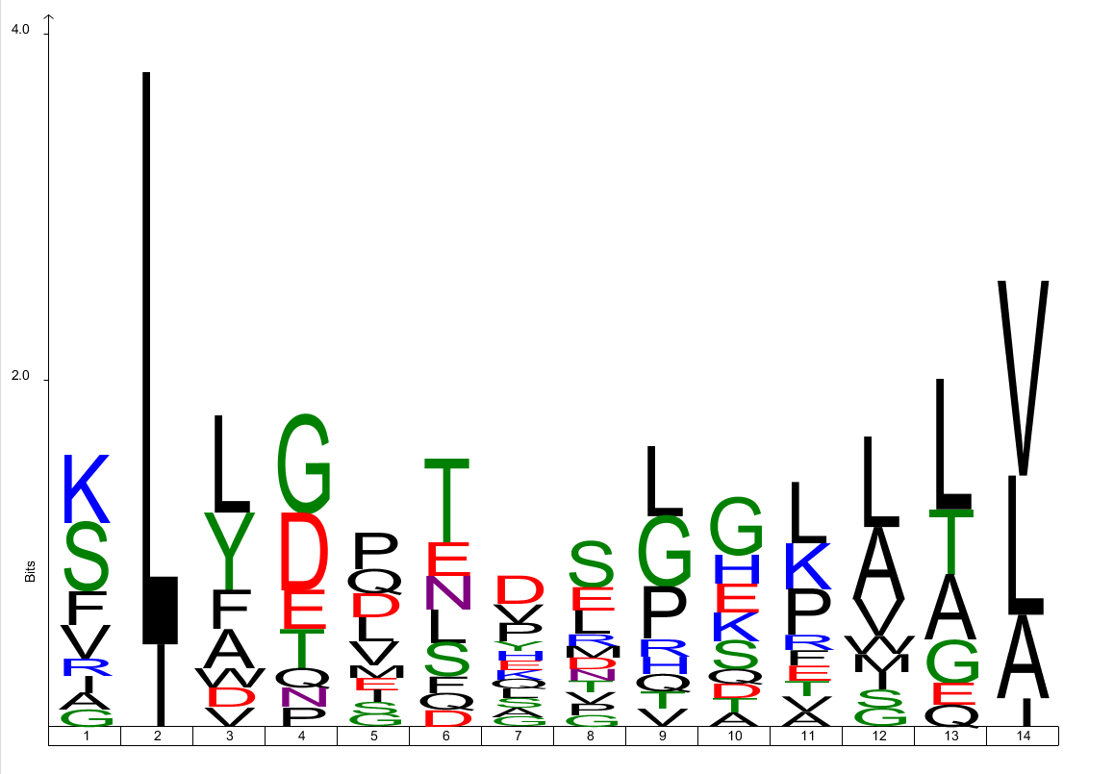
HLA-A2
17 peptides

Slide 9
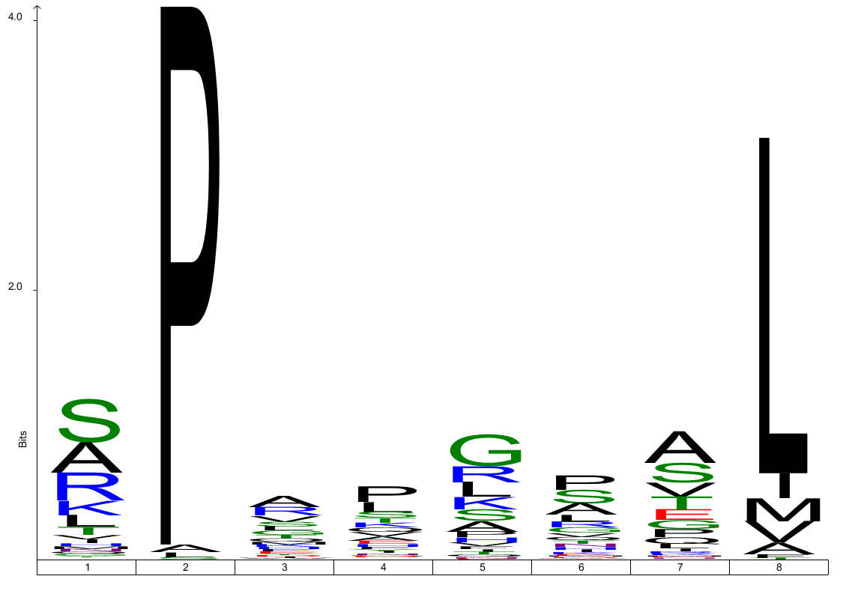
HLA-B7
219 peptides

Slide 10
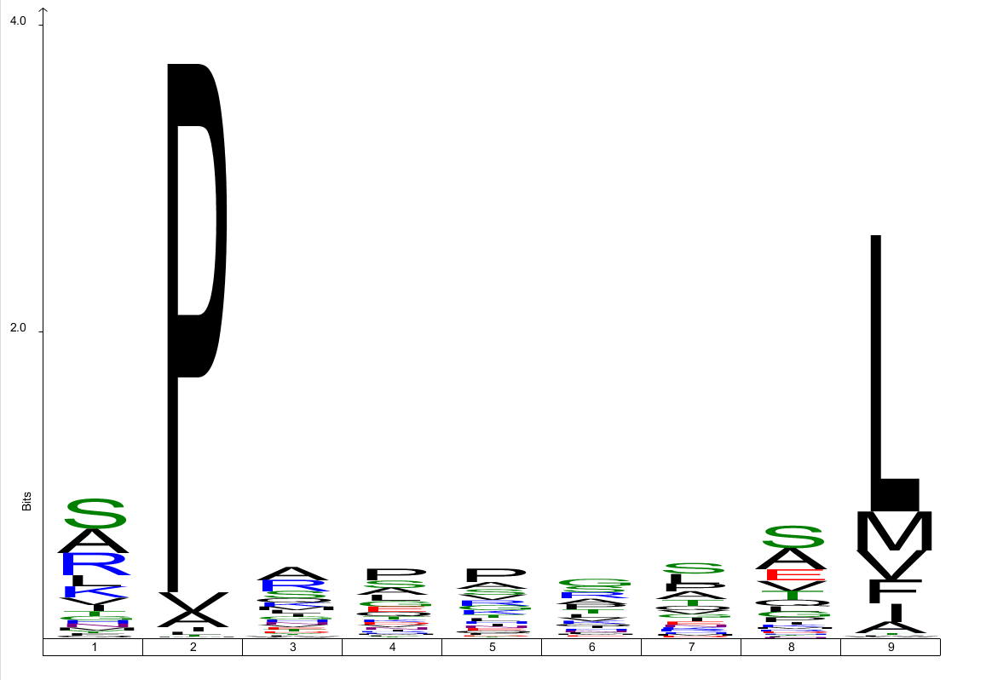
HLA-B7
1964 peptides

Slide 11
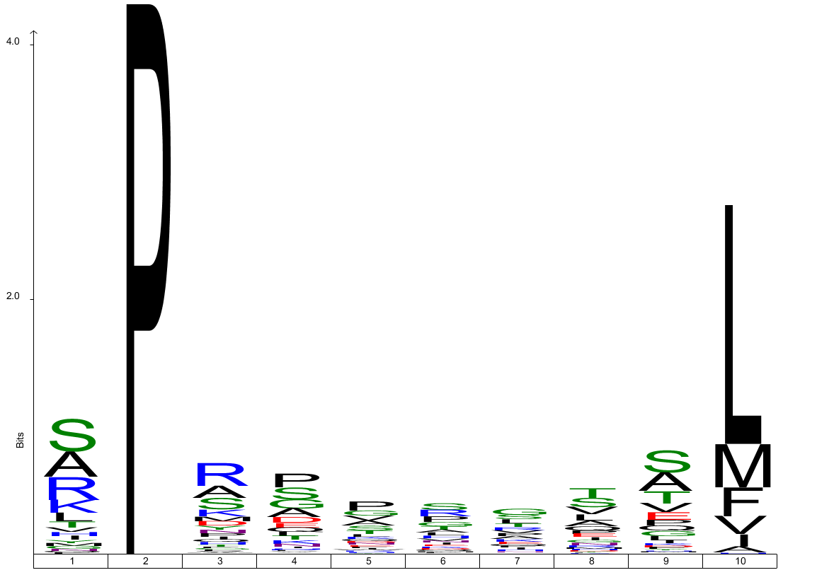
HLA-B7
630 peptides

Slide 12
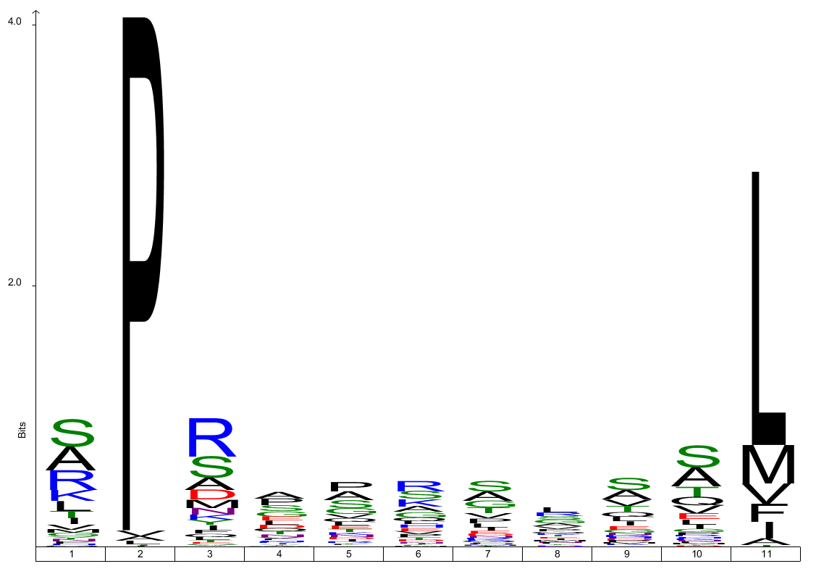
HLA-B7
449 peptides

Slide 13
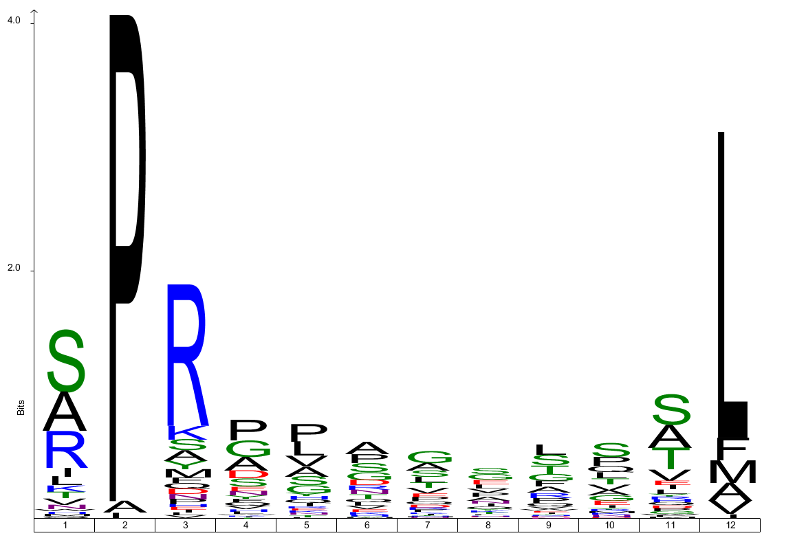
HLA-B7
86 peptides

Slide 14
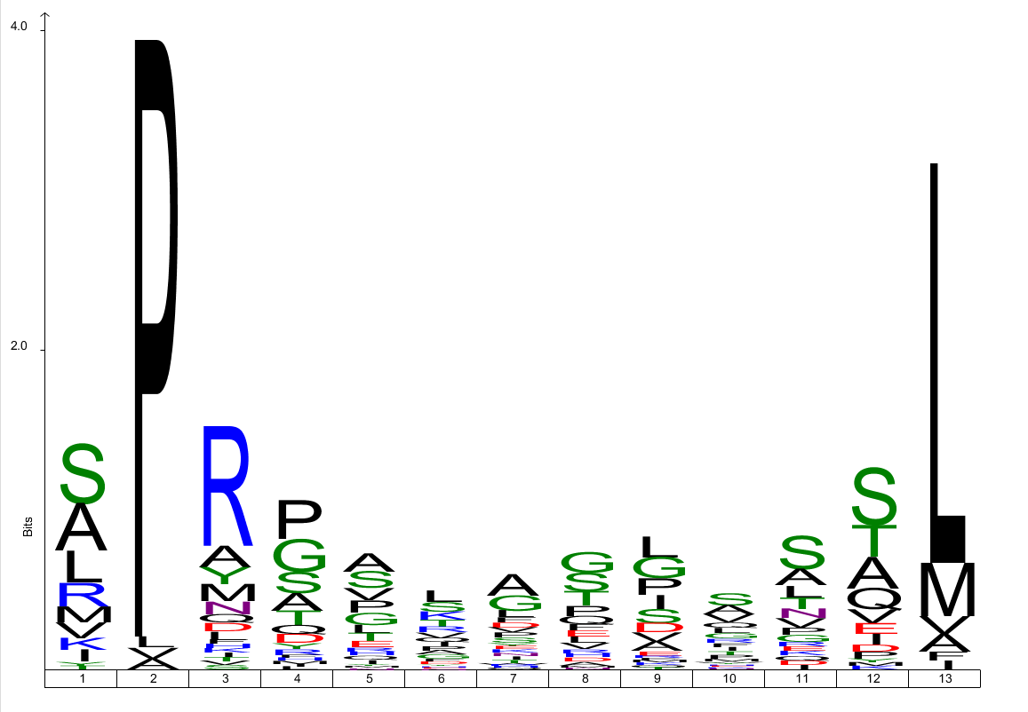
HLA-B7
58 peptides

Slide 15
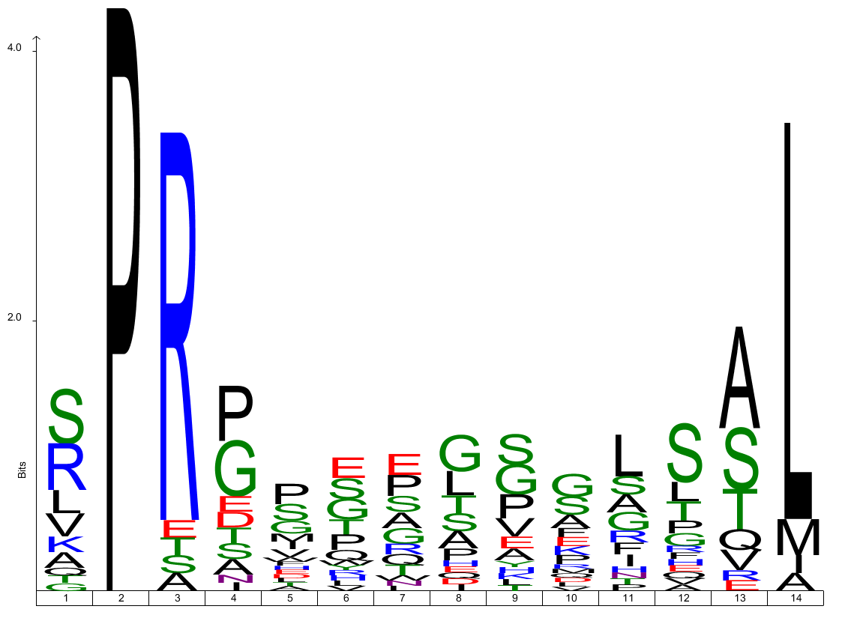
HLA-B7
27 peptides

Slide 16
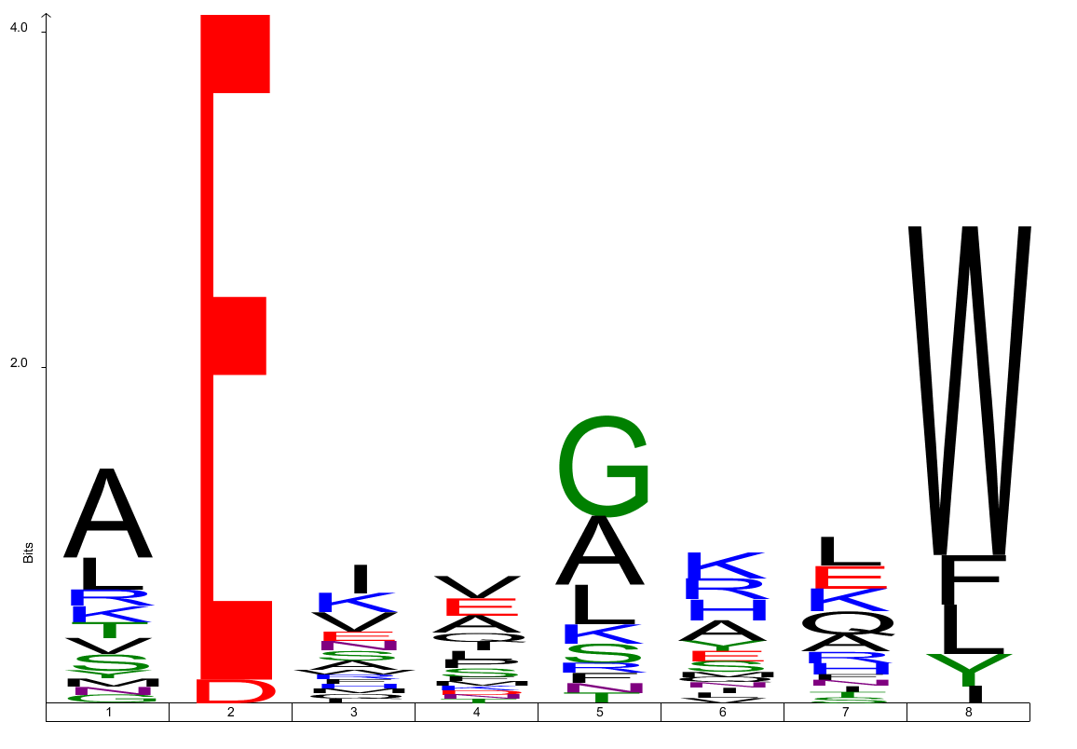
HLA-B44
29 peptides

Slide 17
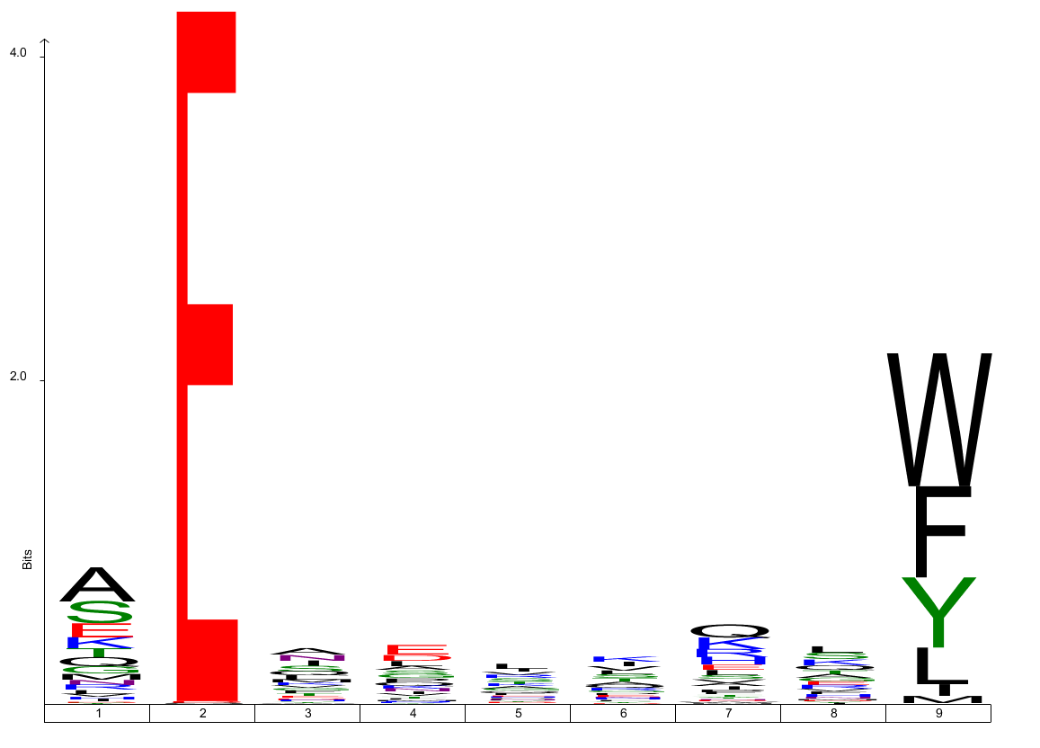
HLA-B44
1180 peptides

Slide 18
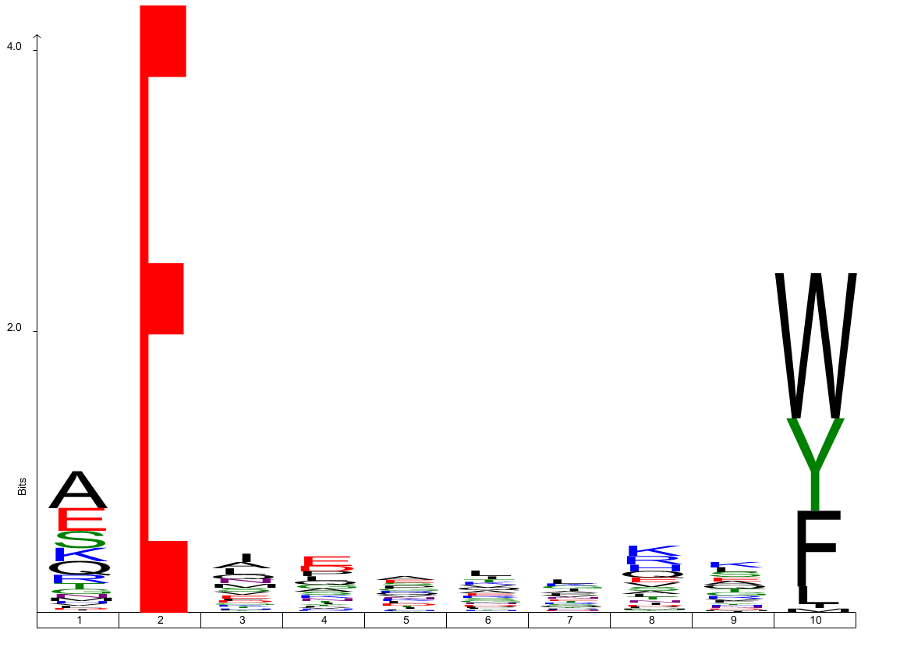
HLA-B44
937 peptides

Slide 19
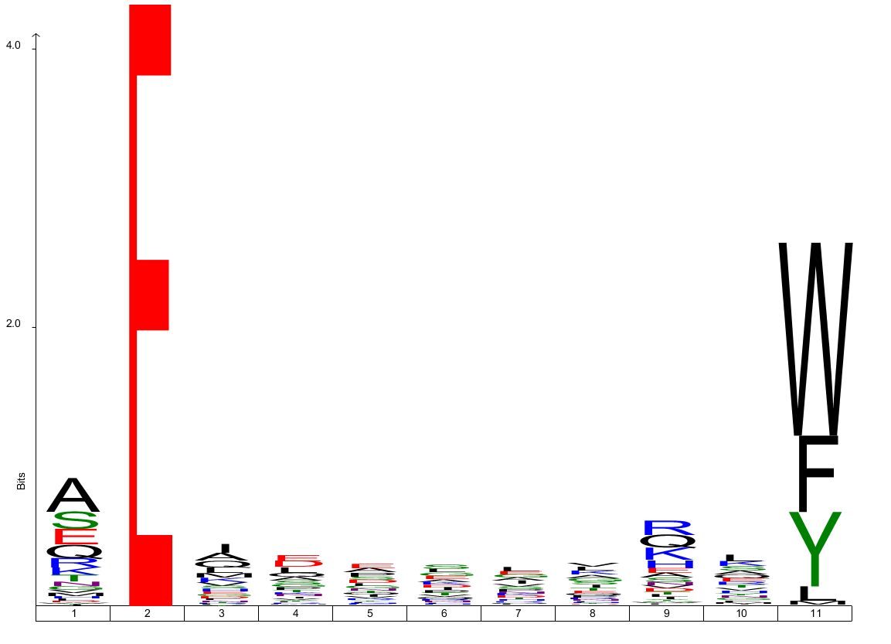
HLA-B44
576 peptides

Slide 20
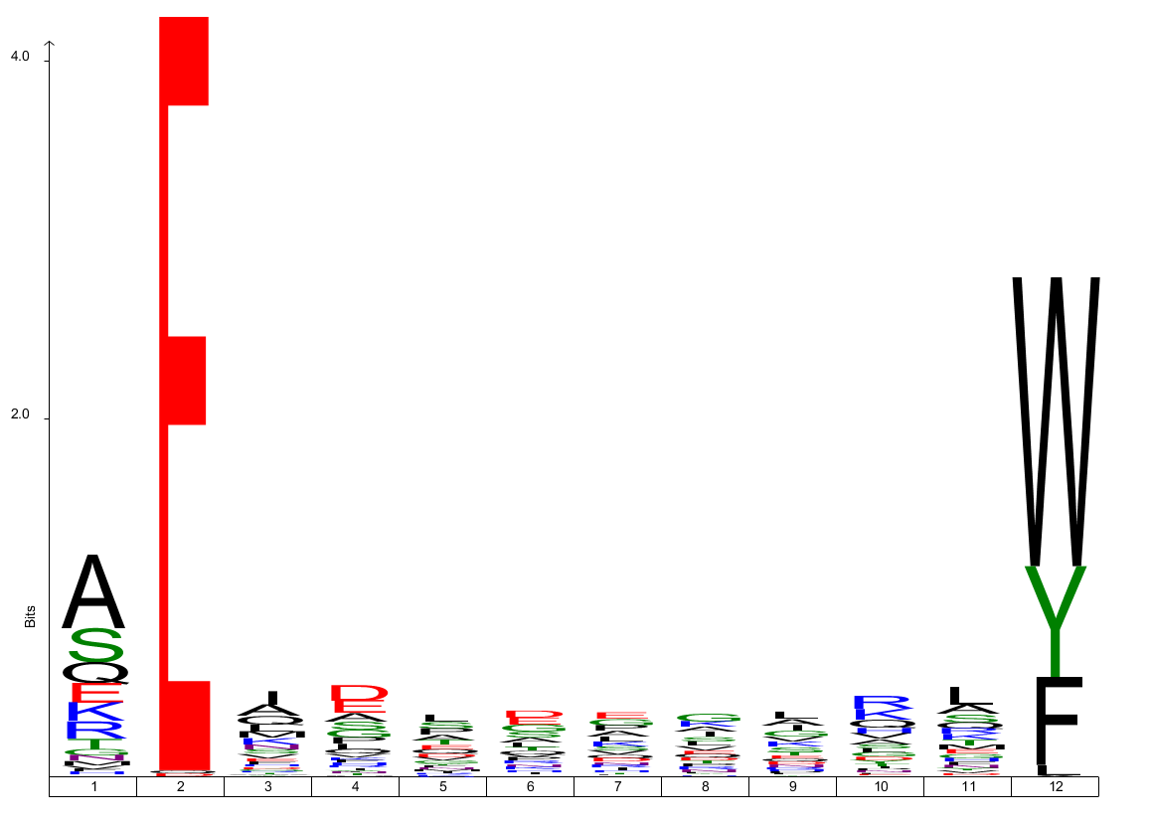
HLA-B44
244 peptides

Slide 21
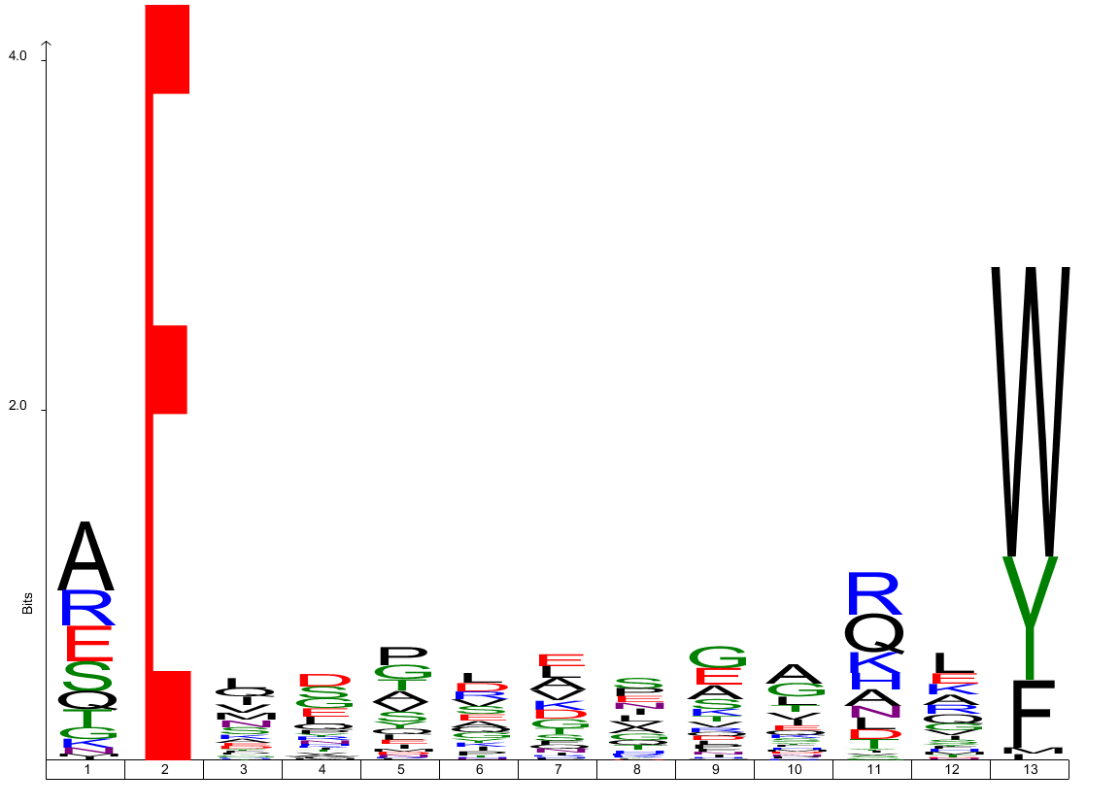
HLA-B44
81 peptides

Slide 22
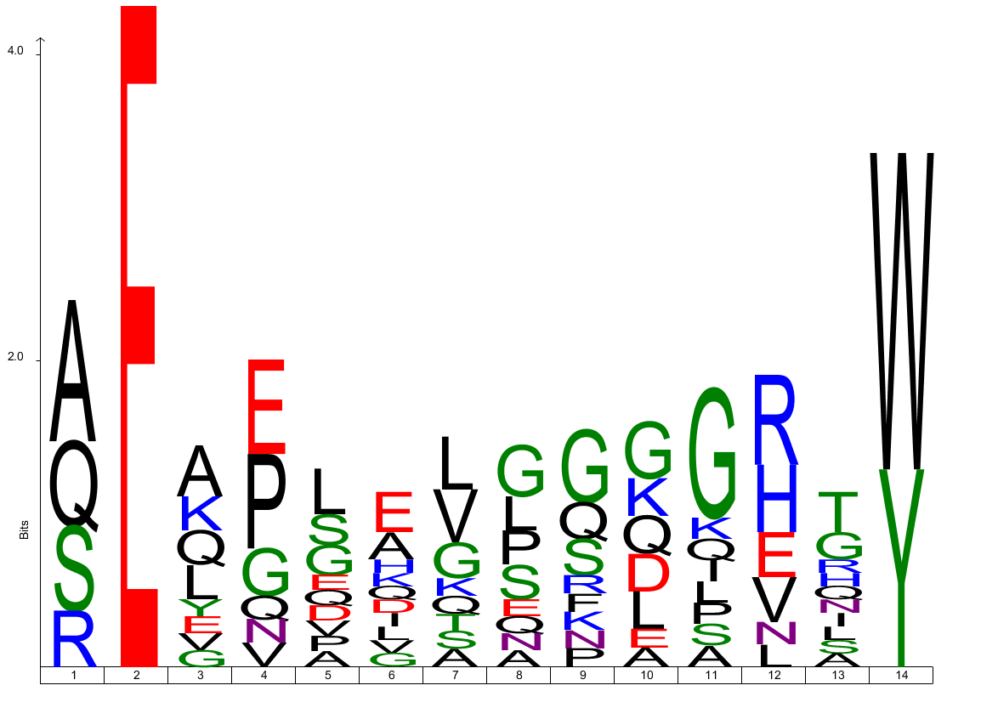
HLA-B44
14 peptides

Slide 23
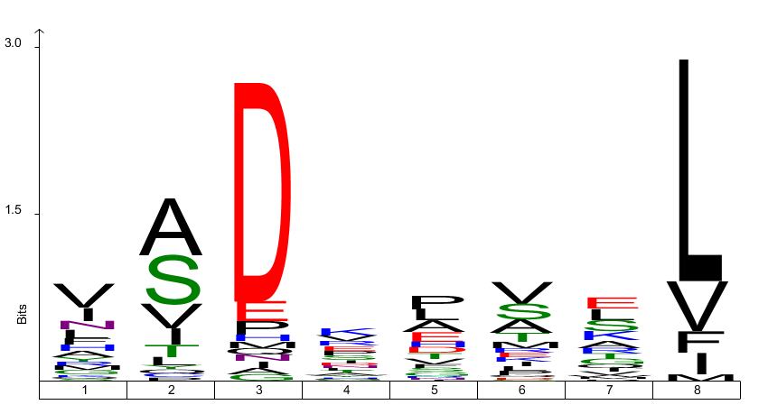
HLA-C
45 peptides

Slide 24
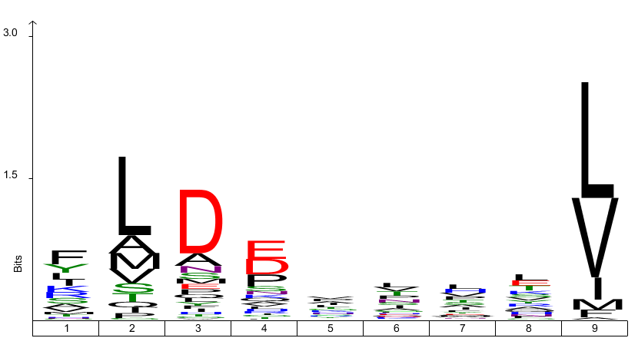
HLA-C
721 peptides

Slide 25
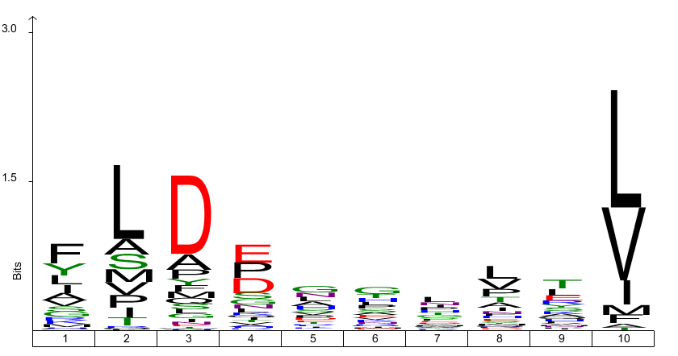
HLA-C
168 peptides

Slide 26
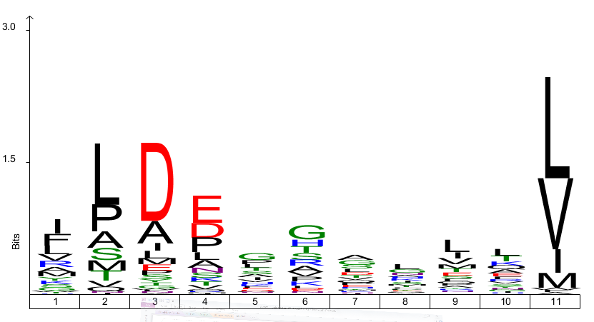
HLA-C
101 peptides

