Slide 1
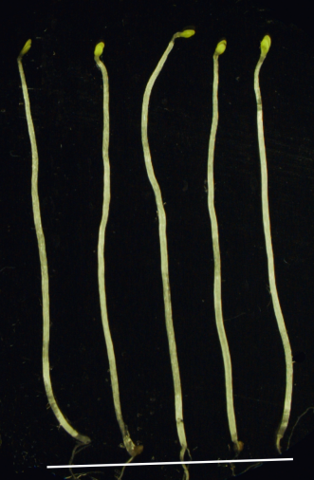
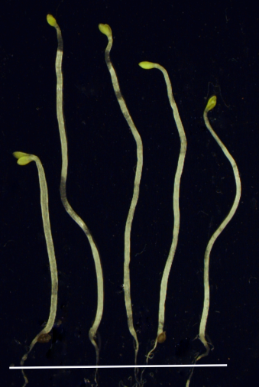
A
-BRZ
B
+BRZ
A
B
BZS1-ox/bzr1-1D
BZS1-ox/bzr1-1D
WT bzr1-1D L16 L6 L3
WT bzr1-1D L16 L6 L3
BZS1-ox/bzr1-1D
C
WT bzr1-1D Line 16 Line 6 Line 3
Hypocotyl length (mm)
Figure S1. Over-expression of BZS1 in bzr1-1D restores the sensitivity of bzr1-1D to BRZ.
(A-B) Dark-grown phenotypes of wild type (WT), bzr1-1D and three transgenic lines of BZS1-ox in bzr1-1D (L6, L6 and L3) on a regular medium (A) or a medium containing 2uM BRZ (B). (C) Average hypocotyl lengths of wild type (WT), bzr1-1D and three transgenic lines (L16, L6 and L3). Error bars indicate SE (n=20).
Notes:
Figure S1. Over-expression of BZS1 in bzr1-1D restores the sensitivity of bzr1-1D to BRZ. (A-B) Dark-grown phenotypes of wild type (WT), bzr1-1D and three transgenic lines of BZS1-ox in bzr1-1D (Line 16, Line 6 and Line 3) on a regular medium (A) or a medium containing 2uM BRZ (B). (C) Average hypocotyl lengths of wild type (WT), bzr1-1D and three transgenic lines (Line 16, Line 6 and Line 3). Error bars indicate SE.

