Slide 1
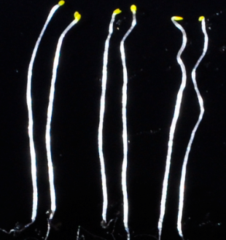
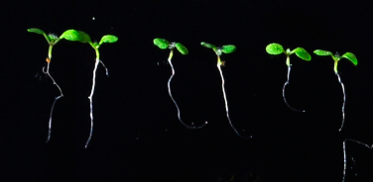
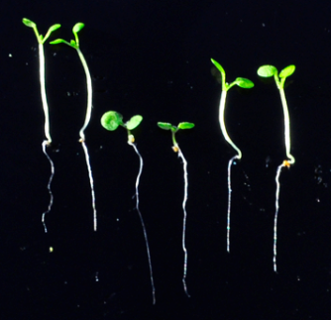
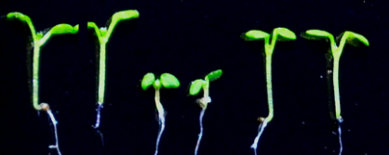
A
White light
A
In the Dark
B
Blue light
WT bzr1-1D;bzs1-D bzr1-1D
Red Light
C
Red light
WT bzr1-1D;bzs1-D bzr1-1D
C
D
WT bzr1-1D;bzs1-D bzr1-1D
WT bzr1-1D;bzs1-D bzr1-1D
E
F
G
H
Hypocotyl length (cm)
Hypocotyl length (cm)
Hypocotyl length (cm)
Hypocotyl length (cm)
WT bzs1-D bzr1-1D
WT bzs1-D bzr1-1D
WT bzs1-D bzr1-1D
WT bzs1-D bzr1-1D
Figure S4. Mutant bzr1-1D;bzs1-D is hypersensitive to different lights.
(A-D)Phenotypes of wild type, bzr1-1D;bzs1-D and bzr1-1D grown in the dark(A), in the white light(B), in the red light(C) and in the blue light (D). (E-H) The measured hypocotyl lengths of wild type, bzr1-D;bzs1-1D and bzr1-1D. From left to right is the hypocotyl length in dark (E), in the white light (F), in the red light (G) and in the blue light (H). Error bars indicate SE (n=20).
Notes:
Figure S4. Mutant bzr1-1D;bzs1-D is hypersensitive to different lights. (A-D)Phenotypes of wild type, bzr1-1D;bzs1-D and bzr1-1D grown in the dark(A), in the white light(B), in the red light(C) and in the blue light (D). (E-H) The measured hypocotyl lengths of wild type, bzr1-D;bzs1-1D and bzr1-1D. From left to right is the hypocotyl length in dark (E), in the white light (F), in the red light (G) and in the blue light (H). Error bars indicate SE.

