Slide 1
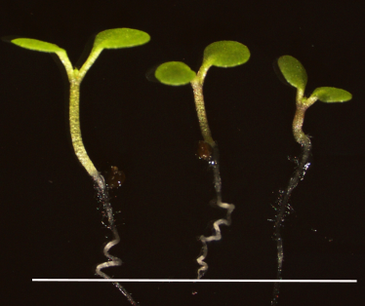
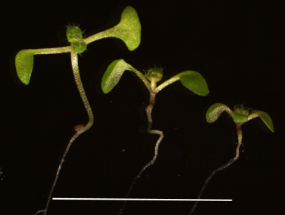
A
Blue 10
B
Relative hypocotyl length
WT OX8 OX21
BZS1-OX
D
Blue Fluence level (μmol/m2/s)
C
Red 10
Relative hypocotyl length
WT OX8 OX21
BZS1-OX
Red Fluence level (μmol/m2/s)
Figure S3. Over-expression of BZS1 shows shorter hypocotyl lengths in the blue and Red lights.
(A) Phenotypes of wild-type and BZS1-OX plants (OX8 and OX21) in blue light at 10μmol/m²/s. (B) Relative hypocotyl length of wild-type and BZS1-OX transgenic lines (OX8 and OX21) under various fluence level of blue light. Error bars indicate standard error. (C) Phenotypes of wild-type and BZS1-ox plants (OX8 and OX21) in red light at 10μmol/m²/s. (D) Relative hypocotyl length of wild-type and BZS1-ox transgenic lines (OX8 and OX21) under various fluence level of red light. Error bars indicate standard error (n=30).
Notes:
Figure S3. Over-expression of BZS1 shows shorter hypocotyl lengths in the blue and Red lights. (A) Phenotypes of wild-type and BZS1-ox plants (L8 and L21) in blue light at 10μmol/m²/s. (B) Relative hypocotyl length of wild-type and BZS1-ox transgenic lines (L8 and L21) under various fluence level of blue light. Error bar indicate standard error. (C) Phenotypes of wild-type and BZS1-ox plants (L8 and L21) in red light at 10μmol/m²/s. (D) Relative hypocotyl length of wild-type and BZS1-ox transgenic lines (L8 and L21) under various fluence level of red light. Error bars indicate standard error.

