Slide 1
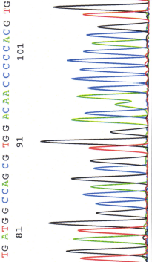
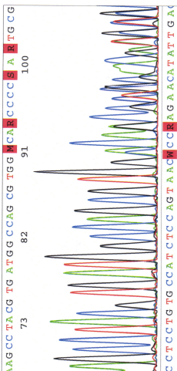
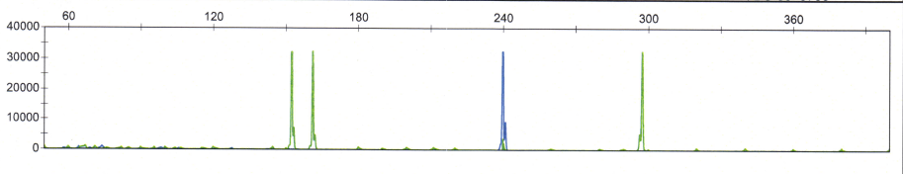
A
D
WT – forward sequence
B
Duplicated sequence
V769_D770insASV
C
*
EGFR exon 20
(9bp insertion)
EGFR
exon 19
(WT)
HER
exon 20
(WT)
Notes:
Supplementary figure 2
Representative case harboring a 9pb insertion mutation V769_D770insASV
Panels A (40X magnification) and B (100X magnification) show the prominent solid growth pattern – a histologic feature that may be over-represented in lung cancers with EGFR exon 20 insertions compared to classic EGFR mutations.
Panel C - Electrophoretogram of the sizing assay shows a heterozygous 9bp insertion (arrow); asterisk marks the wild-type peak (*). This case was concurrently tested for indels in EGFR exon 19 and HER2 / ERBB2 exon 20 using a multiplex assay and illustrates the mutually exclusive nature of these mutations. Panel D - Sanger sequencing defines the insertion as a p. V769_D770insASV (c.2308_2309ins9 [CCAGCGTGG duplication]). The duplicated sequence is inserted starting at the position indicated by the arrow.

