Slide 1
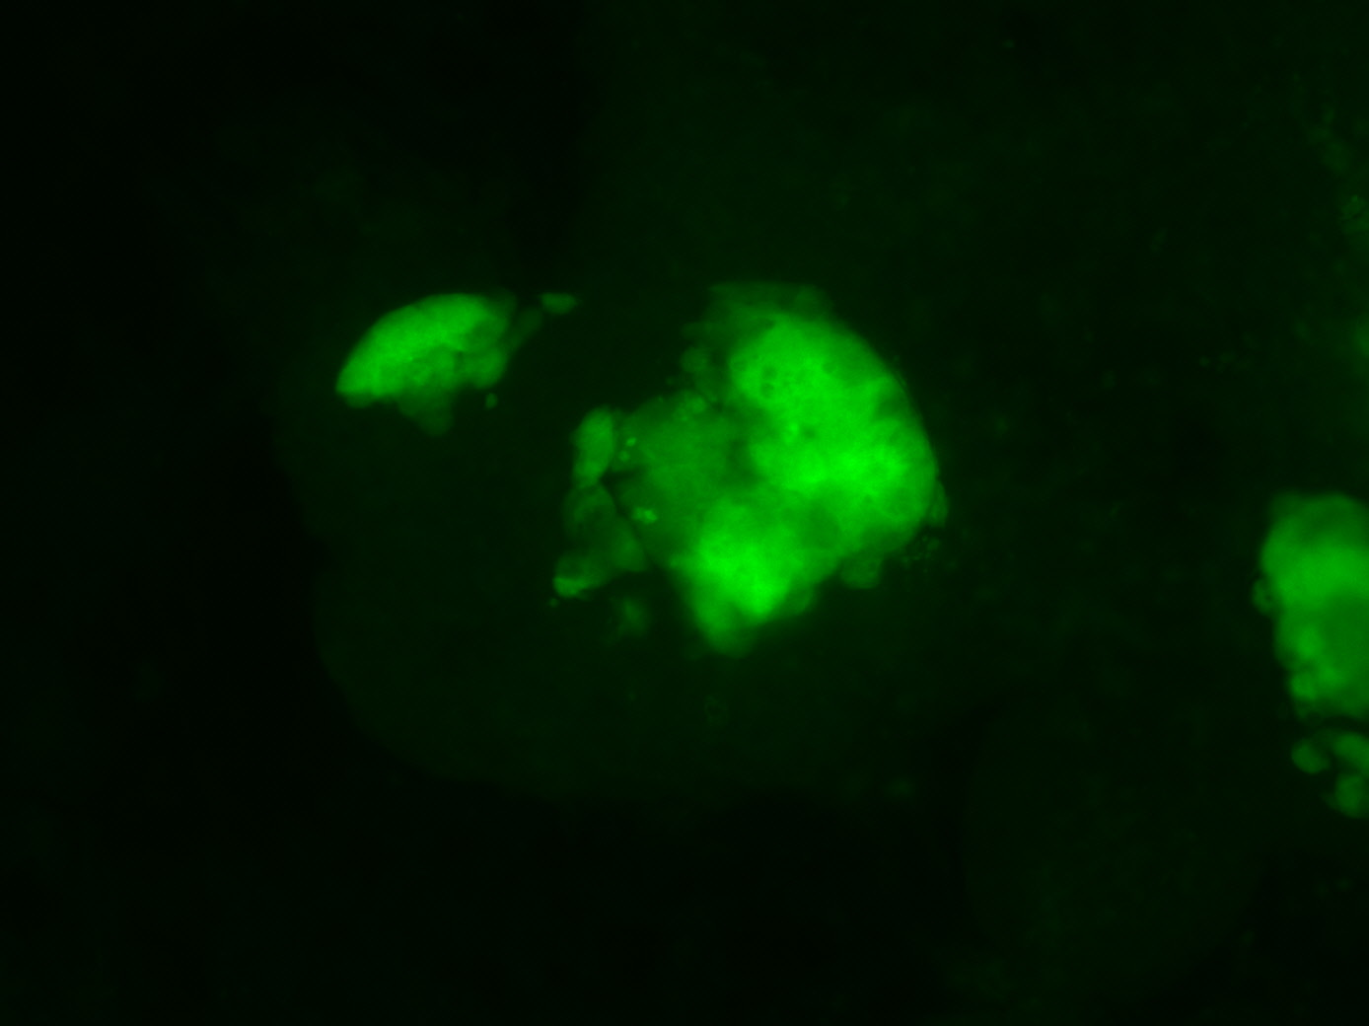
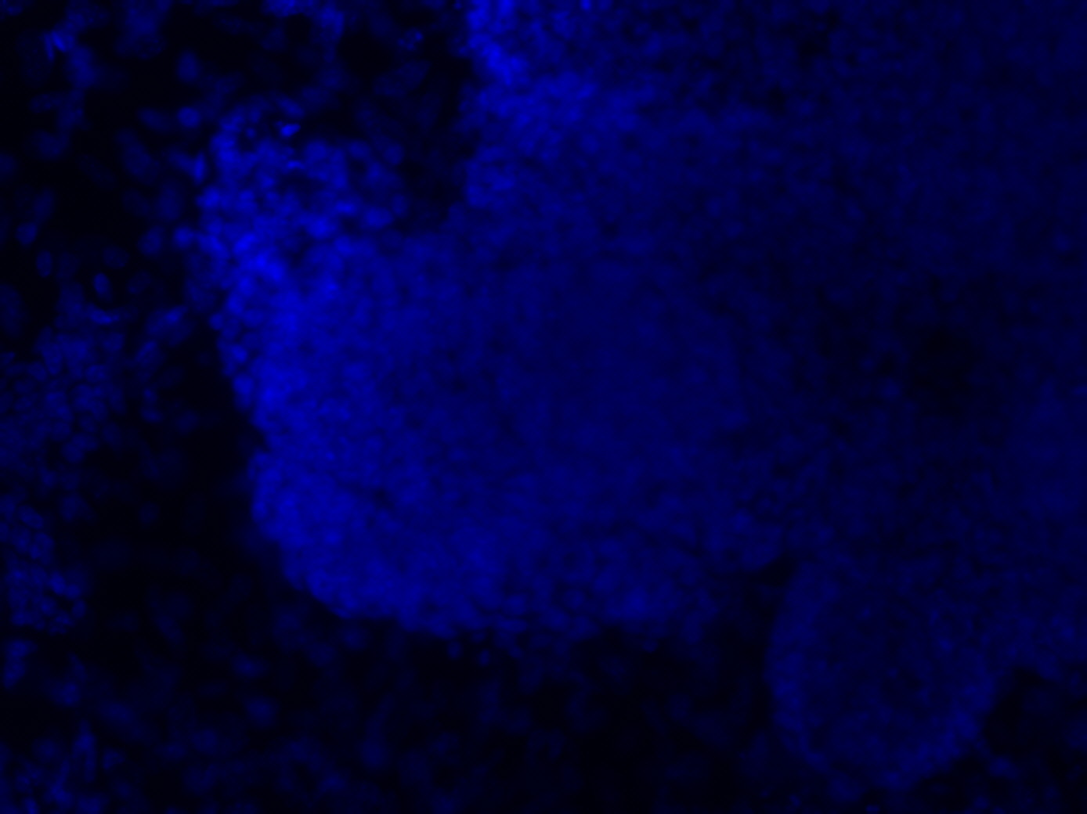
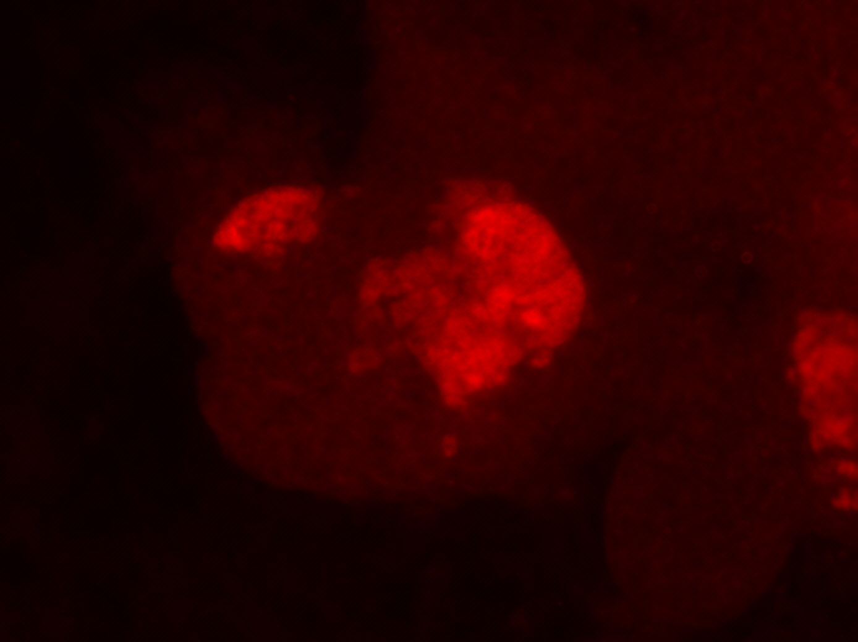
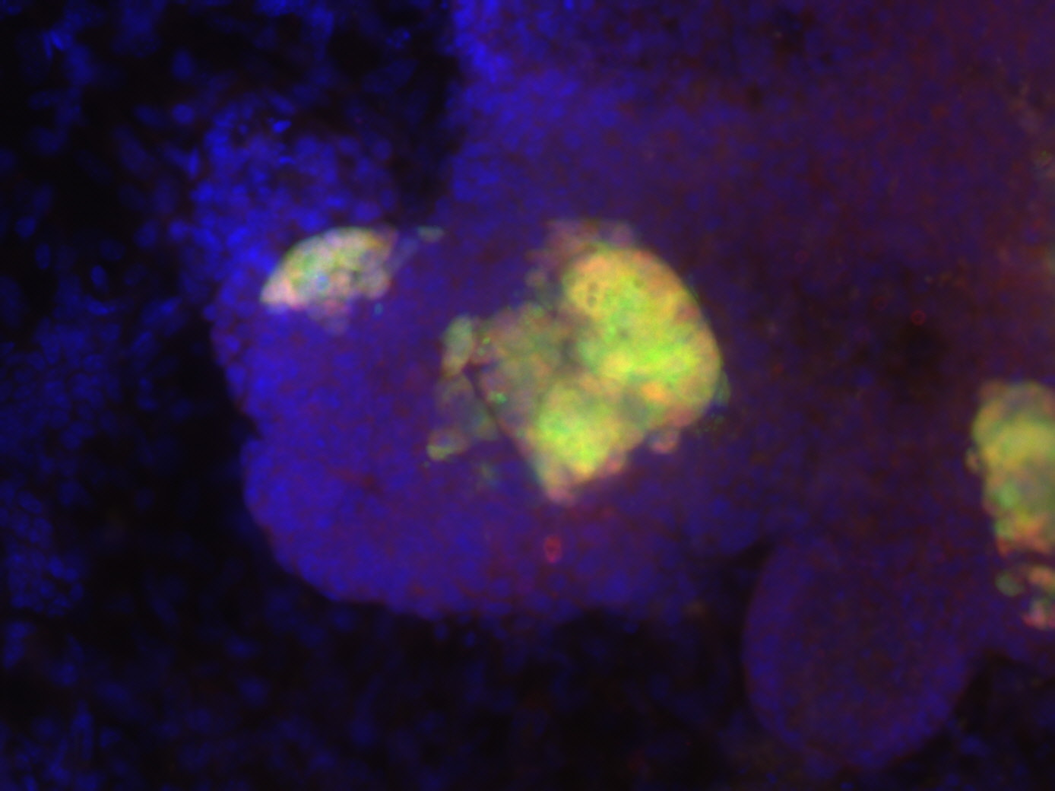
Supplementary Figure 3
a
i
ii
iii
1.0
1.0
3.5
0.8
0.8
2.5
Relative Expression
Relative Expression
Relative Expression
0.6
0.6
0.4
0.4
1.5
0.2
0.2
0.5
Ehmt1
Ctrl
Ehmt2
Ehmt1
Ehmt2
Cbx1
Setdb1
Setdb1
Cbx3
Cbx5
Jmjd2c
3XHMT
b
c
14
d
Ectopic-Oct4 Ectopic-Sox2
Nanog-GFP
DAPI
10
% Nanog-GFP cells
6
Merge
2
Anti-Esrrb
Ctrl
Cbx3
3XHMT
pre-iPSCs
pre-iPSCs
iPSC-Cbx3#2
iPSC-Cbx3#1
iPSC-Cbx3#1
iPSC-Cbx3#2

