Slide 1
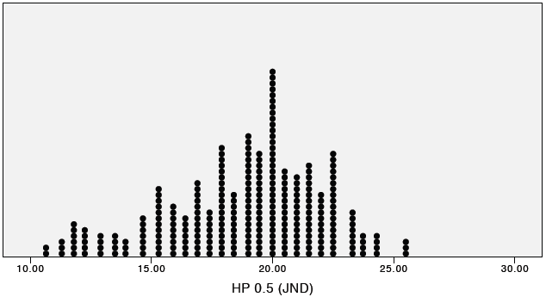
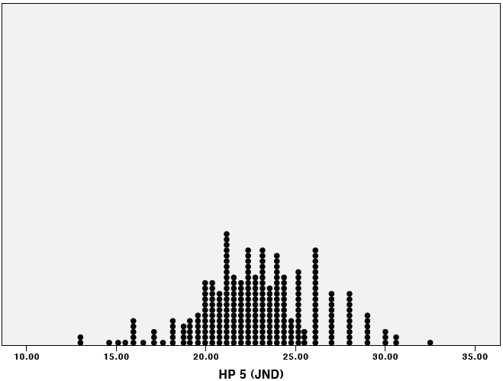
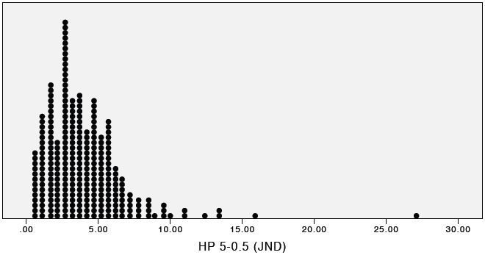
A
B
C
Figure 2. Distribution of QST values for HP 0.5 (A), HP 5 (B) and HP 5-0.5 (C) expressed in units of just noticeable difference (JND). Only the values for HP 5, were normally distributed (P values for Kolmogorov-Smirnov Z > 0.05).

