Slide 1
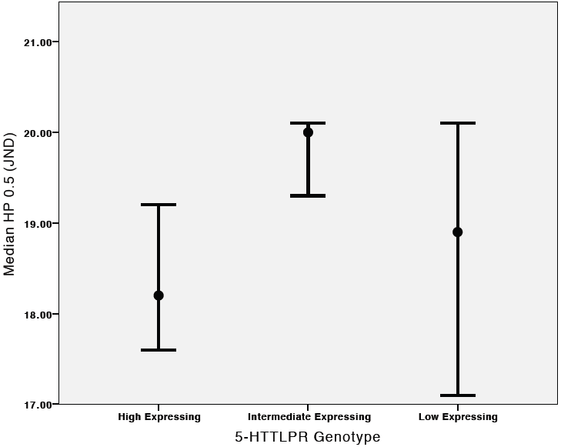
*
Figure 3. Median value of HP 0.5 and 95% confidence interval for the
5-HTTLPR genotype groups in units of just noticeable difference (JND).
Individual group comparisons showed that HP 0.5 was significantly greater
in the intermediate expressing group compared to the high expressing
group (*P = 0.009), but not the low expressing group.

