Slide 1
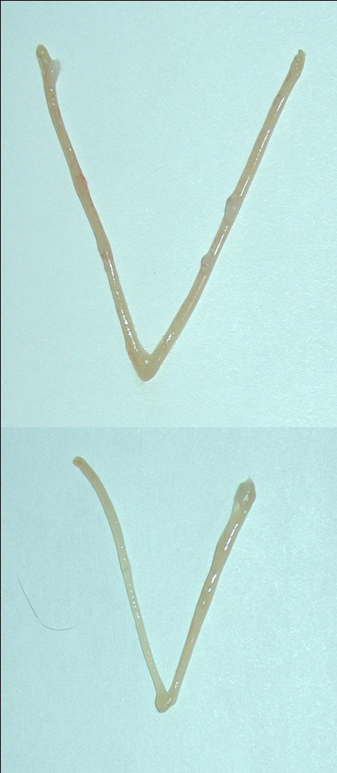
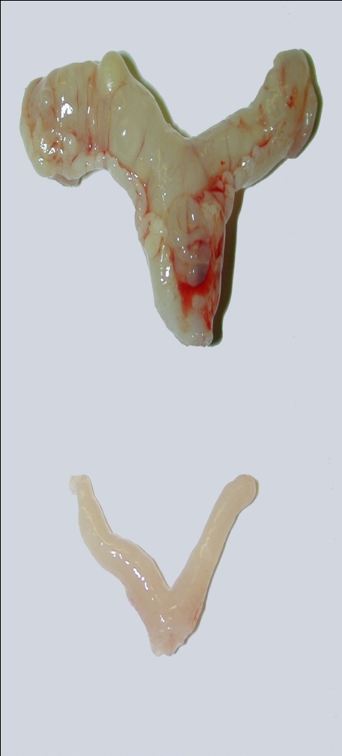
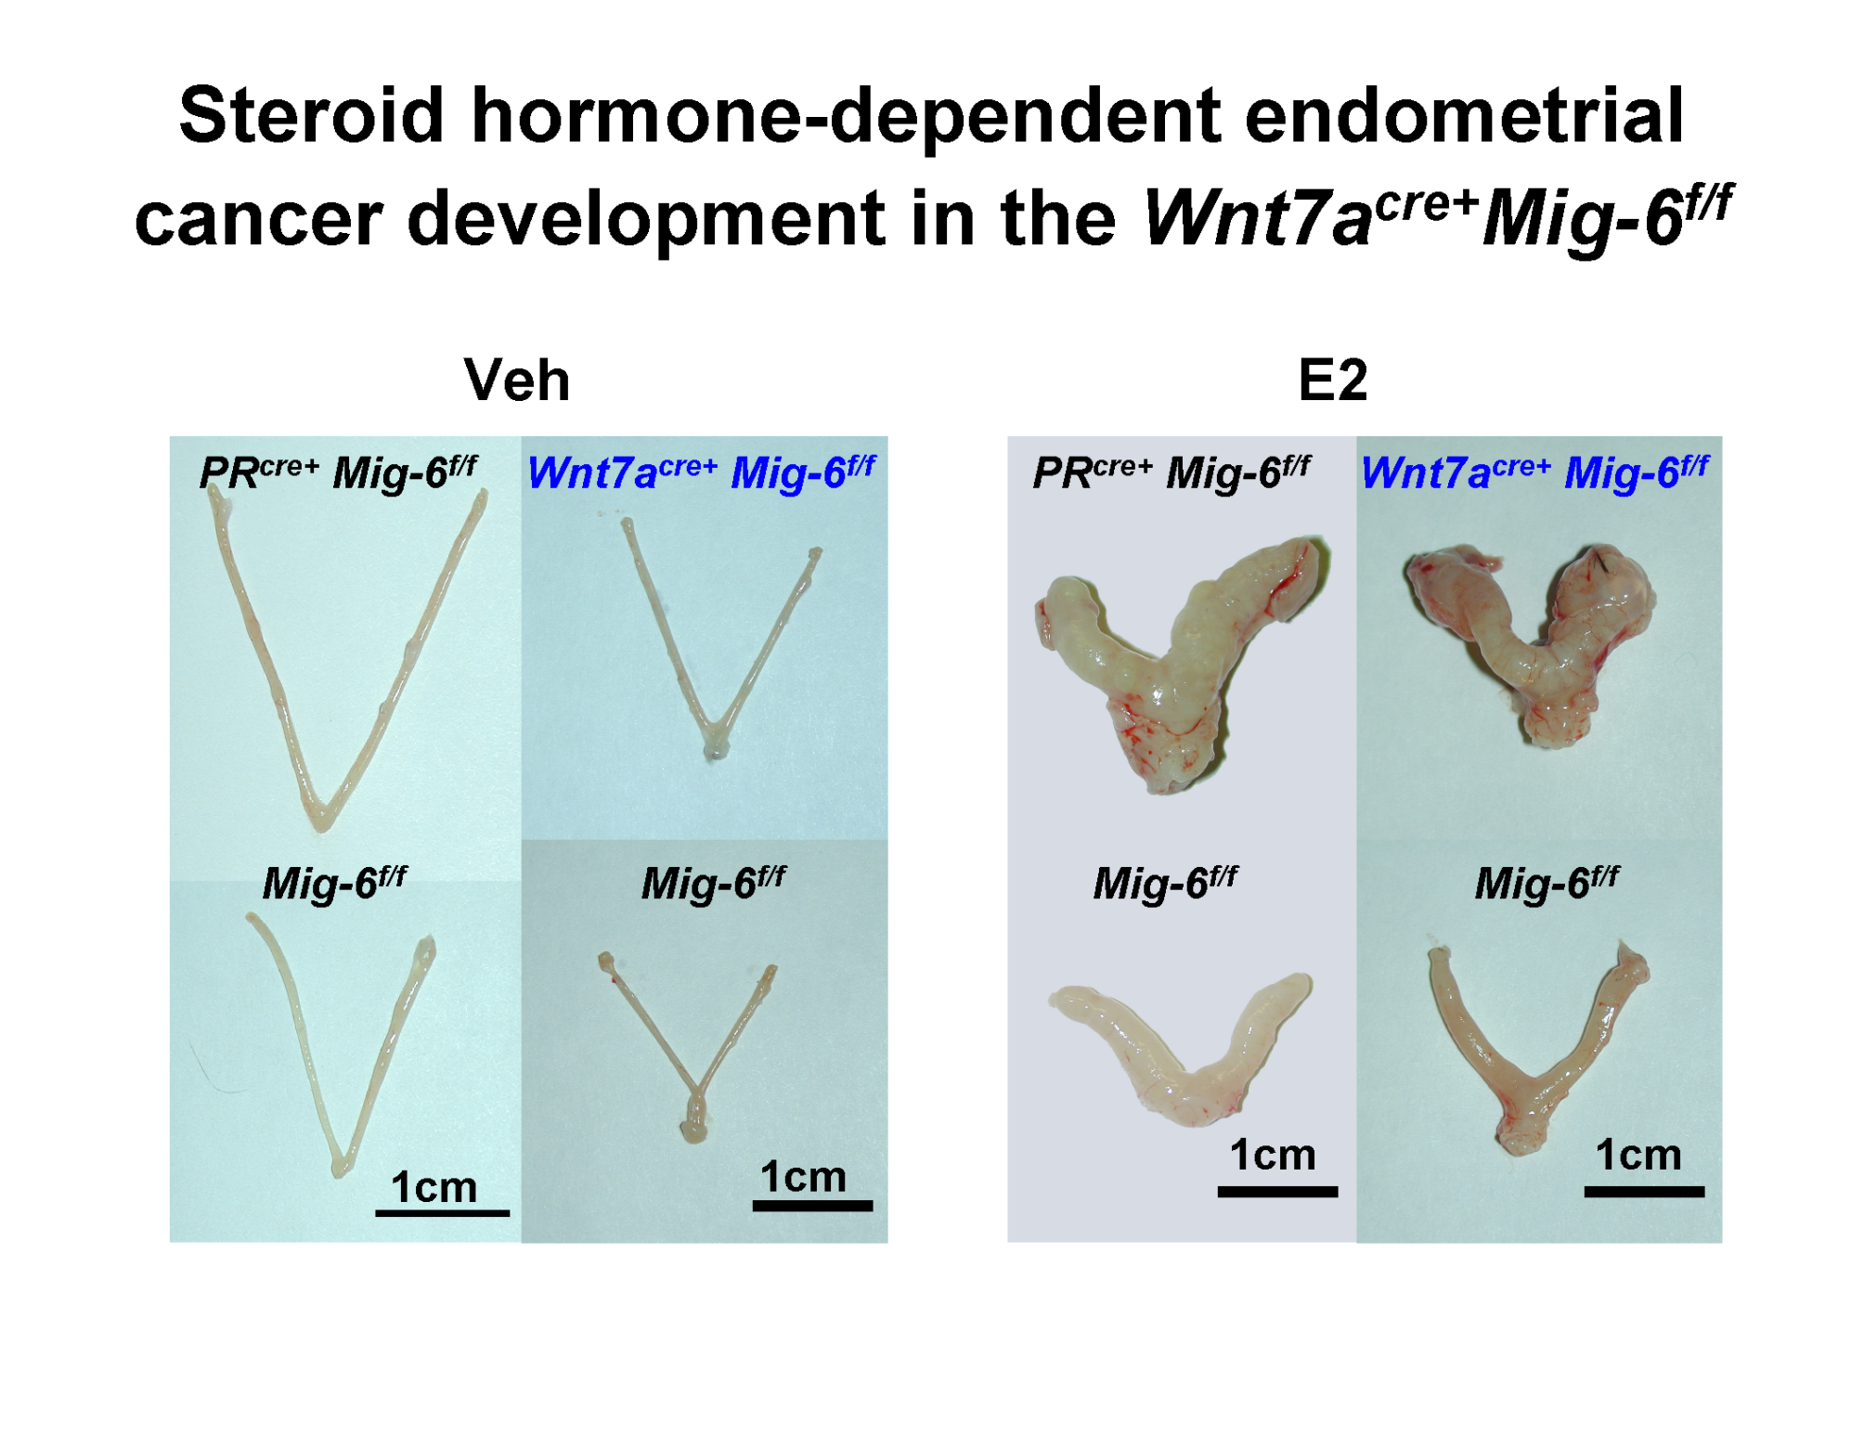
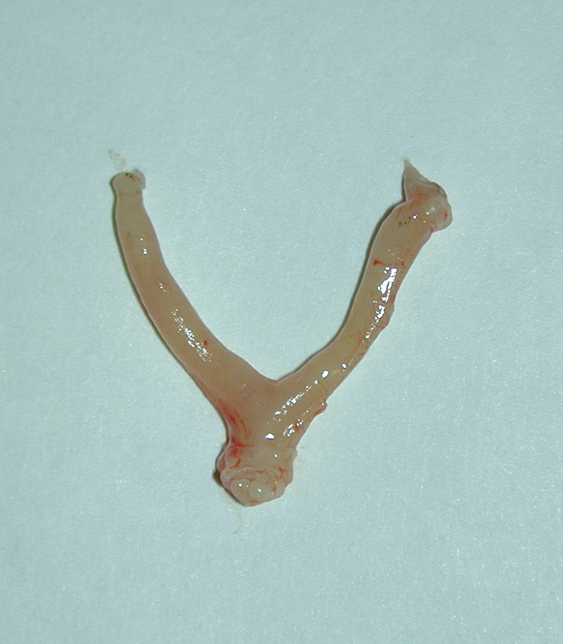
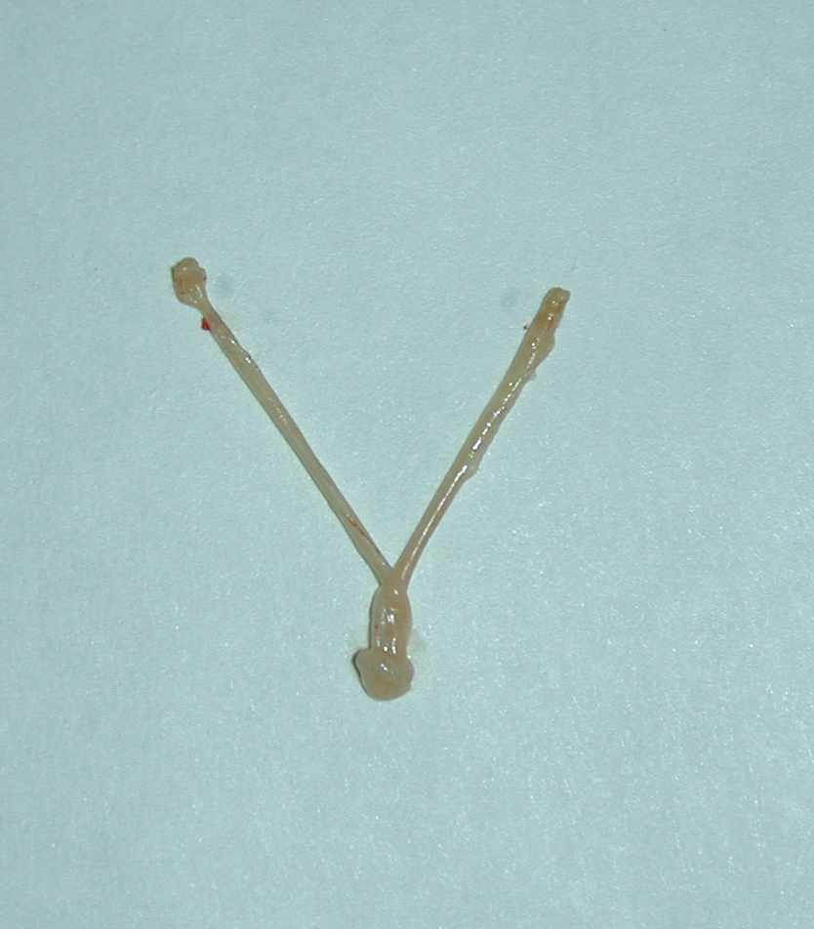
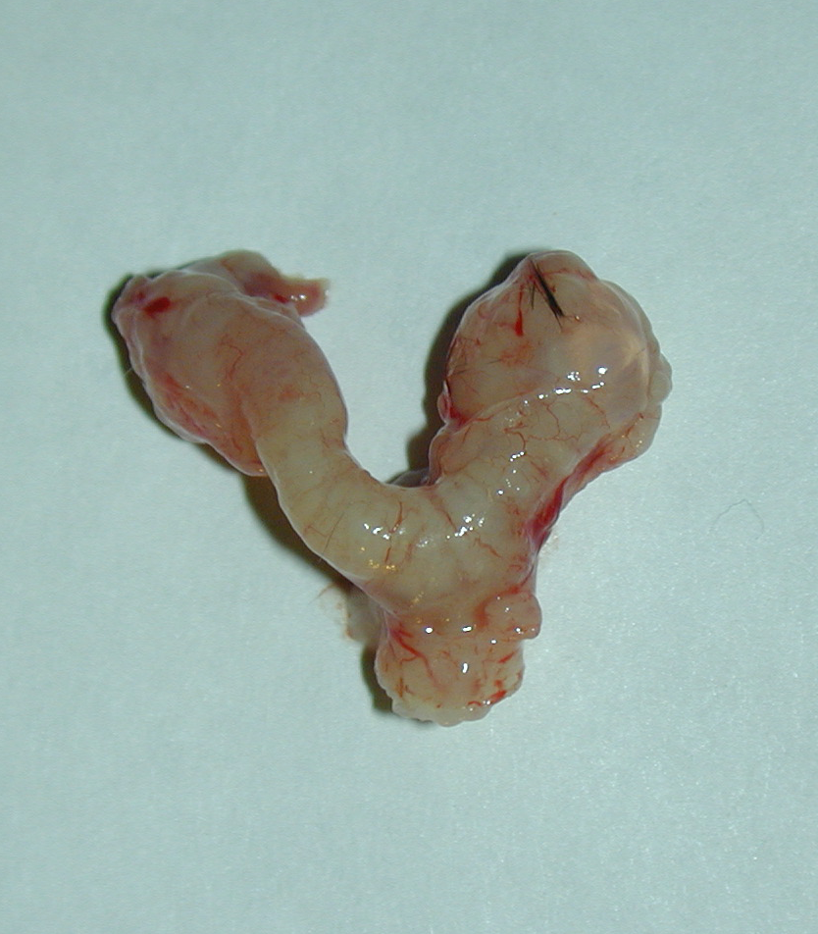
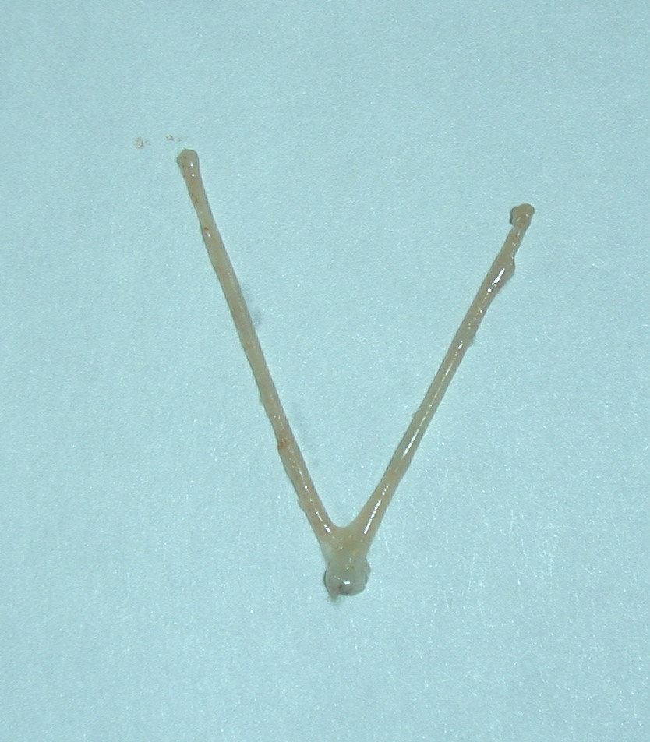
A
B
Vehicle
E2
PR^{cre+} Mig-6^{f/f}
Wnt7a^{cre+} Mig-6^{f/f}
a
PR^{cre+} Mig-6^{f/f}
b
Wnt7a^{cre+} Mig-6^{f/f}
a
b
1cm
1cm
1cm
1cm
c
Mig-6^{f/f}
d
Mig-6^{f/f}
c
Mig-6^{f/f}
d
Mig-6^{f/f}
1cm
1cm
1cm
1cm
Supplemental Figure 2. Steroid hormone-dependent formation of endometrial cancer induced the uteri of Wnt7a^{cre+} Mig-6^{f/f} mice. (A) Gross anatomy of ovariectomized PR^{cre/+} Mig-6^{f/f} mice (a), Wnt7a^{cre+} Mig-6^{f/f} mice (b) and control mice (c and d) treated with Vehicle for 3 months. (B) Gross anatomy of ovariectomized PR^{cre/+} Mig-6^{f/f} mice (a), Wnt7a^{cre+} Mig-6^{f/f} mice (b) and control mice (c and d) treated with E2 for 3 months.

