Slide 1
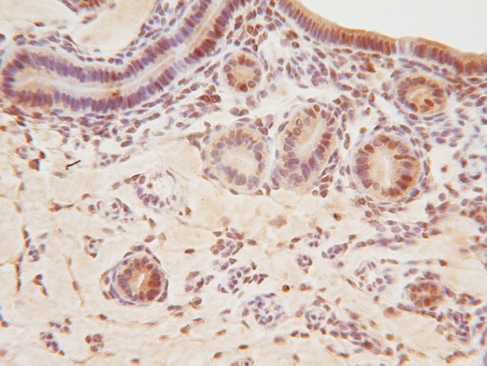
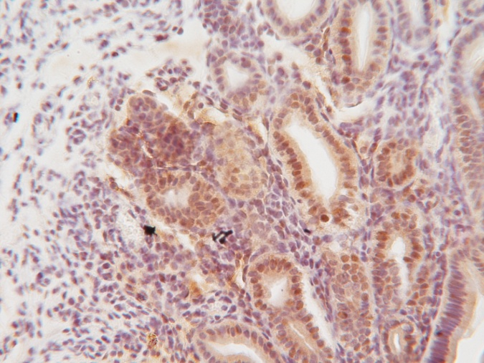
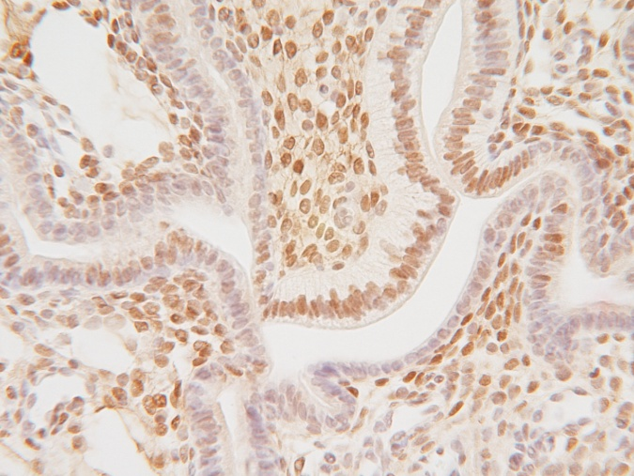
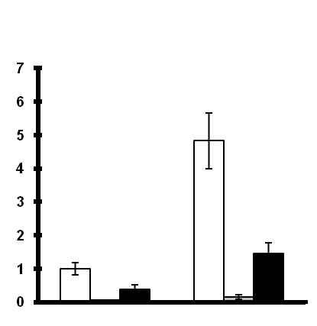
PR
A
Mig-6^{f/f}
PR^{cre/+} Mig-6^{f/f}
Wnt7a^{cre+} Mig-6^{f/f}
a
b
c
50μm
50μm
50μm
B
Mig-6
Fst
Il13ra2
Mig-6^{f/f}
Mig-6^{f/f}
Mig-6^{f/f}
PR^{cre+} Mig-6^{f/f}
PR^{cre+} Mig-6^{f/f}
PR^{cre+} Mig-6^{f/f}
Wnt7a^{cre+} Mig-6^{f/f}
Wnt7a^{cre+} Mig-6^{f/f}
Wnt7a^{cre+} Mig-6^{f/f}
***
**
*
Relative Expression
Relative Expression
Relative Expression
*
Vehicle
P4
Vehicle
P4
Vehicle
P4
Supplemental Figure 3. Expression of PR protein and its target genes in Wnt7a^{cre+} Mig-6^{f/f} mice after P4 treatment. (A) Immunohistochemical analysis of PR in the uteri of control mice (a), PR^{cre/+} Mig-6^{f/f} mice (b) and Wnt7a^{cre+} Mig-6^{f/f} mice (c) after P4 treatment. (B) Quantitative RT-PCR analysis of PR target genes, Mig-6, Fst, and Il13ra2, was performed on uteri of control, PR^{cre/+} Mig-6^{f/f} mice and Wnt7a^{cre+} Mig-6^{f/f} mice after vehicle or P4 treatment for 3 months. The results represent the relative expression of transcripts (transcript mean ± SE) normalized to 18S rRNA for RNA isolated from five mice per group. *, p < 0.05; **, p < 0.01; ***, p < 0.001

