Slide 1
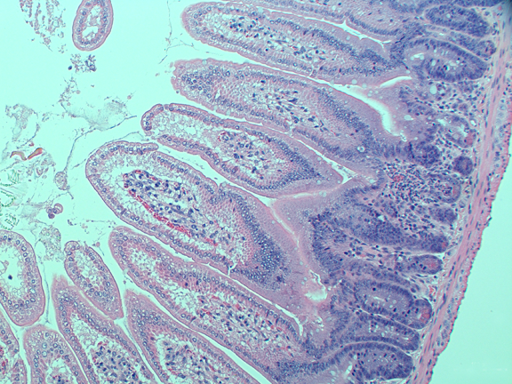
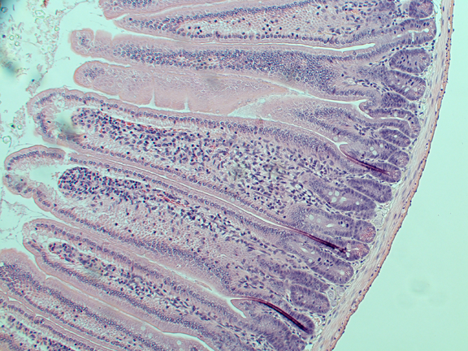
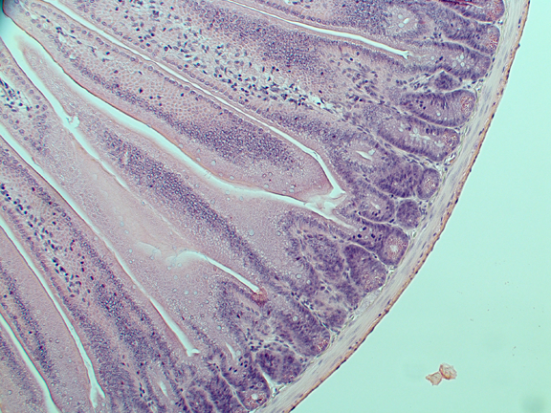
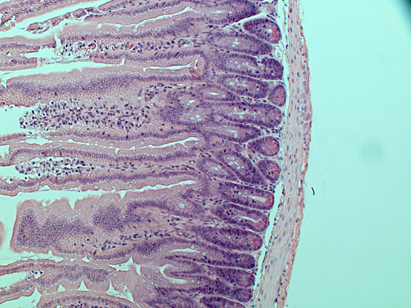
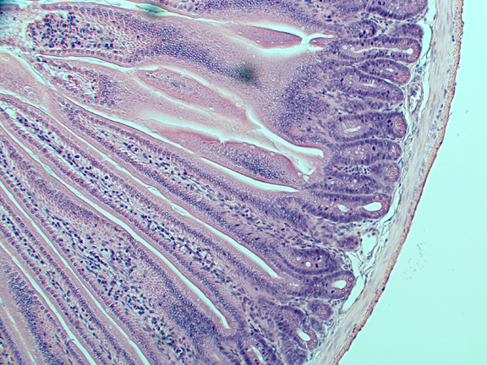
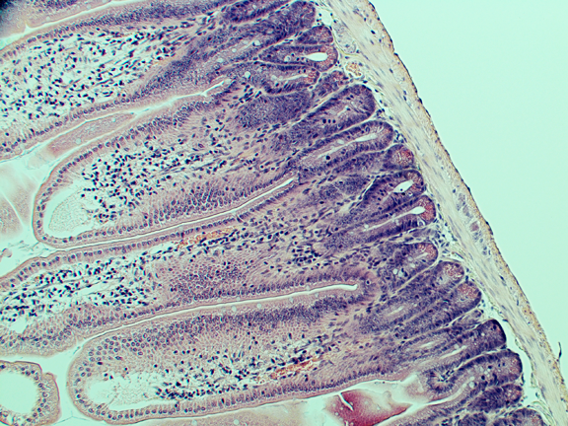
Suppl. Fig. 6.
Positive control
Control
RT
100µM
MK8776+RT
Gem+RT
Gem+MK8776+RT
Suppl. Fig. 6. Jejunal crypt survival following MK8776, gemcitabine, and radiation. Athymic nude mice were treated with Gem (120mg/kg, Mon), MK8776 (50mg/kg, Mon-Fri), and radiation (2Gy/fraction, Mon-Fri) for one cycle. Seventy-two hours after the last fraction of radiation, jejunal segments were harvested and fixed for haematoxylin and eosin staining. Positive control mice were treated similarly except with 500mg/kg Gem (Mon) and 3 Gy/fraction (Mon-Fri). Images were obtained using a 10x objective and illustrate jejunal crypts and villi. A damaged crypt (with invading neutrophils) in the positive control is indicated by an arrow. Images are representative of 2 independently-treated animals per treatment group. All specimens were evaluated by a pathologist for crypt viability.

