Slide 1
Supplemental Table 1. Hydrolysis of Gliadin-Derived Enzyme Substratesª
 | YPQ | QQP | PPF | PFP | LPY
WSA-2B | + 1 hr | - | - | - | + 16 hr
WSA-6 | - | - | - | - | -
WSA-7A | + 16 hr | - | - | - | -
WSA-8 | + 1 hr | - | - | - | + 16 hr
WSA-9 | - | - | - | - | -
WSA-10 | - | - | - | - | -
WSA-11 | - | - | - | - | -
WSA-13 | - | - | - | - | -
WSA-22 | +/- 40 hr | - | - | - | -
WSA-23 | - | - | - | - | -
WSA-7B | - | - | - | +/- 40 hr | -
WSA-21B | + 1 hr | - | - | - | + 16 hr
WSA-24 | + 16 hr | - | - | - | -
WSA-25A | - | - | - | - | -
WSA-26 | + 1 hr | - | - | - | + 16 hr
WSA-27 | + 40 hr | - | - | +/- 40 hr | +/- 40 hr
PA-8 | + 16 hr | - | - | - | -
PA-9 | + 16 hr | - | - | - | -
PA-12 | + 16 hr | - | - | - | -
PA-15 | + 16 hr | - | - | +/-16 hr | + 24 hr
PA-21 | + 24 hr | - | - | - | -
PA-1b | + 1 hr | +/- 24 hr | - | - | + 16 hr
PA-2b | + 1 hr | +/- 24 hr | - | - | + 16 hr
PA-3b | + 16 hr | - | - | - | -
PA-4b | + 16 hr | - | - | - | -
PA-6b | + 16 hr | - | - | - | -
PA-7b | + 16 hr | - | - | - | +/- 48 hr
PA-8b | + 16 hr | - | - | - | +/- 48 hr
PA-9b | + 16 hr | - | - | - | +/- 48 hr
PA-10b | -+ 16 hr | - | - | - | -
PA-11b | + 16 hr | - | - | - | +/- 48 hr
PA-13b | + 16 hr | - | - | - | +/- 48 hr
PA-14b | + 16 hr | - | - | - | +/- 48 hr
PA-16b | - | - | - | - | -
PA-17b | + 24 hr | - | - | - | +/- 24 hr
PA-18b | + 24 hr | - | - | - | +/- 24 hr
PA-19b | + 24 hr | - | - | - | -
PA-20b | + 1 hr | - | - | - | +/- 24 hr
PA-22b | + 24 hr | - | - | - | -
PA-23b | + 24 hr | - | - | - | -
 | YPQ | QQP | PPF | PFP | LPY
PA-24b | + 16 hr | - | - | - | -
PA-25b | + 24 hr | - | - | - | -
PA-26b | + 16 hr | - | - | - | +/- 40 hr
PA-27b | + 16 hr | - | - | - | +/- 40 hr
PA-29b | + 16 hr | - | - | - | -
PA-30b | + 16 hr | - | - | - | +/- 40 hr
PA-32b | + 16 hr | - | - | - | +/-40 hr
PA-8 | + 16 hr | - | - | - | + 48 hr
PA-29 | + 16 hr | - | - | - | + 48 hr
PA-33B | + 1 hr | + 1hr | + 1hr | + 1hr | + 1hr
PA-40 | + 16 hr | - | - | - | + 48 hr
PA-48 | + 16 hr | - | - | - | + 48 hr
PA-53 | + 16 hr | - | - | - | + 48 hr
PA-55 | + 16 hr | - | - | - | + 48 hr
PA-57 | + 16 hr | - | - | - | + 48 hr
PA-59 | +/- 16 hr | - | - | - | -
PA-62 | + 16 hr | - | - | - | + 48 hr
PA-63 | + 16 hr | - | - | - | + 48 hr
PA-64 | + 16 hr | - | - | - | + 48 hr
PA-65 | + 16 hr | - | - | - | -
PA-71 | + 16 hr | - | - | - | + 48 hr
PA-73 | + 16 hr | - | - | - | +/- 48 hr
PA-75 | + 16 hr | - | - | - | + 48 hr
PA-81 | + 16 hr | - | - | - | + 48 hr
PA-83 | + 16 hr | - | - | - | + 48 hr
PA-84 | + 16 hr | - | - | - | + 48 hr
PA-85 | + 16 hr | - | - | - | + 48 hr
PA-86 | + 16 hr | - | - | - | -
PA-89 | + 16 hr | - | - | - | +/- 24 hr
PA-90 | + 1 hr | + 1 hr | + 1 hr | + 1 hr | + 1 hr
PA-90R | + 1 hr | + 1 hr | + 1 hr | + 1 hr | + 1 hr
PA-90B | + 1 hr | + 1 hr | + 1 hr | + 1 hr | + 1 hr
PA-95 | + 16 hr | - | - | - | + 40 hr
PA-97 | + 16 hr | - | - | - | + 40 hr
PA-106 | + 16 hr | - | - | - | + 40 hr
PA-107 | + 16 hr | - | - | - | + 40 hr
PA-115 | - | - | - | - | -
PA-116 | - | - | - | - | -
PA-117 | - | - | - | - | -
PA-33R | + 1 hr | + 1hr | + 1hr | + 1hr | + 1hr
PA-40B | + 16 hr | - | - | - | + 40 hr
PA-78 | + 16 hr | - | - | - | + 40 hr
PA-87 | + 16 hr | - | - | - | -
PA-122 | + 16 hr | - | - | - | -
PA-123 | + 16 hr | - | - | - | -
PA-131 | + 16 hr | - | - | - | + 40 hr
PA-131R | + 16 hr | - | - | - | + 40 hr
ªActivities were assessed using cell suspensions of an OD₆₂₀ of 1.2 in saliva ion buffer and final substrate concentrations of 200 µM. Substrate hydrolysis was determined macroscopically and graded as + (yellow), +/- (light yellow) or – (no color change). The time points examined were: 1 hr, 16 hr, 24 hr, 40 hr and 48 hr.

Slide 2
Supplemental Table 2. Gliadin zymography resultsª
 |  | Prominent Zymogram Band at:
 | ~ 60 kDa | ~ 75 kDa | ~ 150 kDa | No visible band
WSA-2B |  | V
WSA-6
WSA-7A |  |  | V
WSA-8 |  | V
WSA-9
WSA-10
WSA-11
WSA-13
WSA-22
WSA-23
WSA-7B
WSA-21B |  | V
WSA-24 |  |  |  | V
WSA-25A |  |  |  | V
WSA-26 |  | V
WSA-27 |  |  |  | V
PA-8 |  |  |  | V
PA-9 |  |  |  | V
PA-12 |  |  | V
PA-15 |  |  |  | V
PA-21 |  |  | V
PA-1b |  |  |  | V
PA-2b |  |  |  | V
PA-3b |  |  | V
PA-4b |  |  | V
PA-6b |  |  |  | V
PA-7b |  |  |  | V
PA-8b |  |  | V
PA-9b |  |  | V
PA-10b |  |  |  | V
PA-11b |  |  |  | V
PA-13b |  |  |  | V
PA-14b |  |  |  | V
PA-16b |  |  |  | V
PA-17b |  |  |  | V
PA-18b |  |  |  | V
PA-19b |  |  | V
PA-20b | V
PA-22b |  |  |  | V
PA-23b |  |  | V
 | Prominent Zymogram Band at:
 | 60-75 kDa | ~ 150 kDa | No visible band
PA-24b |  |  | V
PA-25b |  |  | V
PA-26b |  |  | V
PA-27b |  |  | V
PA-29b |  |  | V
PA-30b |  |  | V
PA-32b |  |  | V
PA-8 |  |  | V
PA-29 |  |  | V
PA-33B |  |  | V
PA-40 |  |  | V
PA-48 |  |  | V
PA-53 |  |  | V
PA-55 |  |  | V
PA-57 |  |  | V
PA-59 |  |  | V
PA-62 |  |  | V
PA-63 |  |  | V
PA-64 |  |  | V
PA-65 |  |  | V
PA-71 |  |  | V
PA-73 |  |  | V
PA-75 |  |  | V
PA-81 |  |  | V
PA-83 |  |  | V
PA-84 |  |  | V
PA-85 |  |  | V
PA-86 |  |  | V
PA-89 |  |  | V
PA-90 |  |  | V
PA-90R |  |  | V
PA-90B |  |  | V
PA-95 |  |  | V
PA-97 |  |  | V
PA-106 |  |  | V
PA-107 |  |  | V
PA-115 |  |  | V
PA-116 |  |  | V
PA-117 |  |  | V
PA-33R |  |  | V
PA-40B |  |  | V
PA-78 |  |  | V
PA-87 |  |  | V
PA-122 |  |  | V
PA-123 |  |  | V
PA-131 |  |  | V
PA-131R |  |  | V
ªActivities were assessed by loading 150 µl bacterial suspension (OD₆₂₀ 5.0) onto a 6% glaidin zymogram gel.

Slide 3
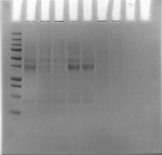
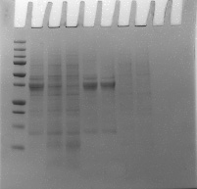
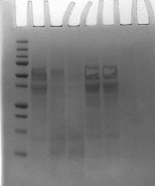
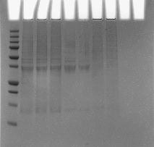
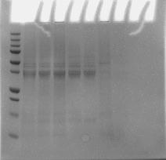
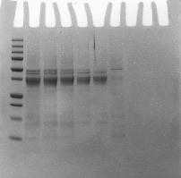
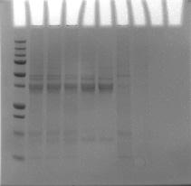
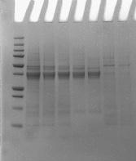
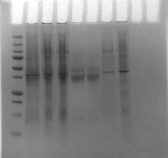
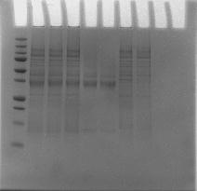
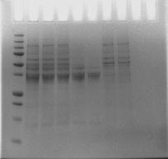
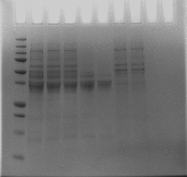
GROUP I
GROUP II
Incubation
time (hr)
controls
Incubation
time (hr)
controls
Incubation
time (hr)
controls
Incubation
time (hr)
controls
Gliad. Bact.
Gliad. Bact.
Gliad. Bact.
Gliad. Bact.
MW
0 2 5
0 5 0 5
MW
0 2 5
0 5 0 5
MW
0 2 5
0 5 0 5
MW
0 2 5
0 5 0 5
WSA-2B
WSA-21B
WSA-26
PA-20b
GROUP III
Incubation
time (hr)
controls
Incubation
time (hr)
controls
Incubation
time (hr)
controls
Incubation
time (hr)
controls
Gliad. Bact.
Gliad. Bact.
Gliad. Bact.
Gliad. Bact.
MW
0 2 5
0 5 0 5
MW
0 2 5
0 5 0 5
MW
0 2 5
0 5 0 5
MW
0 2 5
0 5 0 5
PA-12
PA-21
PA-19b
PA-3b
GROUP IV
GROUP V
Incubation
time (hr)
controls
Incubation
time (hr)
controls
Incubation
time (hr)
controls
Incubation
time (hr)
controls
Gliad. Bact.
Gliad. Bact.
Gliad. Bact.
Gliad. Bact.
MW
0 2 5
0 5 0 5
MW
0 2 5
0 5 0 5
MW
0 4 8
0 8 0 8
MW
0 4 8
0 8 0 8
PA-1b
PA-2b
PA-33R
PA-90R
Supplemental Figure 1. Gliadin degradation in solution. Cells were suspended in saliva ion buffer to an OD₆₂₀ of 1.2. Strains PA-33R and PA90R were suspended to an OD₆₂₀ of 0.2. Gliadin was added to a final concentration of 250 µg/ml. Degradation was assessed in sample aliquots removed at the indicated time points.

Slide 4
WSA-2B + 33-mer
WSA-21B + 33-mer
100
5
100
5
4
4
3
3
50
mVolts
2
50
mVolts
2
% Mobile Phase
% Mobile Phase
1
1
0
0
0
-1
0
-1
25
50
75
25
50
75
Minutes
Minutes
WSA-26 + 33-mer
PA-20b + 33-mer
100
5
100
5
4
4
3
3
50
50
2
2
% Mobile Phase
% Mobile Phase
mVolts
mVolts
1
1
0
0
0
-1
25
50
75
0
-1
25
50
75
Minutes
Minutes
Supplemental Figure 2A. Degradation of the 33-mer gliadin peptide by strains from groups I and II. Strains WSA-2B, WSA-21B, WSA-26 (group I) and PA-20b (group II) were suspended in saliva ion buffer to an OD₆₂₀ 1.2. The 33-mer was added to a final concenteration of 250 µg/ml. After 0, 2h and 5h, 100 µl aliquots were removed, boiled, mixed with 0.1% TFA (buffer A) and subjected to RP-HPLC. Red trace: sample removed at t=0; green trace: sample removed at t=2h; blue trace: sample taken at t=5h. Note the distinctly different pattern of degradation for the PA-20b strain.
Time 0 hr
Time 2 hr
Time 5 hr

Slide 5
PA-12 + 33-mer
PA-21 + 33-mer
100
5
100
5
4
4
3
3
50
2
% Mobile Phase
2
% Mobile Phase
mVolts
50
mVolts
1
1
0
0
0
-1
25
50
75
0
-1
25
50
75
Minutes
Minutes
PA-3b + 33-mer
PA-19b + 33-mer
100
5
100
5
4
4
3
3
50
2
% Mobile Phase
mVolts
50
2
% Mobile Phase
mVolts
1
1
0
0
0
-1
25
50
75
0
-1
Minutes
25
50
75
Minutes
Supplemental Figure 2B. Degradation of the 33-mer gliadin peptide by strains from group III. Strains PA-12, PA-21, PA-3b and PA-19b were suspended in saliva ion buffer to an OD₆₂₀ 1.2. Gliadin peptide was added to a final concenteration of 250 µg/ml. After 0, 2h and 5h, 100 µl aliquots were removed, boiled, mixed with 0.1% TFA (buffer A) and subjected to RP-HPLC. Red trace: sample removed at t=0; green trace: sample removed at t=2h; blue trace: sample taken at t=5h. Note the absence of degradation for any of the examined strains in this group.
Time 0 hr
Time 2 hr
Time 5 hr

Slide 6
PA-1b + 33-mer
PA-2b + 33-mer
100
5
100
5
4
4
3
3
50
2
50
2
% Mobile Phase
mVolts
% Mobile Phase
mVolts
1
1
0
0
0
-1
25
50
75
0
-1
25
50
75
Minutes
Minutes
PA-90R + 33-mer
PA-33R + 33-mer
100
5
100
5
4
4
3
3
50
2
50
2
% Mobile Phase
mVolts
% Mobile Phase
mVolts
1
1
0
0
0
-1
25
50
75
0
-1
25
50
75
Minutes
Minutes
Supplemental Figure 2C. Degradation of the 33-mer gliadin peptide by strains from group IV and V. Strains PA-1b, PA-2b (group IV), PA-90R and PA-33R (group V) were suspended in saliva ion buffer to an OD₆₂₀ 1.2. Gliadin peptide was added to a final concenteration of 250 µg/ml. After 0, 2h and 5h, 100 µl aliquots were removed, boiled, mixed with 0.1% TFA (buffer A) and subjected to RP-HPLC. Red trace: sample removed at t=0; green trace: sample removed at t=2h; blue trace: sample taken at t=5h. Note the absence of degradation by strains PA-1b and -2b, and the rapid degradation of the 33-mer peptide by strains PA-90R and PA-33R.
Time 0 hr
Time 2 hr
Time 5 hr

