Slide 1
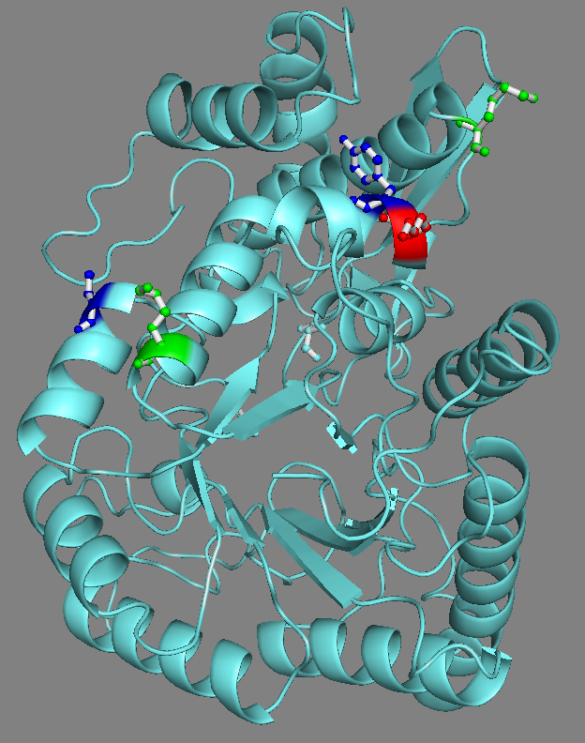
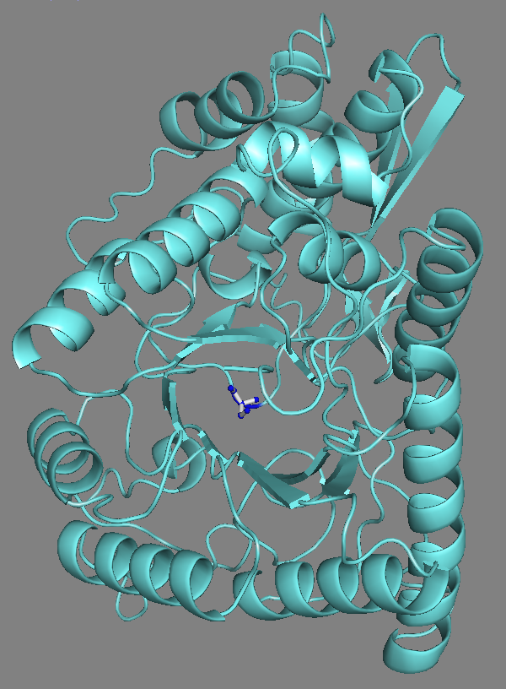
P.yoelii Enolase:
Model 3D- Structure with PTMs.
P.falciparum Enolase:
Model 3D- Structure with PTMs.
pY¹⁴⁸
acK¹⁴²
pT³³⁷
uK¹⁴⁷
acK³⁸⁴
pS42
Active Site
Active Site

