Slide 1




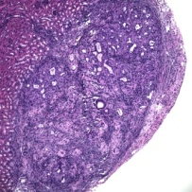
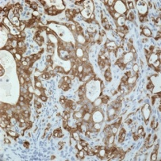
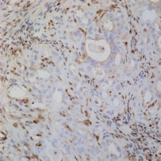
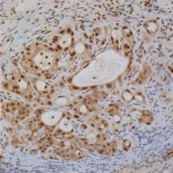
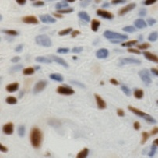


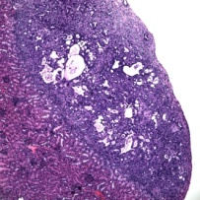
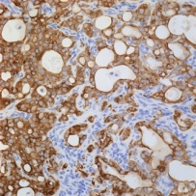
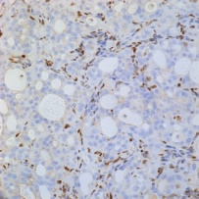
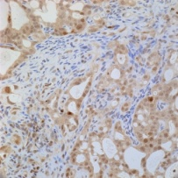
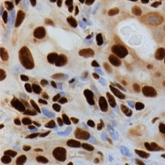


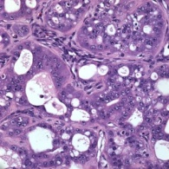
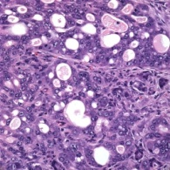
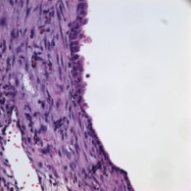
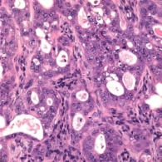
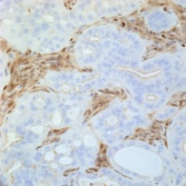
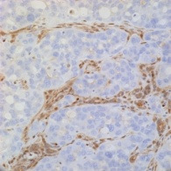
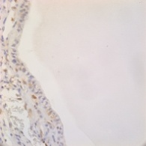
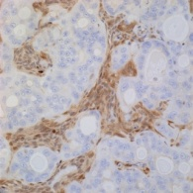
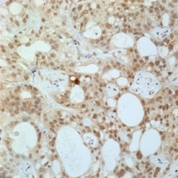
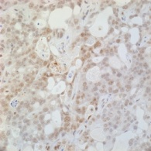
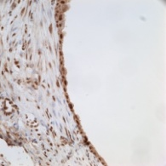
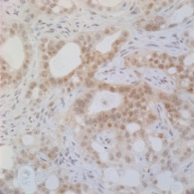
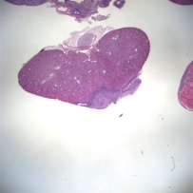
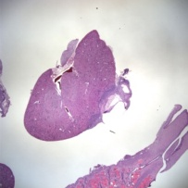
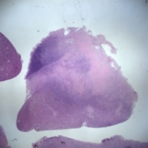
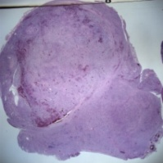
Supplementary Fig. S7
A
a
5’LTR
Ubiquitin
Promoter
hPR
CMV
Promoter
GFP
WRE
3’LTR
b
c
Stroma
+ hPR-GFP
HeLa + hPR-GFP
Stroma
Stroma
+ GFP
HeLa + GFP
HeLa
PR-B
PR-B
PR-A
PR-A
Erk
Erk
B
PTENKO/Kras + GFP pre-therapy
a
b
c
d
e
Pankeratin
PTEN
pErk
PR
PTENKO/Kras + hPR-GFP pre-therapy
f
g
h
i
j
Pankeratin
PTEN
pErk
PR
C
WT Stroma
Stroma + GFP
Exogenous PR in Stroma
Stroma + PR-GFP
Progesterone
Placebo
Progesterone
Placebo
a
d
g
j
HE
HE
HE
HE
b
e
h
k
PTEN
PTEN
PTEN
PTEN
c
HE
f
i
l
pErk
pErk
pErk
pErk
D
Progesterone treated
PTENKO/Kras + hPR-GFP
Placebo treated
PTENKO/Kras + hPR-GFP
a
2mm
b
2mm
c
2mm
d
2mm

