Slide 1


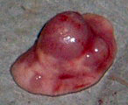
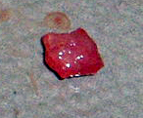
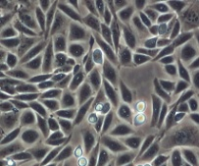
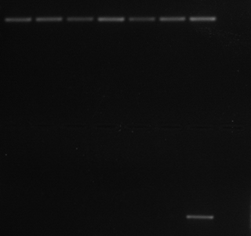



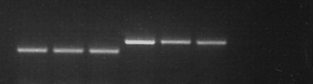
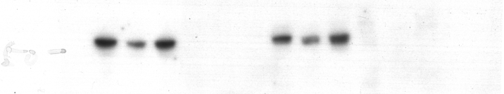
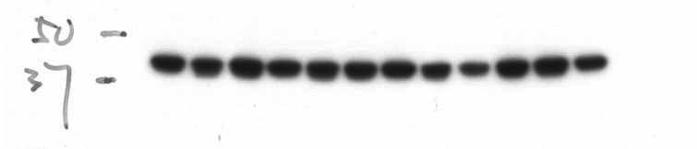
Supplementary Fig. S1
A
Kras^{+/LSL-G12D}Trp53^{L/L}
GEMM
Kras^{+/LSL-G12D}Trp53^{L/L}Lkb1^{L/L}
Induce lung tumor
A lobe of lung
Take nodule
A tumor nodule
Homogenize and culture
Cell line
Kras^{+/G12D}Trp53^{del/del} (Lkb1-wt)
Kras^{+/G12D}Trp53^{del/del}Lkb1^{del/del} (Lkb1-null)
B
Cell lines derived from
lung tumor nodules
634
855
857
H₂O
Genotype | Primer | Sequence 5'-3'
Kras⁺ | mTRR | ttctgaccaccaccaacttcaat
 | mTRWTF | ctaagccggcactccttacaag
Kras^{LSL-G12D} | 5' Kozak 3' LoxP | ctagccaccatggcttgagt
 | 3' Flank 3' LoxP | tccgaattcagtgactacagatg
Trp53^{L/L} | p53-intl-R | agcacataggaggcagagac
 | p53-intl-F | cacaaaaacaggttaaaccca
Trp53^{del/del} | YL9 | cacaaaaacaggttaacccag
 | YL10 | gaagacagaaaaggggaggg
Lkb1^{L/L} | PCR-S5 | tctaacaatgcgctcatcgtcatcctcggc
 | LKB 39 | gagatgggtaccaggagttggggc
Lkb1^{+/+} & Lkb1^{del/del} | LKB 36 | gggcttccacctggtgccagcctgt
 | LKB 37 | gatggaggacctcttggccggctca
 | LKB 39 | gagatgggtaccaggagttggggc
t2
t4
t5
Tail
Kras⁺
Kras^{LSL-G12D}
Trp53^{L/L}
Trp53^{del/del}
Lkb1^{L/L}
Lkb1^{+/+} &
Lkb1^{del/del}
C
634
855
857
t2
t4
t5
LKB1
β-actin

Slide 2
Supplementary Fig. S1
D
A549
NIH3T3
t2
t4
t5
10 μm
634
855
857
Anti-Pancytokeratin (Red) to stain epithelial cells
DAPI (Blue) to stain nucleus
All images are merged signals
E
Relative growth
(Luminescent readout)
Cell doubling time (hour)
18.4
20.2
18.3
17.2
21.1
20
Hour
F
P<0.005
P<0.005
Relative ATP levels
(luminescent readout)
Relative ATP levels
(Fold vs. 634)

Slide 3
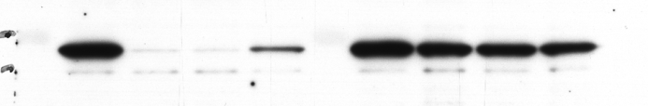
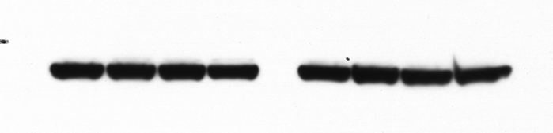
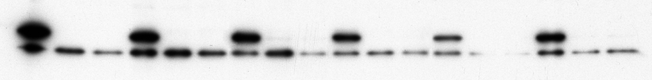
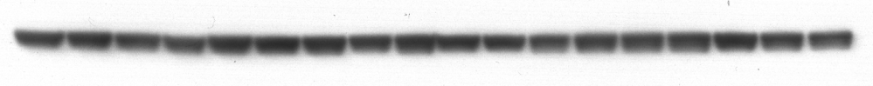
Supplementary Fig. S2
A
Relative DTYMK
transcripts (%)
shDtymk-1
shDtymk-3
shGFP
shDtymk-4
DTYMK
β-actin
B
shDtymk-1
shDtymk-3
shDtymk-1
shDtymk-3
shDtymk-1
shDtymk-3
shDtymk-1
shDtymk-3
shDtymk-1
shDtymk-3
shDtymk-1
shGFP
shGFP
shGFP
shGFP
shGFP
shGFP
shDtymk-3
DTYMK
β-actin
634
855
857
t2
t4
t5

Slide 4
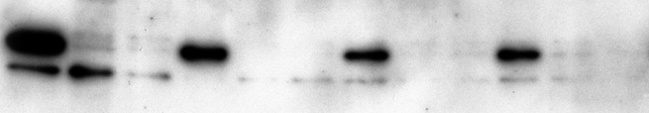
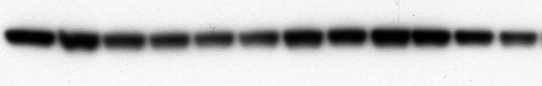
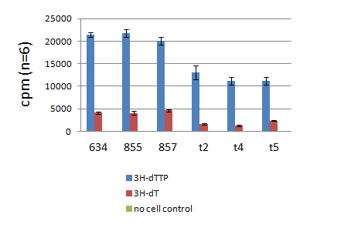
Supplementary Fig. S3
A
shDtymk-1 + dTTP
shDtymk-3 + dTTP
shDtymk-1 + dTTP
shGFP + dTTP
shDtymk-3 + dTTP
shGFP + dTTP
shDtymk-1
shDtymk-3
shGFP
shDtymk-3
shDtymk-1
shGFP
DTYMK
β-actin
634
t4
B
Incorporation of ³H-dTTP (or ³H-dT) into DNA (cpm) (n=6)
³H-dTTP
³H-dT
³H-dTTP/non cell control

Slide 5





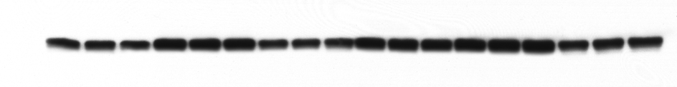
Supplementary Fig. S4
A
+
+
+
+
+
+
DMSO
+
+
+
+
+
+
+
+
+
+
+
+
AZD7762 (100 nM, 3h)
CHIR124 ( 20 nM, 3h)
γH2AX
β-actin
634
855
857
t2
t4
t5
B
+
+
+
+
DMSO
+
+
+
+
AZD7762 (150 nM, 3h)
+
+
+
+
CHIR124 (150 nM, 3h)
γH2AX
β-actin
H358
Calu-1
H2122
A549

Slide 6
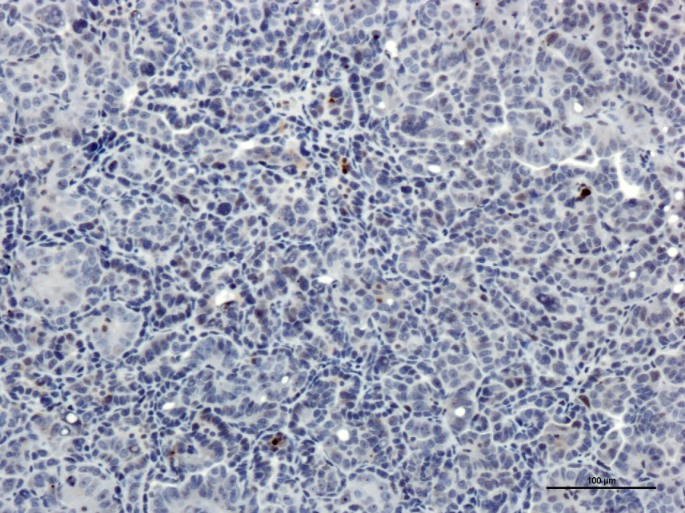
Supplementary Fig. S5
A
P<0.00001
Number of cells with γH2AX per microscopic field
(n=12)
(n=11)
KN4147 mouse lung tumor (Kras/p53)

Slide 7
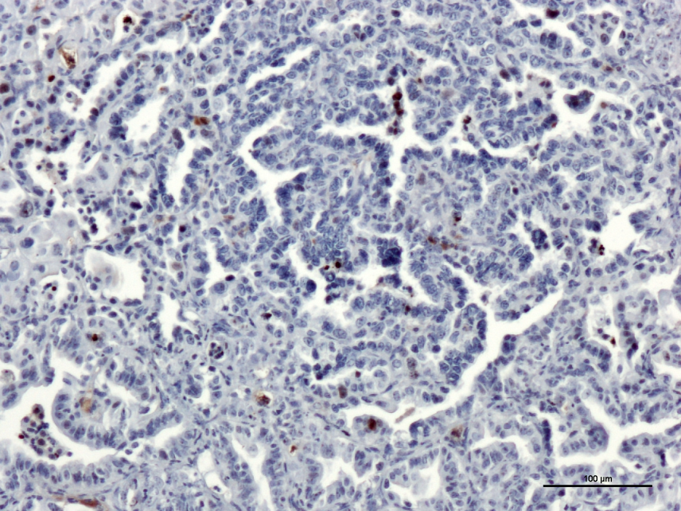
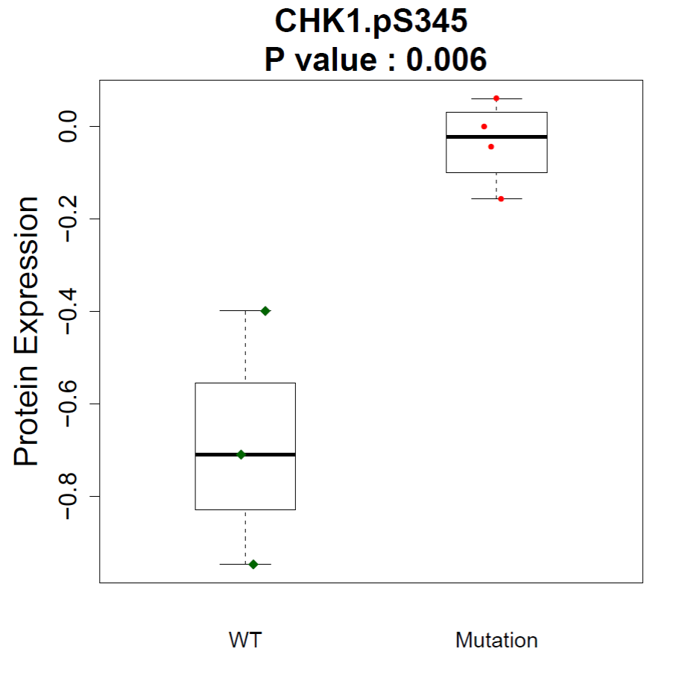


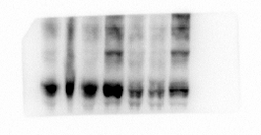

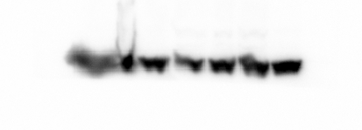
KNC125_306 mouse lung tumor (Kras/p53/Lkb1)
B
C
KNC199-T1
KNC199-T2
KNC199-T3
KN2147-T1
KNC195-T1
KN2123T1
KN2147-T2
LKB1
γH2AX
t-CHEK1
Phospho-CHEK1
Protein Level
DTYMK
β-actin
Lkb1-wt
Lkb1-null
LKB1: wt Mutant

Slide 8

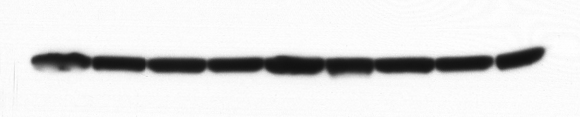
Supplementary Fig. S6
A
shDTYMK-D3
shDTYMK-D8
shDTYMK-D10
shDTYMK-1
shDTYMK-3
Relative DTYMK
transcripts (%)
shGFP
DTYMK
β-actin
B
CHEK1 Protein Level

Slide 9
Supplementary Fig. S7
Lkb1-wt versus Lkb1-null cells
Normal DTYMK (Lkb1-wt)
Less DTYMK (Lkb1-null)
Deplete
DTYMK
beginning
High ratio of dUTP/dTTP
Deplete
DTYMK
moderately
Higher ratio of dUTP/dTTP
Deplete
DTYMK
mostly
Stop dTTP and DNA synthesis
Uracil in DNA
and DNA-DSBs
More Uracil in DNA
and DNA-DSBs
Thymine-less cell death
Checkpoint
activation
Checkpoint
activation
Base excision repair
and DSB repair
Increased
base excision repair
and DSB repair

Slide 10
Supplementary Fig. S8
A
P=0.01
Relative Dtymk transcripts
(%) (VS. 634)
B
P<0.01
Relative Chek1 transcripts
(%) (VS. 634)

Slide 11
Supplementary Fig. S9
A
Relative TK1 transcripts (%)
B
Cell growth
shGFP
shTK1-3
shTK1-4
Cell growth
Days post puro
Days post puro

Slide 12
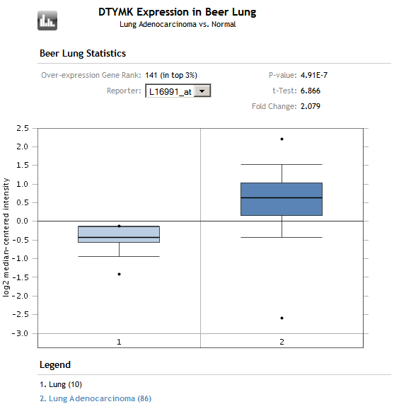
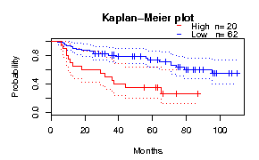
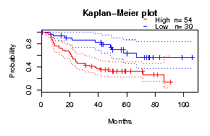
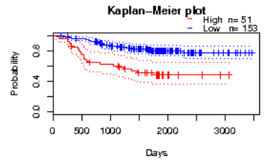
Supplementary Fig. S10
A
DTYMK expression
in Beer dataset
P = 4.9·10⁻⁷
FC = 2.1
Log2 median-centered
intensity
Normal lung
(n=10)
Lung adenocarcinoma
(n=86)
B
CAN/DF dataset
Survival
Low DTYMK (n=62)
High DTYMK (n=20)
Log rank P = 0.01
Cox P = 0.004
Month
Beer dataset
Survival
Low DTYMK (n=30)
High DTYMK (n=54)
Log rank P = 0.02
Cox P = 0.03
Month
NCCRI dataset
Survival
Low DTYMK (n=153)
High DTYMK (n=51)
Log rank P = 0.0001
Cox P = 0.0005
Day

