Slide 1
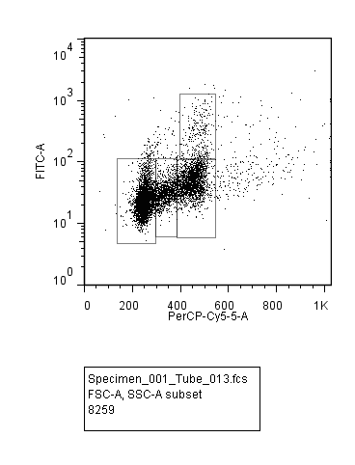
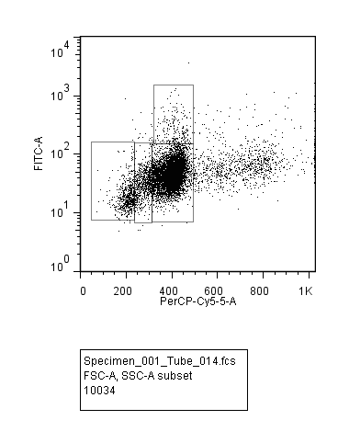
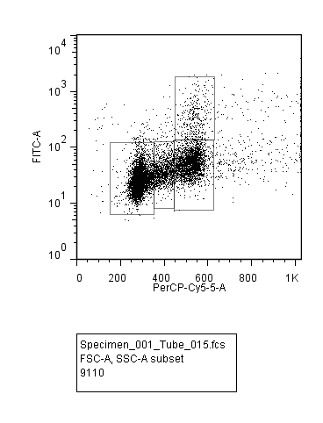
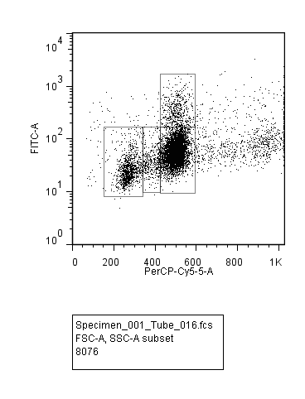
Wei et al. Suppl. Fig. 2
A
16 h post-RT
si-NS
si-NS + IR
si-PPP2R1A
si-PPP2R1A + IR
p-Histone H3
G1: | 55%
S: | 13%
G2: | 25%
M: | 3.4%
G1: | 6%
S: | 8%
G2: | 75%
M: | 2.2%
G1: | 53%
S: | 12%
G2: | 26%
M: | 4%
G1: | 14%
S: | 5%
G2: | 63%
M: | 6.3%
PI
B

