Slide 1
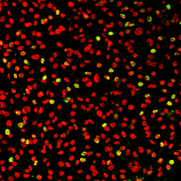
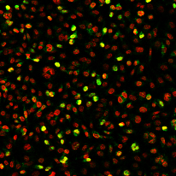
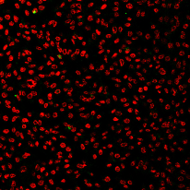
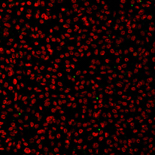
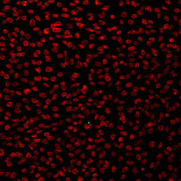
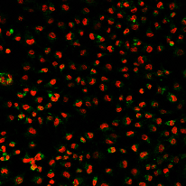
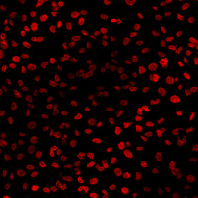
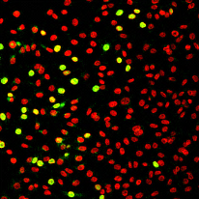
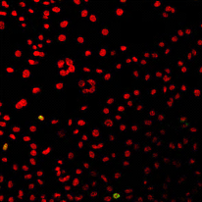
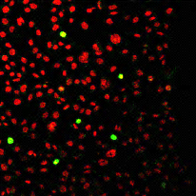
Inf 1
Inf 2
αNS1
46.6±9.9%
25.8±2.2%
1.2±0.1%
1.0±0.4%
0.2±0.1%
6.3±1.4%
2.0±0.6%
1.6±0.8%
αCap
28.0±0.6%
16.7±3.8%
4.0±1.7%
2.3±0.6%
1.1±0.8%
3.2±2.4%
2.5±1.8%
1.1±0.8%
mock
1/500
1/200
1/100
0.1 U/ml
0.2 U/ml
0.5 U/ml
B7
Neuraminidase
B7
Neuraminidase
Inf 1
Inf 2
Supplementary Fig S5

