Slide 1
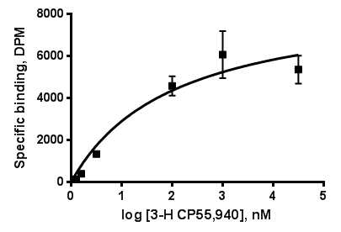
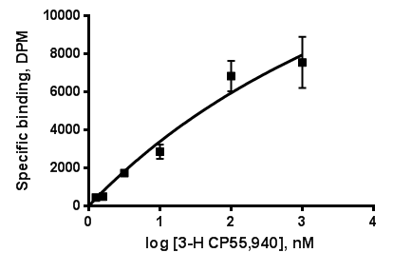
Figure S2. Saturation binding of [³H]-CP-55,940 on CB₂ in E coli membranes.
CB₂-130
CB₂-252
CB₂-255
Membrane preparations from cells expressing CB₂-130, CB₂-252 and CB₂-255 (10 mg total protein) were analyzed in a saturation binding assay with ligand ³H-CP 55,940 as described in Supplemental materials. Due to nonspecific partitioning of the ligand into membranes, the curves do not attain saturation

