Slide 1
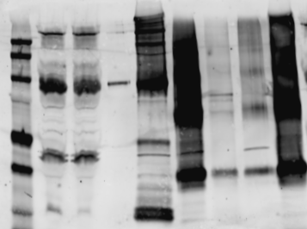
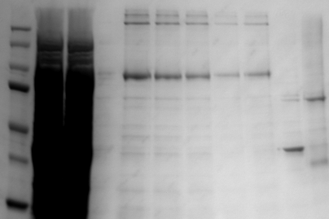
Figure S3. Purification of CB₂-252
Fractions from
1D4-Ab resin
Fractions from
Ni-NTA
Fractions from
1D4-Ab resin
Fractions from
Ni-NTA
kDa M L FT W Fns TEV FT W Fns
kDa M L FT 1 3 4 5 6 7 FT Fns
Anti CB2/Cy5
100
100
50
50
37
37
Western blot: Anti CB₂ Antibody
Coommassie-blue staining
Purification of CB₂-252
A
B
Western blot analysis. M, marker; L, load before 1D4 antibody chromatography; FT, W and Fns, flowthrough, wash and elution fractions from indicated chromatographic step respectively; TEV, proteins after TEV protease digest. Relevant bands corresponding to CB₂ are indicated by squares.
Coomassie blue staining. M, marker; L, load before 1D4 antibody chromatography; FT, flowthrough from indicated chromatographic step; 1, 3, 4, 5, 6,7, Fns, elution fractions from indicated chromatographic step; TEV, proteins after TEV protease digest. Relevant bands corresponding to CB₂ are indicated by squares.

