Slide 1
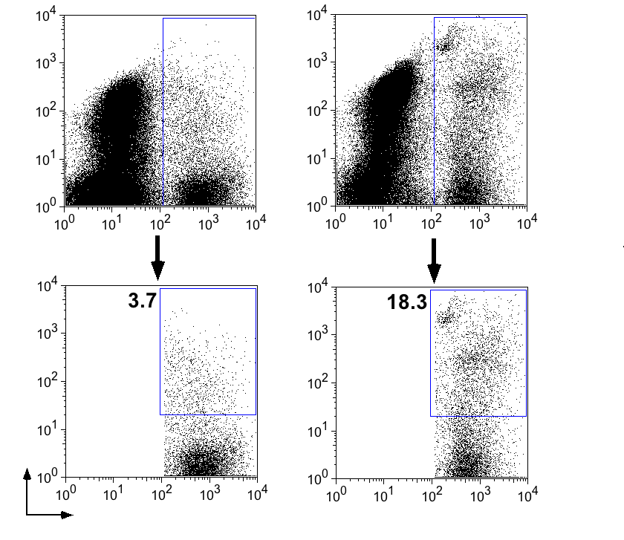
Scramble
miR-124
Splenocytes
+ GL261
GL261
only
PI
CFSE
Supplementary Figure 4

