Slide 1
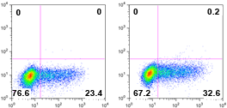
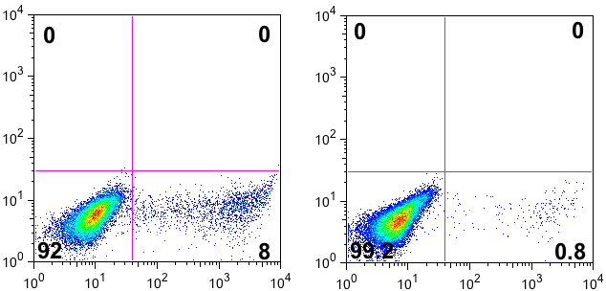
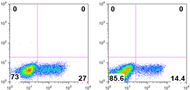
Th1
Scramble
miR-124
IL-12 + anti-IL-4
T-bet
IFNγ
miR-124 or scramble
transfection
Th-17
Scramble
miR-124
TGFβ + IL-6 + IL-1β
+ IL-23 + TNFα
Tnaive
RORγt
IL-17
iTreg
Scramble
miR-124
TGFβ
FoxP3
FoxP3
Supplementary Figure 6

