Slide 1
SELDI-TOF results
Pigs:
Streptozotocin induced diabetic and control pigs
Both fed a high unsaturated fat Mediterranean diet or
A high saturated fat Cafeteria diet:
4 groups in each analysis
Proteomics:
SELDI-TOF arrays:
CM10, pH7 buffer
CM10, pH 4 buffer
H50
IMAC30
Sample enrichment:
Proteominer 4 fractions (fr)

Slide 2
CM10 pH7, fr1
M/Z P-value
4784 0.000896
6249 0.001759
4574 0.005584
4995 0.007090
2654 0.007717
4622 0.008207
22259 0.009799

Slide 3
M/Z 4784, CM10 pH7, fr1

Slide 4
M/Z 6249, CM10 pH7, fr1

Slide 5
M/Z 4995, CM10 pH7, fr1

Slide 6
CM10 pH7, fr2
M/Z P-value
6248 0.001131
2654 0.002628
4784 0.002959
12470 0.004171
6803 0.005150
3647 0.005923
6432 0.007451
7396 0.007603
4999 0.007648
13114 0.009235
89656 0.009593

Slide 7
M/Z 6248, CM10 pH7, fr2

Slide 8
M/Z 3647, CM10 pH7, fr2

Slide 9
M/Z 6432, CM10 pH7, fr2

Slide 10
M/Z 13114, CM10 pH7, fr2

Slide 11
CM10 pH7, fr3
M/Z P-value M/Z P-value
28537 0.000259 8546 0.001510
14264 0.000333 23188 0.002122
7391 0.000390 118652 0.002320
4997 0.000485 3907 0.002462
11810 0.000517 18014 0.002767
89745 0.000572 8336 0.002782
6959 0.000711 67128 0.003214
13785 0.000870 6419 0.003367
21261 0.001100 27658 0.003713
10322 0.001145 123354 0.004163
56277 0.001190 36059 0.005209
6623 0.001191 3650 0.005701
41501 0.001222 7828 0.007046
8651 0.001366 83261 0.008554
8502 0.001455

Slide 12
M/Z 28537, CM10 pH7, fr3

Slide 13
M/Z 11810, CM10 pH7, fr3

Slide 14
M/Z 89745, CM10 pH7, fr3

Slide 15
M/Z 6959, CM10 pH7, fr3

Slide 16
M/Z 10322, CM10 pH7, fr3

Slide 17
M/Z 6623, CM10 pH7, fr3

Slide 18
CM10 pH7, fr4
M/Z P-value
11841 0.000477
6427 0.001857
6621 0.002160
34792 0.002490
10242 0.002639
6504 0.002874
4578 0.005327
4995 0.006458
3907 0.007978

Slide 19
M/Z 11841, CM10 pH7, fr4

Slide 20
M/Z 6427, CM10 pH7, fr4

Slide 21
Principal component analysis
CM10 High Stringent fr3

Slide 22
Principal component analysis
CM10 High Stringent fr3

Slide 23
CM10 pH4(Low Stringent), fr1
M/Z P-value
8333 0.000857
22340 0.001196
10706 0.001219
8545 0.001844
2122 0.003138
7616 0.004524
6803 0.004710
9887 0.004771
4988 0.008042
6208 0.008068
12638 0.009241

Slide 24
M/Z 8333, CM10 pH4, fr1

Slide 25
M/Z 22340, CM10 pH4, fr1

Slide 26
M/Z 6803, CM10 pH4, fr1

Slide 27
CM10 pH4(Low Stringent), fr2
M/Z P-value M/Z P-value
5861 0.000705 7168 0.003184
13103 0.000855 28780 0.004085
6801 0.001287 6958 0.004511
3915 0.001411 4272 0.005260
6431 0.001412 2853 0.005565
8648 0.001429 7828 0.006583
8548 0.001550 34773 0.006602
89704 0.002206 6207 0.006893
6488 0.002440 8834 0.006976
5000 0.002580 7397 0.009650

Slide 28
M/Z 5861, CM10 pH4, fr2

Slide 29
M/Z 6431, CM10 pH4, fr2

Slide 30
M/Z 8648, CM10 pH4, fr2

Slide 31
M/Z 28780, CM10 pH4, fr2

Slide 32
CM10 pH4, fr3
M/Z P-value M/Z P-value
8499 0.000379 13825 0.002813
17680 0.000572 16676 0.002898
34754 0.000688 27656 0.003163
8650 0.000852 56189 0.003296
8539 0.000860 8391 0.003330
8550 0.001347 41518 0.003538
10885 0.001455 6959 0.004262
28527 0.001493 83775 0.004428
14441 0.001544 3944 0.004991
7390 0.001709 23182 0.005046
4996 0.001785 95161 0.005775
8336 0.002360 55475 0.006396
4162 0.002700

Slide 33
M/Z 8499, CM10 pH4, fr3

Slide 34
M/Z 34754, CM10 pH4, fr3

Slide 35
M/Z 10885, CM10 pH4, fr3

Slide 36
M/Z 28527, CM10 pH4, fr3

Slide 37
CM10 pH4, fr4
M/Z P-value
28500 0.000499
4995 0.000553
36225 0.000782
8210 0.000797
8331 0.000842
34742 0.001030
3726 0.001134
14437 0.001154
8647 0.001545
8553 0.001857
3921 0.002626
6956 0.003853

Slide 38
M/Z 28500, CM10 pH4, fr4

Slide 39
M/Z 4995, CM10 pH4, fr4

Slide 40
M/Z 8210, CM10 pH4, fr4

Slide 41
M/Z 8553, CM10 pH4, fr4

Slide 42
H50 arrays, fr1
M/Z P-value M/Z P-value
10874 0.000764 4171 0.004718
8342 0.001264 13105 0.004861
8549 0.002086 5000 0.00507
6952 0.002128 53724 0.005154
8534 0.002256 14553 0.005617
8641 0.002545 4268 0.005744
6967 0.002608 5457 0.006031
8328 0.002699 8835 0.006367
7167 0.003131 14710 0.006705
43504 0.003549 95357 0.008911
55468 0.004025 28504 0.009478

Slide 43
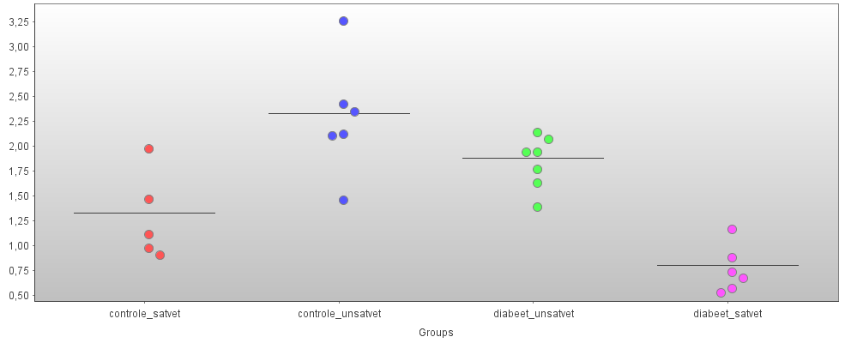
M/Z 10874, H50, fr1

Slide 44
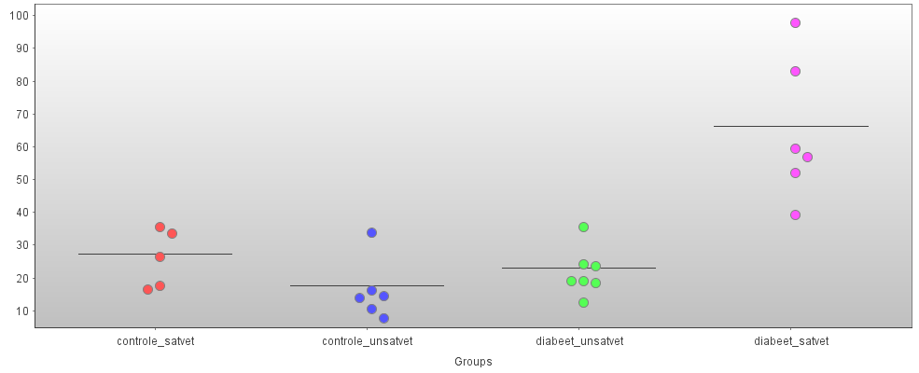
M/Z 8342, H50, fr1

Slide 45
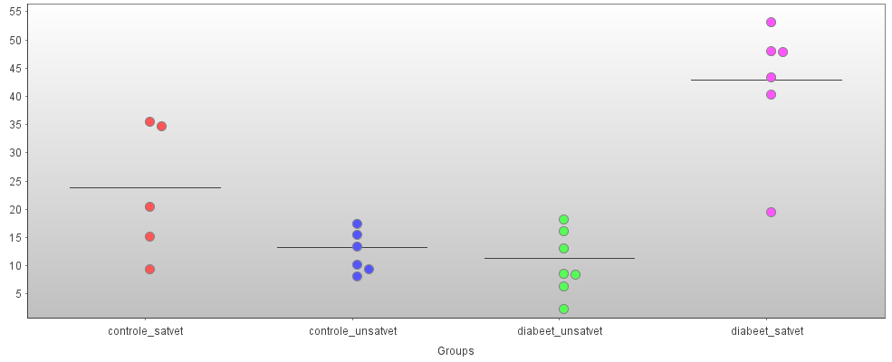
M/Z 6952, H50, fr1

Slide 46
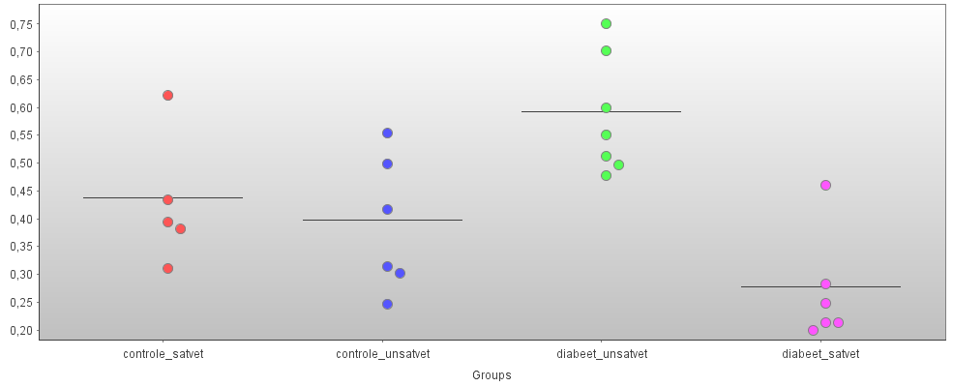
M/Z 53724, H50, fr1

Slide 47
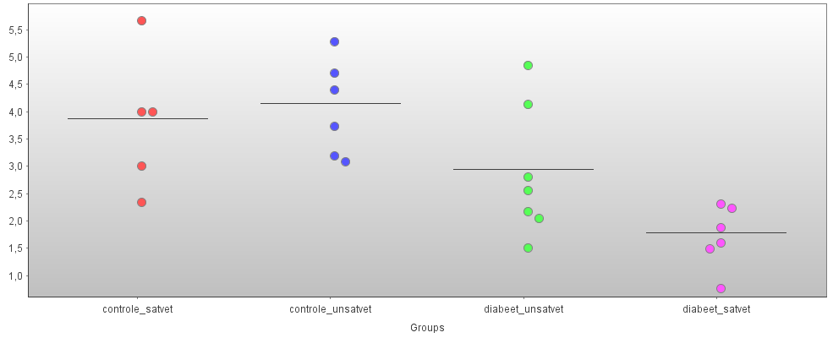
M/Z 14553, H50, fr1

Slide 48
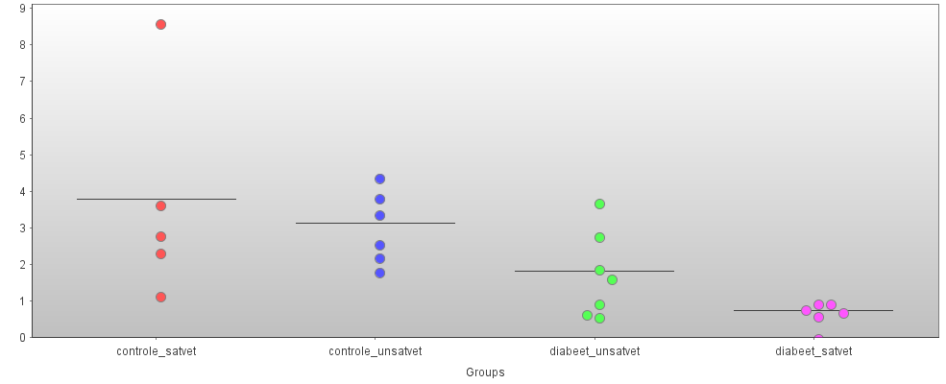
M/Z 5457, H50, fr1

Slide 49
H50, fr1

Slide 50
H50, fr1

Slide 51
H50 arrays, fr2
M/Z P-value M/Z P-value
8642 0.000931 8552 0.002610
28513 0.001352 21225 0.004057
7392 0.001389 14260 0.004135
8535 0.001390 8343 0.004922
3904 0.001460 41466 0.005339
8329 0.001607 126055 0.006718
14547 0.001696 99112 0.008519
4160 0.002116 6800 0.008870
20833 0.002256

Slide 52
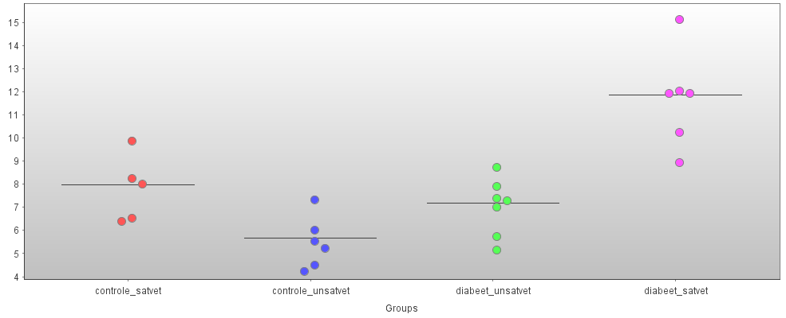
M/Z 8642, H50, fr2

Slide 53
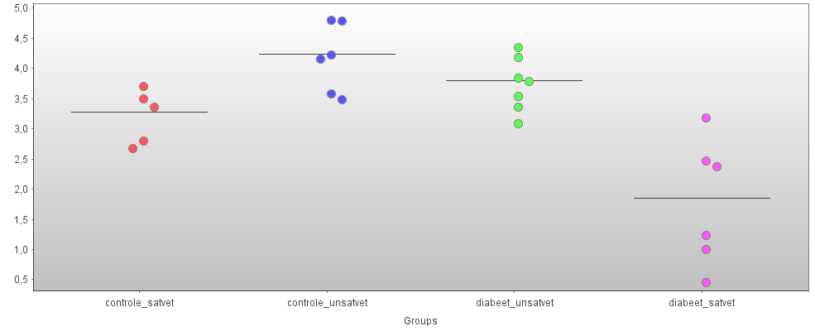
M/Z 28513, H50, fr2

Slide 54
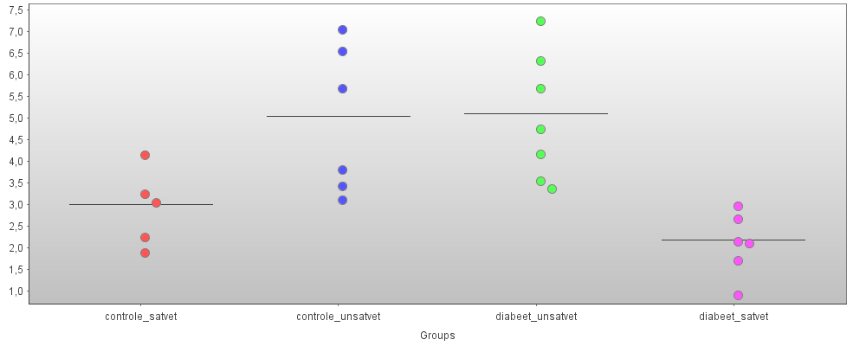
M/Z 7392, H50, fr2

Slide 55
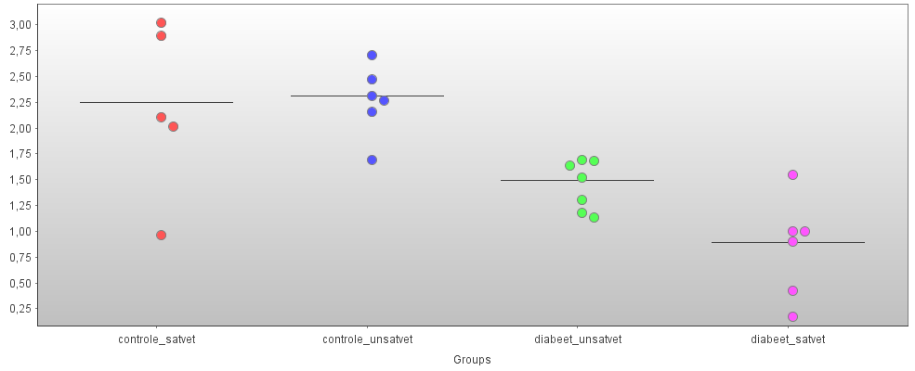
M/Z 14547, H50, fr2

Slide 56
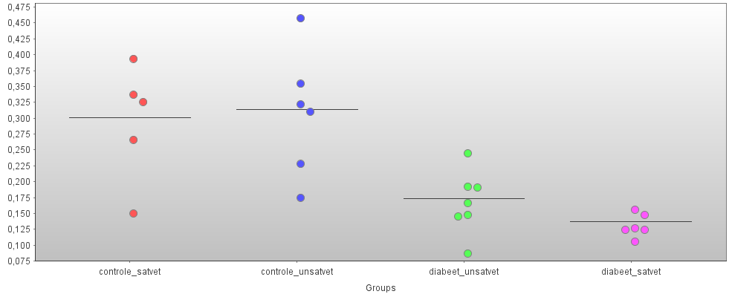
M/Z 20833, H50, fr2

Slide 57
H50 arrays, fr3
M/Z P-value M/Z P-value
7162 0.000593 14256 0.003739
6956 0.001218 28511 0.004824
34193 0.001384 8552 0.005648
8201 0.002309 8647 0.006326
16671 0.002683 4160 0.008796
12002 0.003096

Slide 58
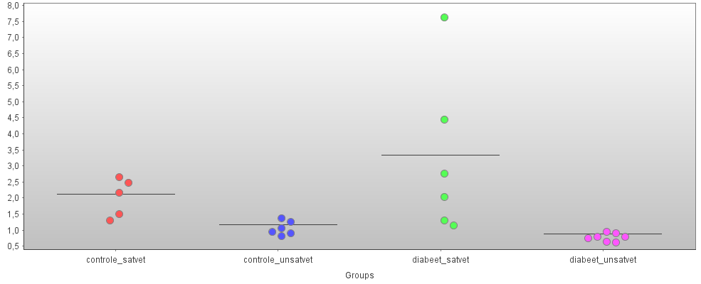
M/Z 7162, H50, fr3

Slide 59
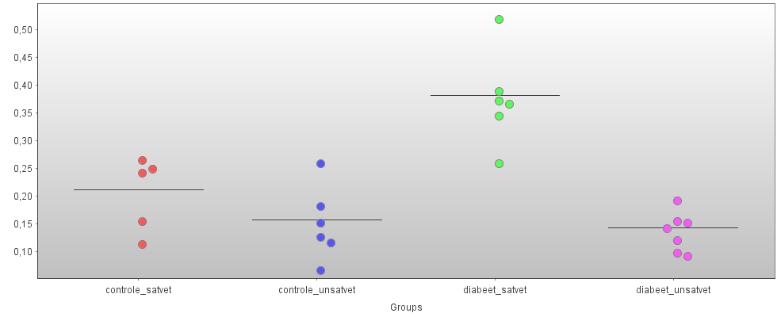
M/Z 16671, H50, fr3

Slide 60
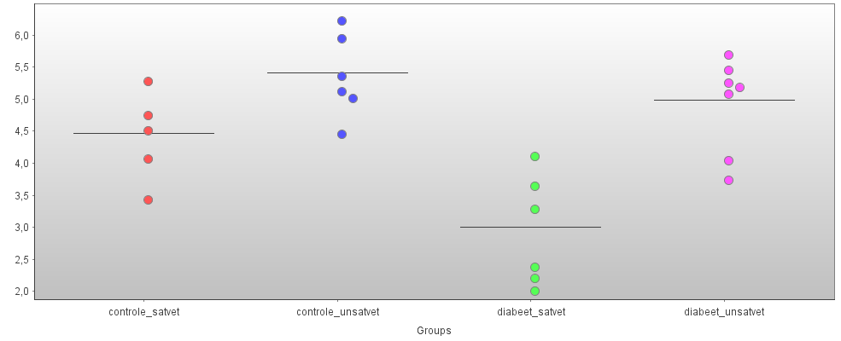
M/Z 28511, H50, fr3

Slide 61
H50 arrays, fr4
M/Z P-value
12007 0.000516
8193 0.000606
14252 0.000729
8209 0.001678
164083 0.006688
28176 0.009644

Slide 62
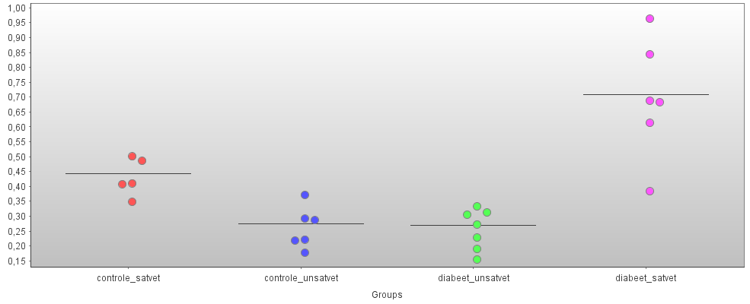
M/Z 12007, H50, fr4

Slide 63
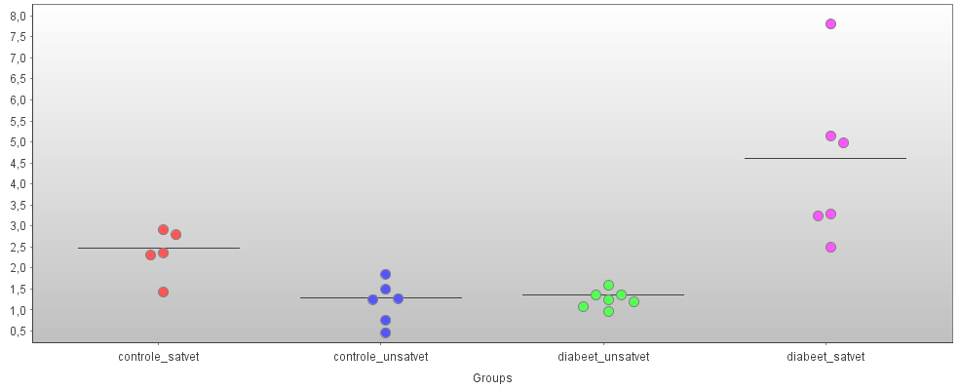
M/Z 8193, H50, fr4

Slide 64
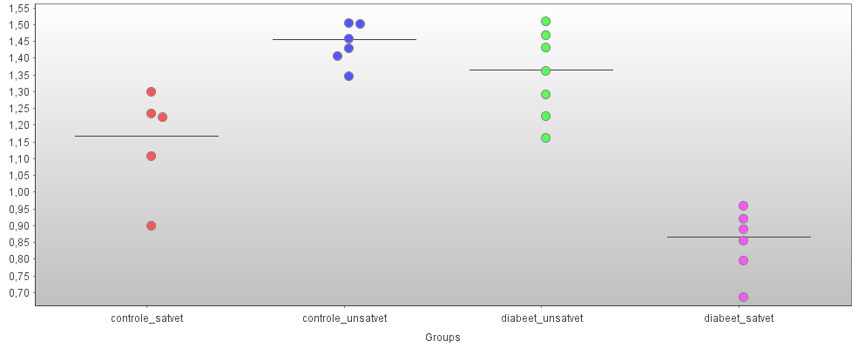
M/Z 14252, H50, fr4

Slide 65
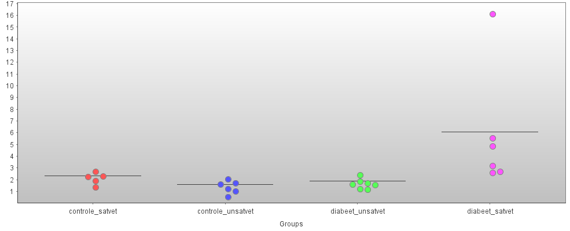
M/Z 8209, H50, fr4

Slide 66
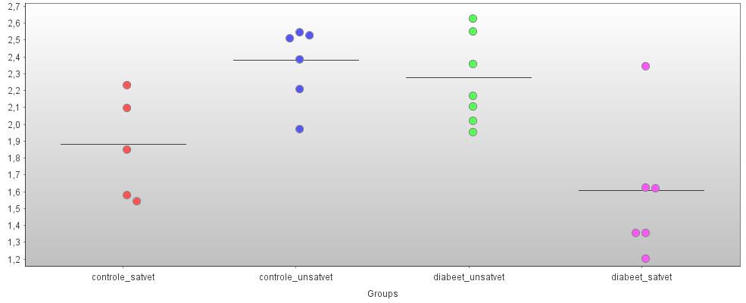
M/Z 28176, H50, fr4

Slide 67
IMAC arrays, fr1
M/Z P-value
2118 0.001235
22366 0.001305
4899 0.004580
4914 0.005734
20133 0.006144
25602 0.006249

Slide 68
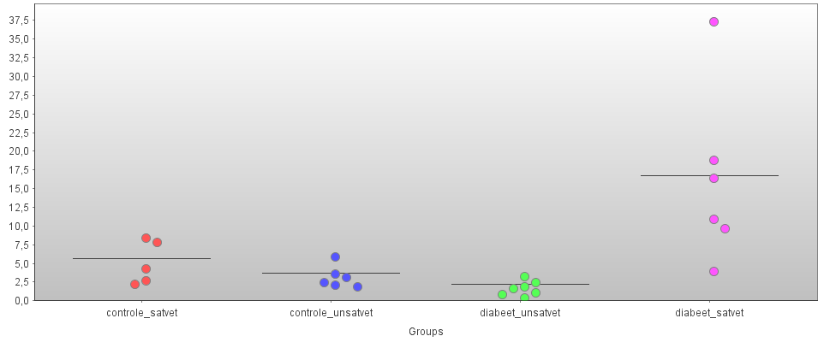
M/Z 2118, IMAC, fr1

Slide 69
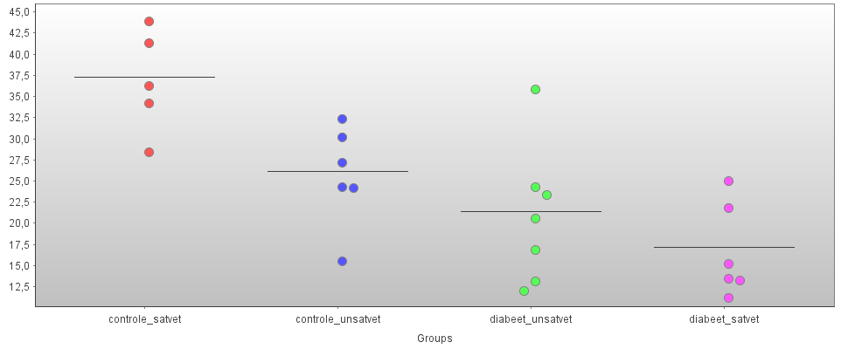
M/Z 4899, IMAC, fr1

Slide 70
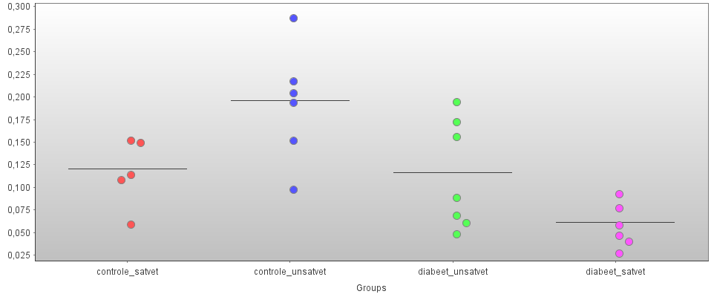
M/Z 25602, IMAC, fr1

Slide 71
IMAC arrays, fr2
M/Z P-value M/Z P-value
8835 0.000597 10241 0.004374
6244 0.001667 4270 0.004515
8329 0.002285 13108 0.007803
20121 0.002454 4993 0.008566
8343 0.002966 4572 0.009452
89856 0.003864 6205 0.009685
34761 0.004239

Slide 72
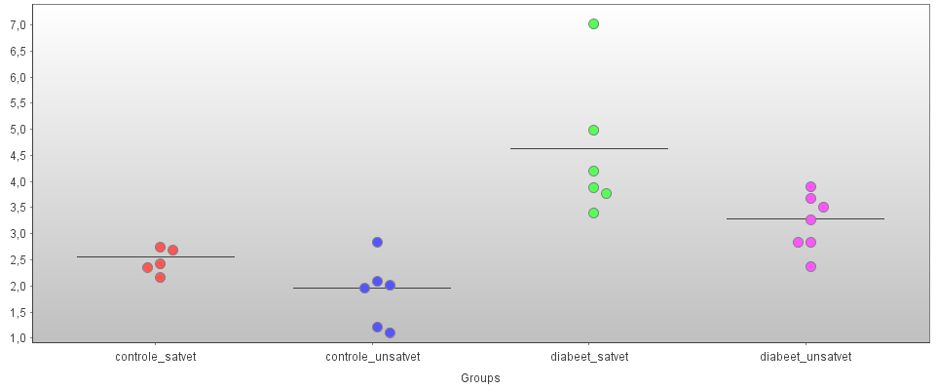
M/Z 8835, IMAC, fr2

Slide 73
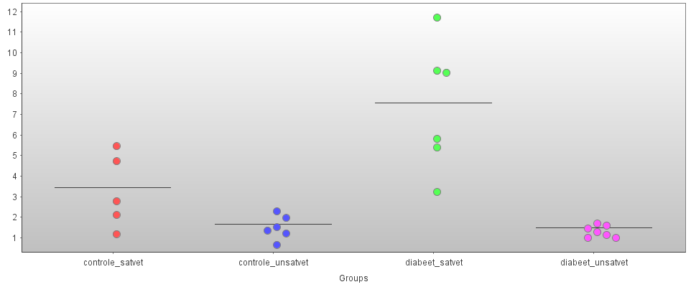
M/Z 6244, IMAC, fr2

Slide 74
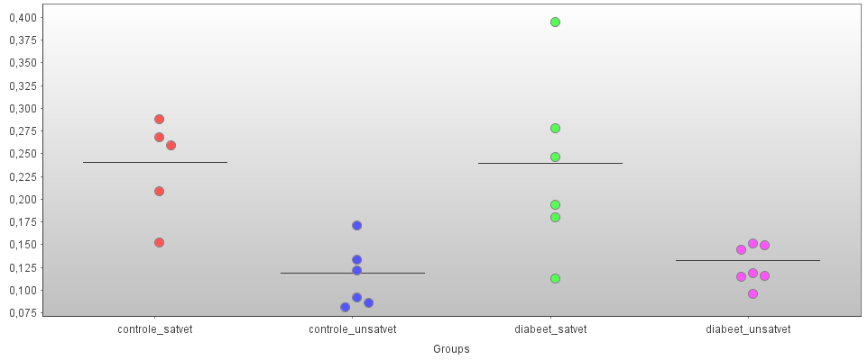
M/Z 34761, IMAC, fr2

Slide 75
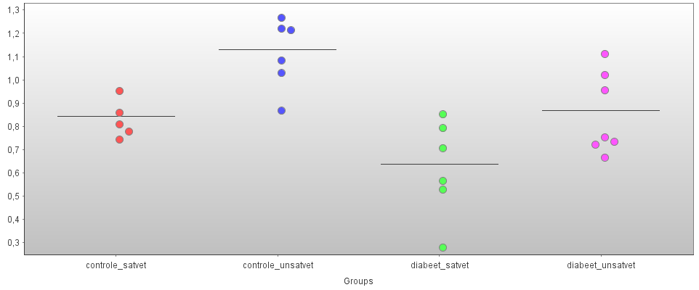
M/Z 10241, IMAC, fr2

Slide 76
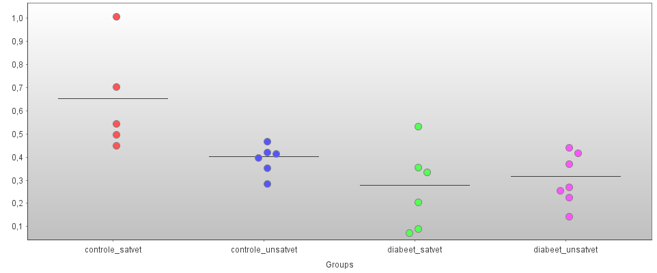
M/Z 13108, IMAC, fr2

Slide 77
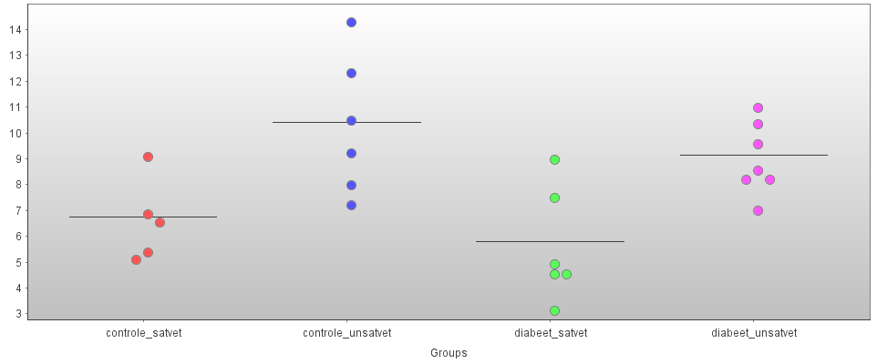
M/Z 4993, IMAC, fr2

Slide 78
IMAC arrays, fr3
M/Z P-value M/Z P-value
34733 0.000571 8536 0.002478
6618 0.000595 8329 0.002826
22231 0.000625 3905 0.002888
4994 0.000644 28514 0.003113
8207 0.000844 10877 0.003245
10233 0.000913 89773 0.003266
7386 0.001186 14432 0.004008
20111 0.001776 6422 0.004730
5223 0.002225 6953 0.007260

Slide 79
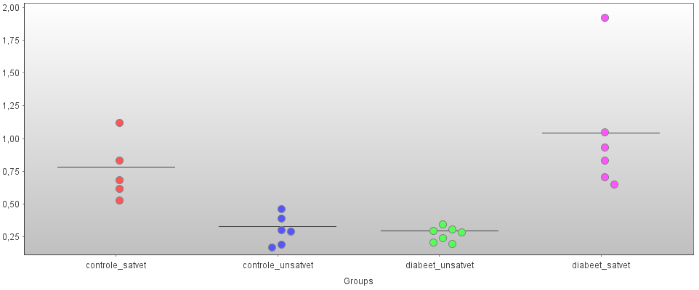
M/Z 34733, IMAC, fr3

Slide 80
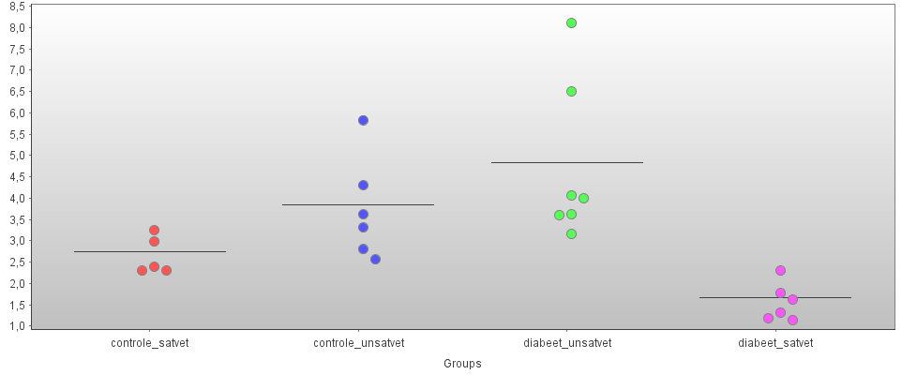
M/Z 6618, IMAC, fr3

Slide 81
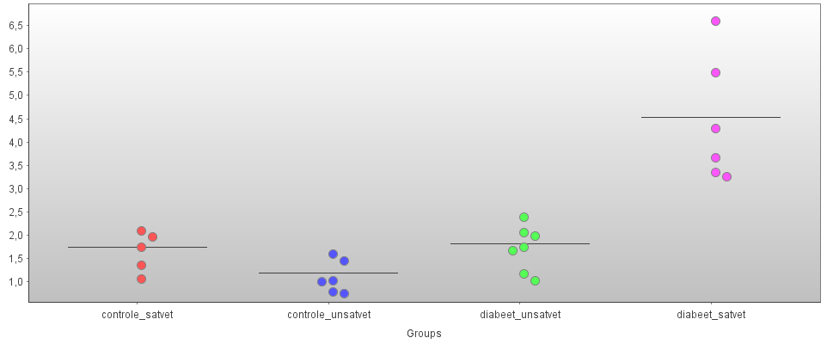
M/Z 8207, IMAC, fr3

Slide 82
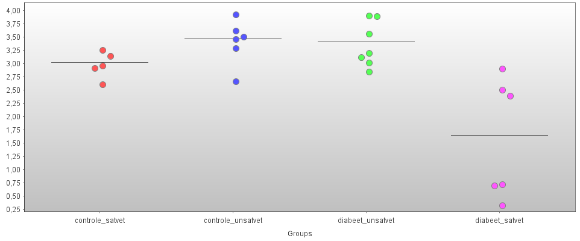
M/Z 28514, IMAC, fr3

Slide 83
IMAC arrays, fr4
M/Z P-value M/Z P-value
6617 0.000628 8199 0.002932
10233 0.000668 3912 0.003517
10154 0.000841 9209 0.004326
4995 0.000965 4040 0.004769
89561 0.001311 91513 0.005585
14252 0.001878 3724 0.008563
67156 0.002234 33611 0.008898

Slide 84
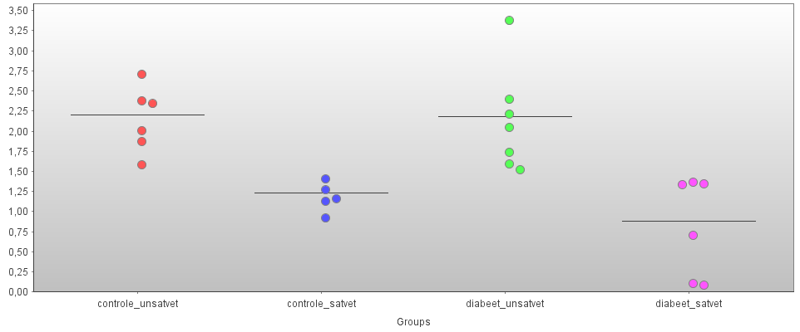
M/Z 6617, IMAC, fr4

Slide 85
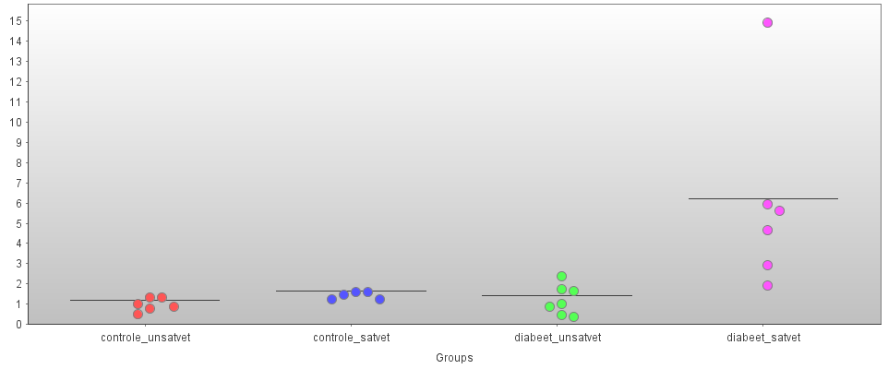
M/Z 8199, IMAC, fr4

Slide 86
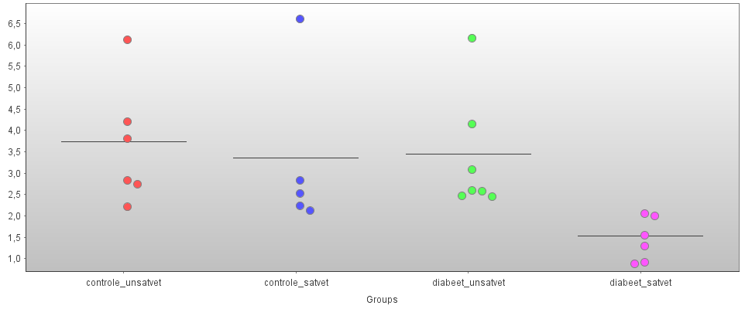
M/Z 3912, IMAC, fr4

Slide 87
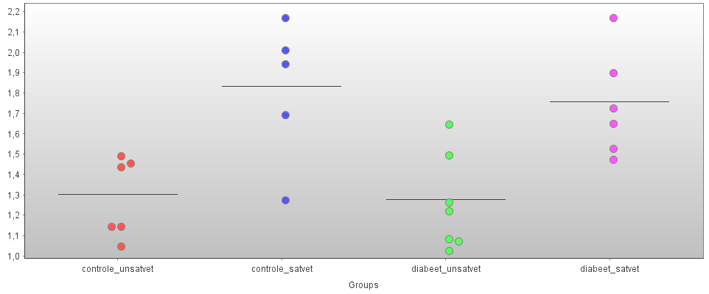
M/Z 9208, IMAC, fr4

Slide 88
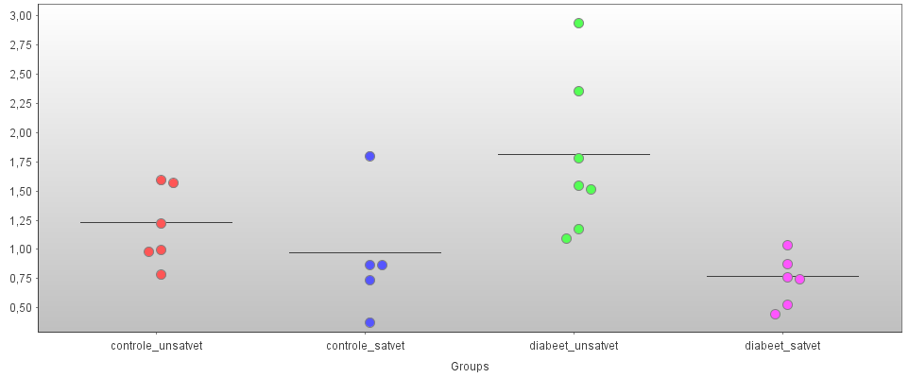
M/Z 3724, IMAC, fr4

