Slide 1
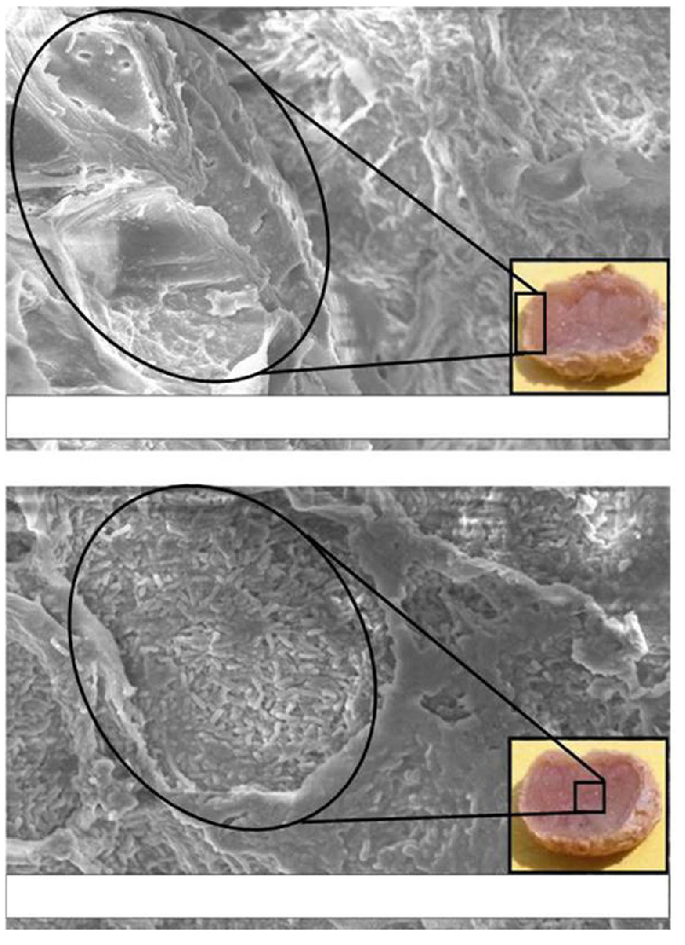
A
10µm*
EHT = 10.00kV Zone Mag = 1.70KX WD = 14mm
Signal A= SE1
Photo No. = 1302
B
10µm*
EHT = 10.00kV Zone Mag = 2.01KX WD = 14mm
Signal A= SE1
Photo No. = 1306
Supplementary Figure 2

