Slide 1
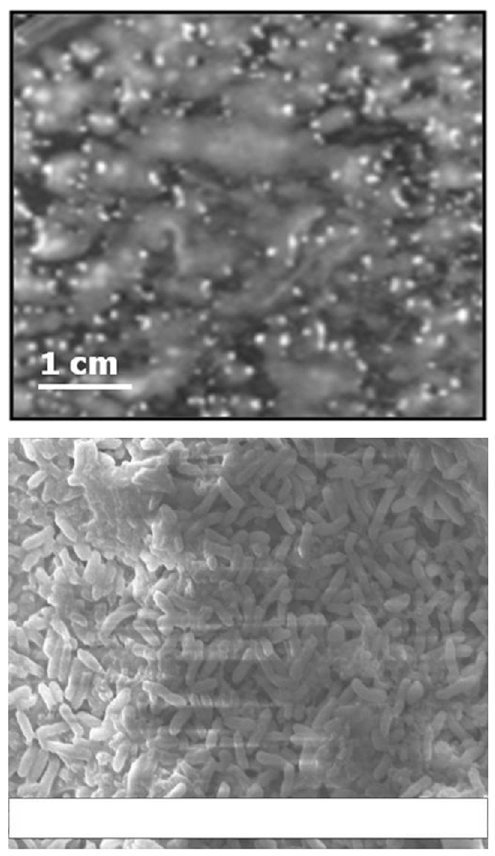
A
B
3µm*
EHT = 10.00kV Zone Mag = 5.01KX WD = 14mm
Signal A= SE1
Photo No. = 1291
Supplementary Figure 3

