Slide 1
Pictorial stepwise depiction of a Midface VFT from Donor to Recipient
PowerPoint presentation, Supplemental Digital Content 2

Slide 2
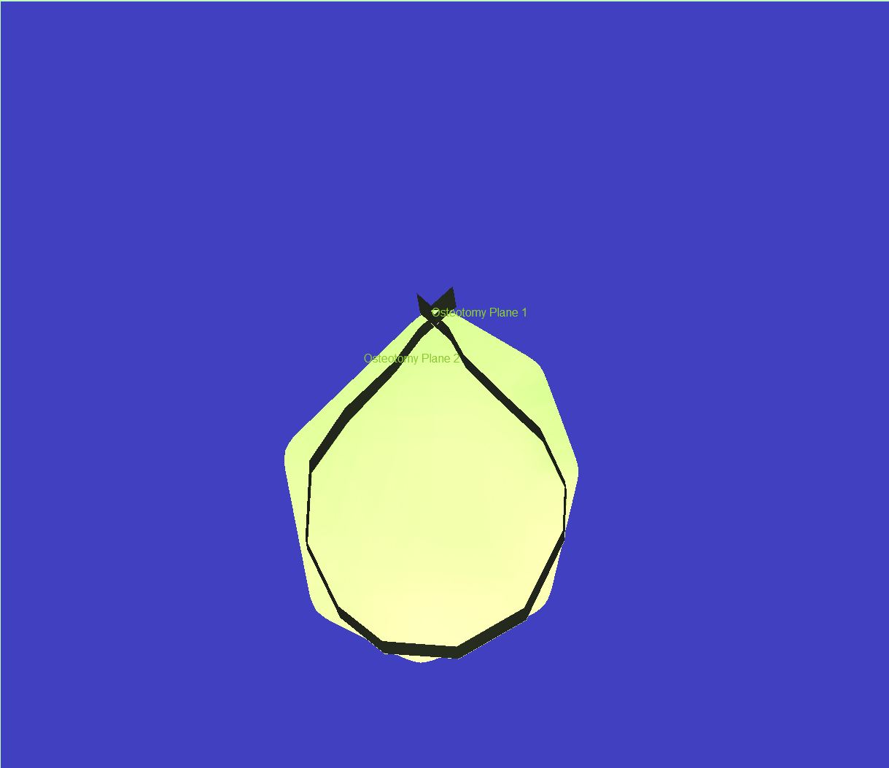
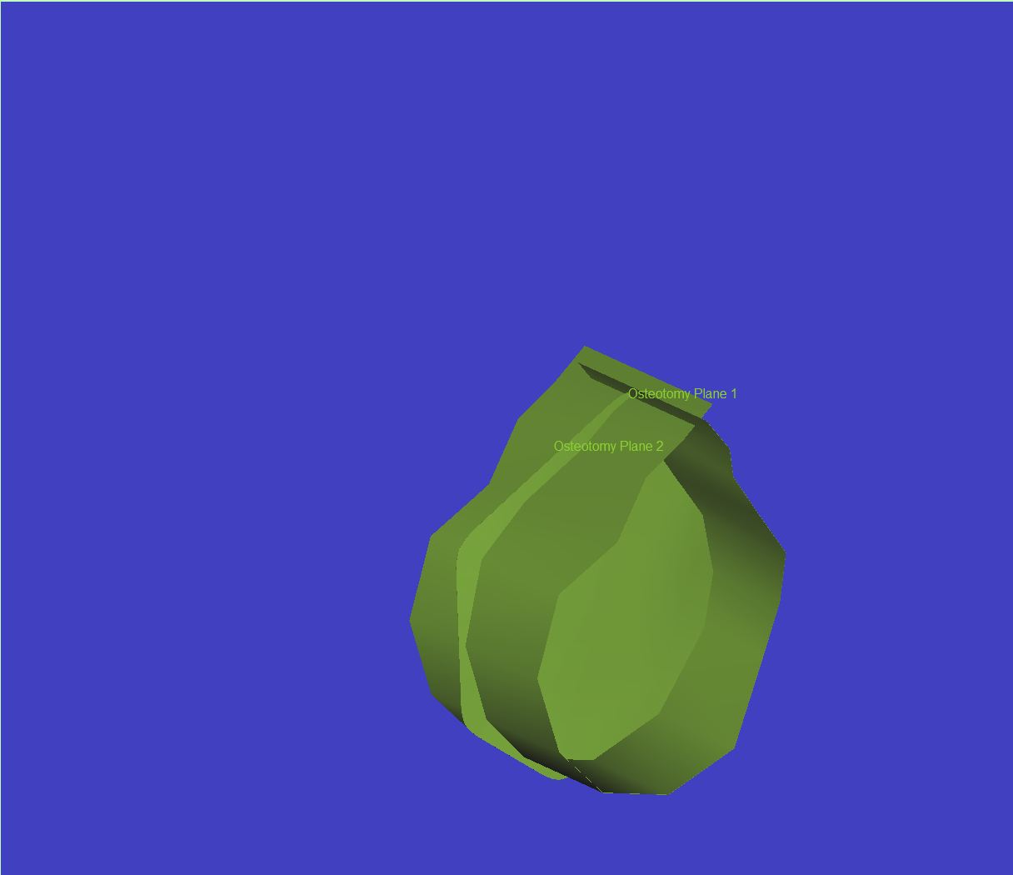
A “cup” shaped cutting plane is designed from two osteotomy planes in the shape of the desired pattern
Frontal view
Profile view

Slide 3
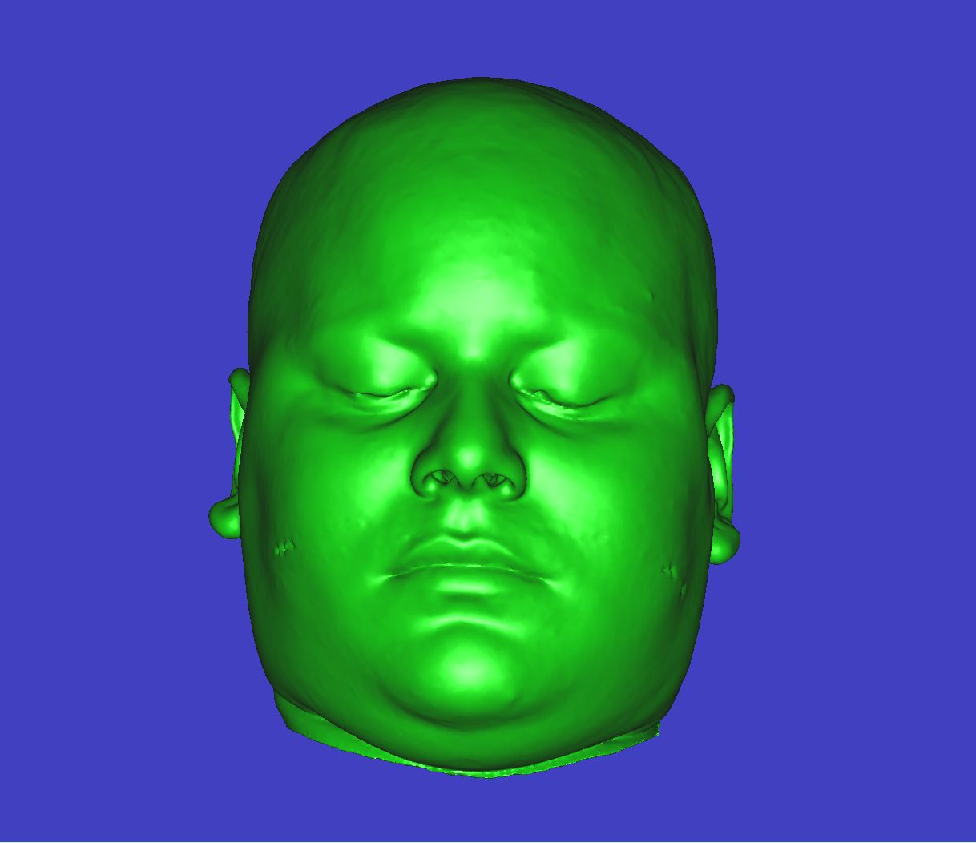
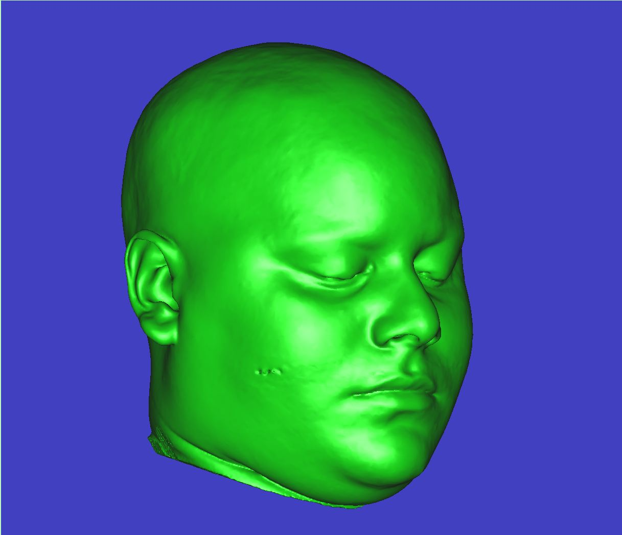
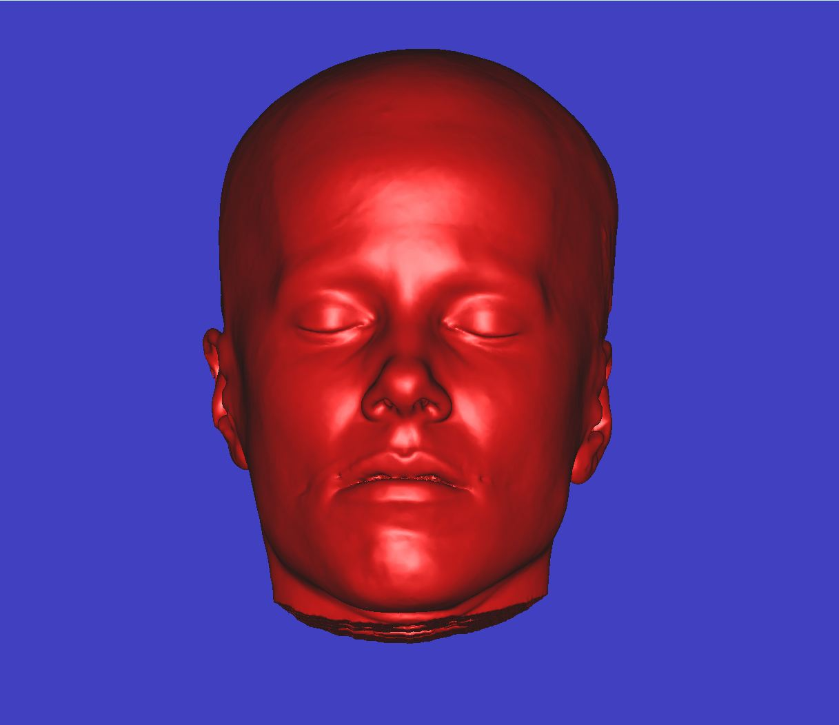
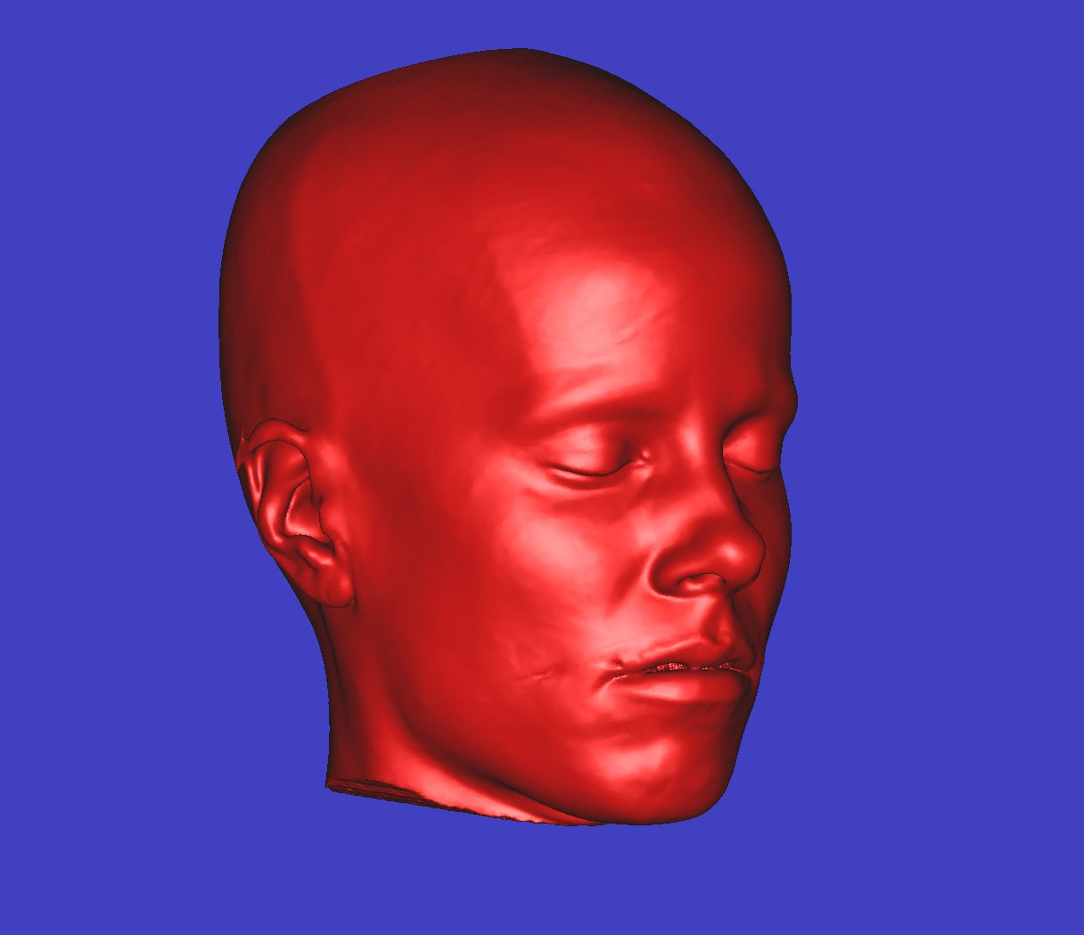
Pre-VFT Donor (green) and Recipient(red)
Donor
Recipient
Frontal view
Profile view

Slide 4
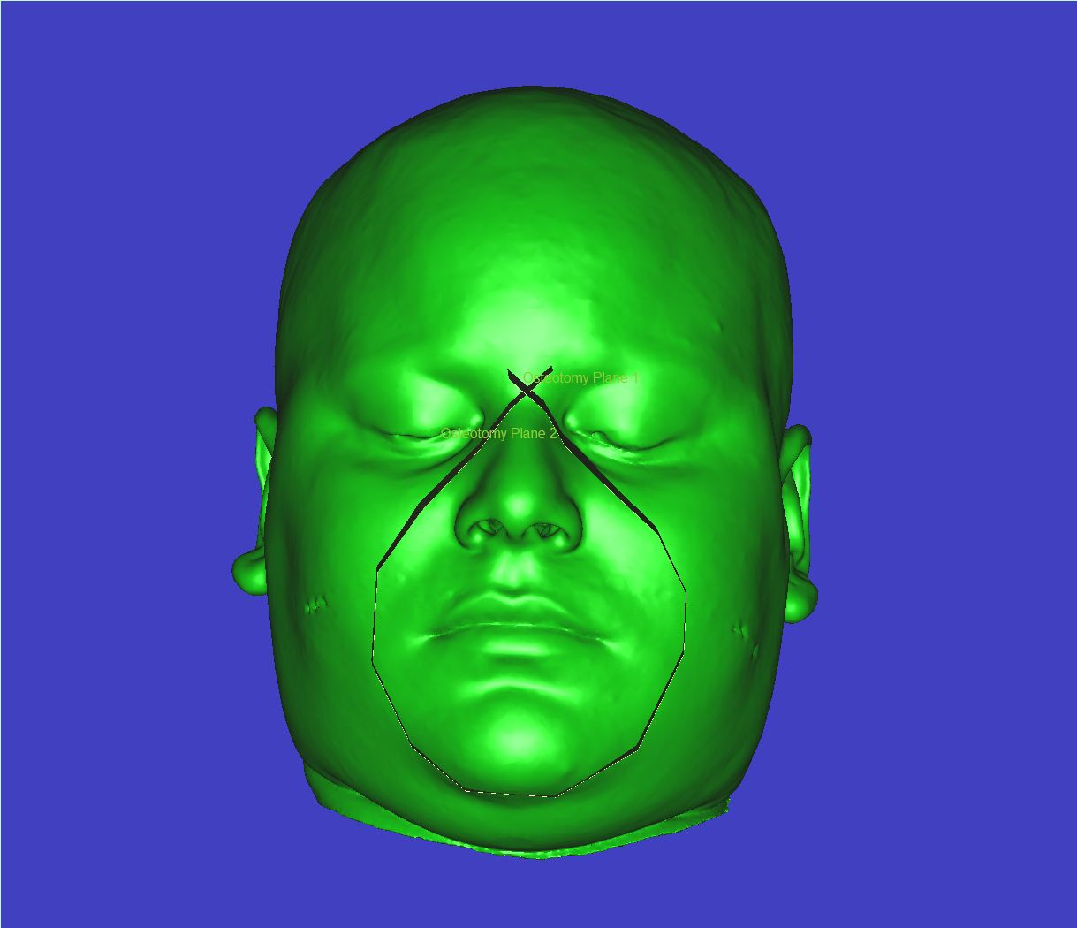
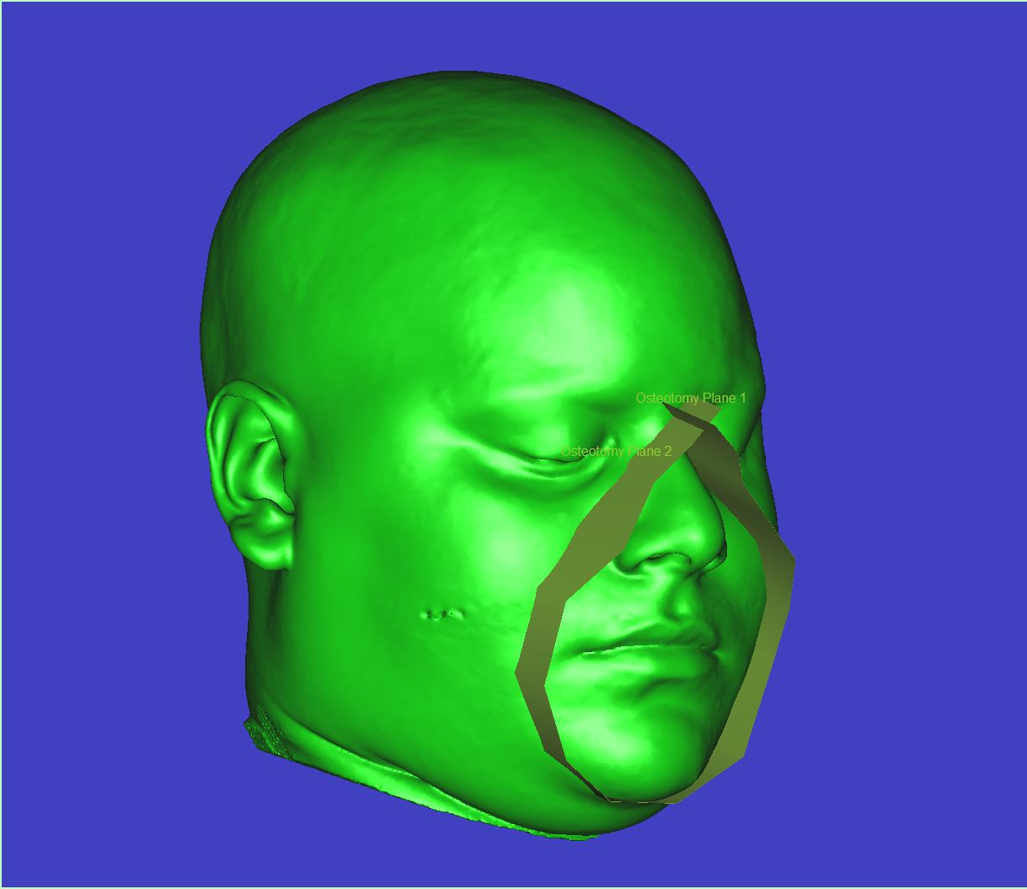
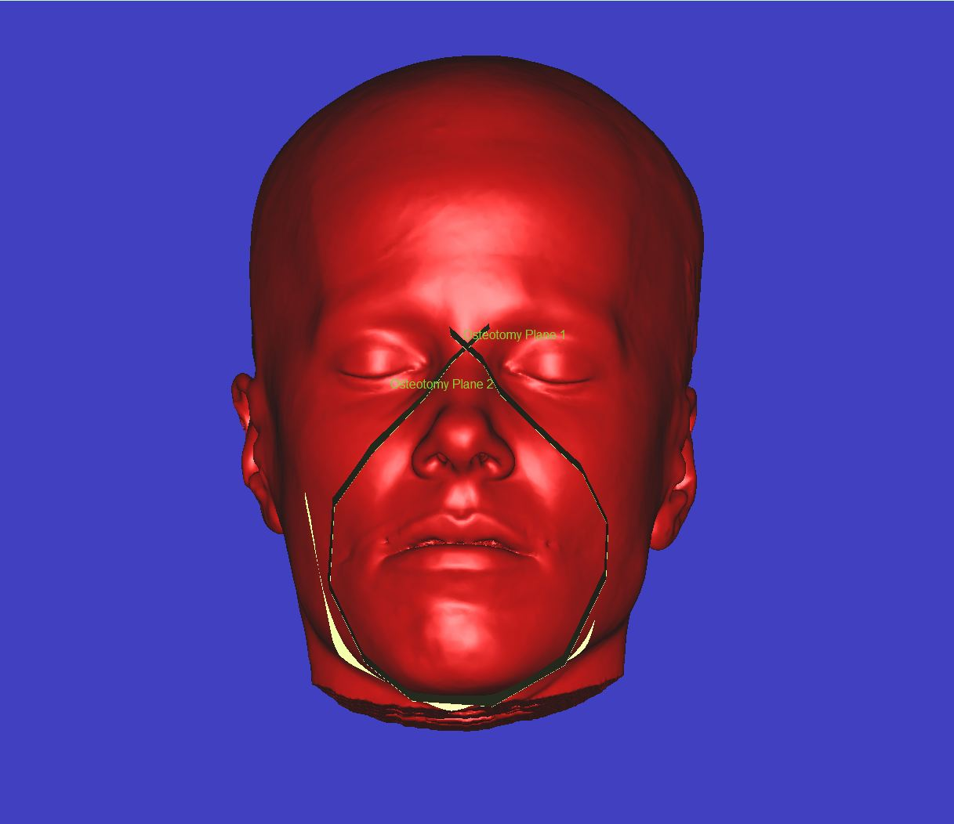
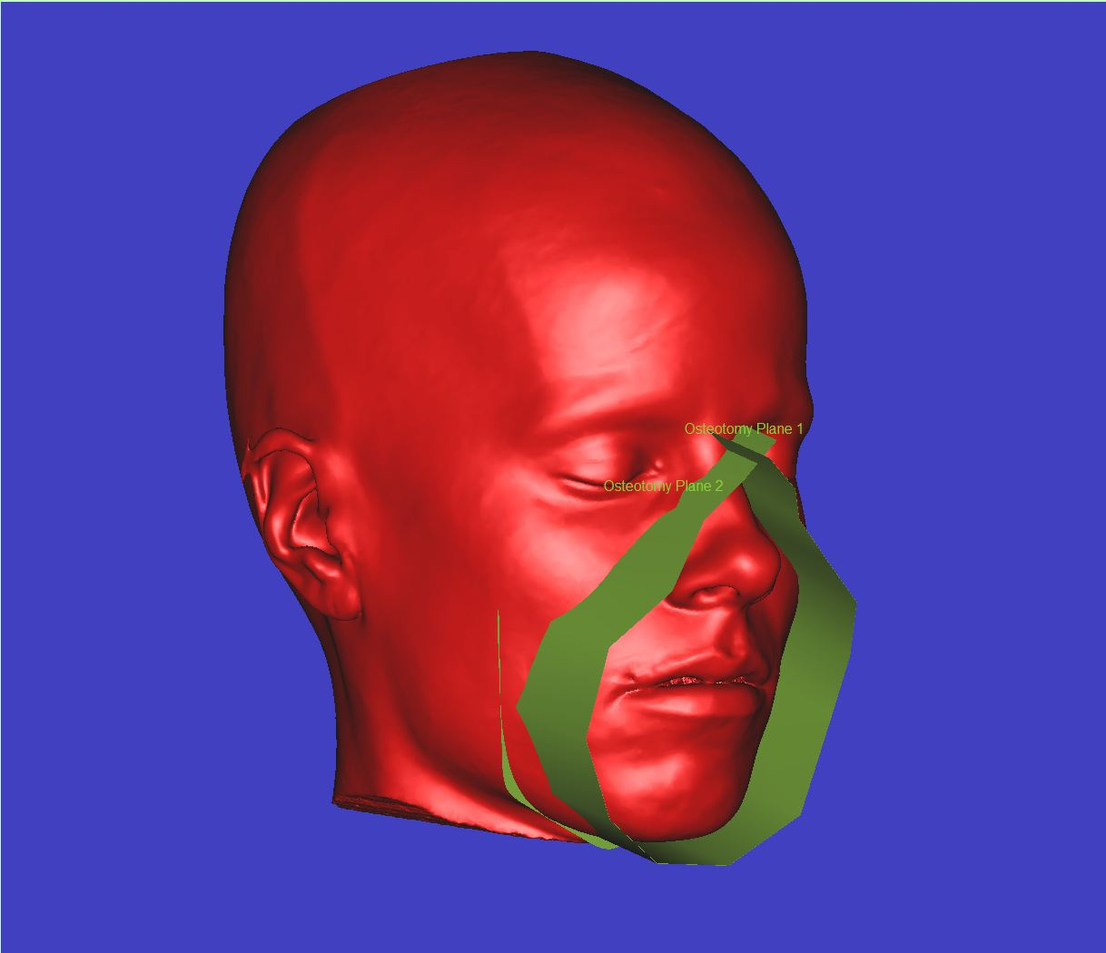
The same cutting plane is used on both Donor and Recipient
Donor
Recipient
Frontal view
Profile view

Slide 5
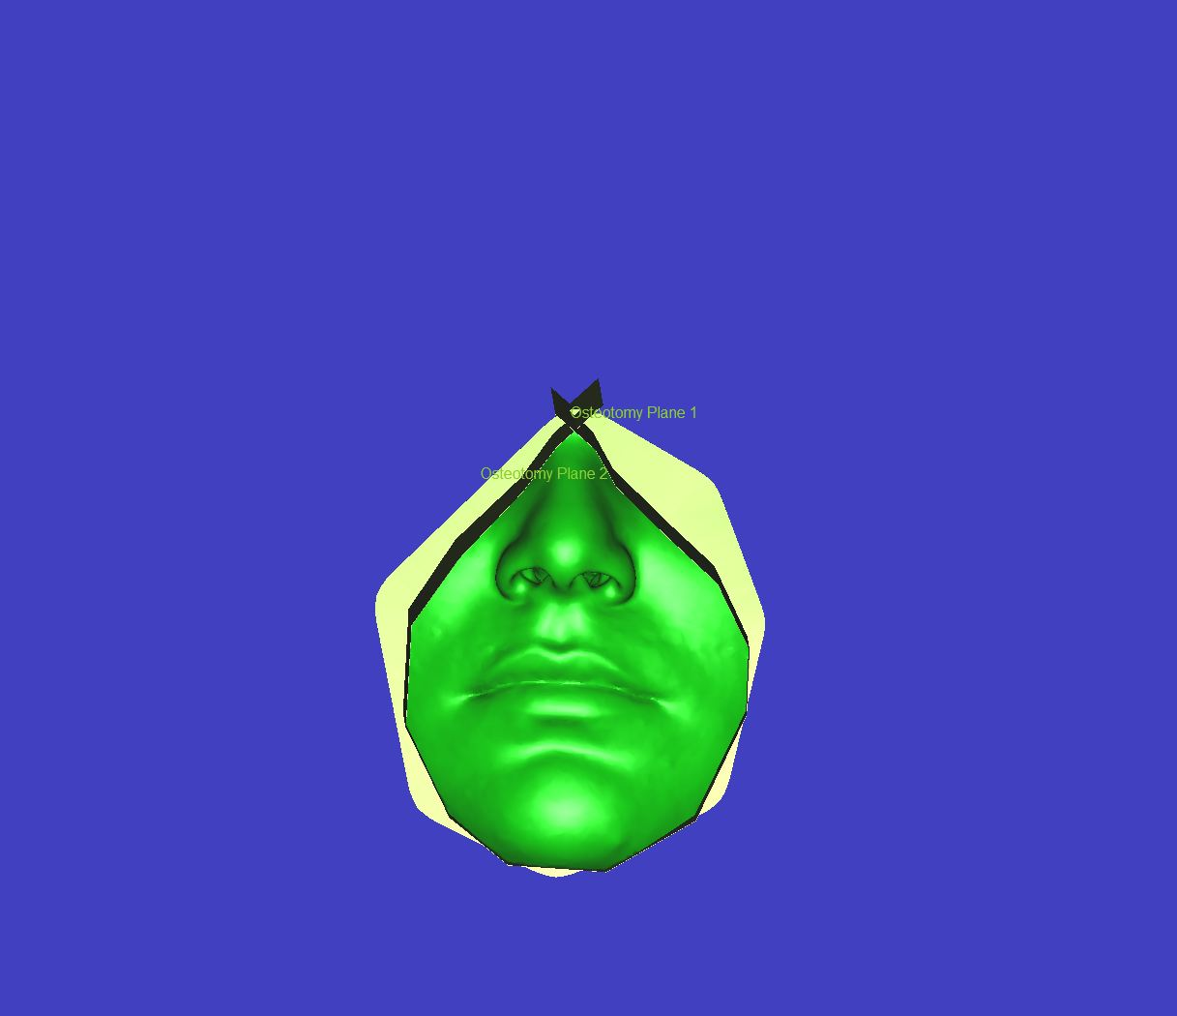
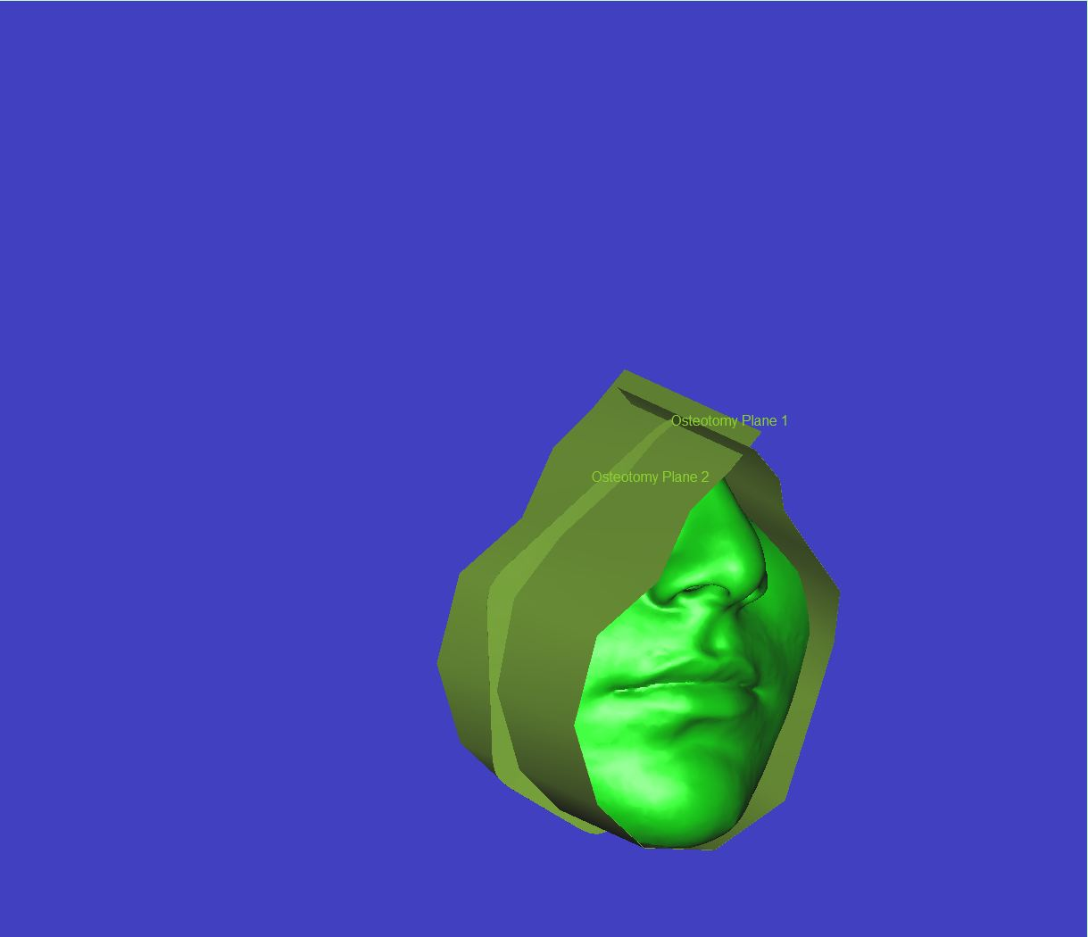
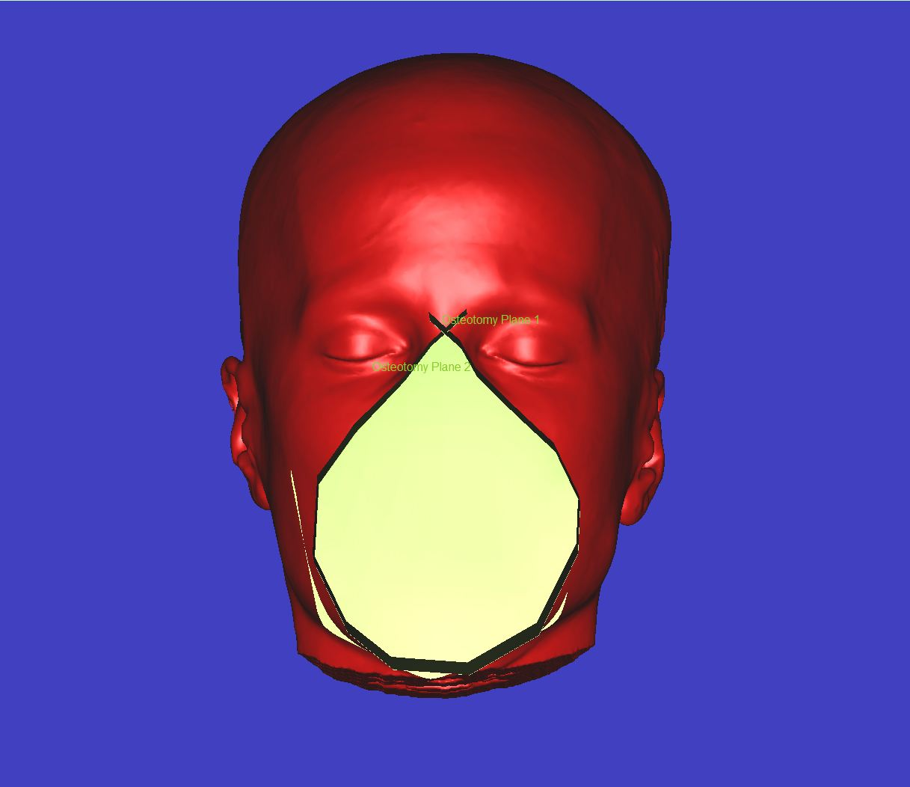
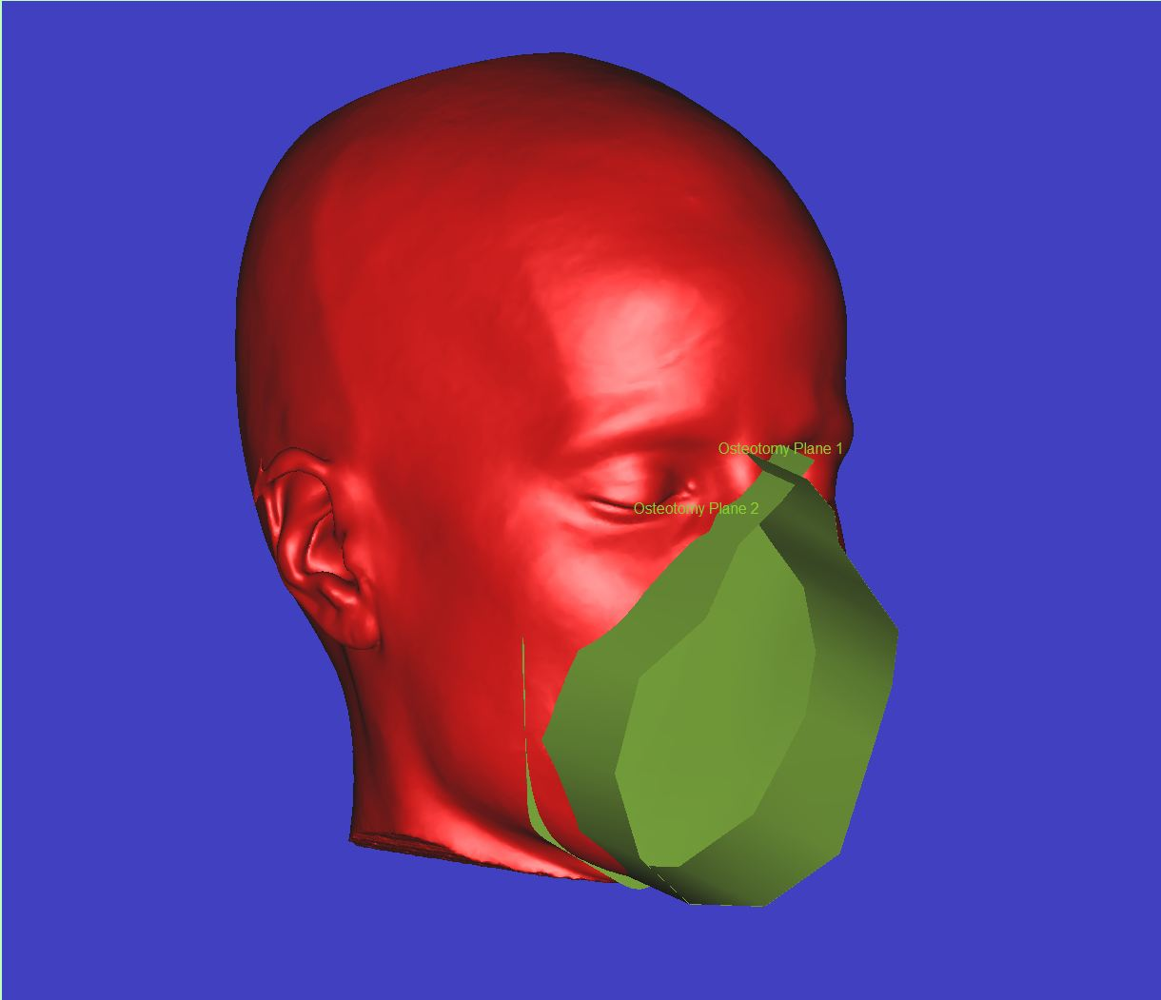
After the cut and prior to removing the osteotomy tool
Donor
Recipient
Frontal view
Profile view

Slide 6
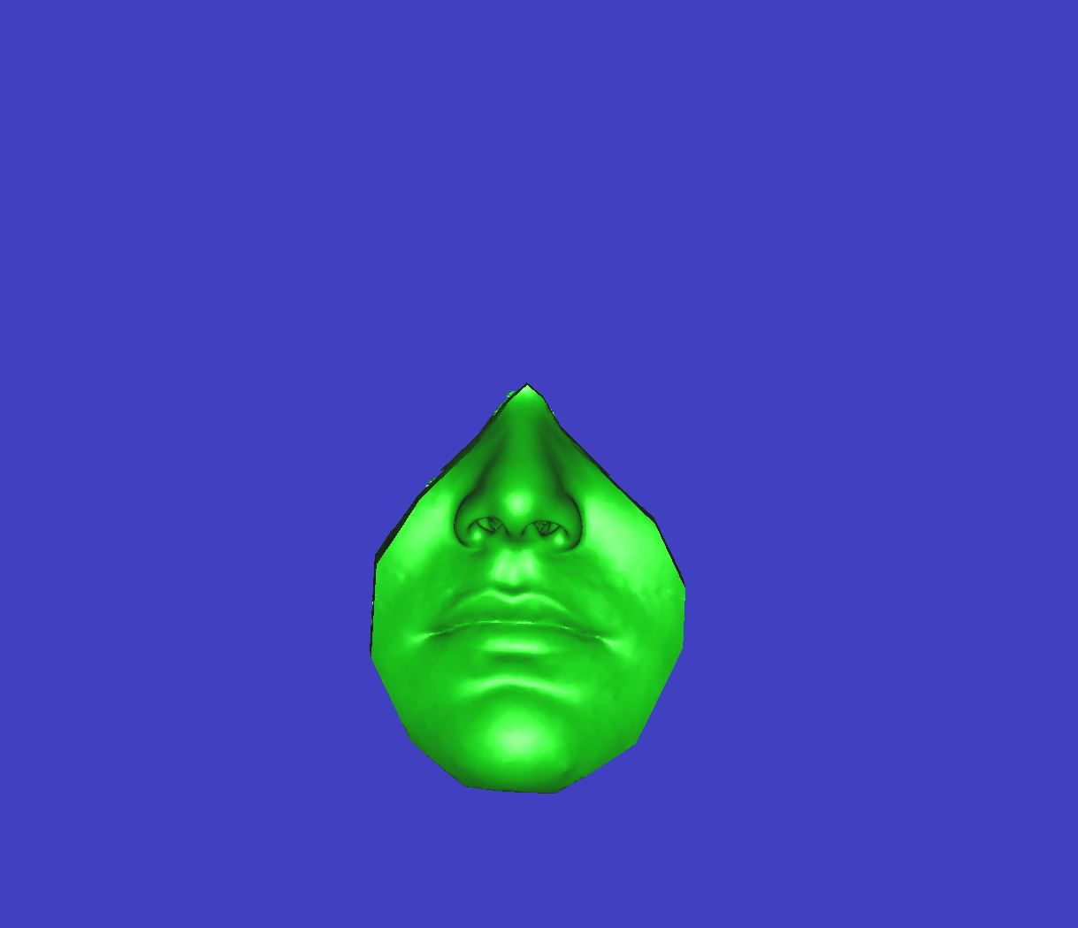
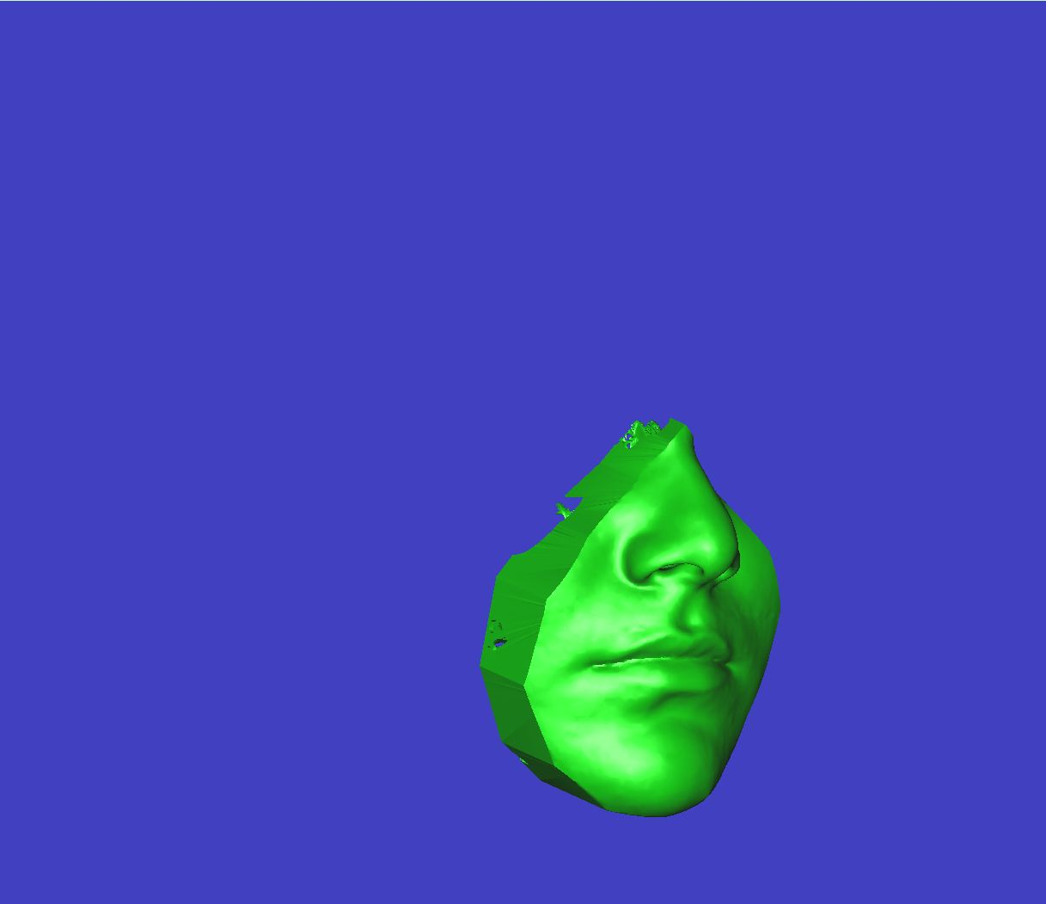
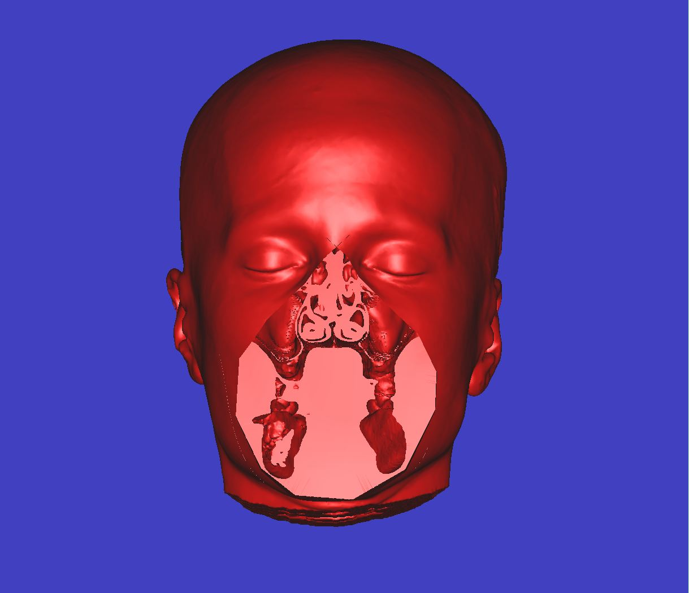
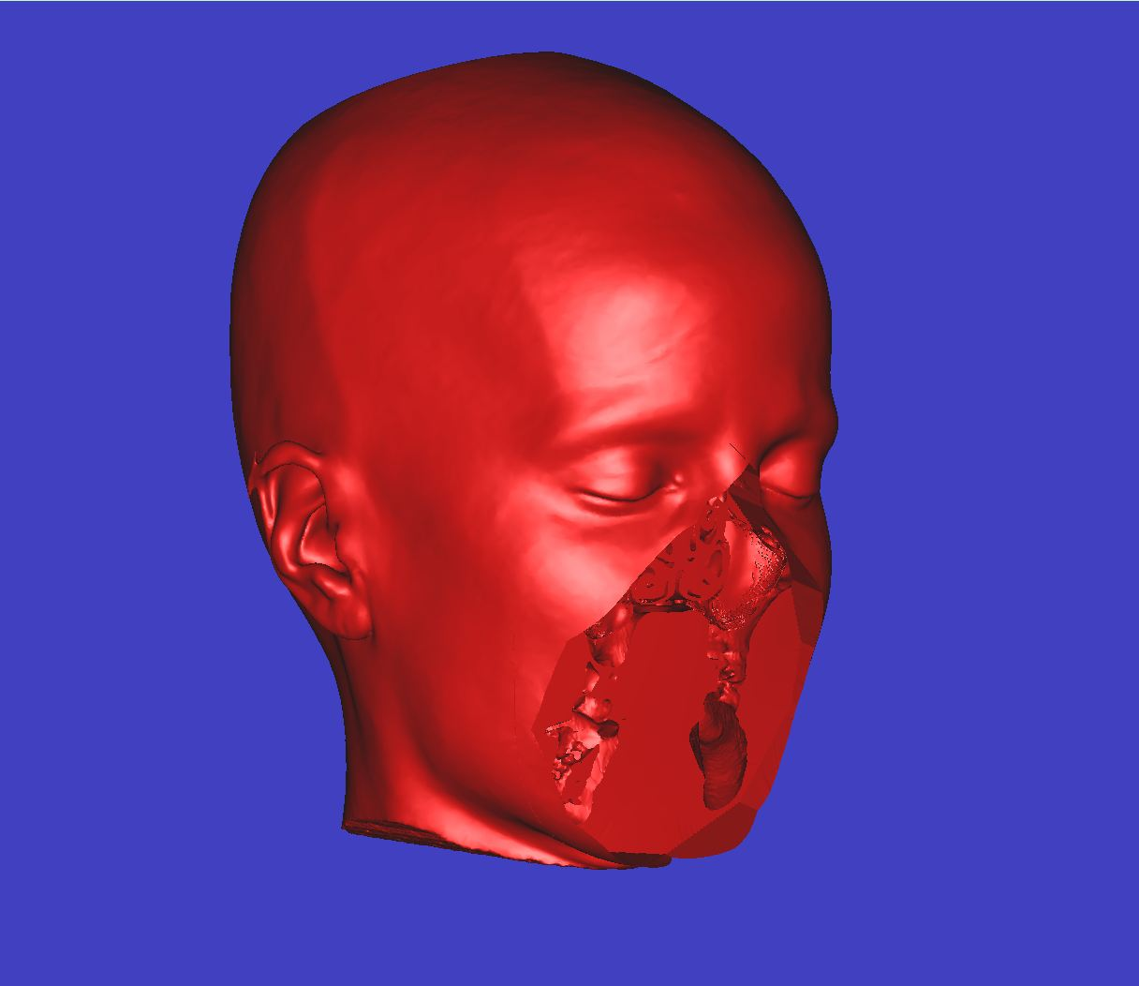
After removing the osteotomy tool, the Recipient model is a face with a defect and the Donor model is a facial allograft
Donor
Recipient
Frontal view
Profile view

Slide 7
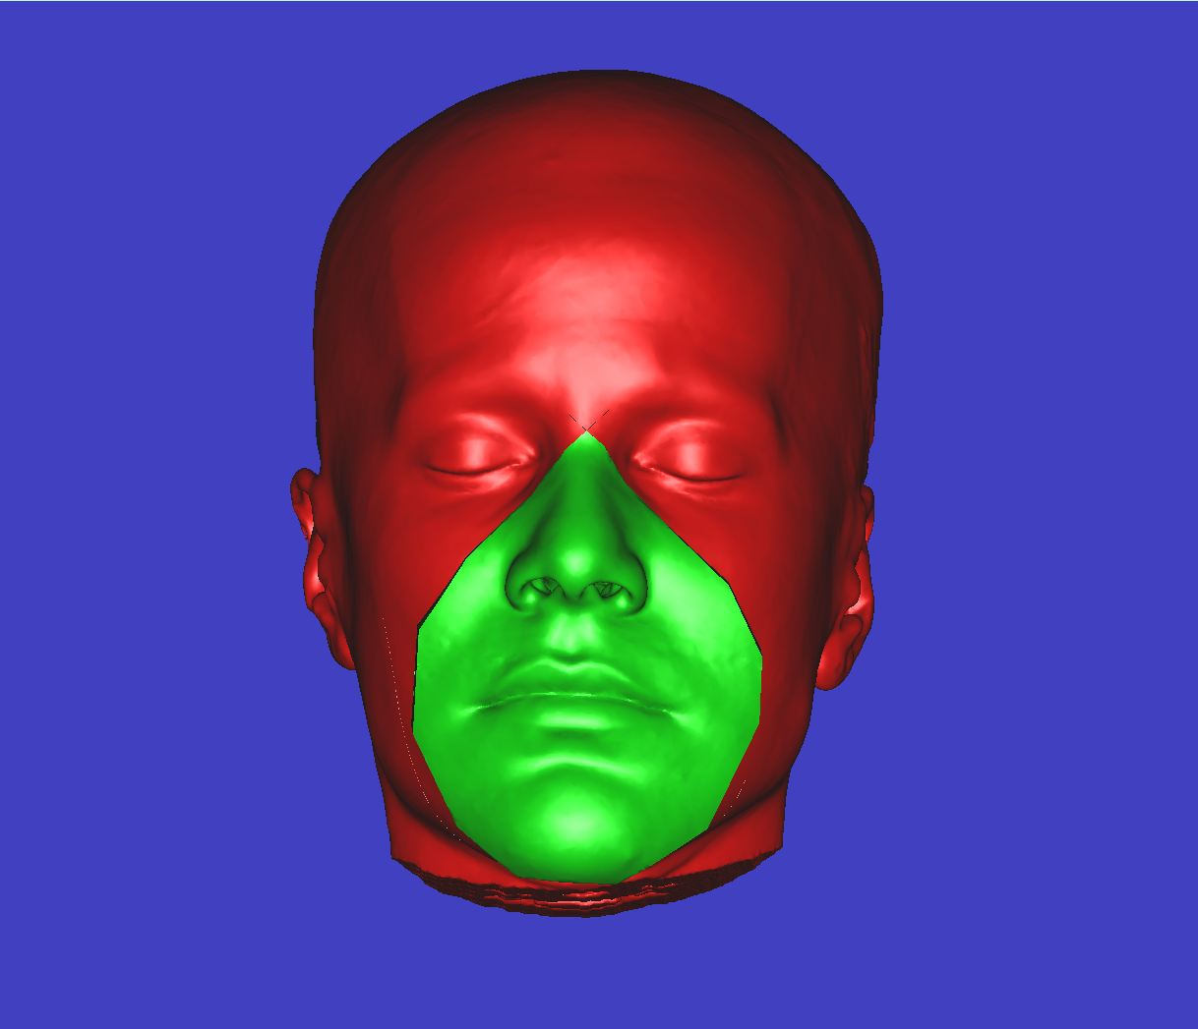
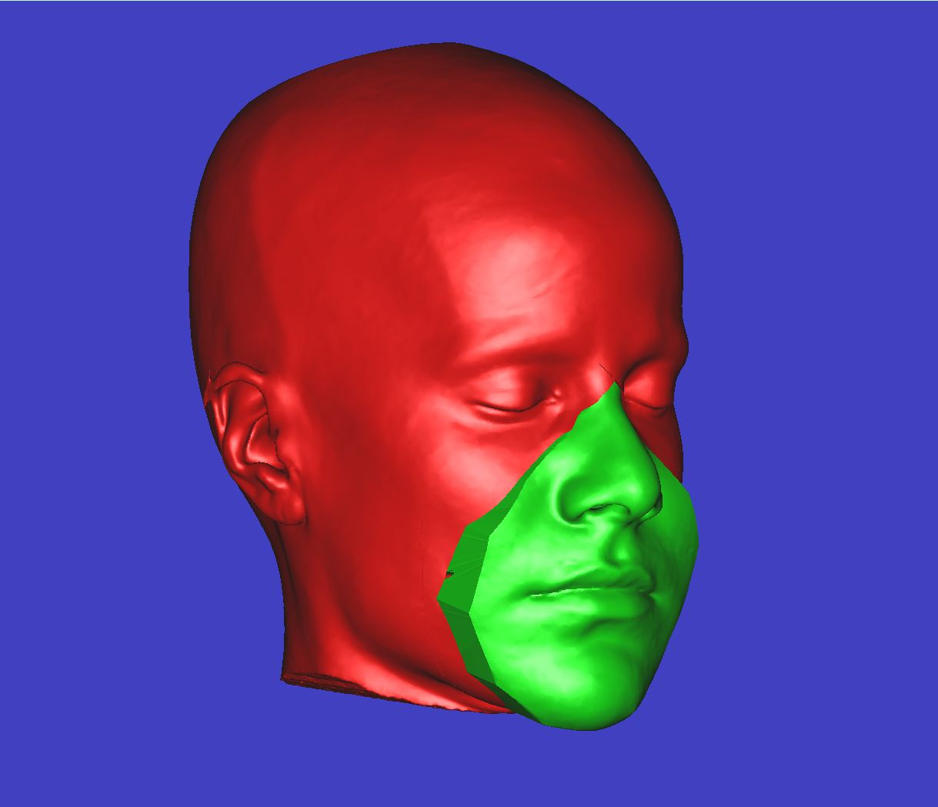
The Donor allograft is superimposed on the Recipient Defect
Frontal view
Profile view

Slide 8
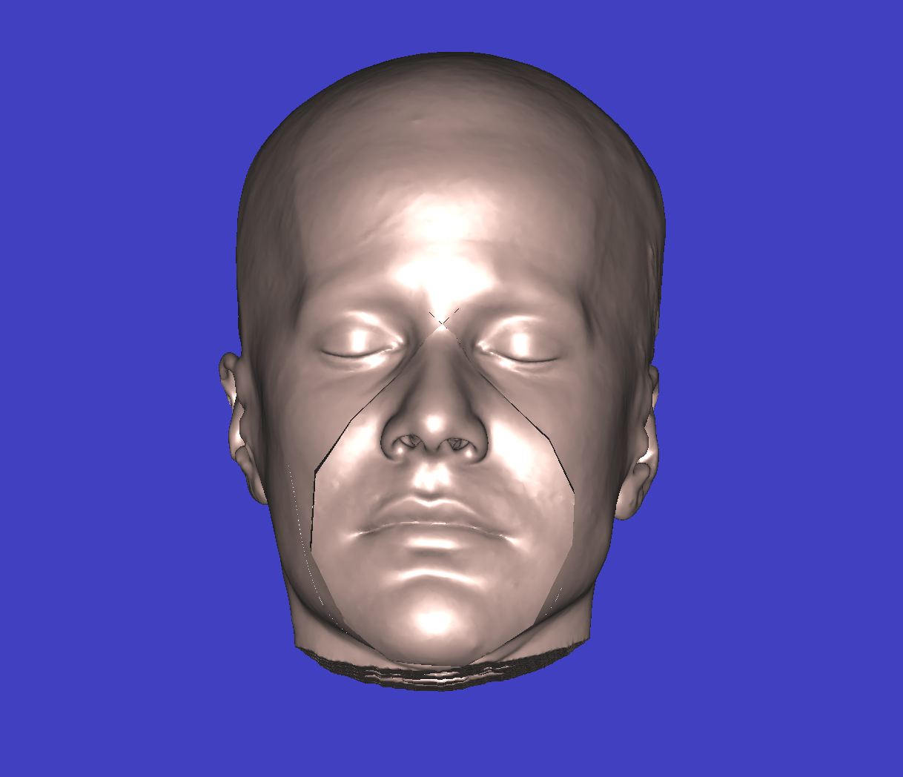
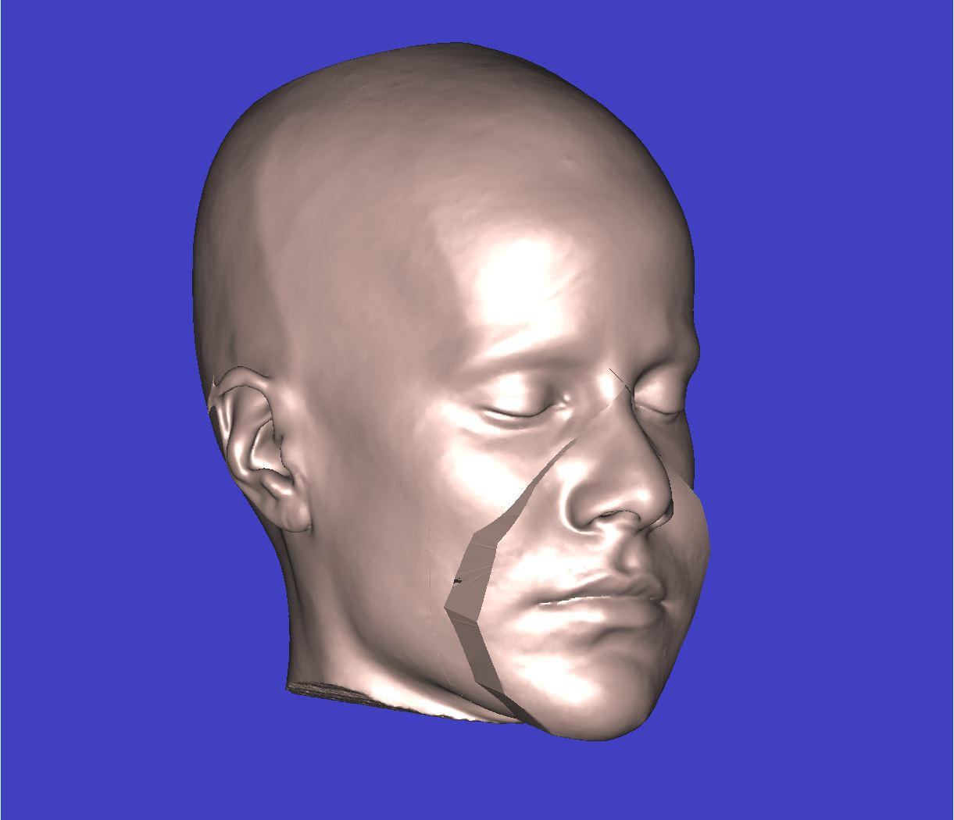
The Post-transplant model is then colored in a uniform tone to simulate reality
Frontal view
Profile view

