Slide 1
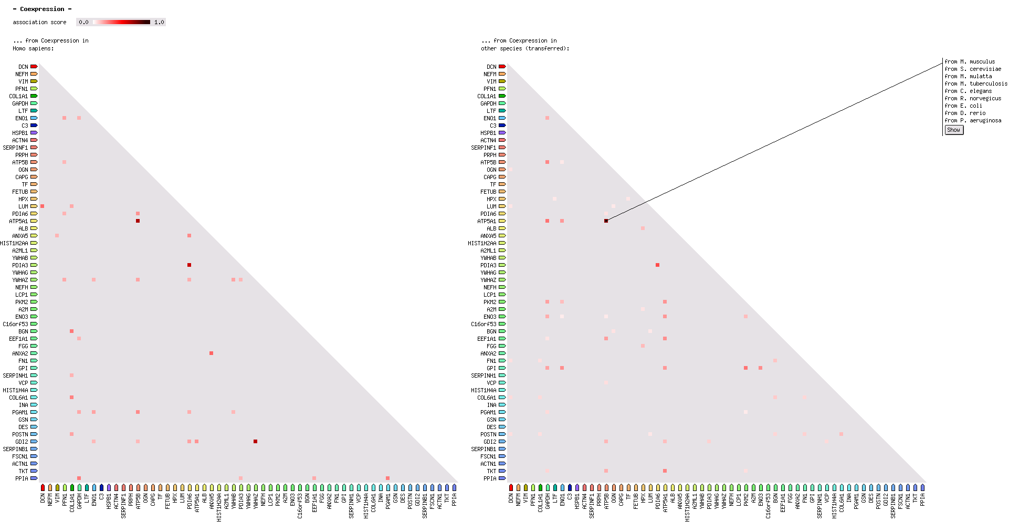
supplementary Figure 1.
A
Association score
B
M. musculus
S. cerevisiae
M. mulatta
M. tuberculosis
C. elegans
R. norvegicus
E. coli
D. rerio
P. aeruginosa

Slide 2
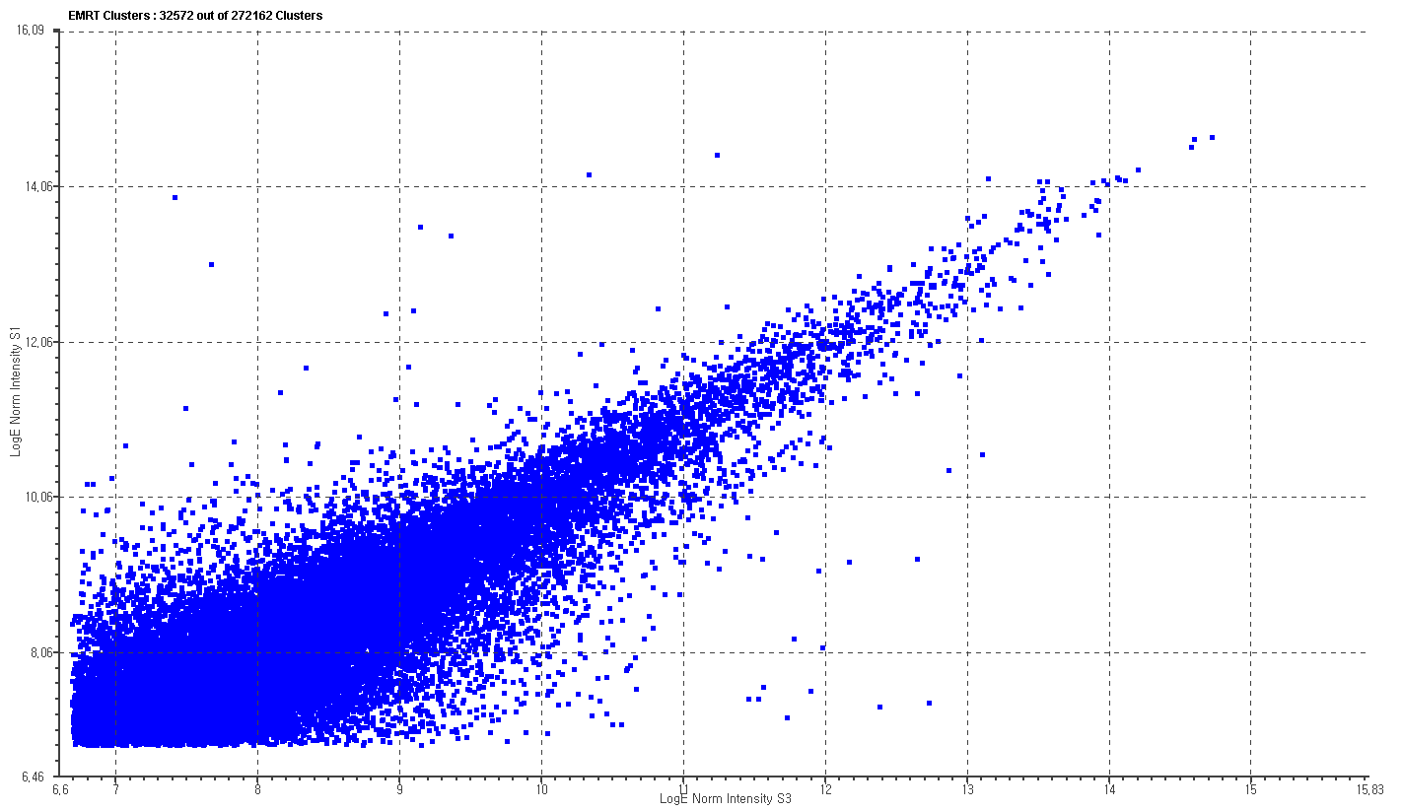
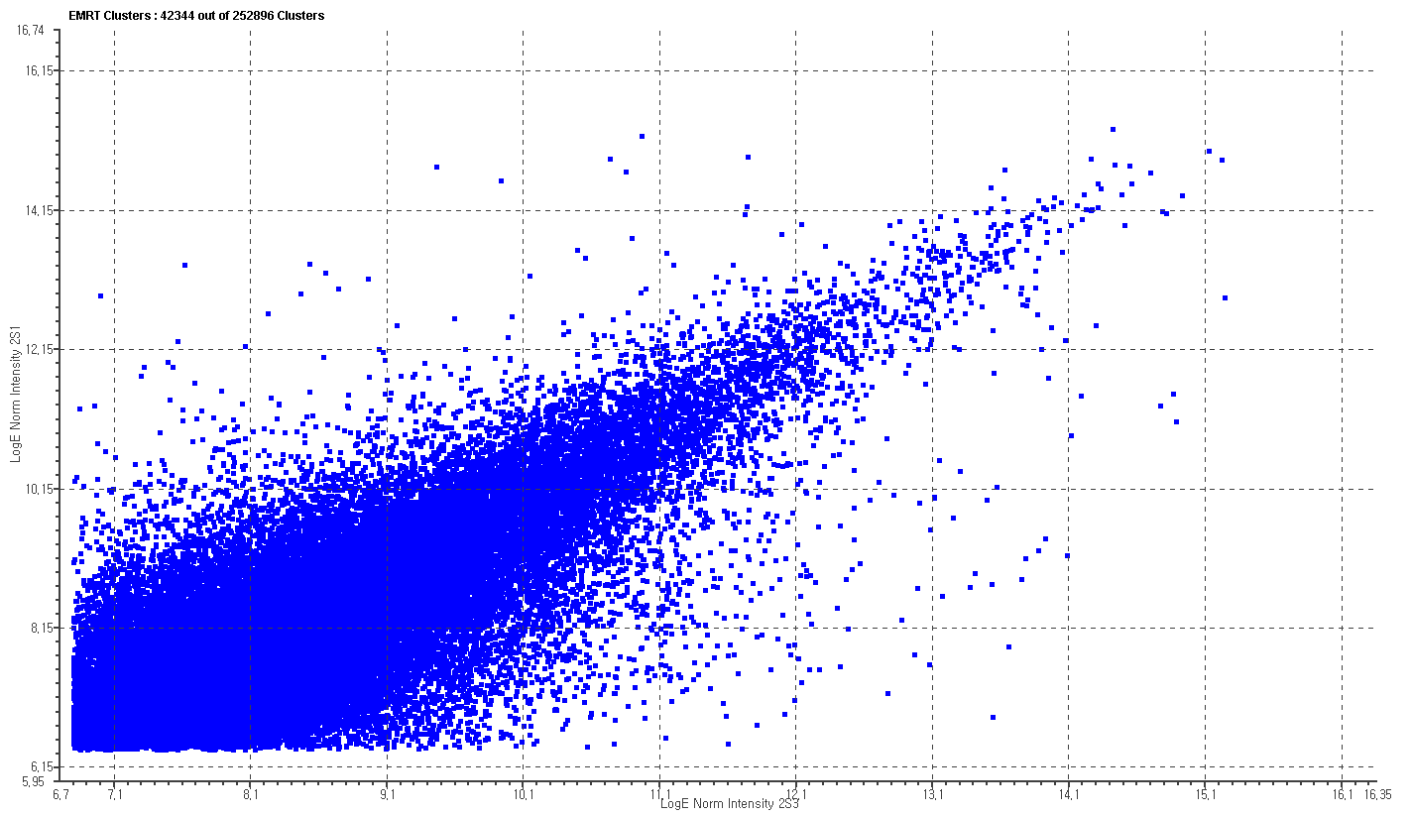
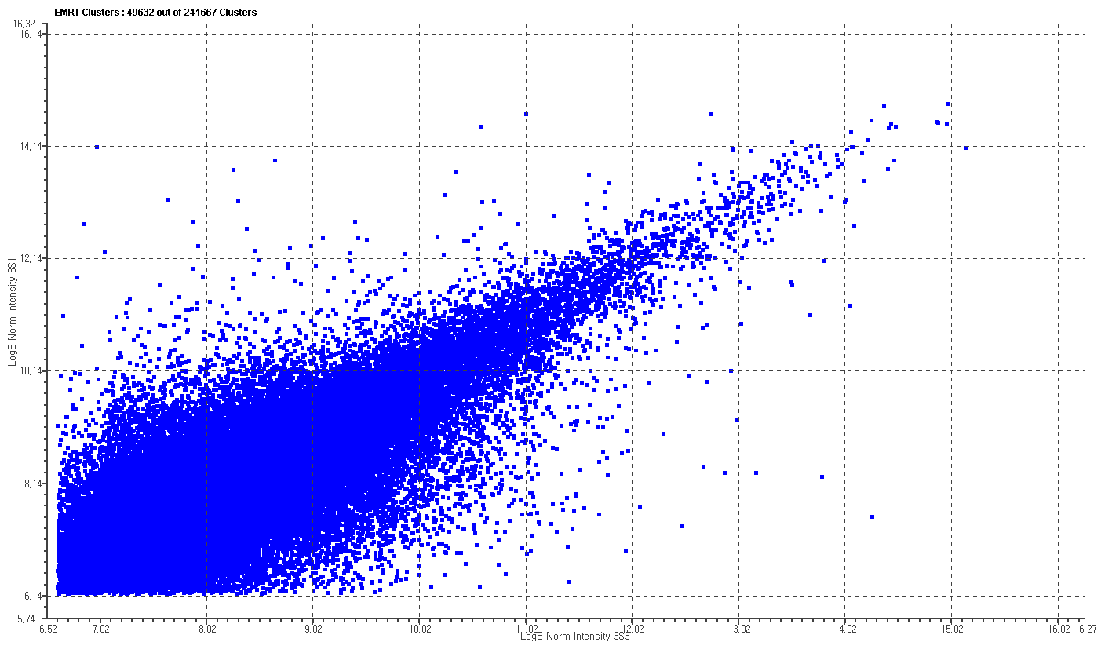
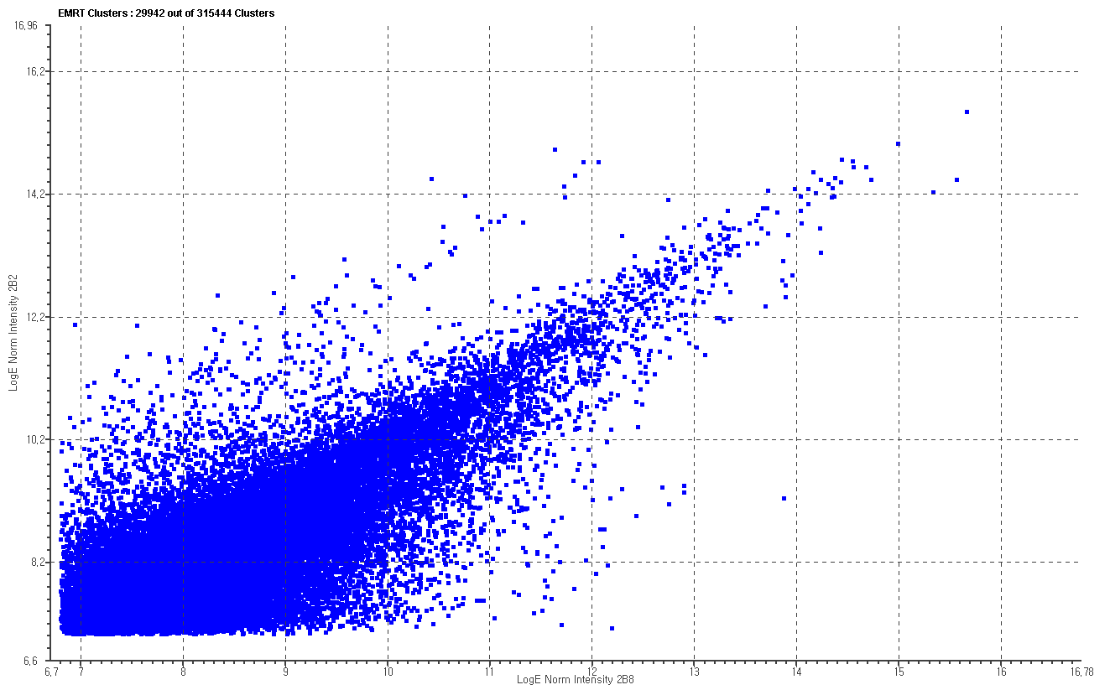
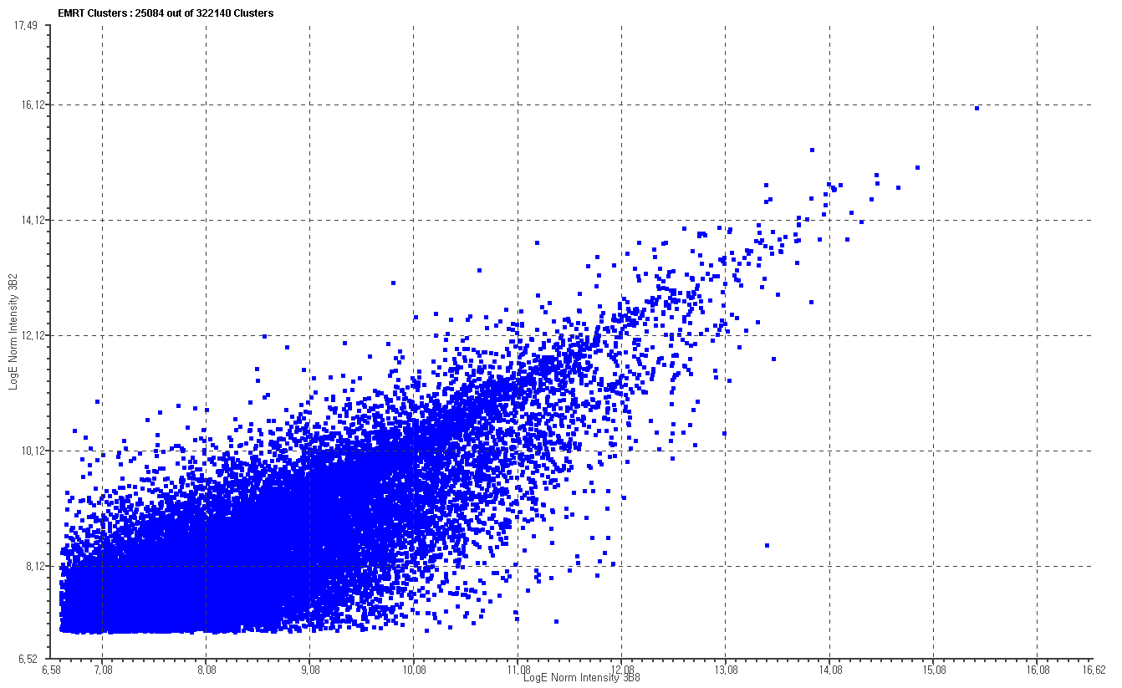
supplementary Figure 2.
Soft 1st set
Decreased in S3
Soft 2nd set
Decreased in S3
Soft 3rd set
Decreased in S3
Log normalized intensity S1
Log normalized intensity S1
Log normalized intensity S1
Increased in S3
Increased in S3
Increased in S3
Log normalized intensity S3
Log normalized intensity S3
Log normalized intensity S3
Bone 1st set
Bone 2nd set
Bone 3rd set
Decreased in B8
Decreased in B8
Decreased in B8
Log normalized intensity B2
Log normalized intensity B2
Log normalized intensity B2
Increased in B8
Increased in B8
Increased in B8
Log normalized intensity B8
Log normalized intensity B8
Log normalized intensity B8

