Slide 1
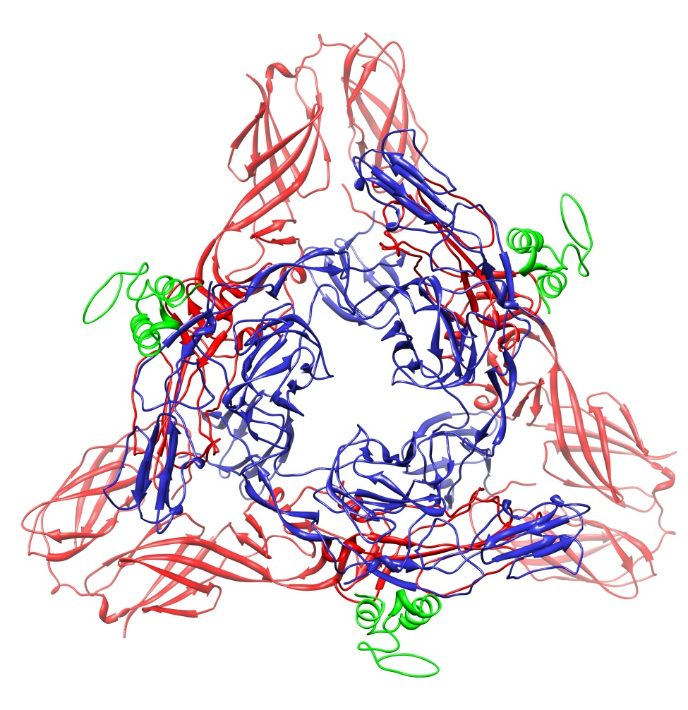
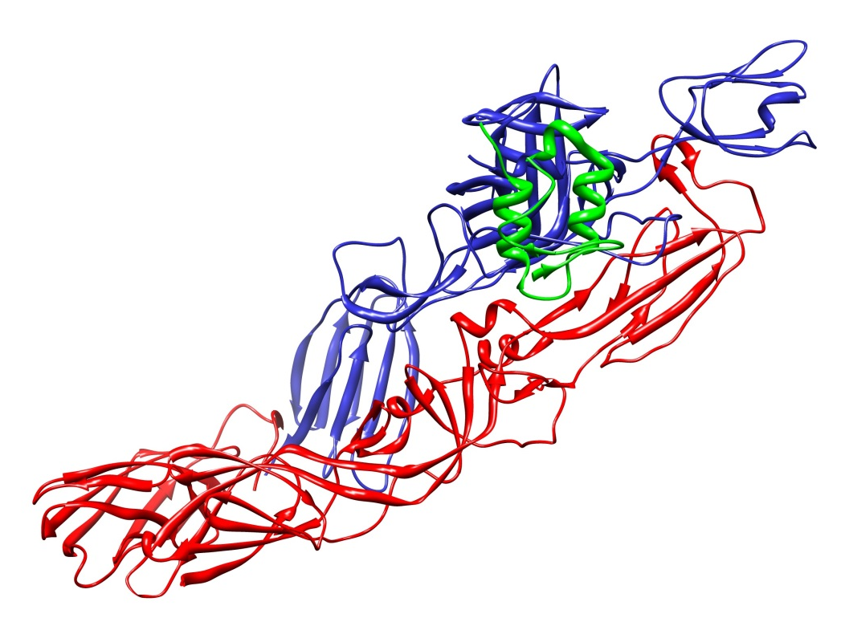
Figure S1. Alphavirus Spike Complex. Side view (left) and top (right) view (down the icosahedral three-fold) of E3-E2-E1 immature spike complex (PDB 3N42). E3 is shown in green, E2 in blue, and E1 in red. The mature spike is almost identical except the E3 protein is not associated with E2 (Voss et al, (2010), Nature, 468:709-712. In our constructs, mApple and Venus in the mature spike are hypothesized to be positioned where the E3 protein is in the immature spike.

Slide 2
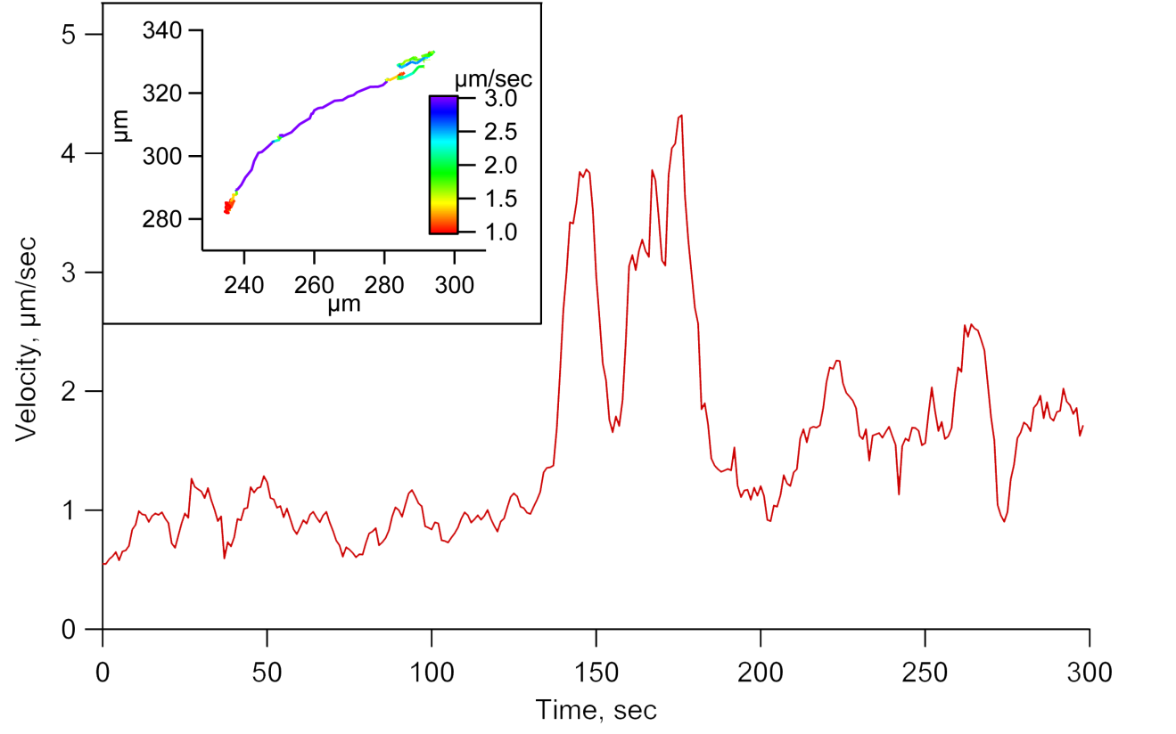
A.
B.
C.
Figure S2. Single-particle tracking of SINV. A) A representative graph of SINV-Apple showing the velocity of particle movement over the duration of imaging the particle inside the cell. The inset shows the trajectory color coded by rate. B) and C) Histograms of kinetics once particle is inside of the cell for SINV-Apple and SINV-Venus.

Slide 3
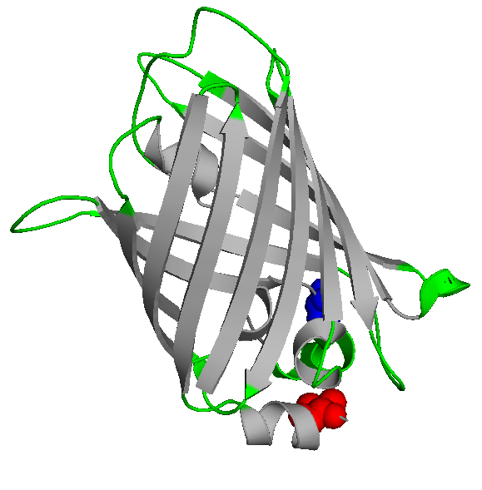

A.
mApple MVSKGEENNMAIIKEFMRFKVHMEGSVNGHEFEIEGEGEGRPYEAFQTAKLKVTKGGPLP 60
Venus MVSKGEE----LFTGVVPILVELDGDVNGHKFSVSGEGEGDATYGKLTLKLICTTG-KLP 55
mApple FAWDILSPQFMYGSKVYIKHPADIP--DYFKLSFPEGFRWERVMNFEDGGIIHVNQDSSL 118
Venus VPWPTLVTTLGYGLQCFARYPDHMKQHDFFKSAMPEGYVQERTIFFKDDGNYKTRAEVKF 115
mApple QDGVFIYKVKLRGTNFPSDGPVMQKKTMGWEASEERMYPED---GALKSEIKKRLKLKDG 175
Venus EGDTLVNRIELKGIDFKEDGNILGHKLEYNYNSHNVYITADKQKNGIKANFKIRHNIEDG 175
mApple GHYAAEVKTTYK--AKKPVQLPGAYIVDIKLDIVS-HNEDYTIVEQYERAEGRHSTGGMD 232
Venus GVQLADHYQQNTPIGDGPVLLPDNHYLSYQSKLSKDPNEKRDHMVLLEFVTAAGITLGMD 235
mApple ELYK 236
Venus ELYK 239
Figure S3. Comparison between mApple and Venus. A) Amino acid sequences of mApple and Venus were aligned using ClustalW²⁵ and secondary structure elements based on the Venus atomic structure (PDB 1MYW) are shown. B) The structure of Venus is shown with the N- and C-terminal residues shown as space filling residues colored in red and blue respectively. Flexible regions of the protein that may change the virus-cell binding properties are shown in green in both (A) and (B). C) Electrophoretic mobility patterns of isolated glycoprotein spikes from SINV-Apple and SINV-Venus on a 0.5% agarose gel.
B.
C.
Apple Venus

