Slide 1
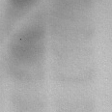

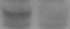

Figure S1
A
A
Untreated
B
siControl
C
1BR3hTERT
D
U2OS
siControl
siORC1 pool
siControl
siControl
siORC1
siORC1 single
siORC1 single
ORC1
siORC1 pool
siORC1 pool
1BR3hTERT
(5 nM siRNA)
Loading
% Viability
% Viability
% Viability
U2OS
ORC1
(0.6 nM siRNA)
Loading
1BR3hTERT
U2OS
mM HU
mM HU
E
Untreated
F
Untreated
1BR3hTERT
U2OS
Relative cell number
Doubling time (hr)
Time (hr)
1BR3hTERT
U2OS

Slide 2
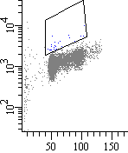
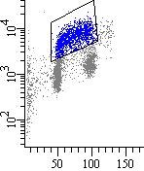
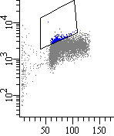
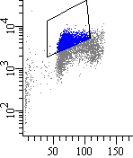
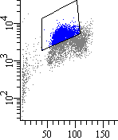
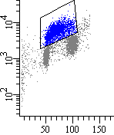
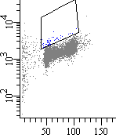
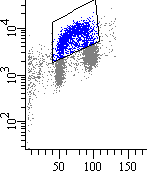
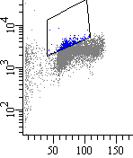
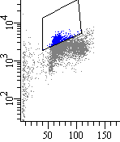
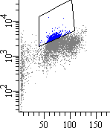
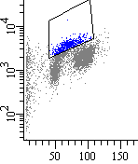
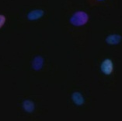
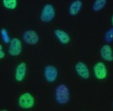
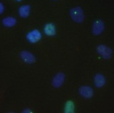
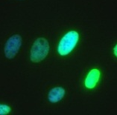
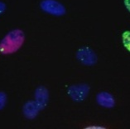
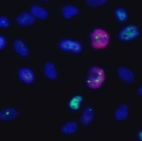
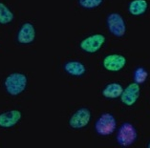
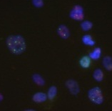
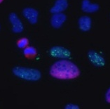
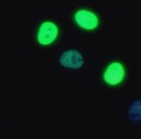
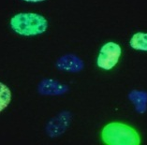



Figure S2
A
No BrdU
No HU
Time (hrs) after 24hr 2mM HU
0.5%
34 %
0 2 4 24
5 %
5 2%
5 8%
44%
BrdU⁺ fraction
siControl
U2OS
BrdU Intensity
1%
35 %
8%
17 %
11 %
14 %
siORC1
B
PI Intensity
No HU
Time (hr) after 24hr 2mM HU
No HU
Time (hr) after 24hr 2mM HU
0
24
0
24
DAPI
siControl
siControl
γH2AX
CENPF
1BR3hTERT
U2OS
siORC1
siORC1
C
D
U2OS
siControl vs. siORC1
20 min. CldU
Ongoing fork
wash
Stalled fork
X
24hr 2mM HU
wash
New origin
1 hr IdU
Harvest, spread fibres, stain

Slide 3
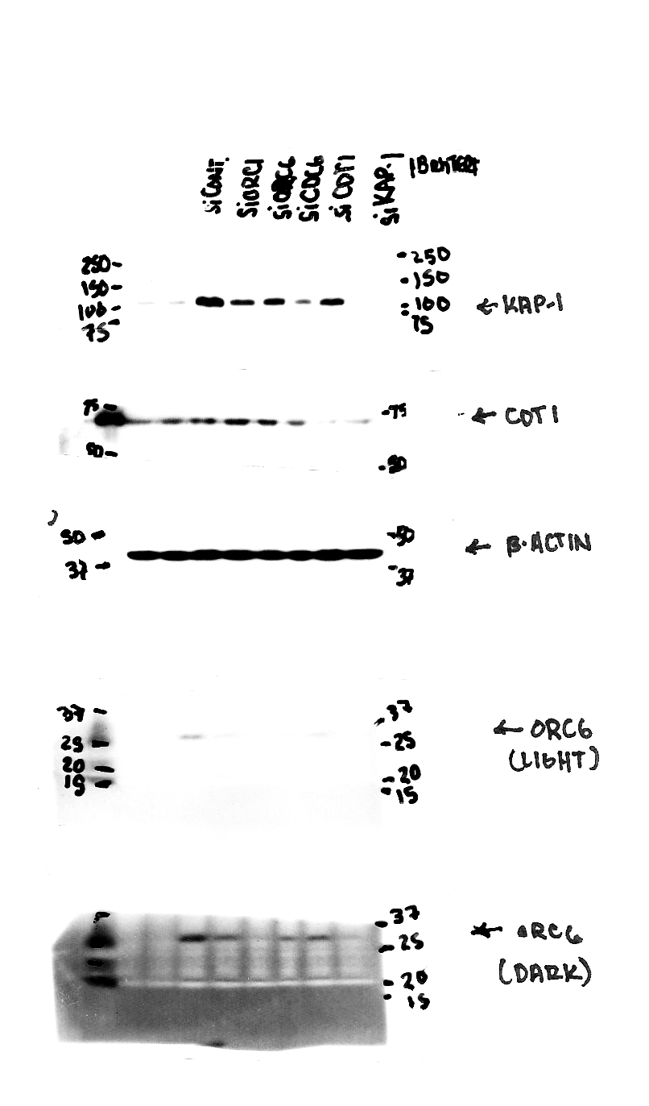
Figure S3
A
1BR3hTERT
B
1BR3hTERT
siControl
siControl
siORC1
siORC6
siControl
siCDC6
siORC1
siORC6
CDC6
siCDC6
ORC6
% Viability
β-actin
β-actin
mM HU

Slide 4
Figure S4
A
BJhTERT
B
48BR
C
MRC-5
% Viability
siControl
% Viability
siControl
% Viability
siControl
siORC1
siORC1
siORC1
nM siRNA
nM siRNA
nM siRNA
D
HeLa
E
MDA-MB-231
% Viability
siControl
% Viability
siControl
siORC1
siORC1
nM siRNA
nM siRNA

Slide 5
Figure S5
A
BJhTERT
B
48BR
C
MRC-5
siControl
siControl
siControl
siORC1
siORC1
siORC1
% γH2AX positive cells
% γH2AX positive cells
% γH2AX positive cells
D
Time (hr) HU
E
Time (hr) HU
Time (hr) HU
HeLa
MDA-MB-231
siControl
siControl
siORC1
siORC1
% γH2AX positive cells
% γH2AX positive cells
Time (hr) HU
Time (hr) HU
F
ORC1-P4hTERT
% γH2AX positive cells
Time (hr) HU

