Slide 1
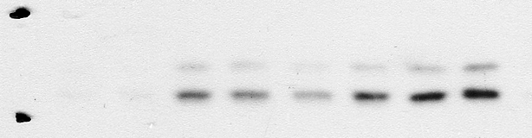
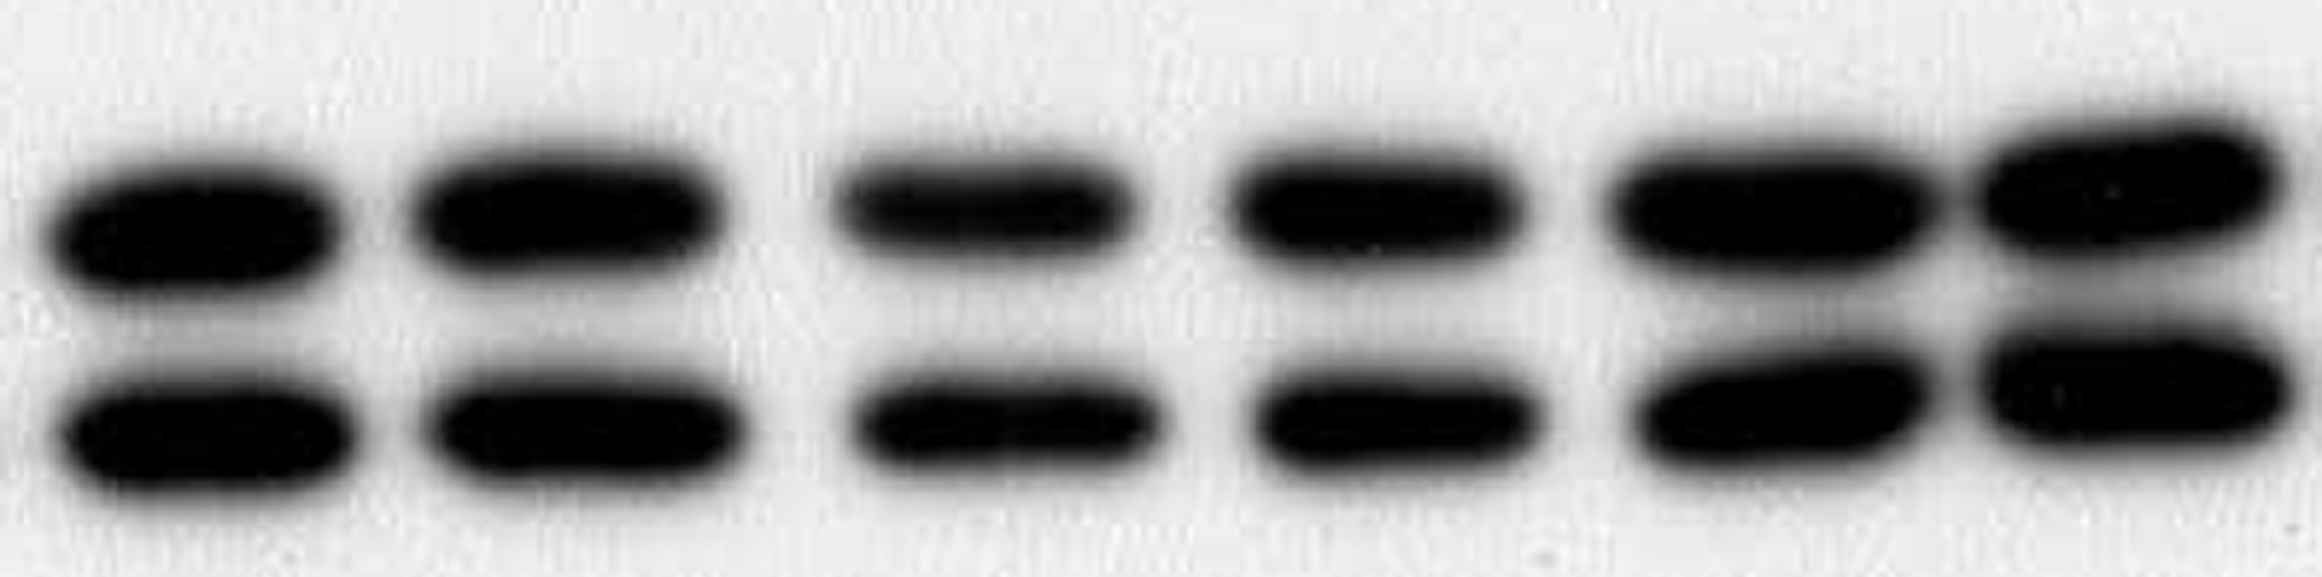
Supplementary Fig. 1
CRAMP
CRAMP (μg/ml)
0
0.5
1
2
10
30
p-ERK1/2
ERK1/2
Figure S1
K.Horibe et al.

Slide 2
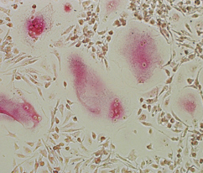
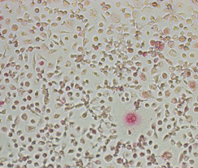
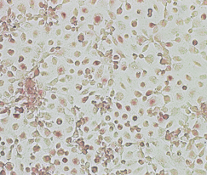
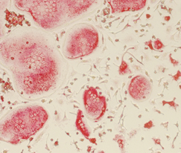
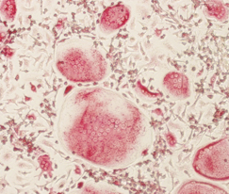
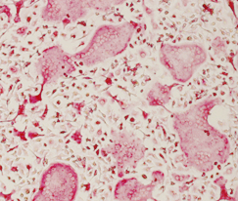
Supplementary Fig. 2
(a)
Human
M-CSF
+
RANKL
200
**
**
150
M-CSF
+
RANKL
+
CRAMP
TRAP(+) multinucleated cells/well
100
50
M-CSF
+
RANKL
+
LL-37
0
M-CSF
M-CSF
+
RANKL
M-CSF
+
RANKL
+
CRAMP
M-CSF
+
RANKL
+
LL-37
(b)
Mouse
1000
M-CSF
+
RANKL
800
600
TRAP (+) multinucleated cells/well
M-CSF
+
RANKL
+
CRAMP
400
200
0
M-CSF
M-CSF
+
RANKL
M-CSF
+
RANKL
+
CRAMP
M-CSF
+
RANKL
+
LL-37
M-CSF
+
RANKL
+
LL-37
Figure S2
K.Horibe et al.

