Slide 1
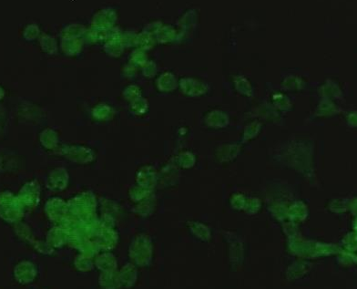
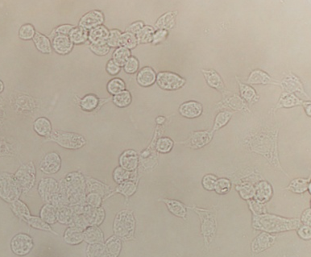

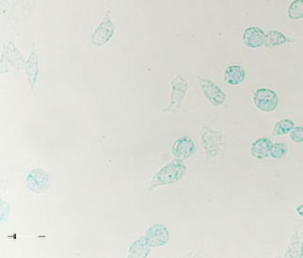
Supplementary
figure 1
C6/36 cell monolayers
NS3
DENV-2
treated
NS3
Mock

