Slide 1

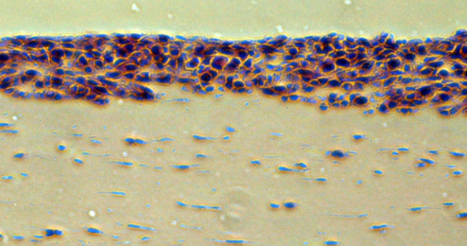
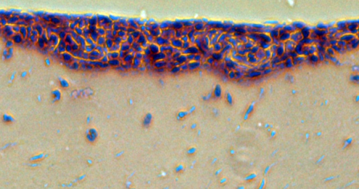
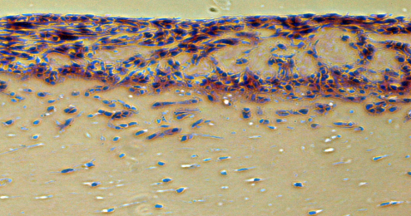
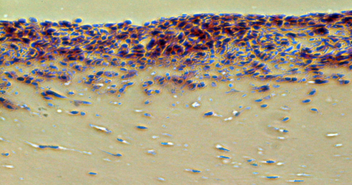
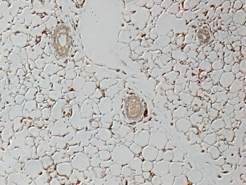
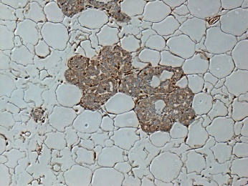
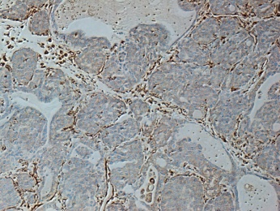
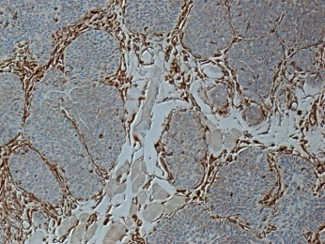
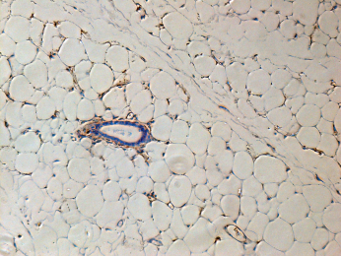
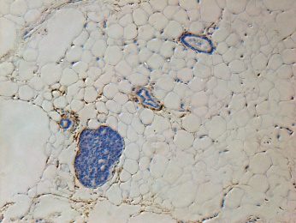
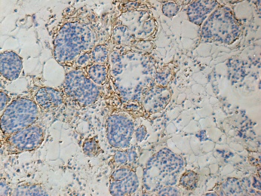
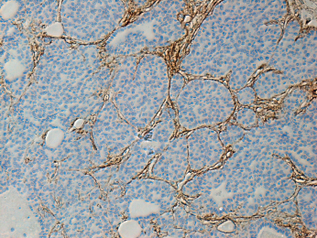
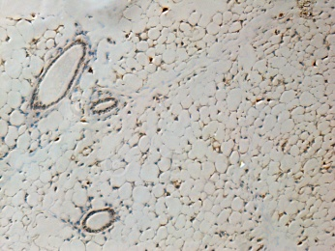
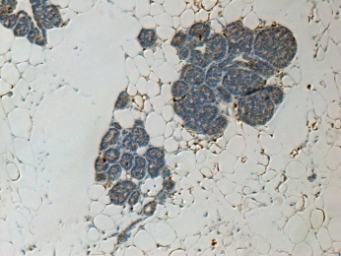
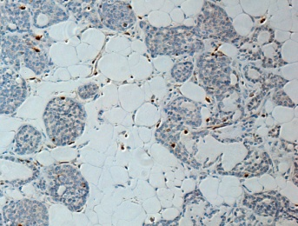
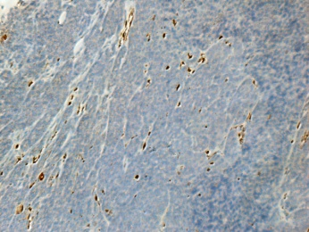
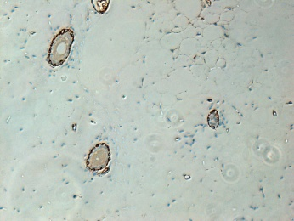
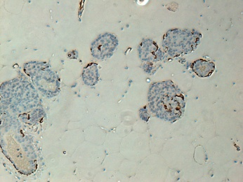
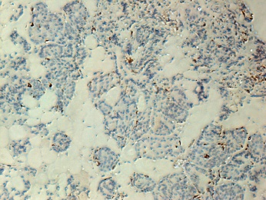
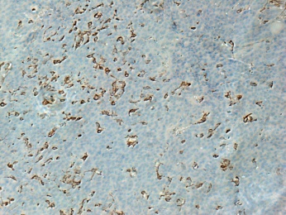
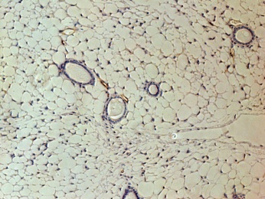
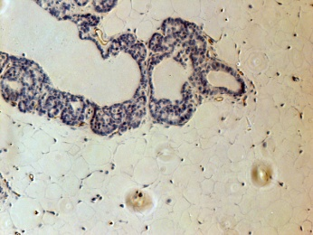
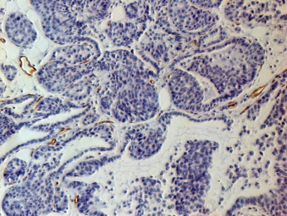
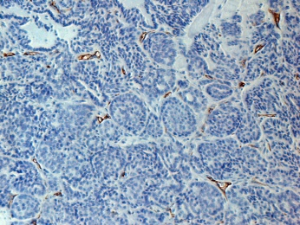
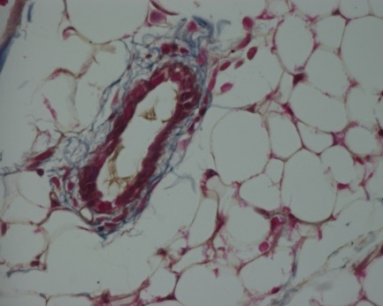
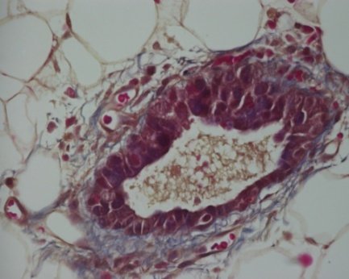
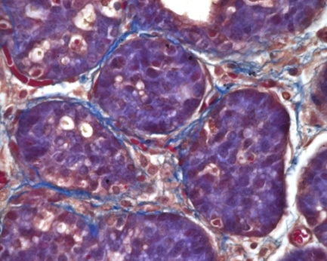
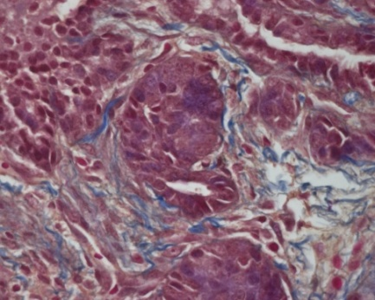
Supplementary Figure 1
A
MMTV-PyMT
C
Live co-culture assay
MMTV-PyMT TS2 cells
tumour
Stage
(H&E)
Normal
Hyperplasia
Adenoma
Carcinoma
+NF#1
**
**
Fibroblast isolation
Marker analysis
+HpAF#1
Invasion index (AU)
mRNA array
Functional analysis
Identification of key molecules and functions for CAFs to drive invasion
+AdAF#1
NF#1
HpAF#1
AdAF#1
siRNA Screening
+CAF#1
CAF#1
B
Normal
Hyperplasia
Adenoma
Carcinoma
Vimentin
Fibronectin
S100A4
αSMA
Endomucin
Masson’s

Slide 2
Supplementary Figure 2
A
***
***
**
**
B
***
**
***
***
*
***
**
Invasion index (AU)
% Gel contraction
C
***
***
***
***
***
***
***
***
***
***
D
αSMA FN DAPI
PyMT tumour
αSMA S100A4 FAP
PyMT tumour
αSMA S100A4 FAP CAF#1
αSMA S100A4 FAP CAF#2
E
F
CAF | aSMA | FAP | S100A4
CAF#1 | + | + | +
CAF#2 | + | + | -
CAF#3 | + | +/- | -
CAF#4 | + | +/- | +/-
CerCAF | + | +/- | -
HNCAF | + | +/- | +
VCAF | +/- | +/- | +

Slide 3
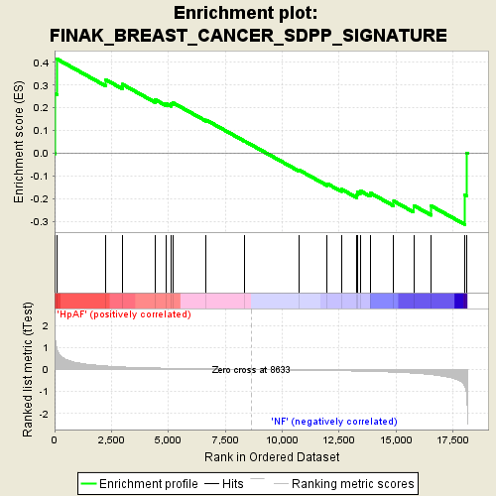
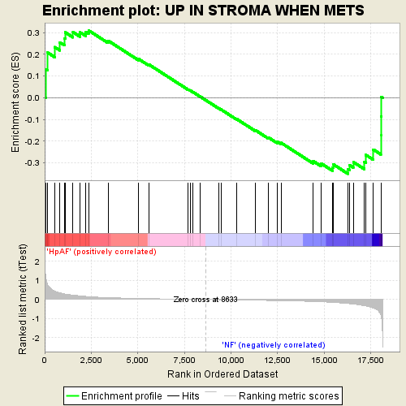
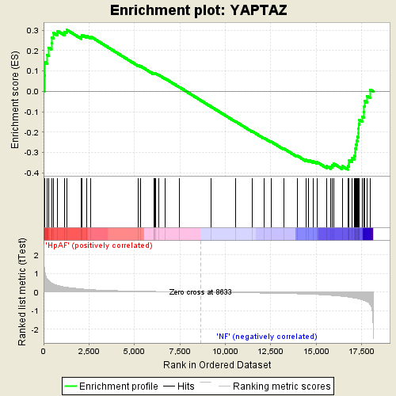
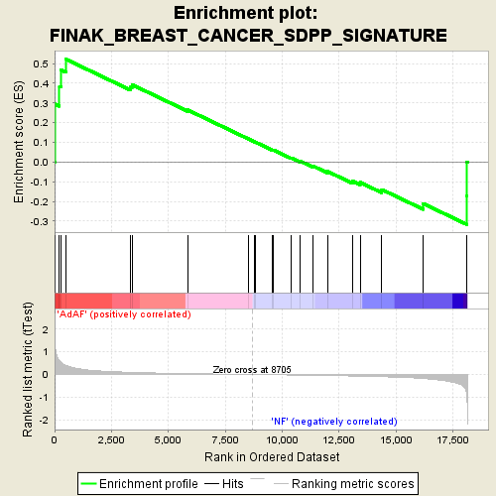
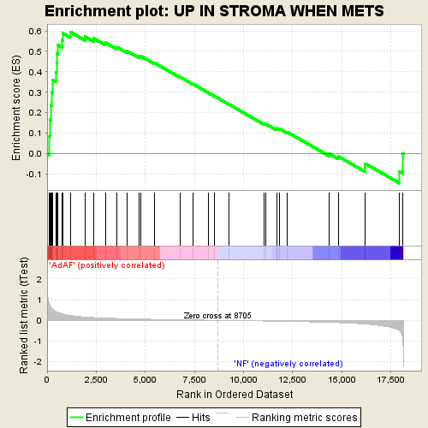
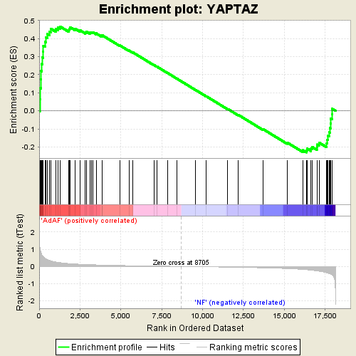

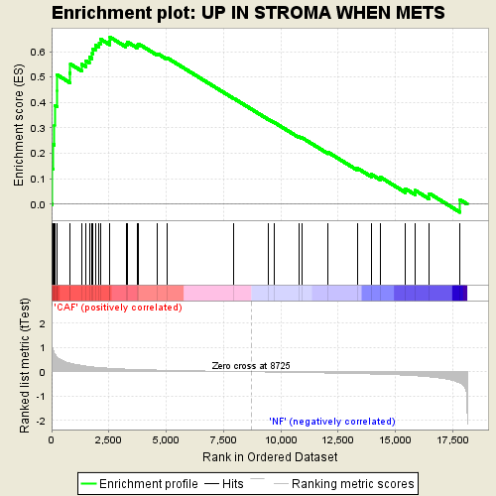
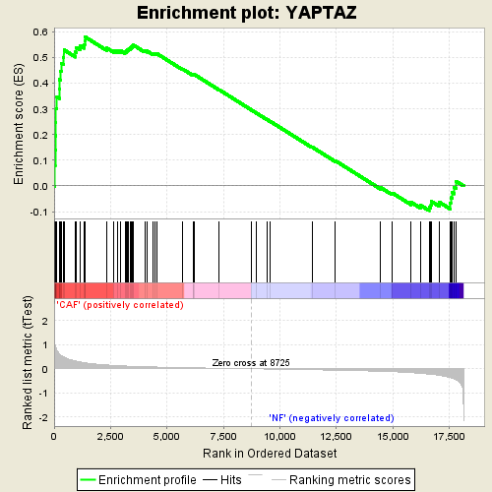
Supplementary Figure 3
A
Finak SDPP²⁵
Up in Stroma when mets²⁴
B
Dupont YAP/TAZ³⁰
HpAF
HpAF
HpAF
AdAF
AdAF
AdAF
CAF
CAF
CAF
C
D
***
***
***
***
***
***
F-actin αSMA YAP
F-actin S100A4 YAP
F-actin FAP YAP
E
F
Fold induction
NF
CAF#2

Slide 4
























Supplementary Figure 4
A
muBrCAF#2
B
NF#1
***
**
***
Cancer Cell Invasion
**
***
C
D
Live co-culture
invasion assay
E
ECM remodelling
Live co-culture
invasion assay
siMYL9#17
siMYL9#18
siMYL10#2
siMYL9#1
siMYL10#4
siYAPsp
siYAPsp
siCtr
siCtr
MYL9/MLC2
MYH10
YAP
YAP
Tubulin
Tubulin
G
muBrCAF#2
huVCAF
siYAP
siYAP&TAZ
siYAP&TAZ
siCtr
siTAZ
siYAP
mock
siTAZ
siCtr
MLC2
MLC2
YAP
YAP
TAZ
TAZ
Tubulin
Tubulin

Slide 5
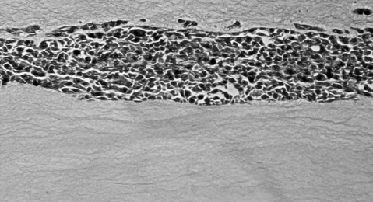
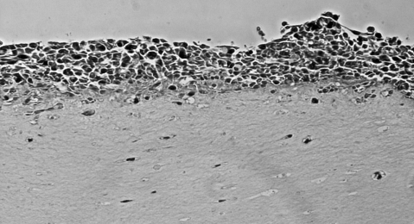
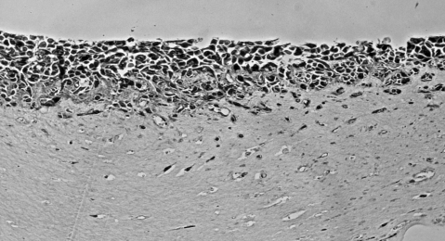
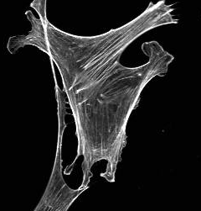
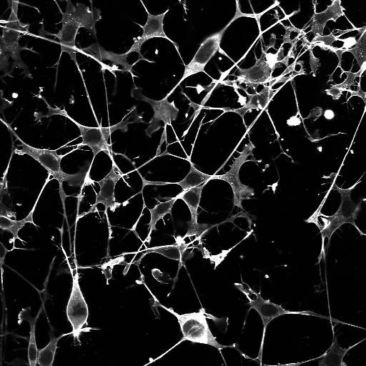


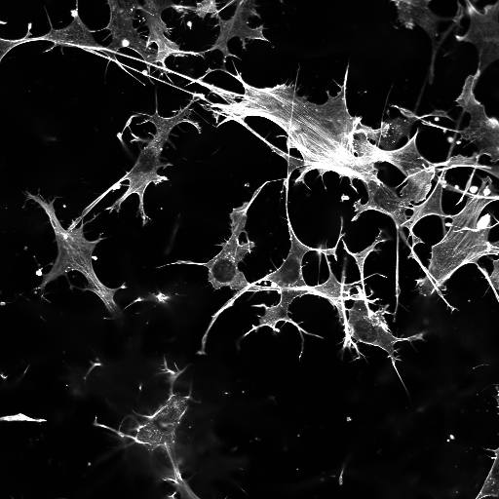
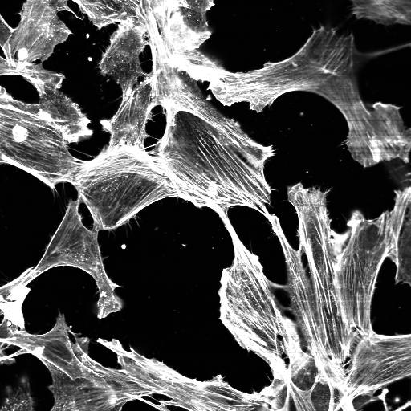



Supplementary Figure 5
A
B
C
Live co-culture
invasion assay
Fibroblast remodelled ECM assay
control
NM
4T1 CM
D
Ctr
Blebbistatin
E
Blebbistatin
Y27632
DMSO
Dasatinib
pY416-Src
pS19-MLC2
Y27632
PP2
pT183/181-MST1/2
pS127-YAP
Tubulin

Slide 6
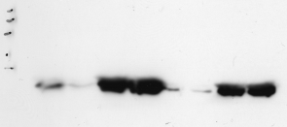
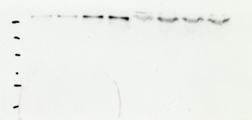
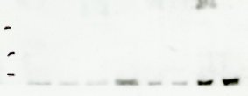
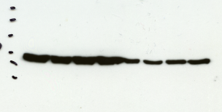
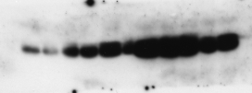
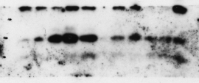
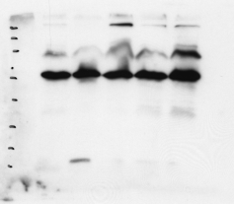
















Supplementary Information
Blots from Figure 1
180
Fig 1b - αSMA
Fig 1b – FN1
Fig 1b – S100A4
Fig 1b – Tubulin
115
180
26
82
115
82
65
82
19
65
49
65
15
49
49
37
37
Fig 1d – pMLC2
Fig 1b – MLC2
180
Fig 1b – MYH9
180
Fig 1b – MYH10
26
26
115
115
19
19
82
82
15
15
65
65
Blots from Figure 2
180
Fig 2c – pMST1/2
Fig 2c – pS909-LATS
Fig 2c – pT1079-LATS
Fig 2c – pS127-YAP
Fig 2c – YAP
115
180
180
180
180
82
115
115
115
115
65
82
82
82
82
65
65
65
65
180
Fig 2d – TEAD4
180
Fig 2d – pan14-3-3
Fig 2d – YAP
115
115
180
82
82
115
65
65
82
49
Short exposure
49
Short exposure
65
37
37
49
Short exposure
26
26
37
19
19
26
15
Lysates IP αYAP
15
Lysates IP αYAP
19
Lysates IP αYAP
180
15
180
115
180
115
82
115
82
65
82
65
49
65
49
37
49
37
Long exposure
26
Long exposure
37
Long exposure
26
19
26
19
Lysates IP αYAP
15
Lysates IP αYAP
19
Lysates IP αYAP
15
15
Blots from Figure 5 & Supp Figure 4
Supp Fig 4g & Fig 5d
– MLC2
Supp Fig 4g & Fig 5d
– YAP
Supp Fig 4g & Fig 5d
– TAZ
Supp Fig 4g & Fig 5d
– Tubulin
26
180
180
180
19
115
115
115
82
82
82
15
65
65
65
48
48

